Slide 1
Exercise four
Look at the picture. What rooms do they want? Complete the sentence using the words below.
DOUBLE/SINGLE/FAMILY/SUITE/TWIN/ONE/FOUR/FIVE/SIX/TWO

Slide 2

example : Tuesday to Friday
I’d like a single room for three night

Slide 3
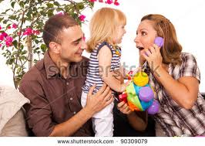
1. Tuesday to Saturday
We’d like a . . . . . . Room for . . . . Nights.

Slide 4

2. Sunday to Saturday
I’d like a . . . . . For . . . . nights

Slide 5

3. Saturday to Sunday
We’d like a . . . . room for . . . . Night.

Slide 6

4. Thursday to Tuesday
We’d like a . . . . room for . . . . Nights.

Slide 7
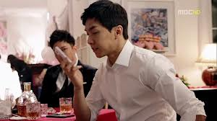
5. Tuesday to Thursday
We’d like two . . . . rooms for . . . nights.

Slide 8
GOOD LUCK

