Slide 1
Vitamin C
A diet high in Vitamin C is known to delay the aging process as well as reduce the risks of cancer, heart disease, and arthritis.
Lycopene
Lycopene is a powerful antioxidant that believed to reduce the risks of certain types of cancera nd lower the risk of heart disease
Ellagic Acid is an antioxidant known for its ability to call death of cancer cells. This antioxidant is also known for reducing the risk of heart disease
Ellagic Acid
Red pepper, guava, strawberries, raspberries, tomatoes and papaya are red foods that excellent sources of Vitamin C
Red fruits rich in ellagic acid include raspberries, strawberries, pomegranate, guava and cranberries
The top three foods that contain the most lycopene are guava, watermelon, and tomatoes, respectively

Slide 2
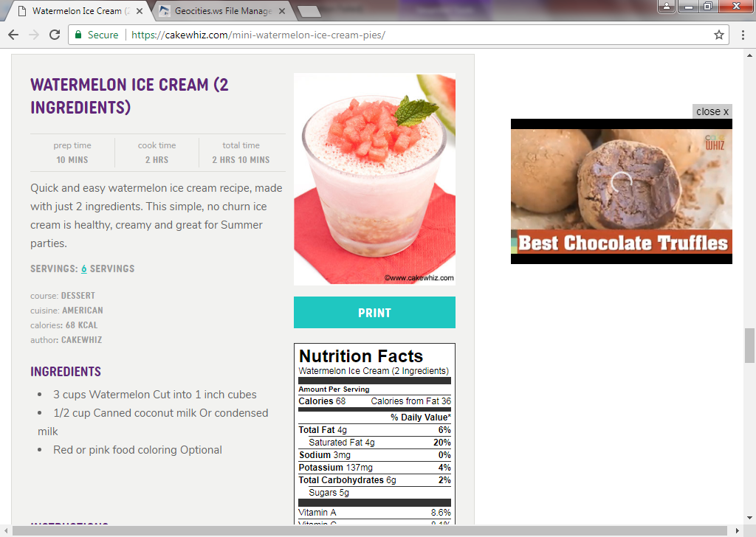

Slide 3


Slide 4
The benefits of Green fruits

Slide 5
Make the body rehydrate
Some of green fruits and vegetables contain high of water which is beneficial to rehydrate the body.
Reduce the risk of diabetes
Less in sugar is being the reason why green fruits and vegetables are recommended to consume for those who are with diabetes.
Help in lose weight
Almost all of fruits and vegetables are low in calories and fats, including green fruits and vegetables.
The health benefits of green fruits and vegetables are as well as other fruits and vegetables or you can read in list benefits fruits vegetables.
Those two nutrients support in gain weight that probably can lead to several disease.
For those who are likely to do exercises, it is recommended to consume many of green fruits and vegetables because they are tend to run into lack of liquid

Slide 6


Slide 7
Lowers blood pressure
Encourages pH balance of the body
Builds healthier bones by working with calcium and magnesium
Fights harmful free radicals in the body

Slide 8


Slide 9
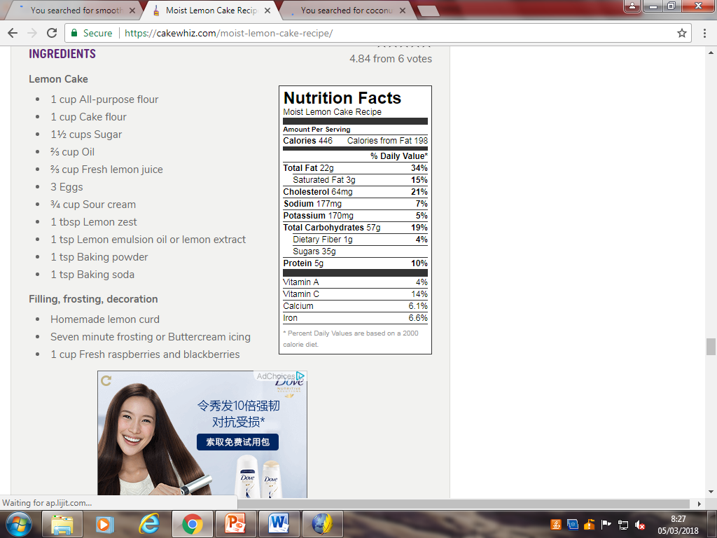


Slide 10
avoid Stroke
One orange provides a range of vitamins and minerals; a staggering 130 percent of your vitamin C needs for the day.
According to the American Heart Association (AHA), eating higher amounts of a compound found in citrus fruits like oranges and grapefruit may lower ischemic stroke risk for women.
Skin
Blood pressure
Diabetes
Maintaining a low sodium intake is essential to lowering blood pressure, however increasing potassium intake may be just as important because of its vasodilation effects.
According to the National Health and Nutrition Examination Survey (NHANES), fewer than 2 percent of US adults meet the daily 4700 mg recommendation.Also of note, a high potassium intake is associated with a 20 percent decreased risk of dying from all causes.
Studies have shown that type 1 diabetics who consume high-fiber diets have lower blood glucose levels and type 2 diabetics may have improved blood sugar, lipids and insulin levels. One medium banana provides about 3 grams of fiber.
The antioxidant vitamin C, when eaten in its natural form (as in an orange) or applied topically, can help to fight skin damage caused by the sun and pollution, reduce wrinkles and improve overall skin texture. Vitamin C plays a vital role in the formation of collagen, the support system of your skin

Slide 11


Slide 12


Slide 13

Fruits in the botanical sense are the parts of the plant that contain the seeds. There is no exact distinction between a fruit and a vegetable. The tomato, for example, is usually called a vegetable; but, like apples and berries, it is a fleshy fruit with the seeds embedded in the flesh. In general, it may be said that a fruit is the edible part of the plant that contains the seeds
It is An important part of a well-balanced diet, fresh fruit contains large quantities of water and is not a substantial food. Fruits are important mainly for the vitamins and minerals they contain. Acids they contain also help digestion

