Slide 1


Slide 2
Value
=
= Response
In the event of a crime, Consumers want:
Immediate Police alarm response while the incident is still in progress!
TO CATCH THE BAD GUYS!
The BEST deterrence is arrests!
How do we create Value?

Slide 3
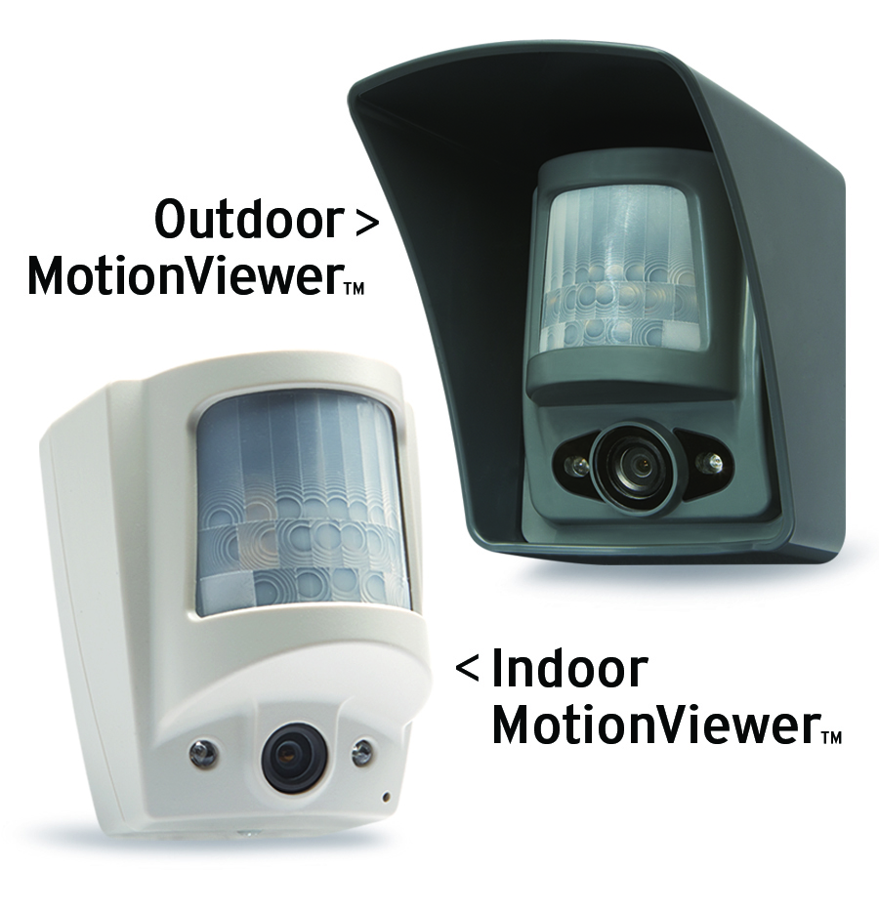
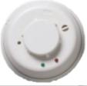
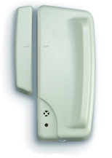
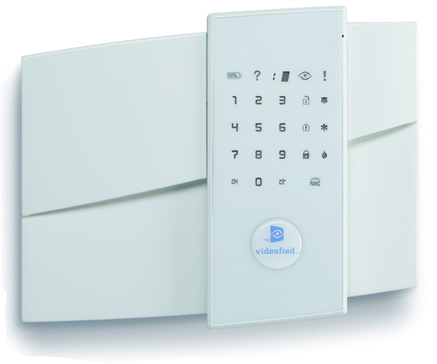
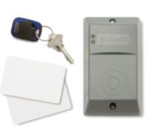
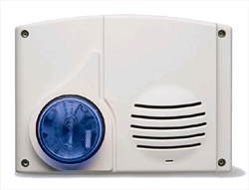
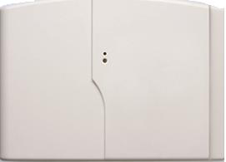
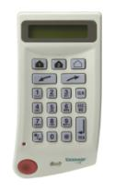

Value with Videofied
MotionViewer
Video Intrusion Alarm System

Slide 4
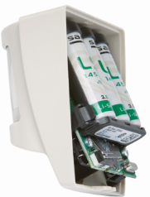
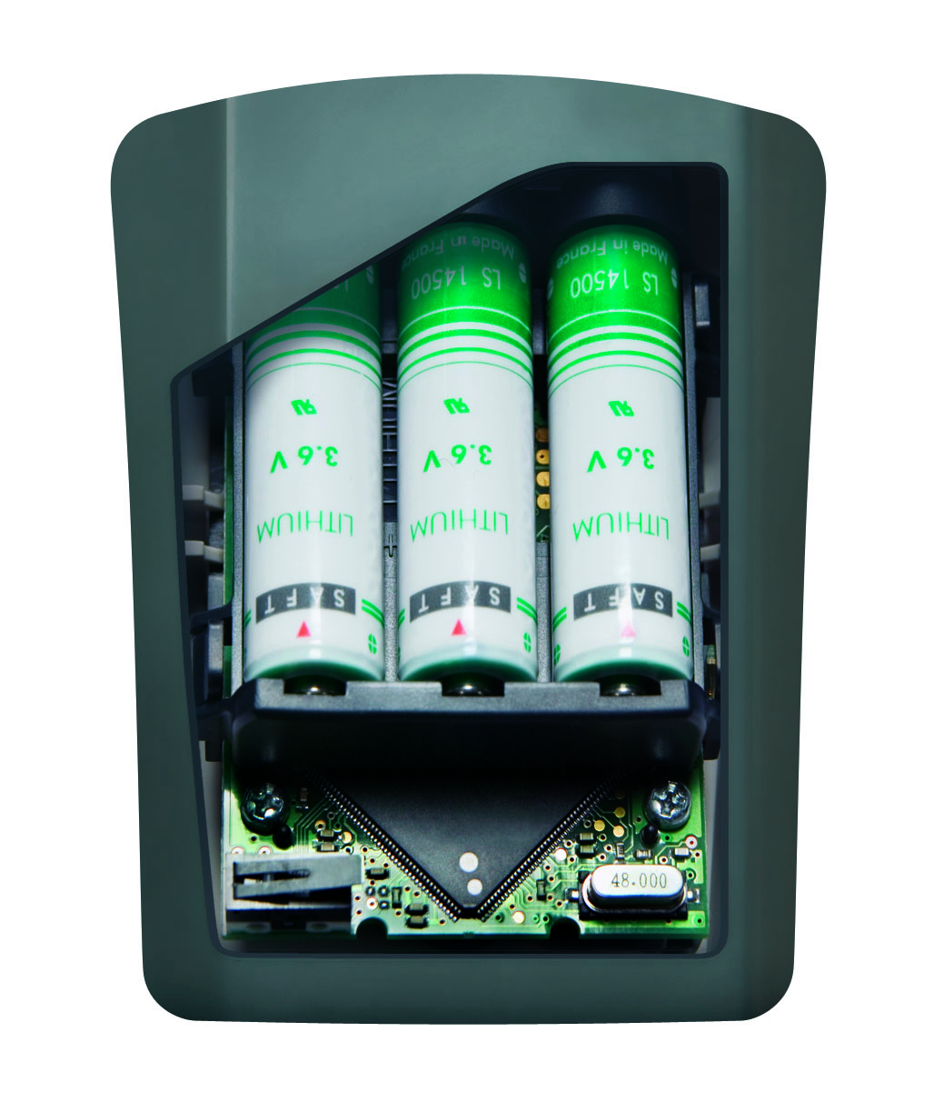
What is a Motionviewer?
PIR Motion Sensor
Entirely
Cordless
Digital Camera
Infrared
Illuminators

Slide 5
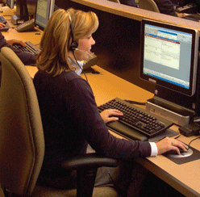
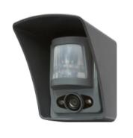
How does Videofied work?
Panel
900 MHz
Monitoring
Station
MotionViewer

Slide 6

How does Videofied work?
Cell Tower
Video
Panel
900 MHz
Monitoring
Station
MotionViewer

Slide 7

How does Videofied work?
Cell Tower
Video
Panel
900 MHz
Monitoring
Station
MotionViewer

Slide 8

How does Videofied work?
Cell Tower
Video
Panel
900 MHz
Monitoring
Station
Responder
MotionViewer

Slide 9
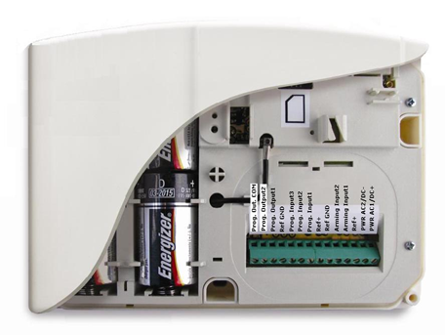
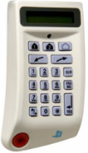

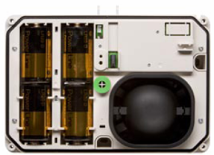
Videofied System Overview
All devices are cordless / wireless
RF Range: 30 - 300+ metres
GSM mobile phone network to Station
Battery Life: 1-4 Years

Slide 10
For more information
Call sales at 1300 50 13 37or email videofied@thompsonbros.com.au
  Phone Support
  Part Numbers
  Site Design
  Online Webinars
  Coordinate outside rep visit

