Slide 1
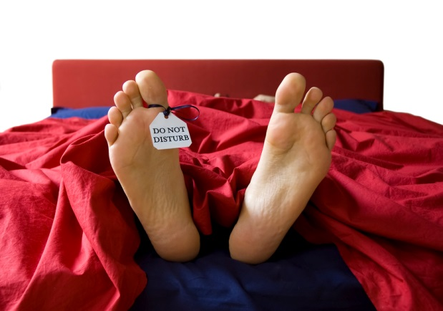
Things that make you
unproductive

Slide 2

Check
email
first in the
morning

Slide 3

Not having a to-do list

Slide 4

Having a to-do list
and
being obsessed with it

Slide 5

Not taking
breaks

Slide 6

Cluttered
workspace

Slide 7

Starting a day
without a plan

Slide 8

Cluttered
inbox

Slide 9

Stuck with
a PC or a Laptop

Slide 10

Stuck with
online social sites

Slide 11

No healthy
eating

Slide 12

Not having
enough sleep

Slide 13

Not encouraging
ideas

Slide 14

Not being
creative

Slide 15

Hesitation
to
delegate

Slide 16

Not saying
“NO”

Slide 17

\
Going on an
information
hunt

Slide 18

Not having
clear goals

Slide 19

Not having the
right
technological gadgets

Slide 20

Having
no
priorities
- the bird image for this slide.

Slide 21

Not developing
necessary
skills

Slide 22

Laziness

Slide 23

Unable
to
manage
your
team

Slide 24

Having
no or less
determination

Slide 25

Not
having
the
attitude to learn
from
mistakes

Slide 26

Not making good use of
constructive criticism

Slide 27

Trying
to
do
everything

Slide 28

Trying
to do
everything
right
now
right now

Slide 29

Obsessed with being
perfect

Slide 30

Trying
to
please
everyone

Slide 31

Worrying
too
much

Slide 32

Too much thinking with
no action

Slide 33

Procrastination
Procrastination

Slide 34
What’s YOUR reason to be unproductive?

Slide 35
If you’ve found your reason in any of the slides, get rid of that right now and just get productive!

