Slide 1



Slide 2
RELATIONSHIP SELLING

Slide 3
DEFINITION
Relationship selling is a process that involves attracting the right type of customers, and then building, maintaining, and enhancing interactions with them in order to develop long-term satisfaction through mutually beneficial partnerships.

Slide 4
Transaction- orientation | Relationship-oriented
Traditional way Aim is to close a specific sale with a customer | Alternative/ newer way Long-term partnerships are sought The seller knows how to build and manage strong relations

Slide 5
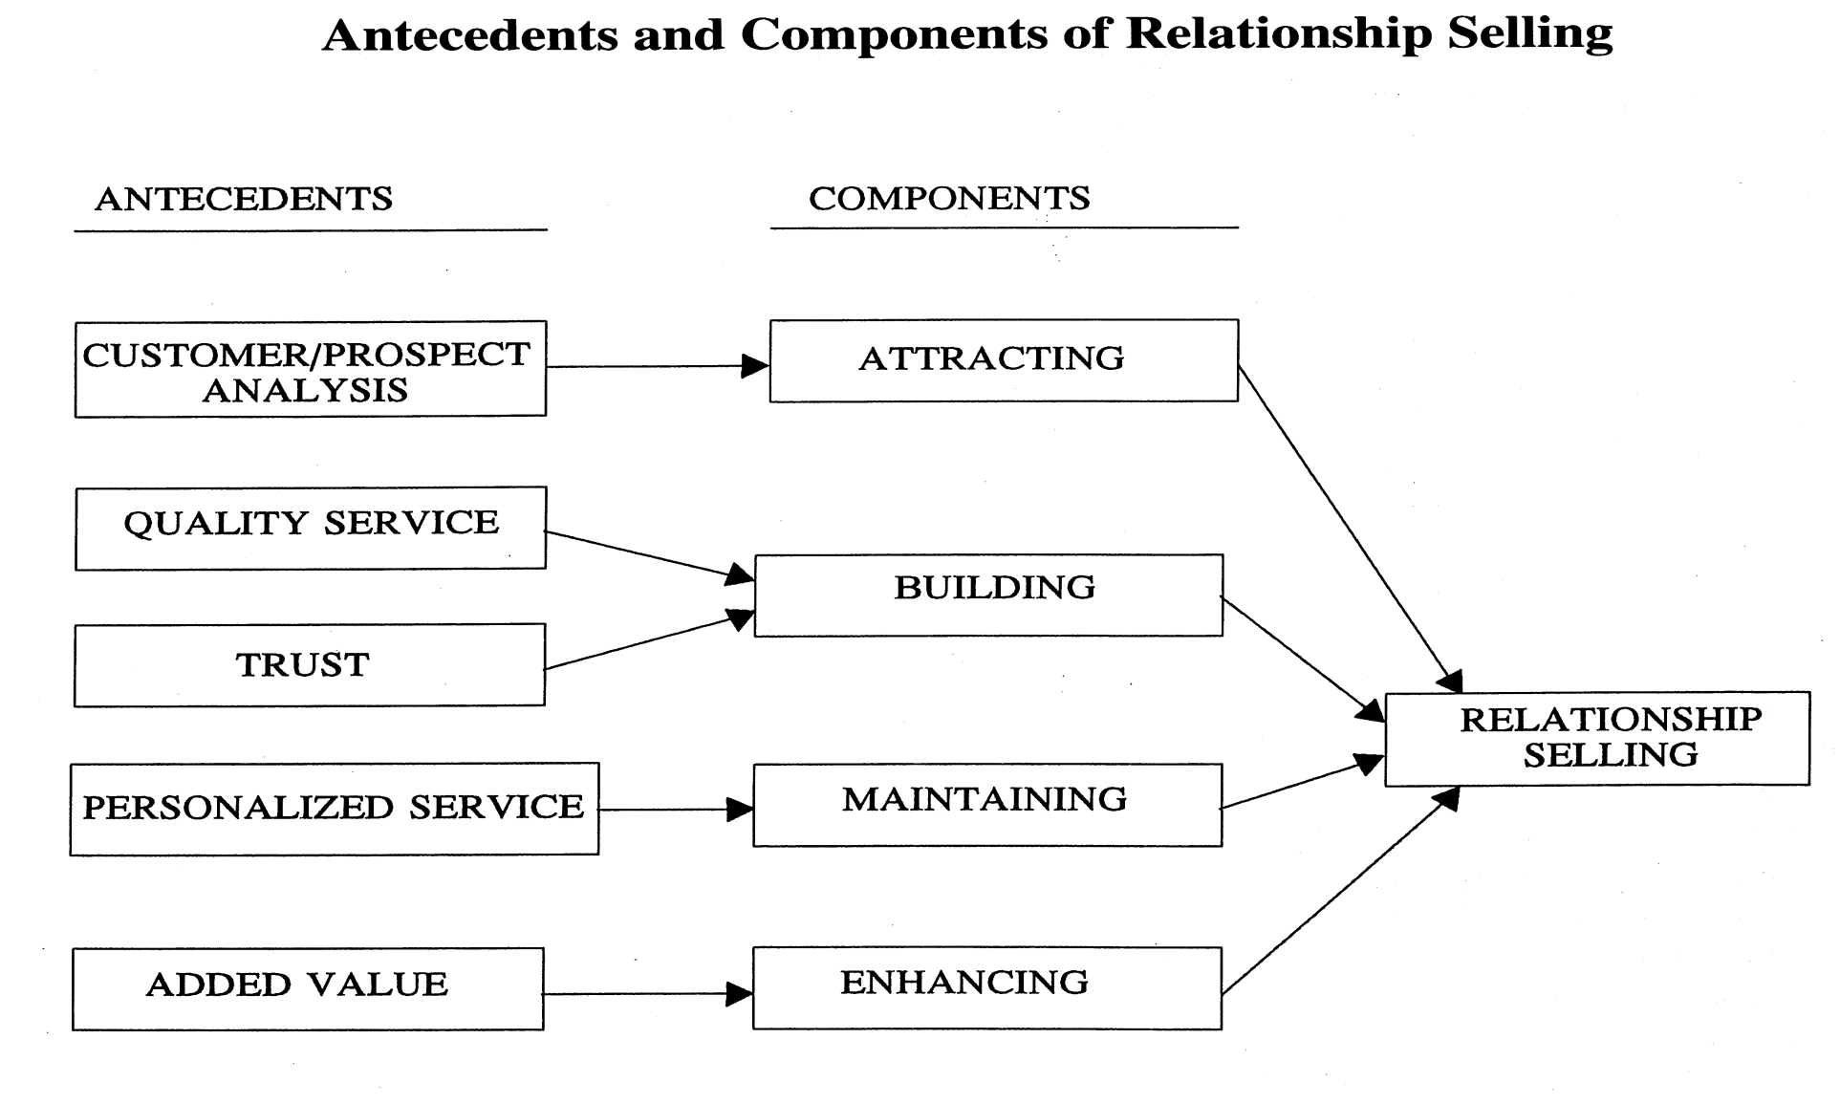

Slide 6
LEVELS OF RELATIONSHIPS
Non-existent relationship
Reactive relationship
Accountability relationship
Showing-continuing-interest relationship
Real-partnership relationship

Slide 7
Benefits of Building Relationships
More opportunities to Cross Sell
More Referrals
Word of mouth support
Less costly
Higher Persistency

Slide 8
Antecedents of Relationship Selling
Customer/Prospect Analysis
Selling to existing clients
Determine how much service each customer warrants
ABC analysis- volume, potential, amount of service
Selling to prospects
Target specific markets,
Seek for prospects who will be profitable, who will have potential and who will respond favorably to personal services

Slide 9
Service Quality
Reliability
Responsiveness
Assurance
Empathy
Tangibles

Slide 10
Trust
Dependable
Candid
Competent
Customer- oriented
Establish Rapport

Slide 11
Peronalized Service
Staying in touch with customers
Customizing Relationships
Relationship Check-Up

Slide 12
Value Added
Extras over and above what the customer expects.
Providing customized, personalized service that recognizes the unique situation faced by each customer.
Social reinforcement, reassurance, benefit reinforcement, problem solving assistance.

Slide 13


