Slide 1
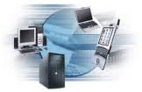
Information technology
A need for SME’s
Presented By Hemankshu Sawant
Reviews

Slide 2
Why IT is need for Hour for SME’s
Lots of Disorganized Work
Lots of paperwork and utilization of Space
Lack of time and lack of funds.
Resource planning
Productivity Problems
No Analysis of Risk

Slide 3
Cloud Computing
sharing computing resources rather than having local servers
metaphor for "the Internet
different services -- such as servers, storage and applications -- are delivered.
unused processing cycles of all computers in a network are harnesses to solve problems too intensive for any stand-alone machine.

Slide 4
Why IT is Important For SME’s
Lack of time and lack of funds
Required less Manpower
Pay as you go subscription
Effective disaster recovery
Easy scalability [extra resources that are necessary]
Free trials before purchase [identification]
Increased scope for mobility
Increased storage
Highly automated updating for software

Slide 5
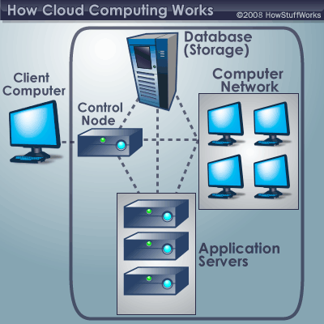
How it Works

Slide 6
Price of Cloud Computing
Outgoing: $0.12/GB
Incoming: No charge
Bandwidth in Private Network: No charge
  Internal network (ServiceNet)
  Isolated networks (Cloud Networks)

Slide 7
Price as you Subscribe
Size | Disk space | VCPU | Price/ hour | Price/ month
1 GB | 40Gb | 1 | 0.08$ | $58.40
2 GB | 80 Gb | 2 | 0.16$ | $116.80
4Gb | 160 Gb | 2 | 0.32$ | $233.60
8 GB | 320 GB | 4 | 0.58$ | $423.00
15 GB | 620Gb | 6 | 1.08$ | $788.40

Slide 8
Companies Providing Cloud Computing In India
TCS
Ingram Micro
Reliance EIDC
IBM

Slide 9
MIS
MIS stands for Management Information System
Managing five primary components:
1] Hardware,
2] Software,
3] data (information for decision making)
4] procedures (design,development and documentation)
5] people (individuals, groups, or organizations).

Slide 10
How it is classified
Management :
Planning, control, and administration of the operations of a concern.
Information :
Information, in MIS, means the processed data that helps the management in planning, controlling and operations [Reports]
System :
A System is made up of inputs, processing, output and feedback or control.

Slide 11
Important Components Of MIS
Data Entry
Data transformation
Data Utilization

Slide 12
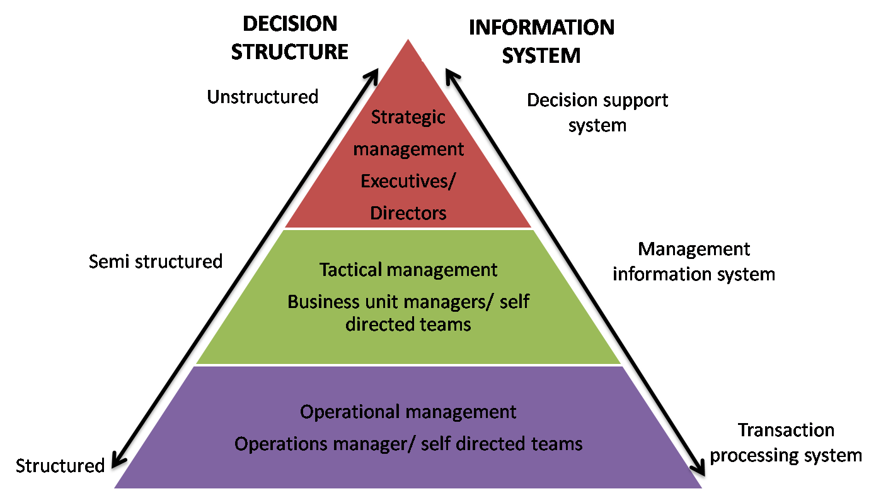
Usage of MIS

Slide 13
Importance
to record ,process, route & tabulate all important business transactions.
Decision making
Analyses
A Two way communication flow
planning & controlling
Decentralisation
Co-ordination
SWOT analysis

Slide 14
Uses For SME
Summary reports
Trends
Exception [Inventory planning]
On-Demand

Slide 15
Price
From 25000 onwards to depending upon configuration

Slide 16
ERP
It stands for Enterprise Resource Planning
MIS is part of ERP
a system of integrated applications to manage the business.
all facets of an operation, including product planning, development, manufacturing processes, sales and marketing.
multiple enterprise software modules that are individually purchased, based on what best meets the specific needs and technical capabilities of the organization.

Slide 17
ERP Vendors for SME’s
Small Business ERP (ERP Tier III)
Exact Globe, Syspro, NetSuite, Visibility, Consona, CDC Software and Activant Solutions round out the ERP vendors for small businesses.

Slide 18
Components of ERP
Transactional database
Management portal/dashboard
Business intelligence system
Customizable reporting
Simple resource planning - Who Is Doing What and When?
Analysing the product
External access via technology such as web services
Search
Document management
Messaging/chat/wiki
Workflow management

Slide 19
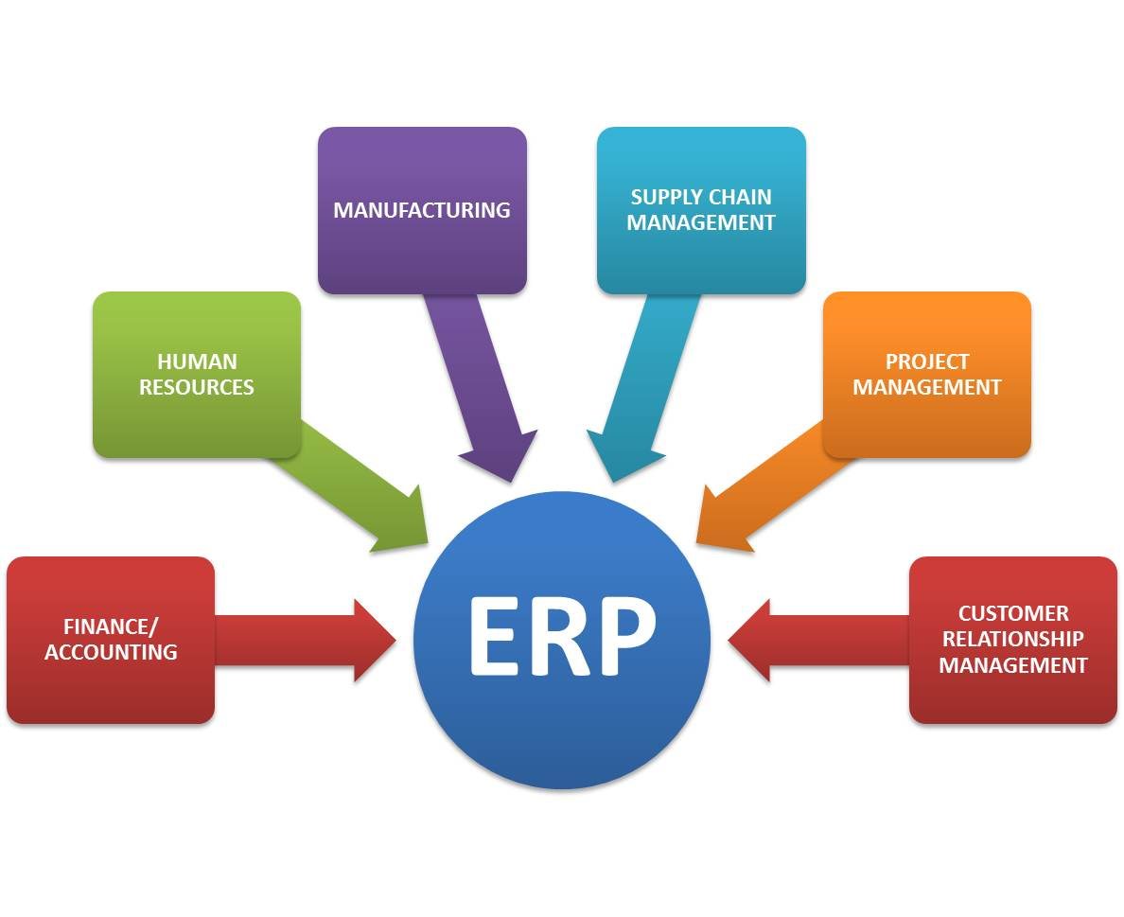
How does it work

Slide 20
Functional Areas
Financial Accounting
Management accounting
Human resources
Manufacturing
Supply chain management
Project planning
Customer relationship management
Data services

Slide 21
Advantages using ERP
Sales forecasting, which allows inventory optimization
Chronological history of every transaction through relevant data compilation in every area of operation.
Order tracking, from acceptance through fulfillment
Revenue tracking, from invoice through cash receipt
Matching purchase orders (what was ordered), inventory receipts (what arrived), and costing (what the vendor invoiced)

Slide 22
ERP systems centralize business data, which:
Eliminates the need to synchronize changes between multiple systems
legitimacy and transparency to statistical data
Facilitates standard product naming/coding
Provides a comprehensive enterprise view
making real–time information available to management anywhere, any time to make proper decisions
Protects sensitive data by consolidating multiple security systems into a single structuctures
Quality and efficeny of business is Improve
Helps in critical decision making
More flexibility in operations

Slide 23
Pricing
Starts from 3 lakhs onwards to billion of Rupees based on requirement
HUL implemented SAP for 2800 crores which is a type of ERP for supply distribution channels across India required 7 years to build it.
AMC criteria and cloud computing charges will be added separately.

Slide 24
Important points to be considered
Study top line and bottom line of company while stating MIS or ERP
Tally ERP is not Erp it is just a financial customized module for accounting and small time finance operations.
Understand their requirements and then state MIS or ERP
It Adds to cost of company, and even AMC criteria is different for different vendors.

Slide 25
Completion of IT module 1
Thank You

