Slide 1

Delegation
Hemankshu sawant

Slide 2

What is delegation
Art of getting work done through others

Slide 3
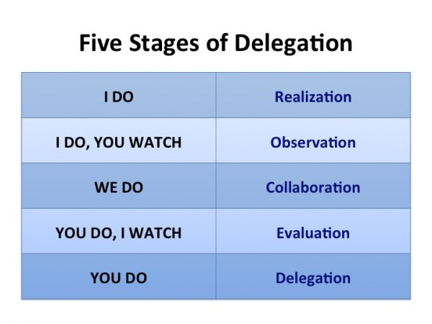

Slide 4
Four levels of delegation
DT 1 : delegation [training required : 0 to 1 years]
DT2 : Decentralisation [training required 0 to 6 months]
DT3 : Empowerment [training required 0 to 3 months]
DT4 : Enablement [training required 15 to 30 days] or else can train you

Slide 5
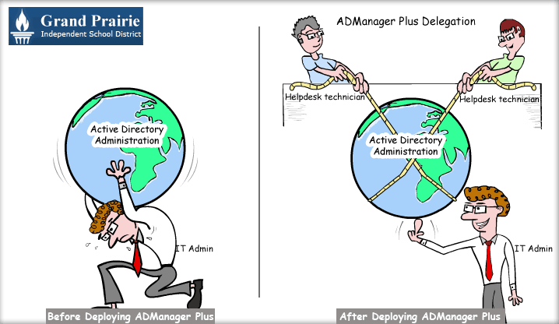

Slide 6
How to get into delegation mindset
Think in Terms of the Big Picture
Embrace the Value of Others
Arm Your Team with Information
Be Around, but Not in the Middle
Make it Ongoing

Slide 7
Six steps of effective delegation
Decide What Functions You Should Not Be Doing
Make An Annotated List of All Functions to Delegate
Decide Who Should Handle Which Tasks
Train Them Well
Monitor Quality
Review Your Processes Regularly

Slide 8
Tips for succesful delegation
Be as specific as possible about what you want done.
Let the other person get on with it.
Do not delegate many tasks at once.
Do not give up too quickly.

Slide 9
How to do effetive delegation
Analyze Your Needs First
Explore Your Options
Document Everything
Develop a Prioritized Assignment Plan
Use Technology
Communicate Well and Often
Cultivate Trust

Slide 10
Delegation Don’ts
Don't: Focus on the Process
Don't: Become the Bottleneck
Don't: Withhold Information
Don't: Hesitate to Share Wins ... and Losses
Don't: Revert to Your Old Ways

Slide 11
Collins’ Five Level Leadership Hierarchy (Collins, 2001. Good to Great)
Level 5 – Executive Builds enduring greatness through paradoxical combination of personal humility plus professional will
Level 4 – Effective Leader Catalyzes commitment to and vigorous pursuit of a clear and compelling vision; stimulates the group to high performance standards
Level 3 – Competent Manager Organizes people and resources towards effective and efficient pursuit of predetermined objectives
Level 2 – Contributing Team Member Contributes to the achievement of group objectives; works effectively with others in a group setting
Level 1 – Highly Capable Individual Makes productive contribution through talent knowledge, skills, and good work habits

