Slide 1
Presented By – Roshni Mishra

Slide 2
Chanakya
Born in 4th Century B.C in India , also known as Vishnugupta And Kautilya.
Originally a professor of economics and political science at the ancient Takshashila University, Chanakya managed the first Maurya emperor Chandragupta’s rise to power at a young age.
He is widely credited for having played an important role in the establishment of the Maurya Empire, which was the first empire in archaeologically recorded history to rule most of the Indian subcontinent.
Chanakya served as the chief advisor to both Chandragupta and his son Bindusara.

Slide 3
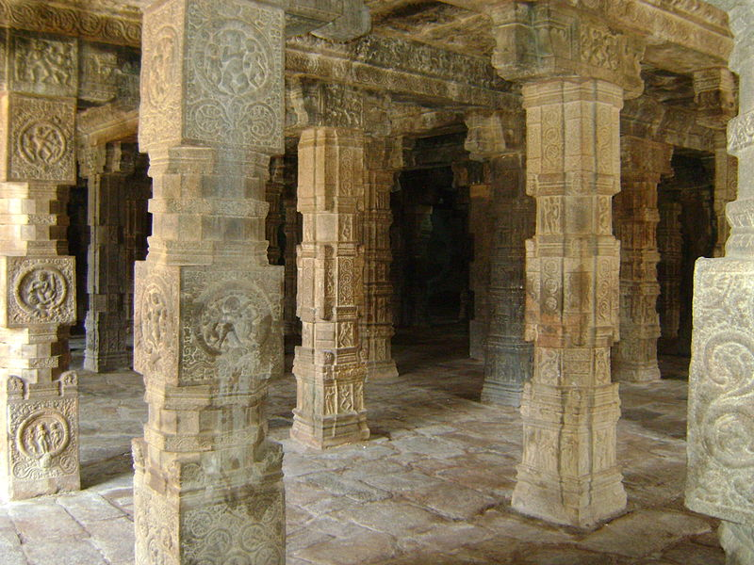
The 7 Pillars Of Business
“ The king , the minister, the country, the fortified city, the treasury, the army , and the ally are the constituent element of the state.” – Chanakya

Slide 4
The King ( The Leader)
The Minister ( The manager)
The Country ( The Market / Client / Customer)
The Fortified City ( Head Office)
The Treasury
The Army (The Team)
The Ally (Friend / Consultant)

Slide 5
Three aspects Of Success
“ Success is threefold – that attainable by the power of counsel is success by counsel, that attainable by the power of might is success by might , that attainable by the power of energy is success by energy.”
- Chanakya

Slide 6
Success by Counsel –
“ Any undertaking that one takes should be with the help of advisors who are specialists in that particular field”.
Success by Might –
- Muscle power is strength too. Might also means what benefits one derives due to one’s position, or the chair that one holds.
- Another way of becoming mighty is to associate
with someone mightier than oneself.
Success By Energy –
- This is called will power. A person can achieve success on the basis of the enthusiasm and the passion he shows.

Slide 7
Qualities Of a Leader
Multiple Tasking –
The key to success for a leader lies in effective delegation
“ Because of the simultaneity of undertakings, their manifoldness and their having to be carried out in many different places , be (leader) should cause them to be carried by minister, unperceived (by him), so that there is no loss of place and time”.

Slide 8
Delegation
Work happens simultaneously
Work happens , At various places
Tips for effective delegation –
Selection
Setting up the MIS
Training
Control

