Slide 1



Slide 2
Achieving Customer Service excellence
Presented by :
Hemankshu Sawant
Executive reviews
p

Slide 3
The fundamental belief of customer focused organisation
“Customers are the reason for work, not an interruption of work”.

Slide 4
What is customer service ?
How a company deals with its consumers before, during and after a purchase or use of a service.
A series of activities designed to enhance the level of customer satisfaction – that is, the feeling that a product or service has met the customer expectation.
A proactive attitude that can be summed up as: I care and I can do

Slide 5
Terms associated with customer service
Customer focused : Meeting the customer’s need
Delighting the customer : Exceeding the customer’s need. [5 references]
Satisfying the customer : Giving the customer what they want, not what we think they want.
Adverse publicity

Slide 6
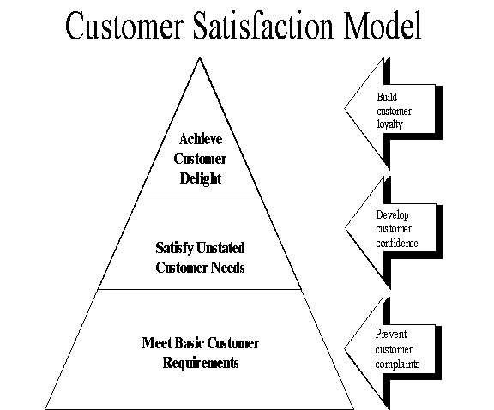

Slide 7
Some facts about customer service
Typically 68% of customers are lost through poor customer handling. i.e. They don’t come back. But it’s cheaper to keep customers than to gain new ones
80% of business leaders believe their companies are doing a good job in the way they treat customers.
Only 8% of customers agree.
.

Slide 8
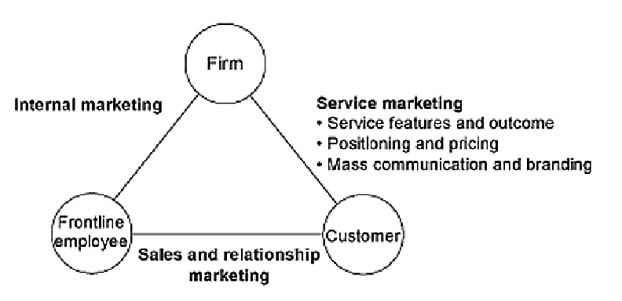
Service quality triangle
ESI
CSI

Slide 9
The service marketing triangle framework for quality
The 3 Sides of the Triangle:
Firm to Customer: Service design issues
Firm to Employee: Service management issues
Employee to Customer: Service delivery issues

Slide 10
The two dimensions of quality customer service
1 procedural dimension :
Systems, procedures and processes
2 personal dimension
The human or interpersonal side.

Slide 11
Rules for good customer service
Answer your phone.
Don’t make promises unless you WILL keep them
Deal with complaints
Be helpful, courteous, and knowledgeable

Slide 12
Rules for customer service
Positive Attitude
      Attentive – listen and care (make them know they matter)
      Friendly approach – watch for non-verbal and body language signs
      Learning to say no with tact and courtesy and confidence
      Attention to detail
Work Ethics
      Punctuality
      Time Management
      Manage multi-tasking
      Follow the chain of command

Slide 13
Keep in touch management
“It’s all about making it personal, making it magic, and making the experience unforgettable so that two or 10 years down the road they’ll remember to call you

Slide 14
Why keep in touch management ?
Lets understand bucket theory

Slide 15
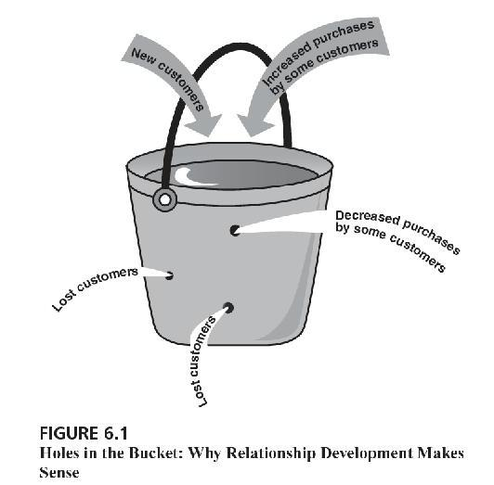

Slide 16
Why customer retention is important?
Repeat customers spend 33% more than new customers.
It costs 6 times more to acquire a new customer than it does to keep an existing one.
As little as a 5% increase in customer retention can increase profits by 25 to 95%.

Slide 17
How to do it?
Send personalized cards on their birthdays and festivals
Send memorable gifts
Deliver some news they can use
Congratulatory cards: Remember graduations, wedding anniversaries, or a new baby in the family.
Give them a call
Take regular feedbacks of products and services
Make a social networking connection
Host a party
Help them get organized

Slide 18
12 tips for successful complaint handling
Treat the person as an individual who has feelings, values and a sense of self worth
Let the customer have their say
Say you sorry to hear what has happened
Listen actively
Get the facts by questioning effectively
Keep an open mind, don’t make assumptions
Don’t argue or be defensive
Try and find out what outcome the customer wants

Slide 19
continue
9. Concentrate on what you can do and explain what you cannot do and why
10. Don’t impose your own solution
11. Summarise and check that the customer understands and agrees
12. Agree a timescale which is acceptable to the customer for resolving the complaint

Slide 20
Complaint handling procedure
The standard operating procedure :
Receive & classify
Acknowledge
Investigate
Resolve & Confirm
Respond to Customer
Follow up
QA & Close

Slide 21
Receive and clasify
Must be logged on
Priority must be defined
If urgent : then resolved in three working days
If not urgent : within one week
Reputation can be stake due to adverse publicity for urgent issue
Balance response should be generated with resonable time
Staff : review
Office manager : appropriate person for investigation

Slide 22
Acknowledge
It should be acknowledge within a day
Written proforma should be sent to customer on day of reciept

Slide 23
investigate
Follow up on the complaint
Identify key facts and problems
Time scale defined
All areas of interaction and communication should be established (who, what, where, when, why etc) and documented where possible.

Slide 24
Resolve and confirm
final resolution should be Clear and fair
Proposed action and resolution with senior person
Corporate guideliness
Document it and take approval of senior hierarchy
Discuss and review the solution form both the corporate and customer viewpoint
review should include recognition and documentation of any underlying issues that have contributed to the complaint
recommendations for actions to prevent further occurrence.

Slide 25
Respond to customer
Within timescale that is promised
If not call them about the required further time to meet with problem

Slide 26
Follow up
All Priority 1 complaints and 95% of priority 2 complaints must be followed up within a reasonable timescale.
This will be carried out by the Customer Relations team.
Is the customer satisfied with the response?
Did they feel that their complaint was properly and fairly handled?
Any negative responses to these questions should be referred to Operations Managers for action and direct follow up with customers.

Slide 27
Q & A close
All complaints should be reviewed monthly as part of the CST review meetings.
Any complaints where action can be taken to avoid recurrent must be acted upon and raised with the appropriate managers/teams across the organisation.

Slide 28
Thank you for your
co-operation

