Slide 1


Search Engines and Web Research
Eric Shen
ITEC 1301 – 18255
Prof. Anastasia Golovko
University of Houston
Notes:
Speaker notes – this is the title page. Don’t get nervous! Imagine everyone has a potato.

Slide 2

Content
Purpose of Search Engines
Importance of Search Engines
How do Search Engines work?
Search Engine Optimization (SEO)
Future of Search Engines
Conclusion

Slide 3
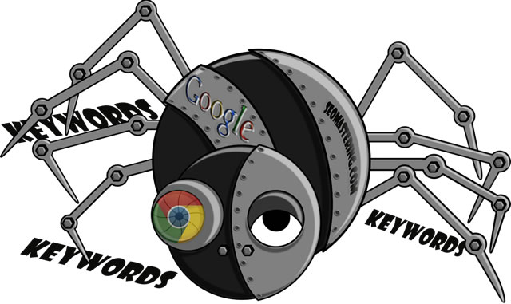
Purpose of Search Engines
The web makes it easier for users to find information by following hyperlinks.
  However the internet is so large that it is difficult to find exactly what you need

Slide 4

Purpose of Search Engines (cont.)
Search engines enable you to find information by specifying keywords related to your topic of interest
  Can use operators such as AND, OR, & NOT to get more specific results

Slide 5

Importance of Search Engines
Now the biggest applications online
  Google is now one of the world’s most profitable with more than $16.5 billion annual revenue
Everyone uses search engines
Money is made through advertisements
  Advertisers want their ads shown along with their search results

Slide 6

How do Search Engines Work?
“Spiders”
  Automated programs that follow all web links
  Try to catalogue every web page by topic
  Each page is analyzed and ranked using unique algorithms
    Results are stored in a database

Slide 7

How do Search Engines Work? (cont.)
A search isn’t really a search of the internet
It is a search of a database that stores information about webpages.
  The database is constantly checked and updated
Many search engines such as Google and Bing can also search media
  Images, video, music, games

Slide 8

Search Engine Optimization (SEO)
Process of driving more viewers to a website by increasing the site’s ranking in search results
  Web pages on the first page of a search result has a greater chance of being visited
  SEO professionals study search engine algorithms and alter content to increase ranking

Slide 9

Future of Search Engines
Search engines will continue to increase in importance
  Google expanding into phones, tablets OS and web-bases laptops and Google Glass
Even better search results
  Personalized search
New ways of search
  Voice& image recognition on phones

Slide 10

Conclusion
Search Engines allow user to find the information they need
Search Engines are invaluable to the modern user
Web site owners use SEO to increase their page ranking
Search Engines will continue to expand and improve the services they provide

Slide 11








Search Engines: Past and Present

Slide 12


Video
This is a short video from Google that explains how they come up with their search results.

Slide 13

Wiki
  Open source and open editing
    Allow user to add and edit articles at any time
    Quick access to information
  Largest wiki is Wikipedia
    Articles vetted by 1,700 administrators

Slide 14

Credits
Pictures
Slide Background
Slide 1 Picture
Slide 2 Picture
Slide 3 Picture
Slide 4 Picture
Slide 5 Picture
Slide 6 Picture
Slide 7 Picture
Slide 8 Picture
Slide 9 Picture
Slide 10 Picture
Slide 11 Yahoo Picture
Slide 11 Google Picture
Slide 11 Bing Picture
Slide 11 Ask Jeeves Picture
Slide 11 Globe Picture
Slide 11 Lycos Picture
Slide 11 AltaVista Picture
Slide 11 WebCrawler Picture
Slide 12 Youtube Picture
Slide 13 Picture
Slide 14 Picture
Slide 15 Picture
Animated Red Back Button
Sources
Reynolds, George, and Ralph Stair. Fundamentals of Information Systems. 6th. Mason,OH: South-Western, 2011. Print.
Youtube Video
Wall, Aaron. "Future of Search Engines." Search Engine Marketing. N.p., n. d. Web. 23 Jun. 2013. <http://www.search-marketing.info/future-of-search-engines/>.

Slide 15

This is the end of the
Presentation.

