Slide 1

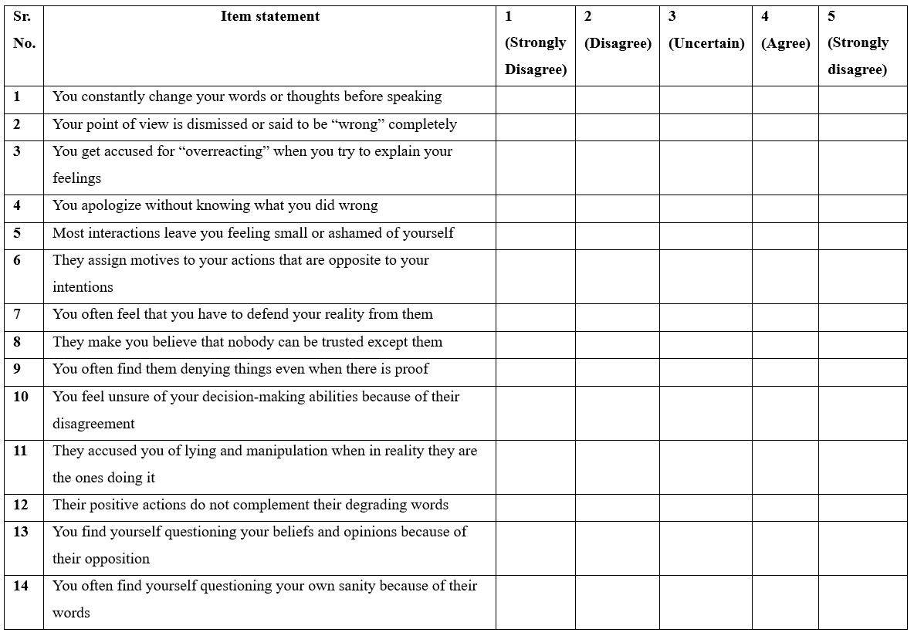
Bahria University Lahore Campus
A Project of Pakistan Navy
Discovering Knowledge
Victim Gaslighting Scale (VGS)

Slide 2
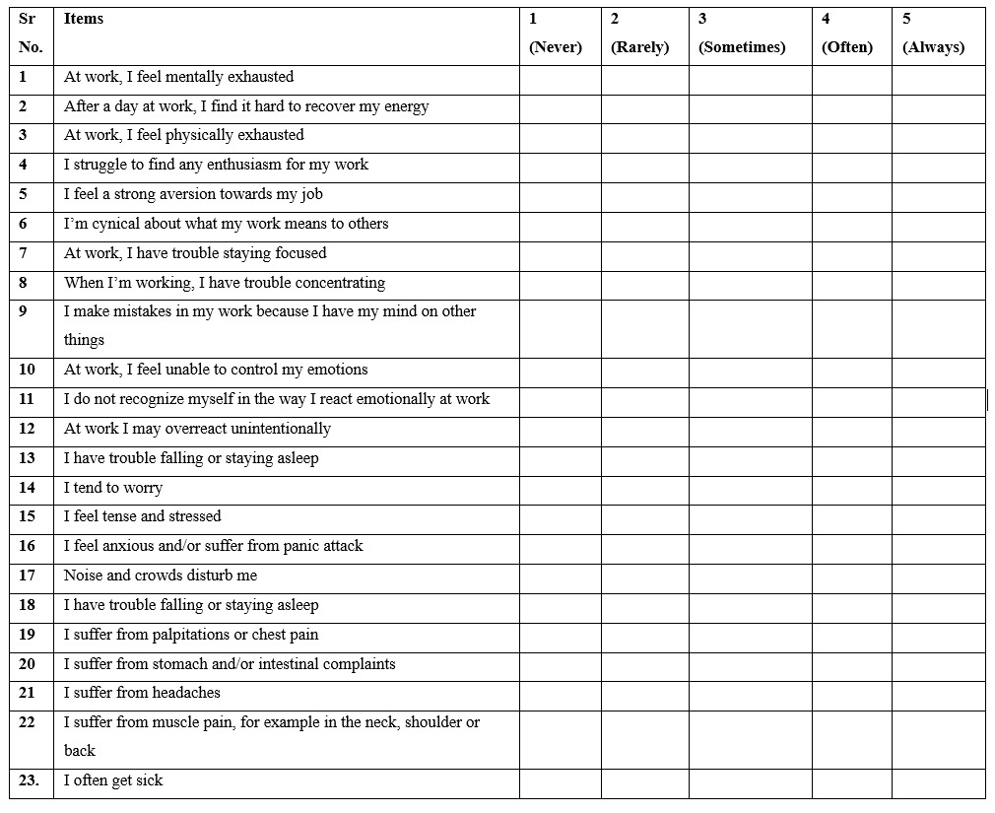
Bahria University Lahore Campus
A Project of Pakistan Navy
Discovering Knowledge
Burnout Assessment Tool (BAT)

Slide 3
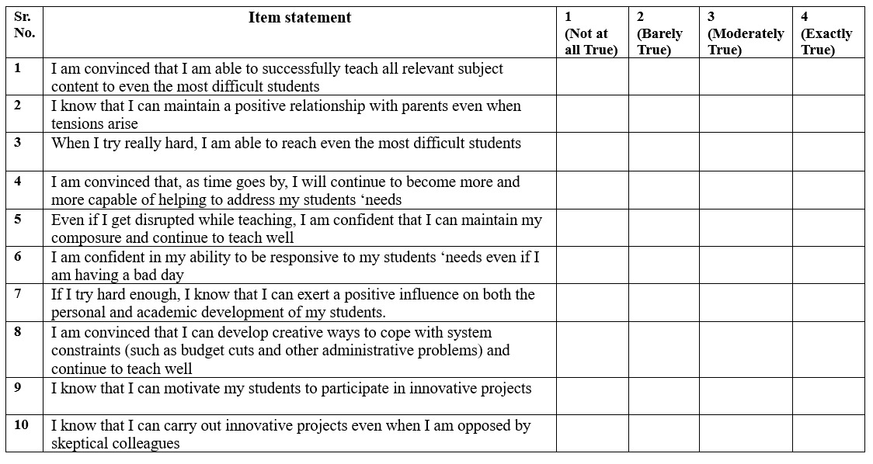
Bahria University Lahore Campus
A Project of Pakistan Navy
Discovering Knowledge
Teacher Self-Efficacy

Slide 4
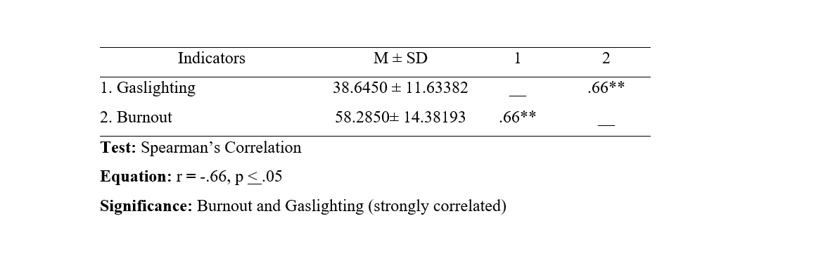
Bahria University Lahore Campus
A Project of Pakistan Navy
Discovering Knowledge

