Slide 1
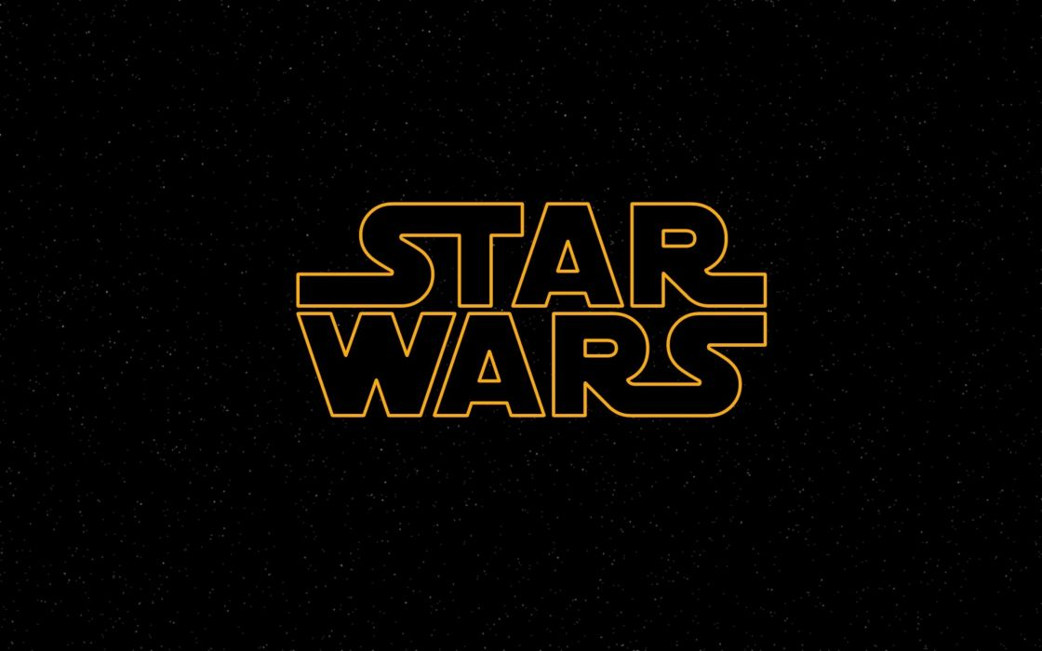
“Do. Or do not. There is no try”-Yoda
START QUIZ

Slide 2
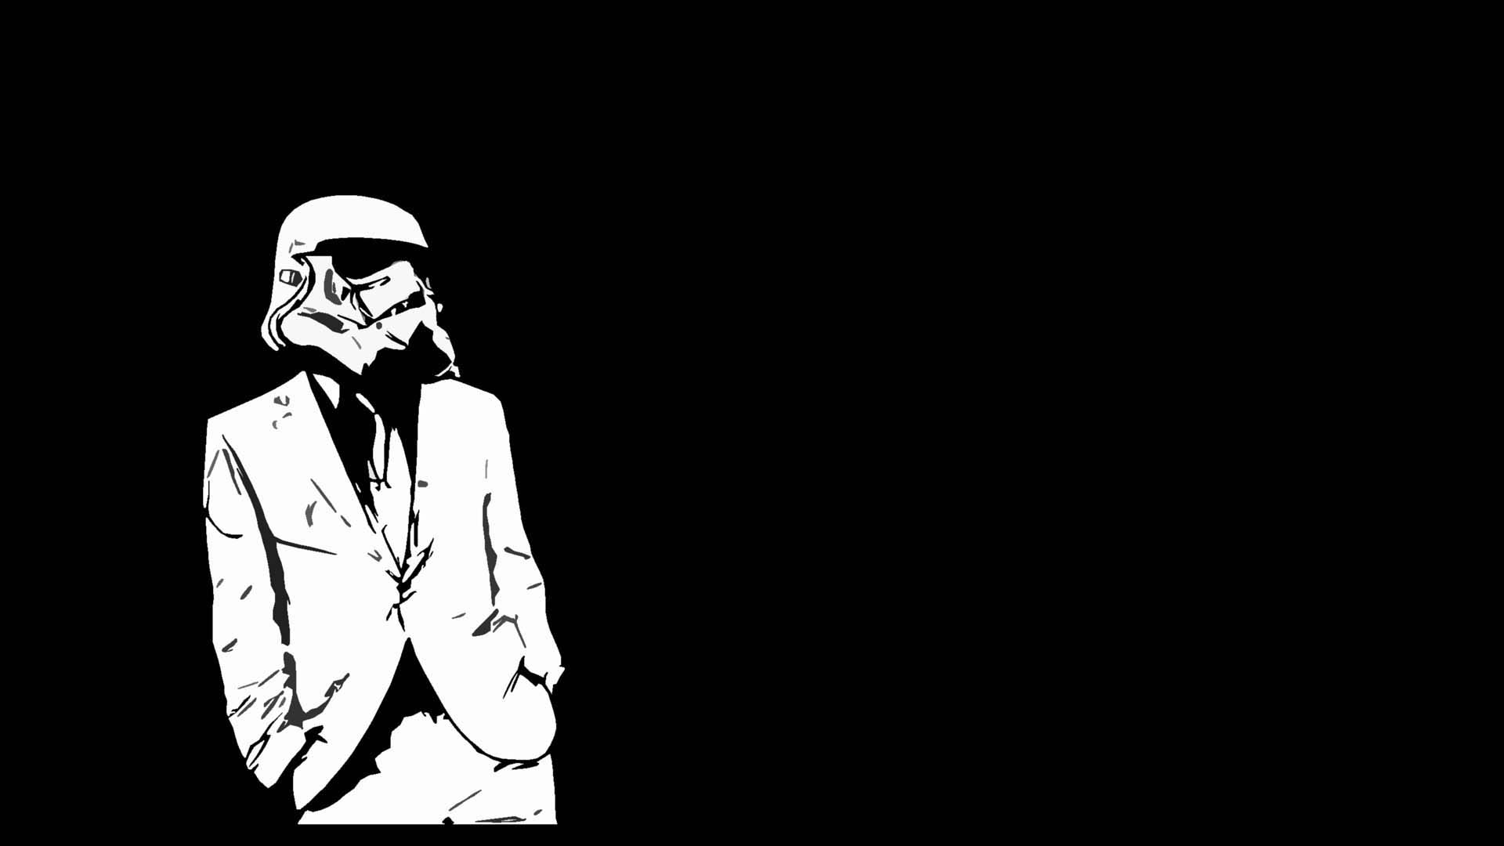
1. What color is Yoda’s lightsaber in Attack of the Clones and Revenge of the Sith?
2. Who is Luke and Leia’s mother?
3. What bounty hunter captures Han Solo?
4. Who was also known as Darth Sidious?
5. What was the name of the planet the clones were made on?

Slide 3
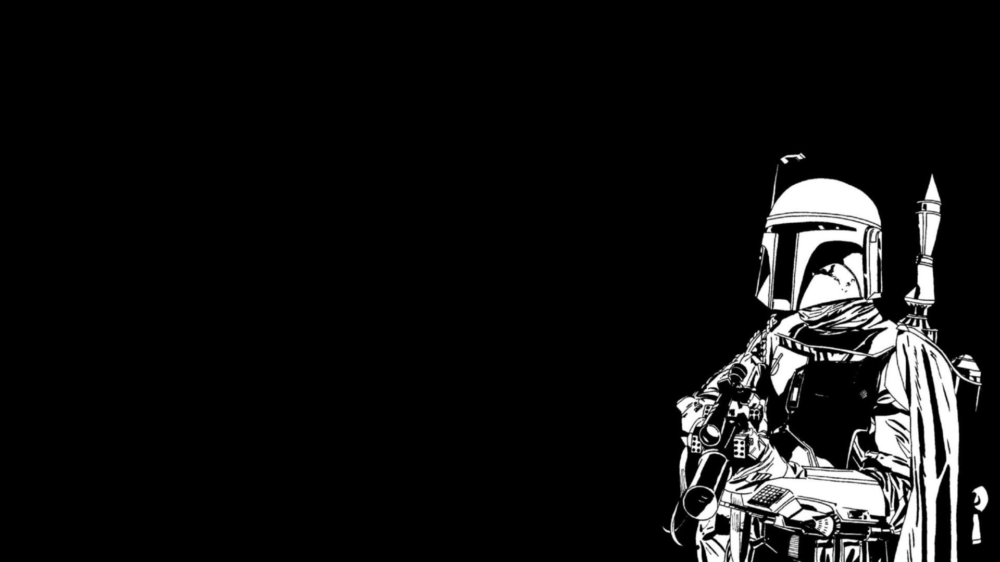
6. In which episode did Han Solo and Luke Skywalker free Princess Leia from the Death Star?
7. In Attack of the Clones, who says “Oh, not good”?
8. Which planet is Princess Leia From?
9. What type of droid is R2-D2?
10. How many characters appear in every one of the six movies?

Slide 4
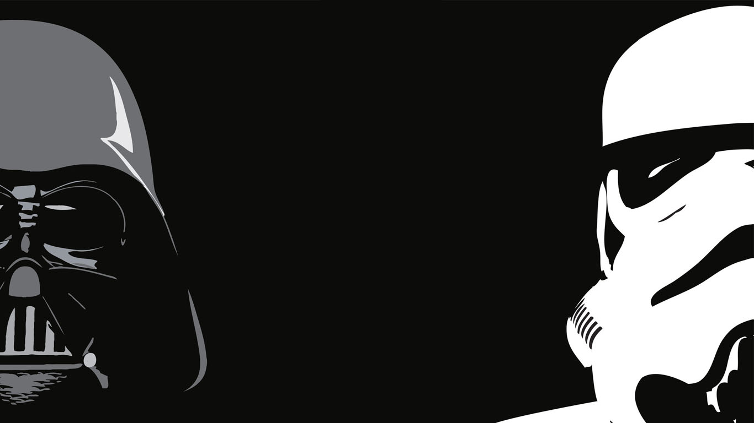
ANSWERS
Green
Padme Amidala
Boba Fett
Palpatine
Kamino
Episode IV - A New Hope
Obi-Wan Kenobi
Alderaan
Astromech
4

Slide 5
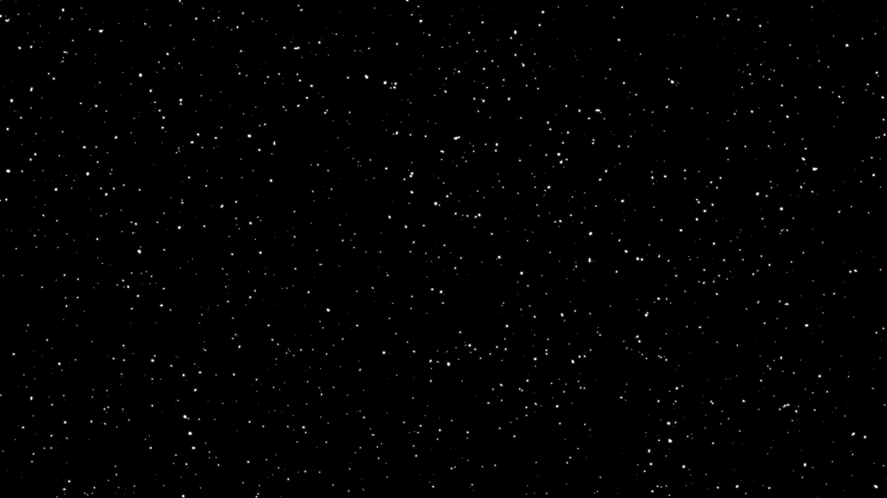
Cultural and societal issues
When creating this quiz I kept in mind the fan base for these movies. Most Star Wars fans are very passionate about the movies and have been following them for a long time. I used questions that only people who are real die hard fans could answer. Movies like star wars have a lot of people who say they are fans but don’t really know much about them. They say their a fan because its so popular right now and they want to follow the crowd.

Slide 6
General education lens
The lens that influenced the creating of this quiz is social sciences.
I’m trying to test who is a true Star Wars fan and how they would react to taking this quiz. If there a die hard fan they’d get the answers right no problem. If you’re a regular fan you might look up the answers you don’t know so that you can learn more about it. If your not a fan at all you most likely won’t even bother taking the quiz.

Slide 7
Social impact and use
The social impact fan quizzes have is they can make people feel smart and knowledgeable. Knowing a lot about something you are passionate about makes you feel good. You can talk to other people about it and not feel like your missing out on the conversation.
This quiz really wouldn’t help me in my professional life because it wouldn’t be giving me and info that I could use. It may help me figure out if there truly are a lot of Star Wars fans which could make me refer to it more in a professional setting as a conversation starter.

Slide 8
Popular/fan culture
It seems like today that anything that’s popular is somehow turned into a quiz. Whether it’s to test your knowledge on something or to find out what Disney character you most relate to. I think people just like to feel more connected to the things they enjoy and love. So knowing that your most similar to the Disney princess Belle makes you feel closer to that character. Being able to get all the questions right on a trivia quiz for your favorite show makes you feel like you’re their number one fan.

Slide 9
”Remember…
the force will be with you, always.”
- Obi Wan Kenobi

