Slide 1
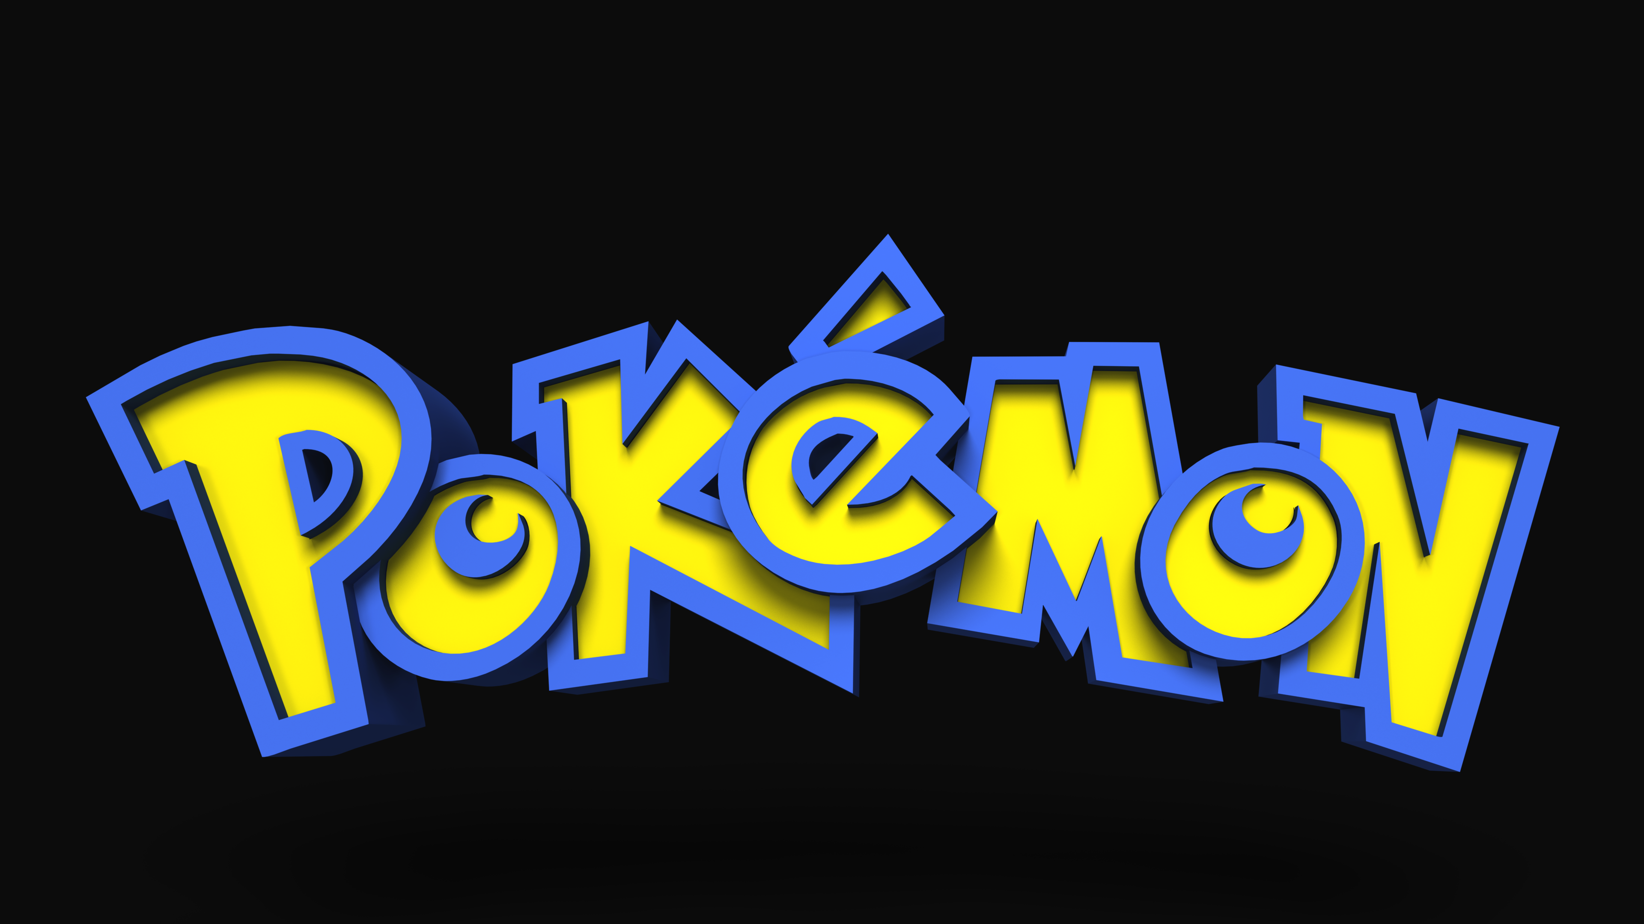
Notes:
By Stephanie Lermond

Slide 2
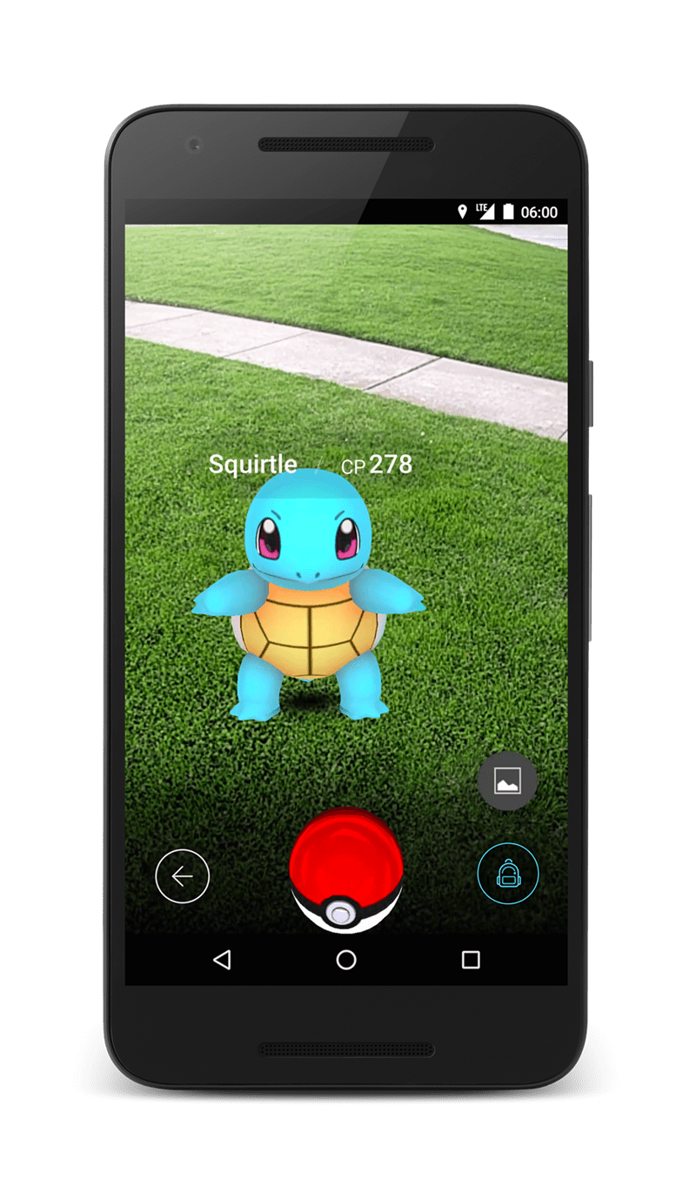
The Impact popular culture has on Pokémon
90’s culture is popular which has helped with there being more Pokémon products being sold today.
Everyone is using their phones constantly, which would contribute to them creating a Pokémon app.
Cartoons and Anime’s are popular so they continue to make new Pokémon episodes and movies.
Notes:
Something that is popular right now is products that look like they were from the 90s. When I go into stores now I see so much fashion, toys, and products that I remember seeing and/or having when I was a child. It brings back so many happy memories to see things that remind me of my childhood in the 90s and I think Pokémon is a great example of using this to their advantage. I remember this show being on when I was a child and buying trading cards to compare with my friends. People who are buying Pokémon products now are mostly adults who grew up watching it and wanting to relive a happier time or just love the nostalgia of it.
A popular product that is effecting Pokémon is cell phones, we are constantly on them and use them for so much. Pokémon has taken advantage of this by creating the app Pokémon Go so that people can “catch” Pokémon whenever they want. They make it appear like your really catching your own Pokémon that you can battle other players with. There also using Virtual Reality which as also become very popular.
Cartoons and Anime’s are also popular which helps Pokémon with still being able to create new episodes and movies. I do think that with all 3 of these popular culture things that effect Pokémon a lot of it has to do with nostalgia. People who love Pokémon now love it because it was something they had as a kid and remember it as a good memory or time in their life.

Slide 3
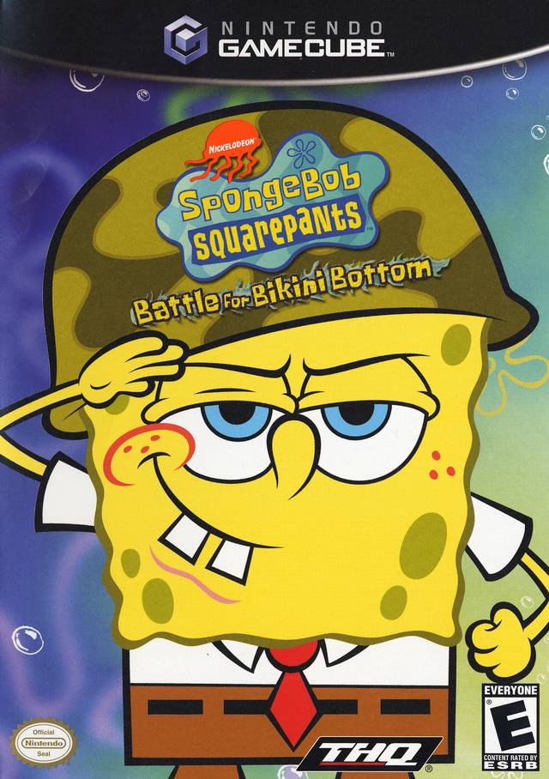
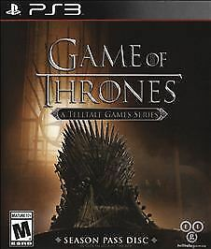
The impact Pokémon has on Popular culture
It created a way to enjoy a show with your friends by creating trading cards, which other shows started to do too.
The show was based off a game but continued to create more games based off the show. Now other shows create games so you can interact with the characters even more.
It’s popularity helped make Japanese culture popular in the United States.
Notes:
Pokémon made trading cards so you could enjoy the concept of the show even more. It created a way for kids to socialize with their friends when they weren’t watching the show. Since Pokémon cards became so popular other shows started creating playing cards to go along with their shows too.
Another thing Pokémon did is create video games to go along with their shows. Video games are so popular now that you see a lot of shows that have game based off of them.
Because this show was from Japan you’d see a lot of their culture throughout the show which I believe helped kids grow up with an appreciation for Japanese culture. Shows like Pokémon showed kids who otherwise wouldn’t know about that culture what it’s like in a different part of the world.

Slide 4
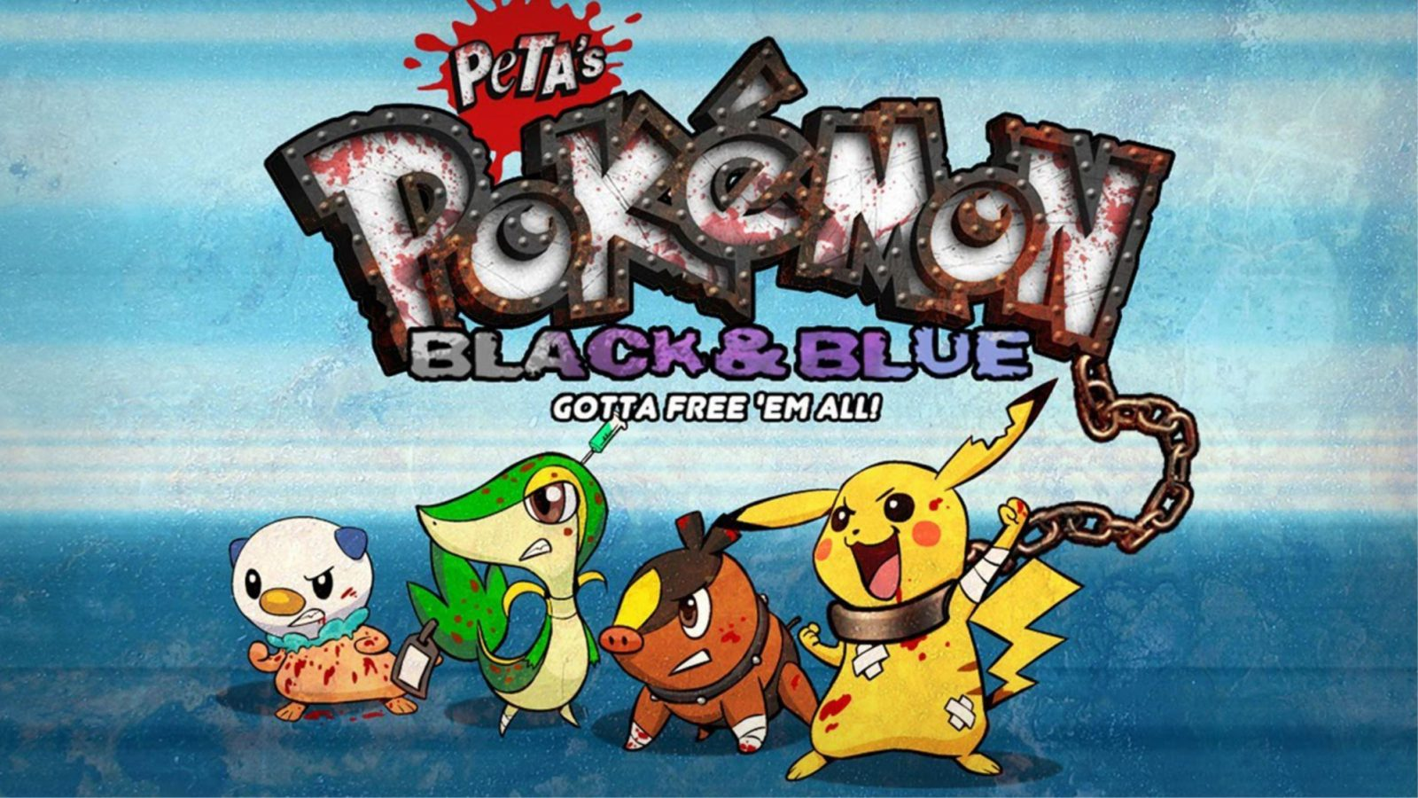
The impact cultural and societal attitudes, choices, and behaviors have on Pokémon
Organizations like PETA getting upset about the way the Pokémon are treated could have changed how the show continued.
Technology becoming more and more advanced.
Millennials loving 90s culture again and getting nostalgic.
Notes:
PETA who is an organization fighting against animal cruelty is against Pokémon because of the way the “animals” are being treated in the show. They think that is condoning animal fighting and cruelty. If enough people were upset over this Pokémon could have changed a lot of how the show portrayed the animals fighting and interacting with the characters. This is a great example of the word opposition which is "the action of opposing, resisting, or combating." When people strongly disagree with something and fight against it. PETA is so against the concept of this show that they are fighting to do something about it.
Technology has grown substantially since the 90s when this show had started, its growth in popularity has also impacted where the Pokémon franchise has gone. They have created video games and apps to grow with technology and still have products that relevant today.
Danesi, M. (2015). Popular culture Marcel Danesi. Lanham, Md: Rowman & Littlefield.
Kerr, D. (2012, October 09). PETA wages war on Pokémon for virtual animal cruelty. Retrieved from https://www.cnet.com/news/peta-wages-war-on-pokemon-for-virtual-animal-cruelty/

Slide 5
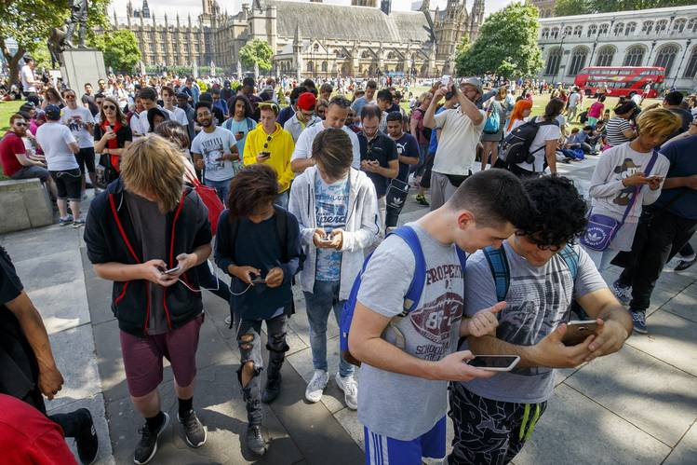
The impact Pokémon has on Society
Older generations and newer generations coming together for the love of the show/game.
People going out using the app becoming more social and learning about new locations.
Using the app also gets you outside and getting physical activity.
Notes:
The creation of the Pokémon Go app has had a great impact on society today. It’s a way for the older generation to interact with their kids and enjoy a game together. It gets people to get outside and explore the world around them instead of sitting at home in front of the TV. There’s been times while I’ve played Pokémon Go where I discovered new locations or met new people who were also playing the game. The app also makes you walk around to find Pokémon or to hatch eggs which is helping people get more physical activity and sunshine in their day.
Chamary, J. (2018, February 21). Why 'Pokémon GO' Is The World's Most Important Game. Retrieved from https://www.forbes.com/sites/jvchamary/2018/02/10/pokemon-go-science-health-benefits/#3b26f24a3ab0

Slide 6

Since I’ve been analyzing Pokémon its really made me start to think differently about how I view popular culture. I used to just see it as a way to describe something that is popular to a majority of people. Now I see that there are so many different factors that go in to why something is popular and how it impacts society. There are so many things today that are popular like video games and phones that wouldn't be around today without the advancement in technology. It’s interesting to really study an artifact and discover why it’s popular and if it’s impacting other popular culture artifacts.

Slide 7
I think studying popular culture and knowing the impact it can have on society will help me in my career as a Graphic Designer. A lot of creating designs is making products that a majority of people would want to buy. Having the knowledge of what's popular and having a sense for what could be popular will help me with creating work that lots of people will love. Creating designs that look dated would really deter my career, while creating designs that have popular aspects will help me thrive.

Slide 8
Critically analyzing a popular future artifact especially one that I don’t understand can really help with talking and interacting with people. I’m a quiet person and sometimes find it hard to find topics to talk about. Being able to discuss popular culture artifacts in more detail and more understanding will help me create conversations with my peers. It would also help me better understand why some things are popular even if I don’t like the particular artifact.

Slide 9
One day I hope to be working as a Graphic Designer and I believe that having a better knowledge of popular culture will help me reach this goal. Being able to tell an employer that I have a great understanding of what and why something is popular will give me a skill not many other people might have. I believe in a lot of careers it’s important to analyze popular culture artifacts so you can learn why it’s popular and it will give you guidance on how to create your own product that the majority of people would want to buy.
Notes:
In Graphic Design alone there are many different trends or things that are popular during a certain time. With design things change constantly like what colors or typography is considered trendy. With a career in design it’s important to always be aware of what people are visually attracted to and that can change constantly. Things that might have looked trendy once might look tacky now if you put them into your design work.

Slide 10
I believe that studying popular culture makes you a better person because it makes you easier to talk to and more relatable. Closing yourself off from popular culture will make it harder for you to interact with other people and for them to interact with you. There are so many different things that are considered popular culture that it shouldn't be hard to find a topic you love. Further studying it just helps you have more to talk about and it will increase your love for it.

