Slide 1

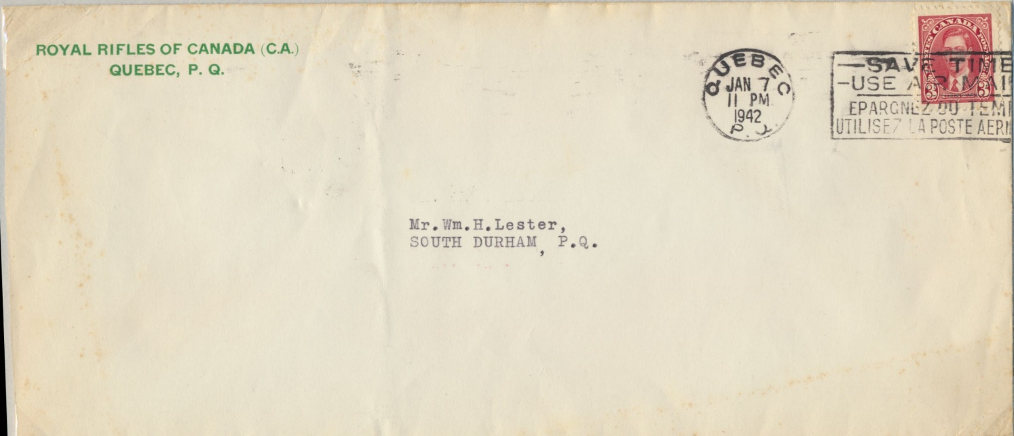
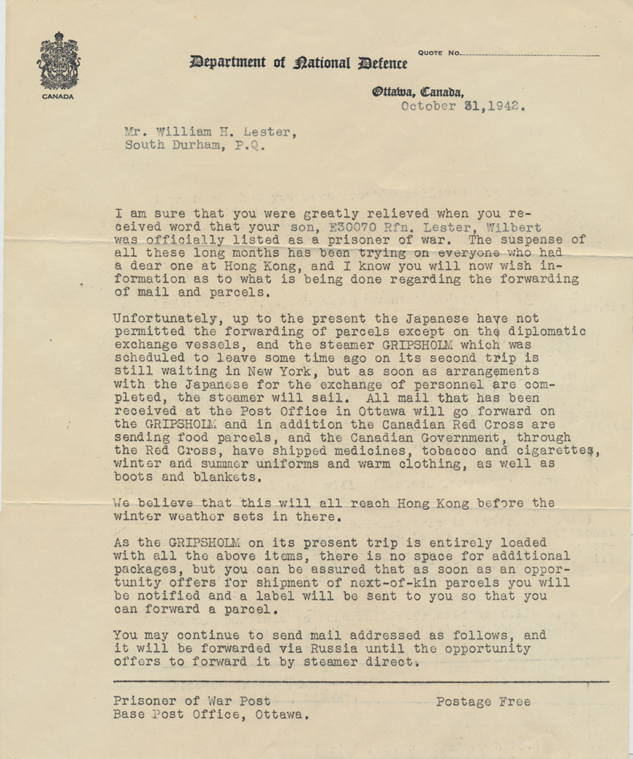
Items 1/2
Lester became a POW after the capitulation of Hong Kong. His father was notified about the Fall of Hong Kong by the letter in this cover dated 1942 January 7. At the time, the fate of Lester was unknown. The letter had since been lost.
A follow-up letter dated 1942 October 31 from Royal Rifles of Canada to Lester’s father. It took that long to confirm Lester was still alive and had became interned as a POW.
It also told of Gripsholm’s second trip to exchange personnel with all mail addressed to the POWs that were already sent to Ottawa.

Slide 2
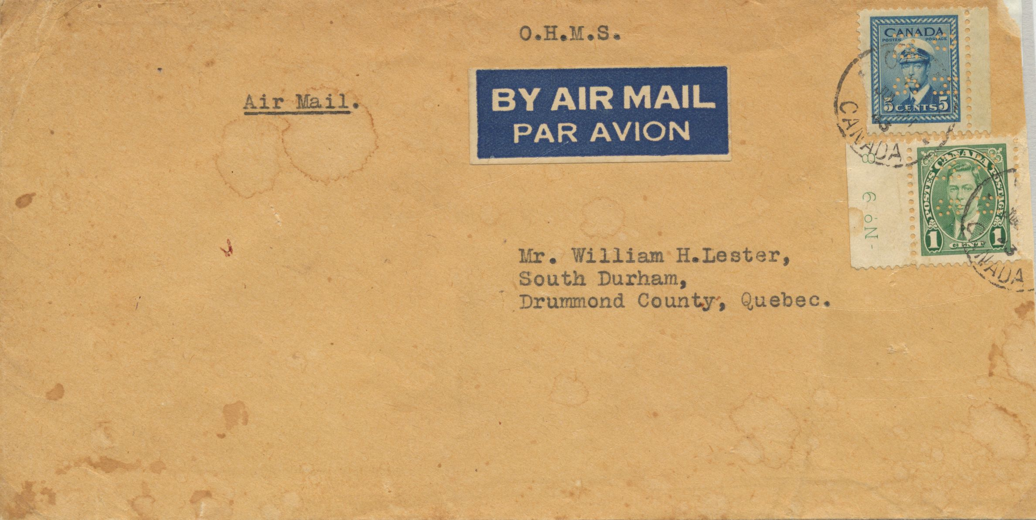
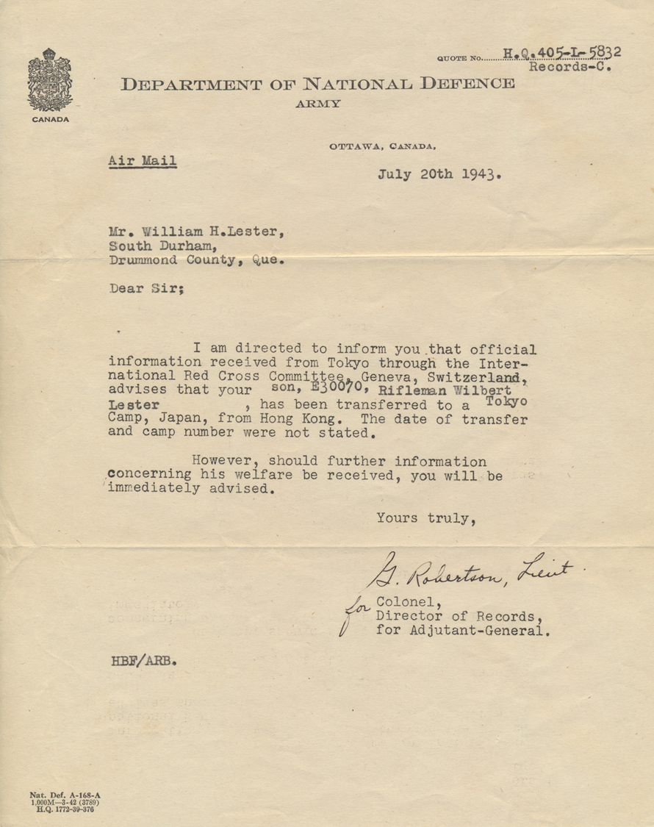
Items 3/4
Dated 1943 July 20 from the Department of National Defence to Lester’s father notifying him of Lester’s transfer from Hong Kong to a POW Camp in Tokyo.

Slide 3
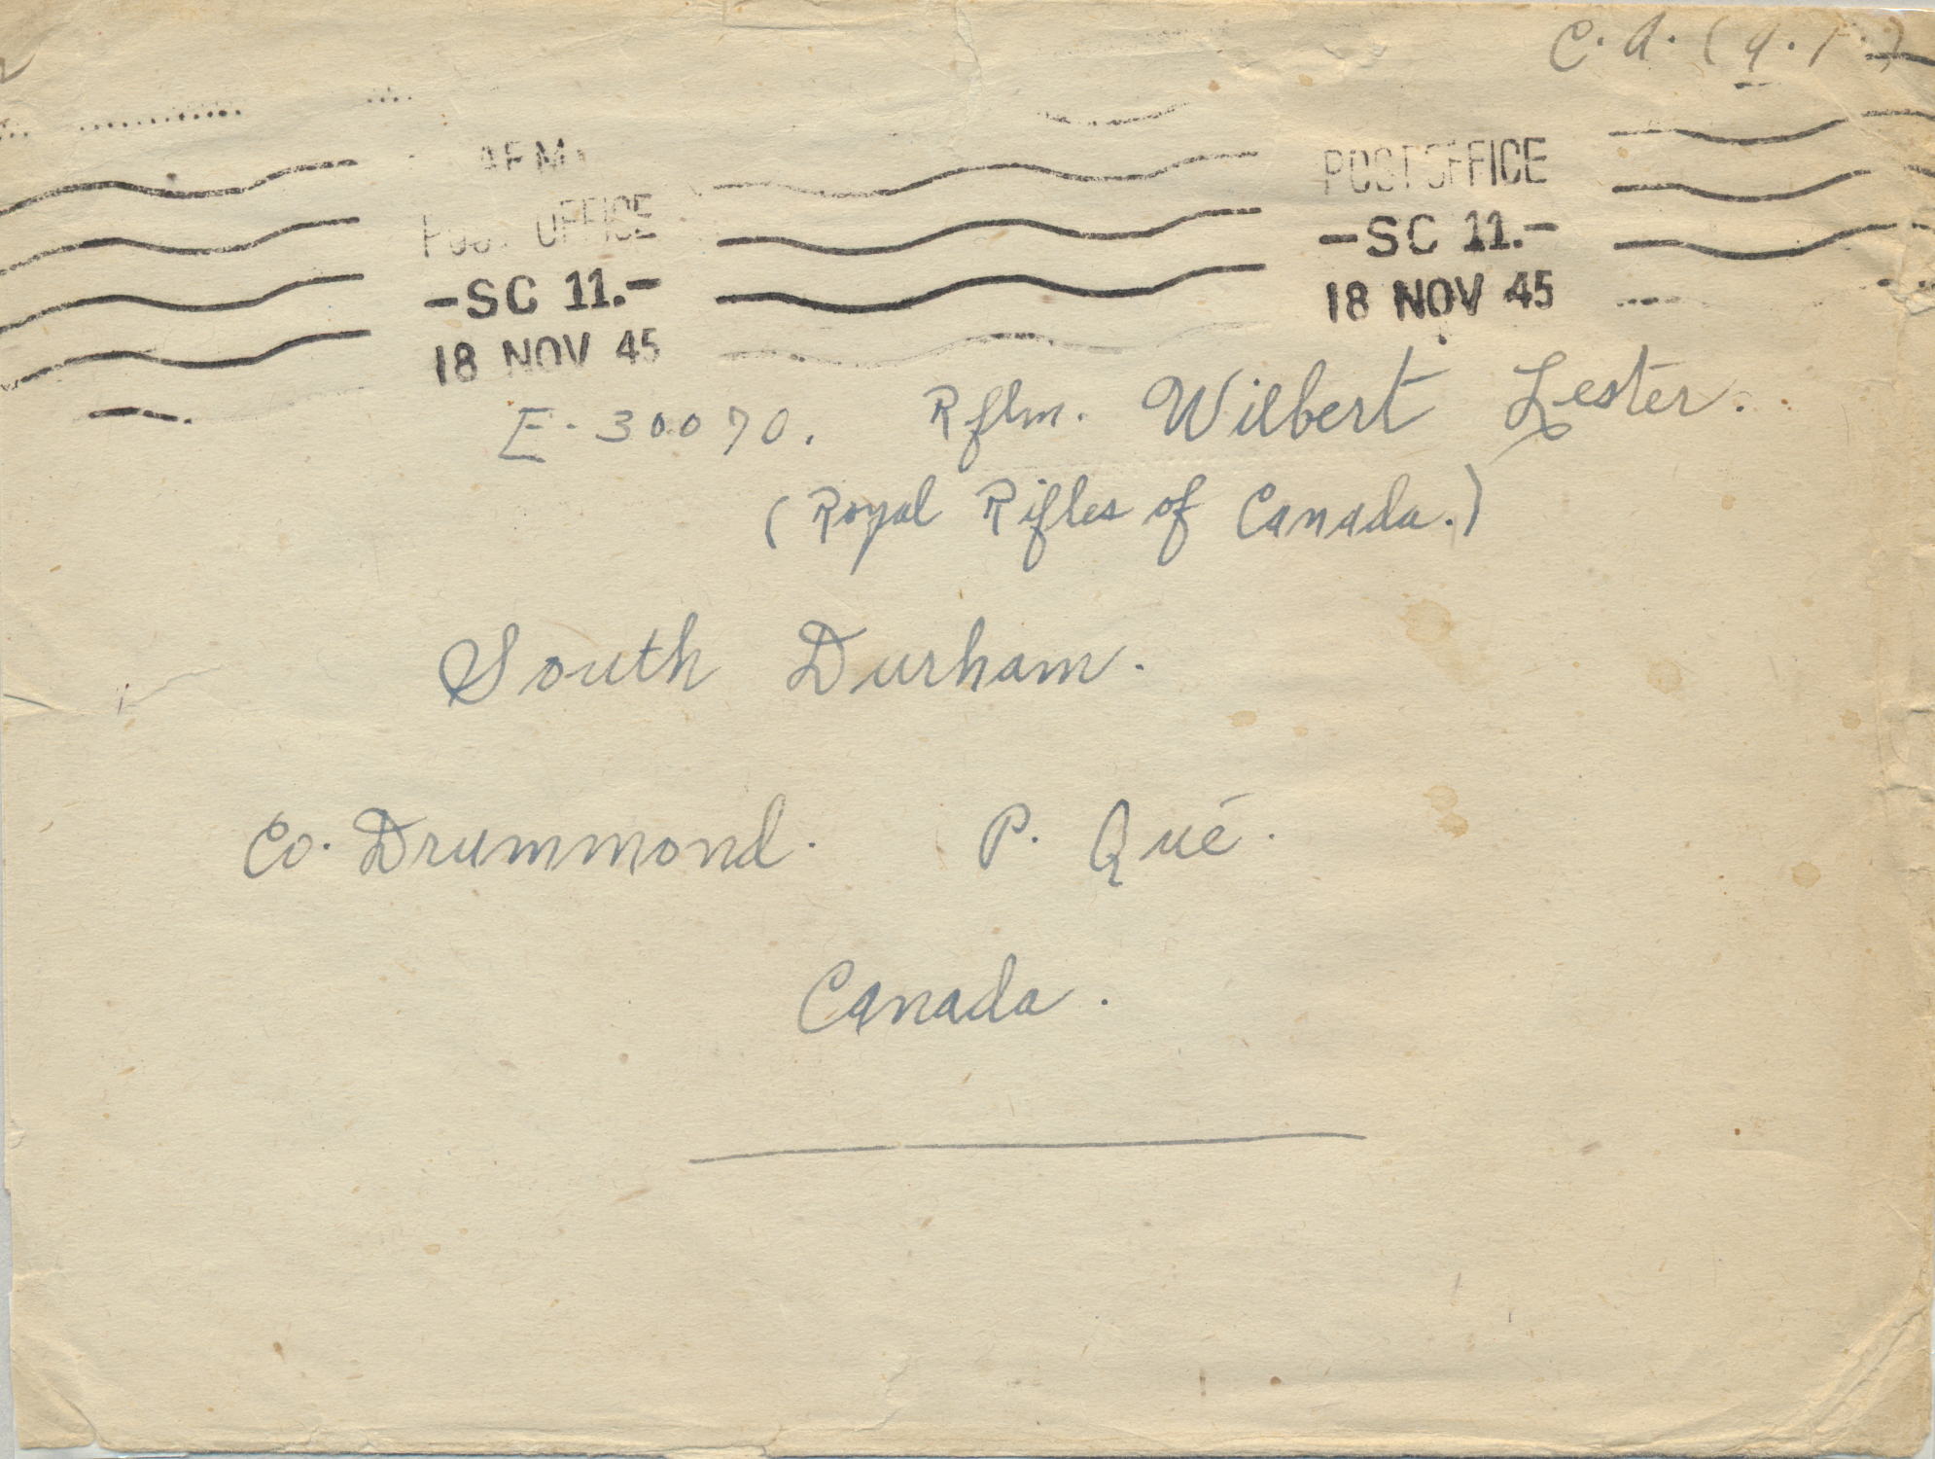
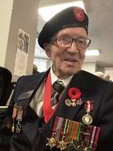
Item 5
Letter written by Corporal A. Noel RRC to Lester with PO SC11 marking of 1945 November 18. Lester would most likely have been repatriated and be back at his family’s home in South Durham, Quebec.
Lester became a carpenter and after his retirement, he was seen walking daily to the local post office with his friend Eddie Campbelton, who was also in the Royal Rifles of Canada and a former Hong Kong POW.
(HKVCA website)

Slide 4




In Summary
Postal History items for WG as Y-Force in Jamaica as forerunner, on route to HK, arrival in HK, detained mail, returned mail and POW mail HK/Japan.
Benton Correspondence WG (use of HK POW cards from HK to Canada, his hand written record of the casualty list in HK and some of his photos at home and in Jamaica)
Dowling Correspondence RCCS (letters from Canada to HK POW camp, his notebook made from POW stationery, the rare LPW letter sheets, Welcome Home card and notice to Allied POW and civilians)
Lester Correspondence RRC (notices from Canadian government to POW families)

Slide 5
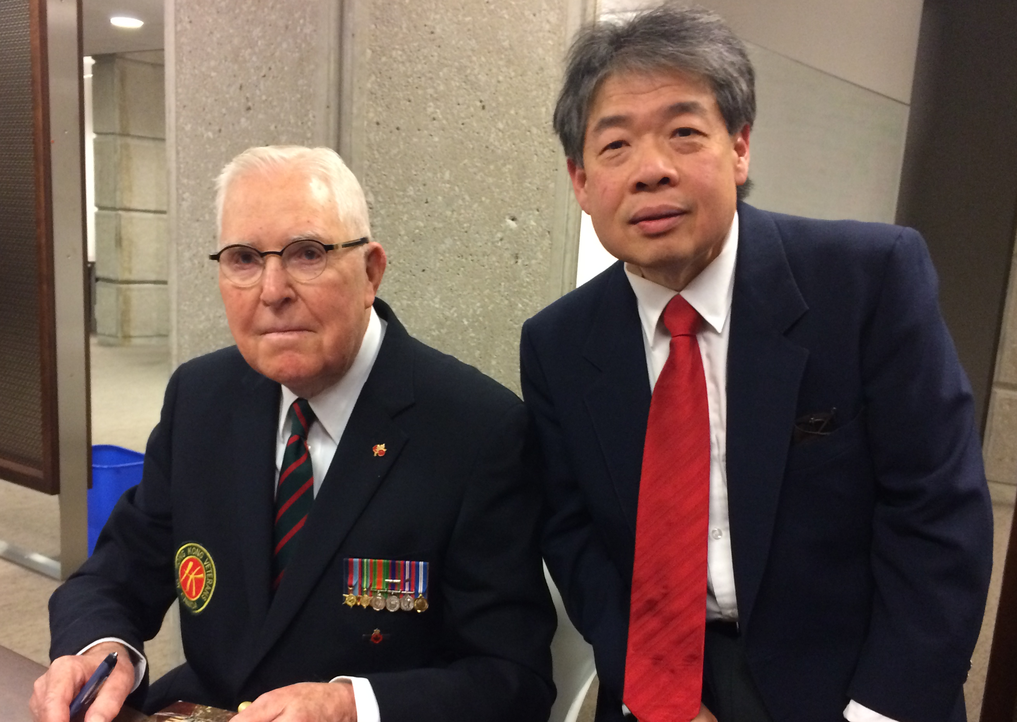
With George MacDonell, RRC 2016

Slide 6
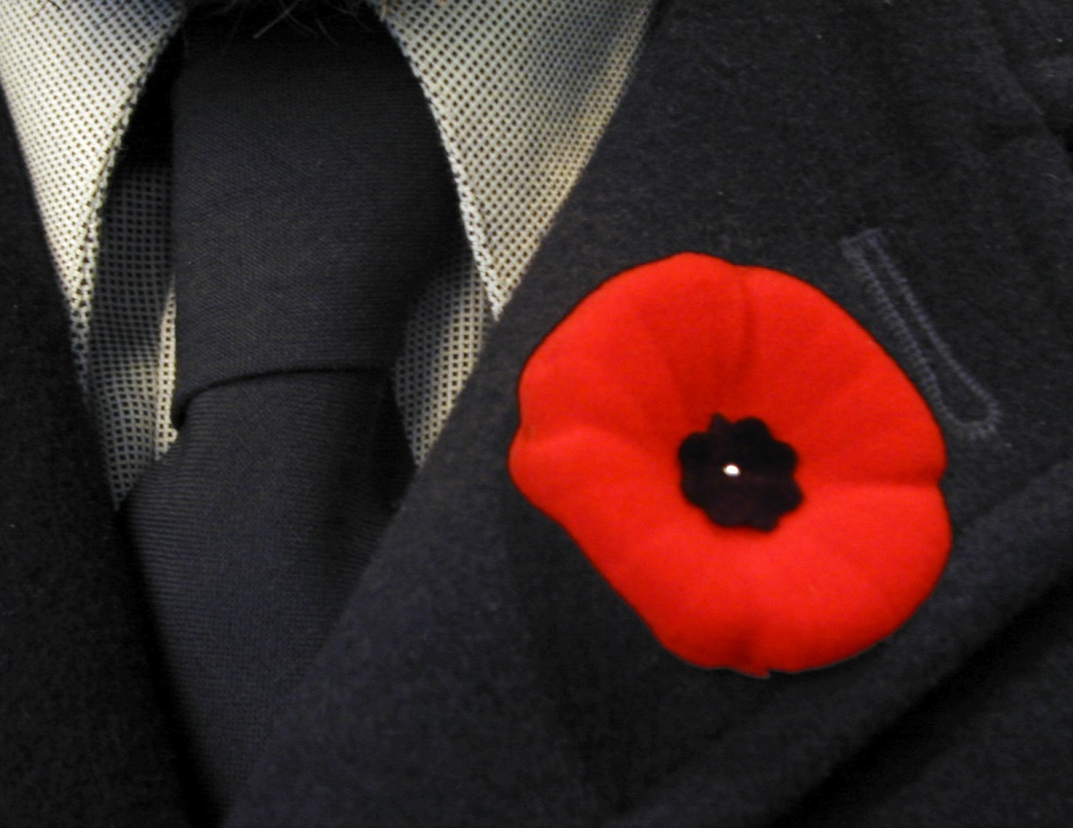
Thank You

