Slide 1
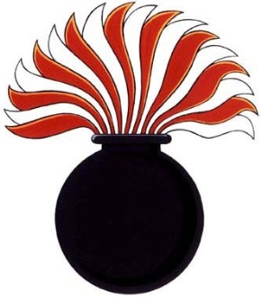
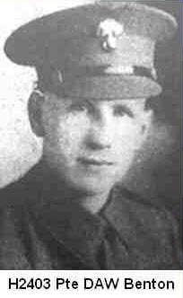
3 The Benton Correspondence
Private Duncan Albert William Benton H2403, A-Company, 1st Battalion,
Winnipeg Grenadiers
Wounded in action 1941 Dec 21
In North Point Camp H, 1941 Dec 20 - Dec 21
In Argyle Camp A, 1941 Dec 22 - Dec 26
Captured and put in Sham Shui Po Camp S, 1942 Jan 22
In North Point Camp H 1942 Jan 22-Sep 26
In Sham Shui Po Camp S 1942 Sep 26-1945 Sep 10
Date of Death: 2003 Jan 1
(HKVCA website)

Slide 2
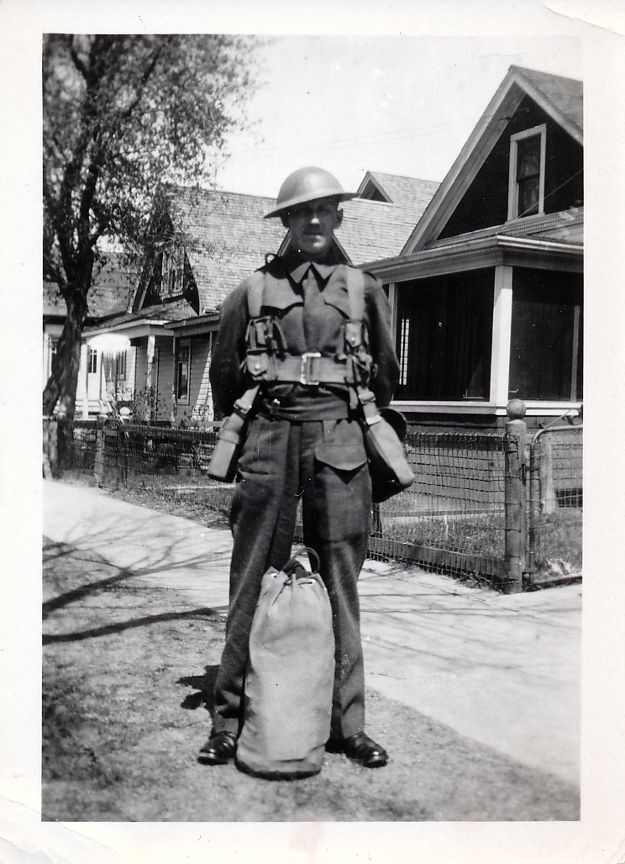
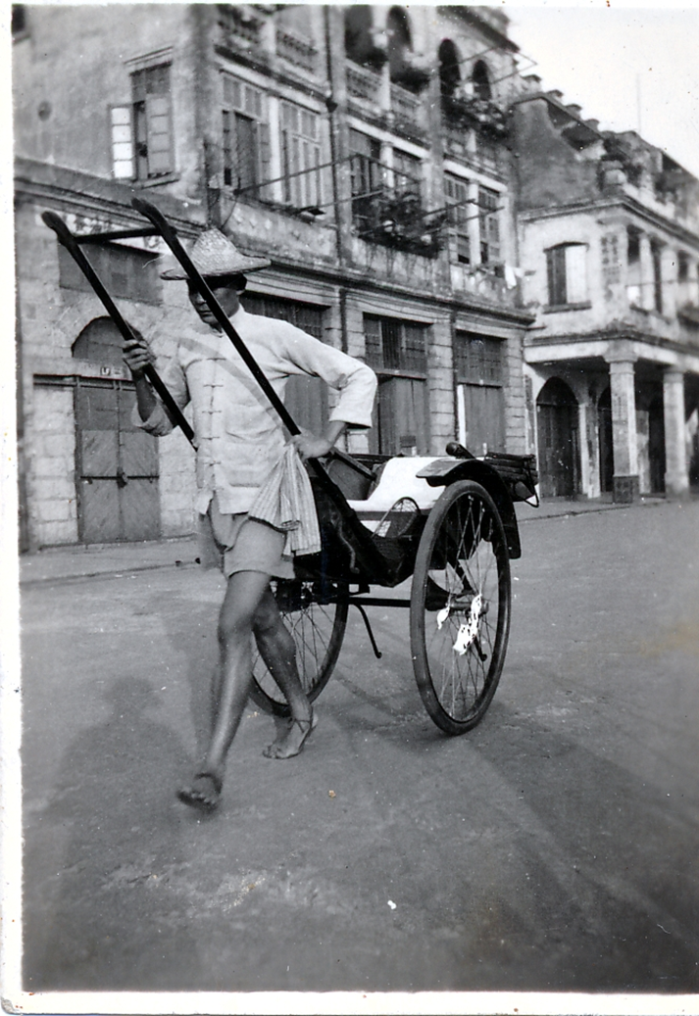
In uniform in Winnipeg
Only photo in HK (Rickshaw)
Shadow of Benton(?) taking this photo

Slide 3
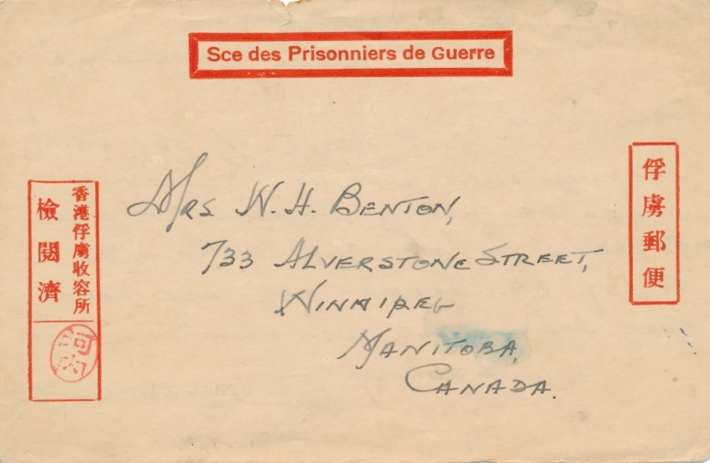
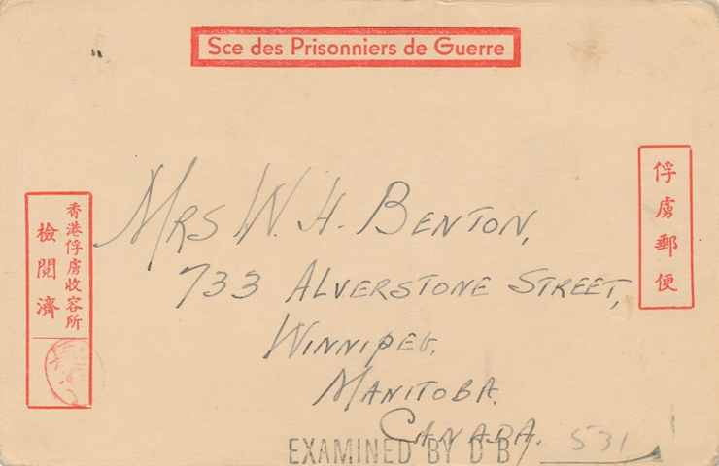
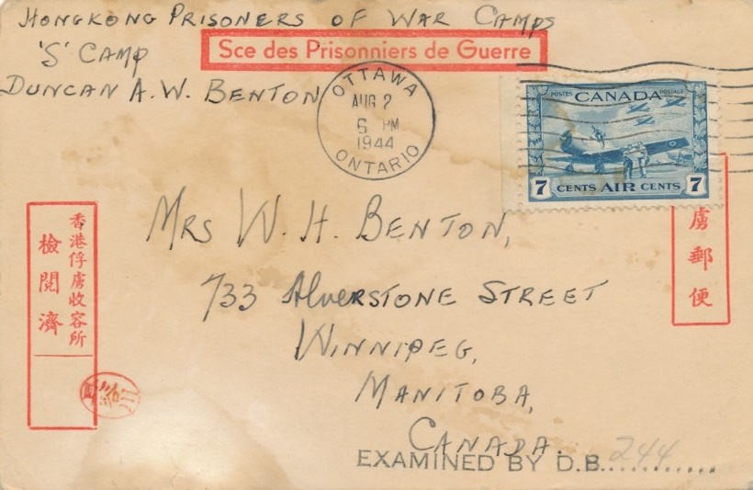
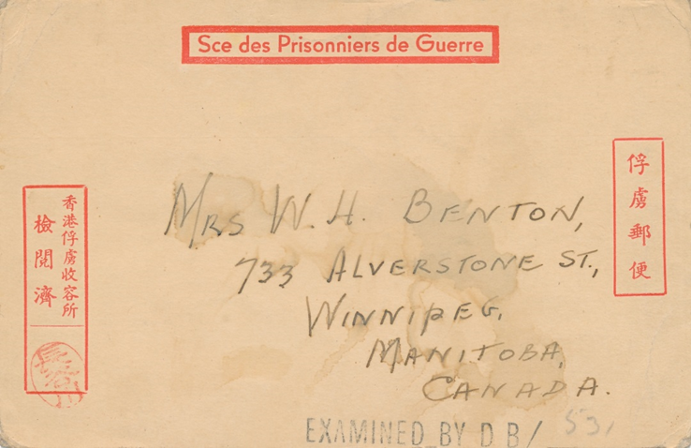
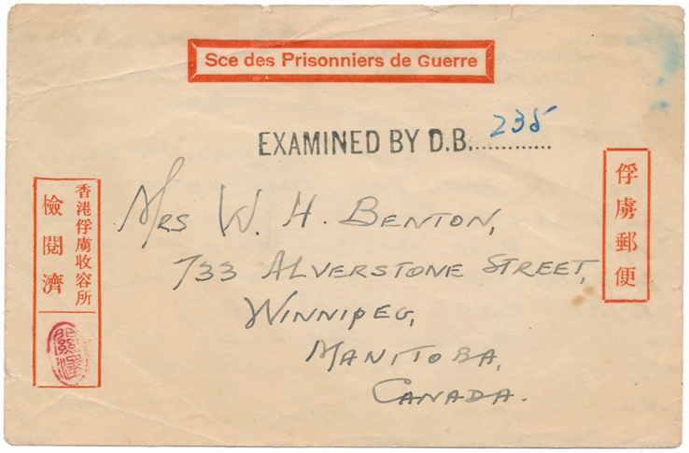
5 HK POW postal stationery card

Slide 4
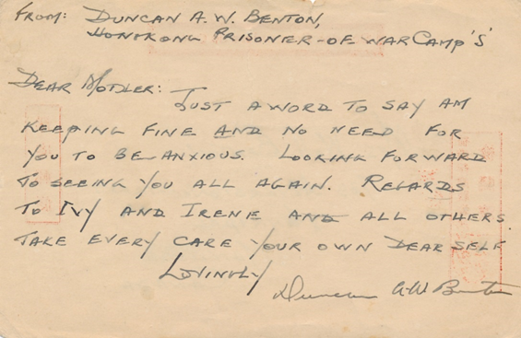
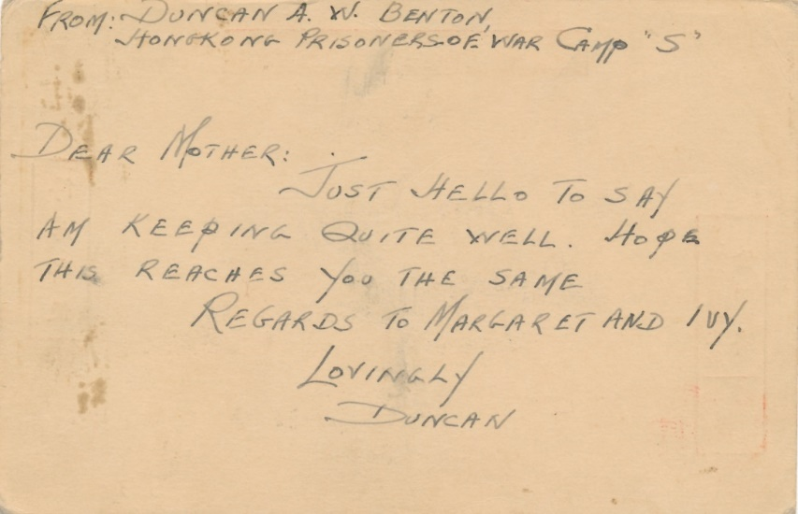
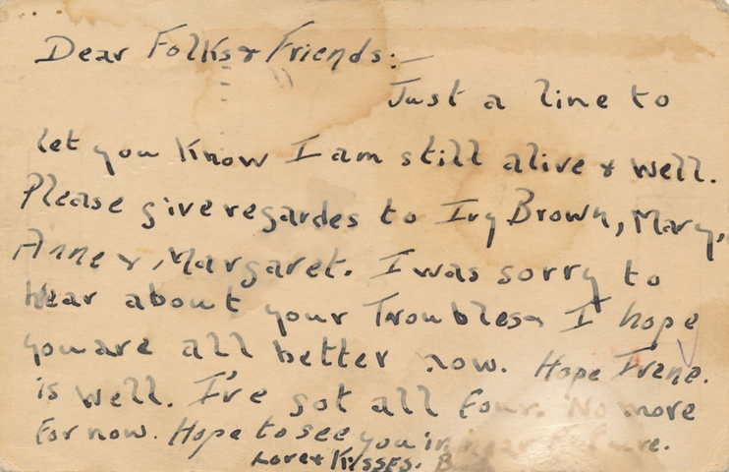
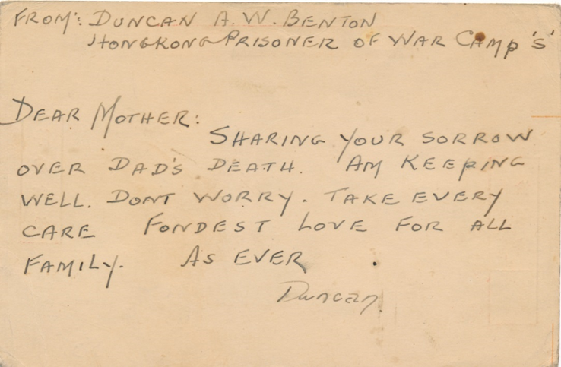
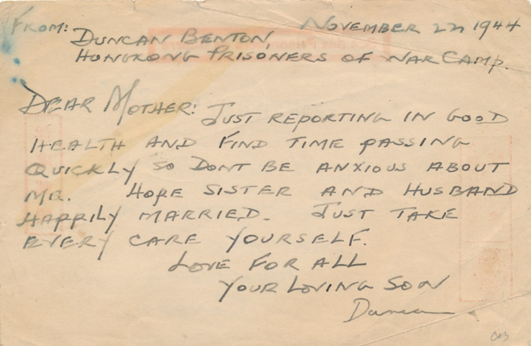
The back of the cards
Notice the handwriting styles of these cards

Slide 5

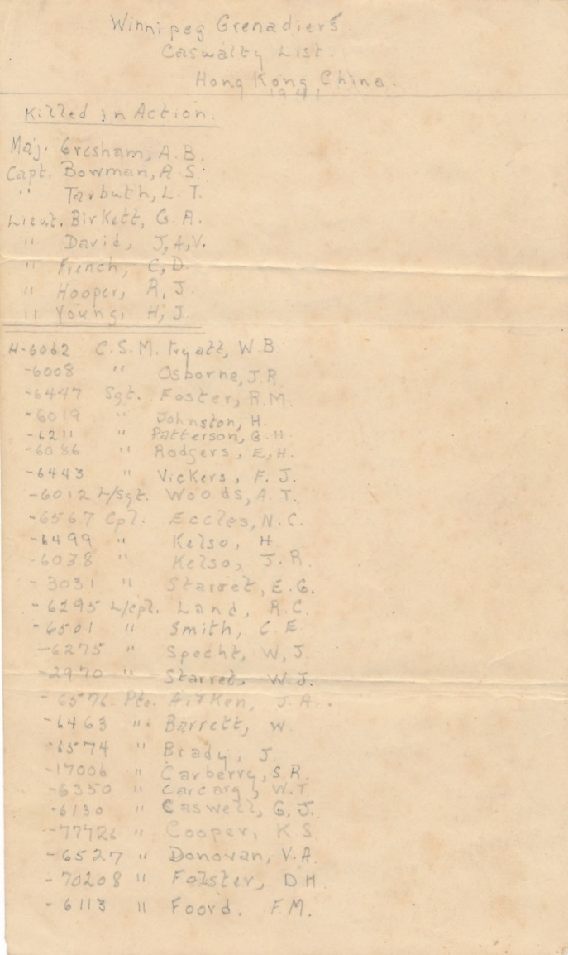
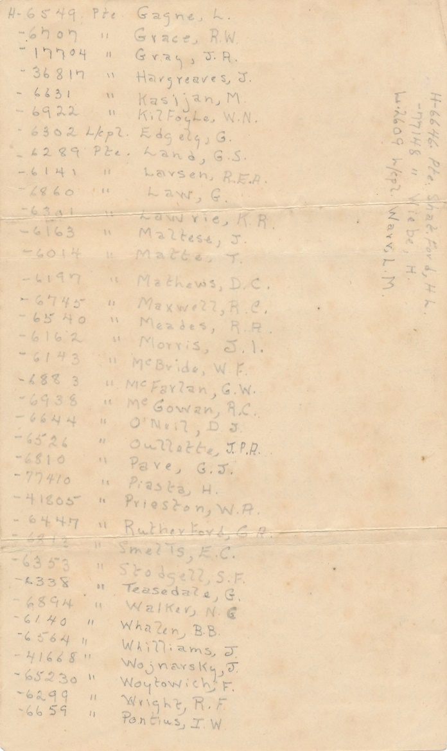
why I must buy this correspondence:
4 pencil written notes made by Benton of the casualties listings of WG when he was interned as a POW in Camp S
List 1
back
Killed-in-Action

Slide 6

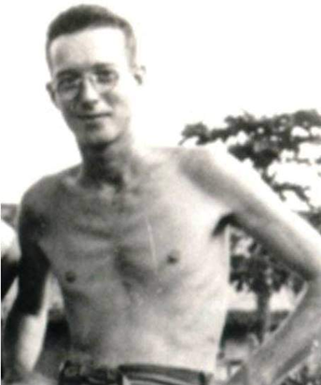
4 The Dowling Correspondence
Signalman Lawrence Fredrick Dowling B32015, Brigade HQ,
Royal Canadian Corps of Signals (RCCS)
(HKVCA website)
The first 2 Canadian casualties of WWII were 2 Royal Canadian Corps of Signals stationed at Sham Shui Po during the first attack. This was the same unit and location where Dowling was posted!
Record only showed he was interned at Sham Shui Po, Camp S, from Sept 1942 till liberation. It did not showed whether he was interned at North Point, Camp H, before Sept 1942. (HKVCA website)
With item 4 in this correspondence, we can now add to the knowledge that he was indeed interned at North Point, Camp H before Sept 1942, as there were directing instruction to deliver to Camp H.
Dowling belonged to this very small HQ force, which was the third component dispatched to Hong Kong. They were often forgotten and overshadowed by its much bigger cousins, The Winnipeg Grenadiers and Royal Rifles of Canada.

Slide 7
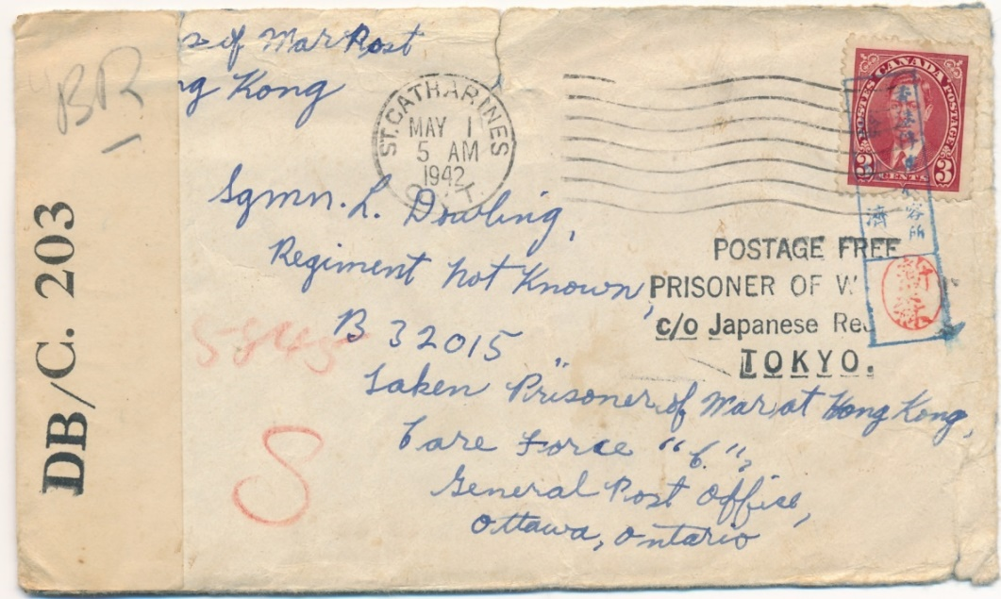
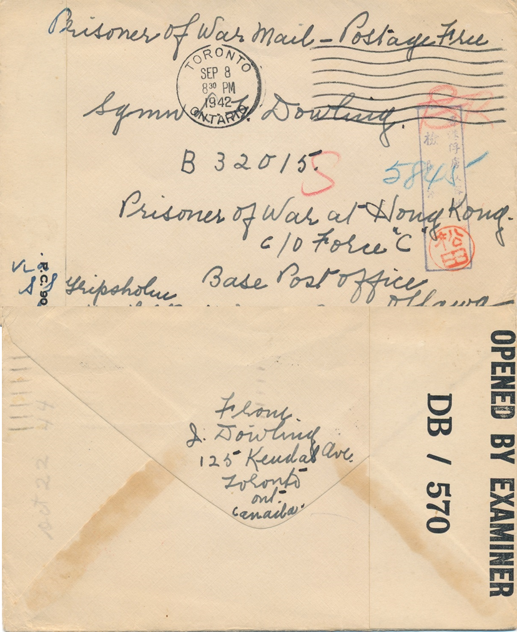
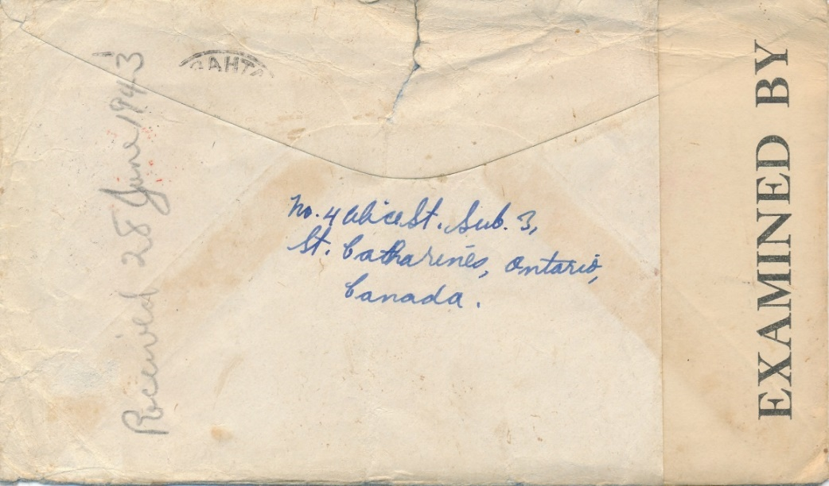
Item 2: Sent from Toronto, ON 1942 Sept 8th written by his aunt, directed to Camp S and received 1944 Oct 22nd. Censored by Matsuda 松田. Again, what does BR in red pencil stand for?
Item 1: Sent from St. Catharines, ON 1942 May 1st. By the time it reached Dowling in 1943 June 28th, he was already interned at Camp S. Censored by Niimori 新森.
DB/C.203 Censor Tape Ottawa
An important item clearly endorsed for SS Gripsholm’s second transfer in Oct 1943. It took another year for the letter to reach Dowling.
What does BR stand for? British? Brigade?
5845 seemed to be a POW number put on in HK.

Slide 8
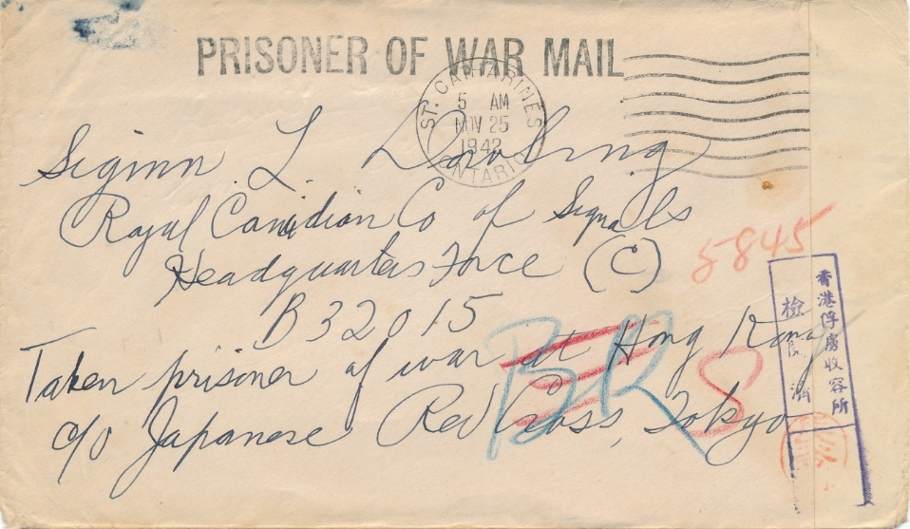
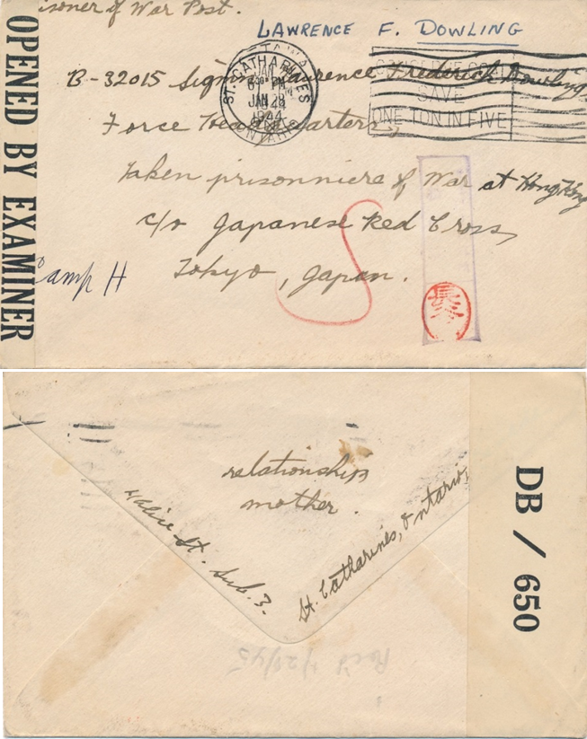
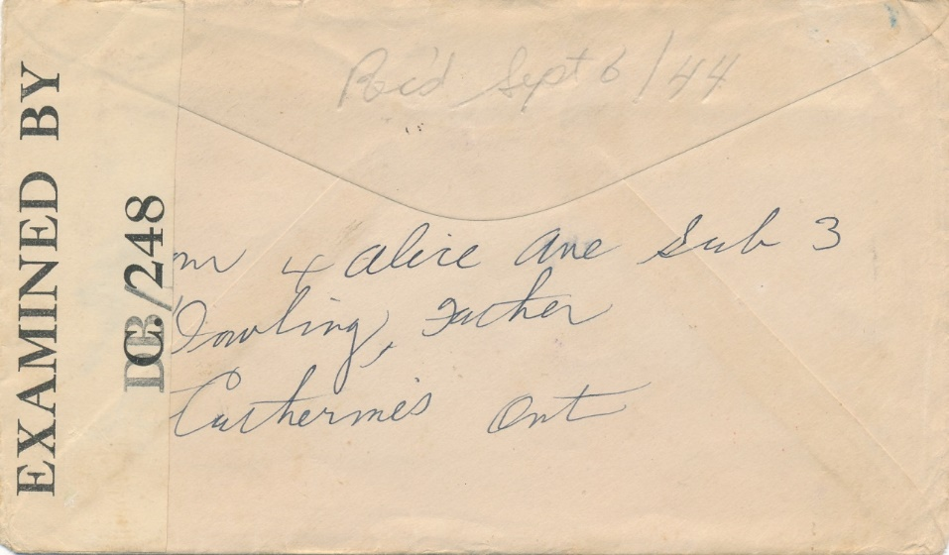
Item 3: Sent from St. Catharines, ON 1942 Nov 25th written by his father and directed to Camp S and received 1944 Sept 6. Censored by Hasegawa長谷川. BR now crossed out and replaced by S.
Item 4: Sent from St. Catharines ON 1944 Jan 28th written by his mother, directed to Camp S and received 1945 Jan 28th. Censored by Hasegawa 長谷川.
DB/ C.248 Censor Tape Ottawa
This item had relatively similar originating and receiving dates when compared to the previous item, even though this had no endorsement to be shipped by SS Gripsholm.
There had been no record on the whereabouts of Dowling before Sept 1942. The fact that this was marked as Camp H, North Point, showed he must have been interned there before being transferred to Camp S.

Slide 9
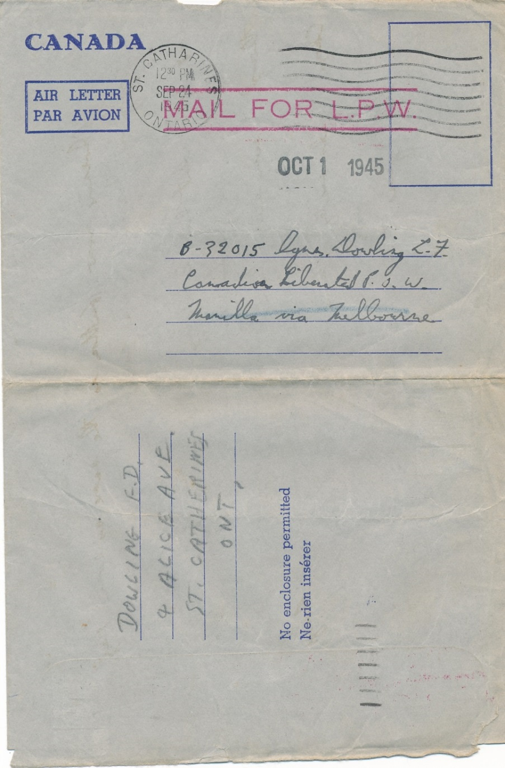
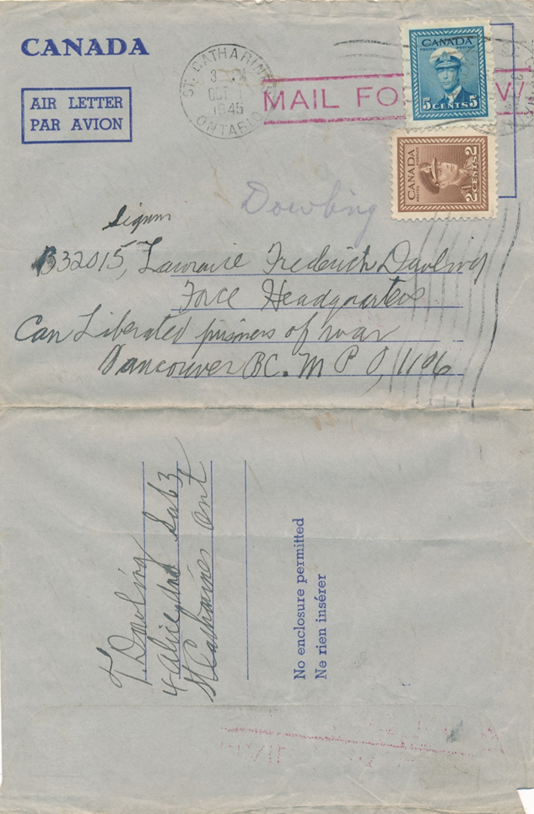
Why I must buy this correspondence:
Item 5/6: “Mail for L.P.W. air letter”
(Liberated Prisoners of War)
Mail for LPW air letters are very rare.

Slide 10
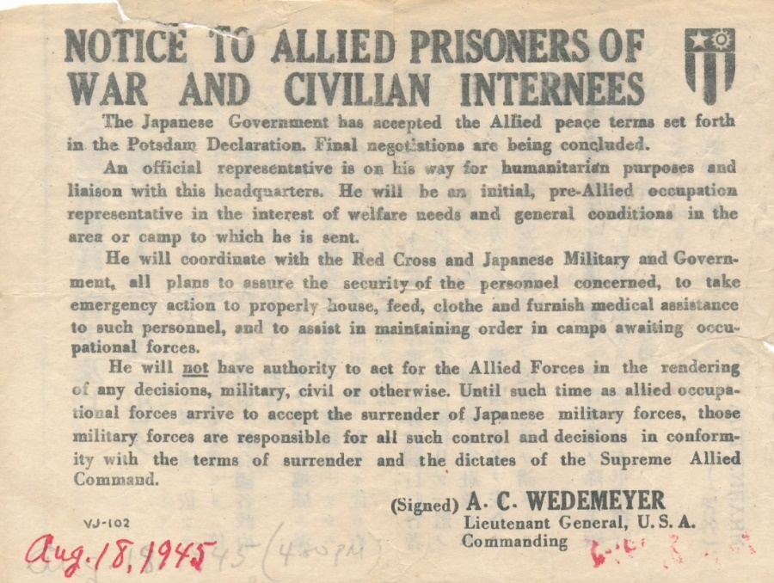
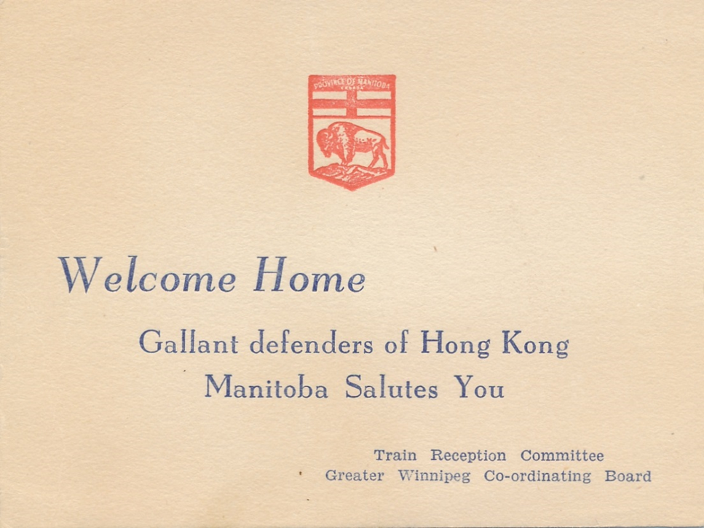
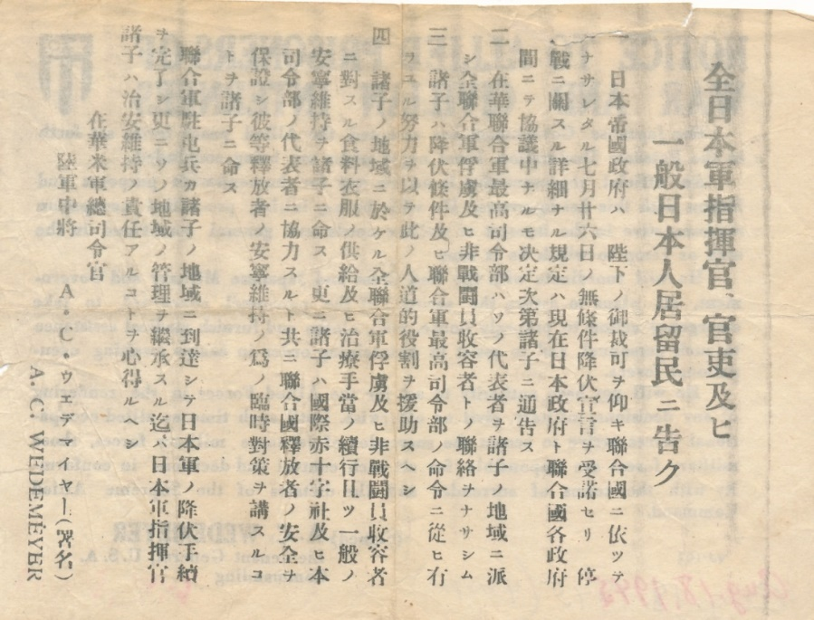
ITEm 8 Notice to Allied POW and Civilian Internees
Item 7 Welcome Home Card
presented to WG members

Slide 11
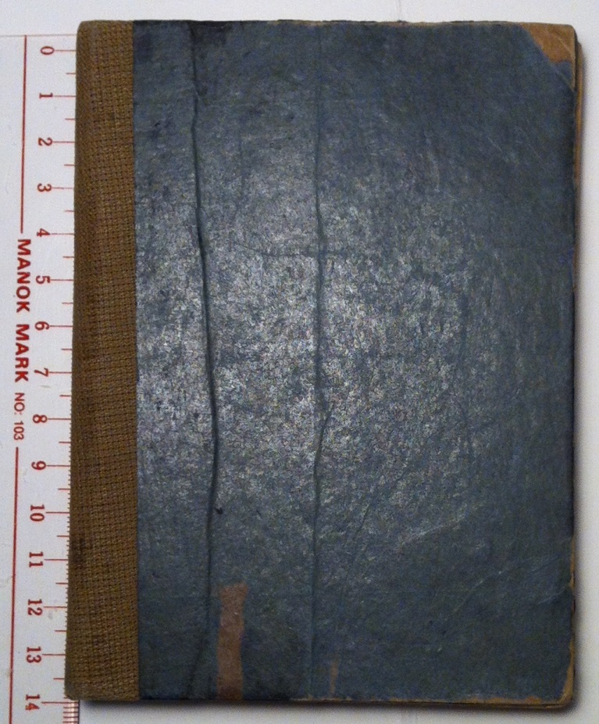
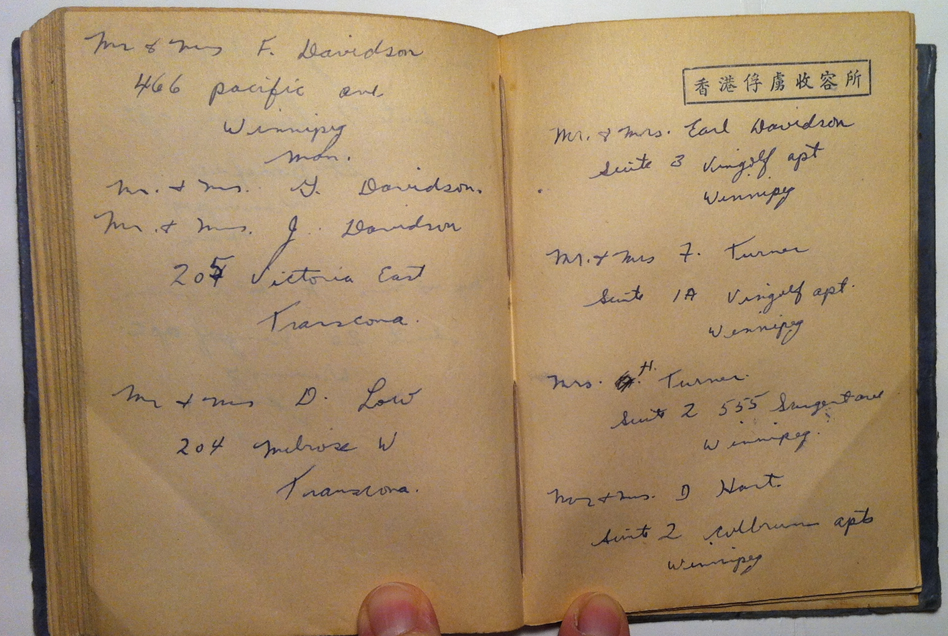
ITEM 9 Dowling’s Notebook
Small note book Dowling had made with POW stationery that he used as a record of his friendship with fellow POWs and their addresses; also with messages and drawings from his peers

Slide 12
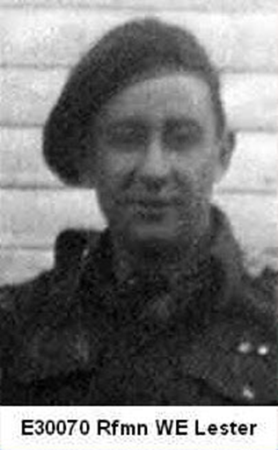

5 The Lester Correspondence
Rifleman Wilbert Ernest Lester
E30117 1st Battalion / HQ Company
Royal Rifles of Canada
(HKVCA website)
Wounded in Action 1941 Dec 19
Was in Stanley Hospital during the massacre
Captured at Stanley Hospital 1941 Dec 30
In North Point Camp from 1941 Dec 30 to 1942 Sep 26
In Shum Shui Po Camp from 1942 Sep 26 to 1943 Jan 19
Transported to Japan from 1943 Jan 19 and put to work at Nippon Steel Tubes in Tsurumi Shipyard until 1945 May 13
Transferred to work at Joban Coal Mining Company from 1945 May 13 to 1945 Sep 15
Day of Death: 2003 Sep 19
(HKVCA website)

