Slide 1
iPad Guide
Jack DeLeo

Slide 2
Here is what is on the outside of your iPad
Headphone jack: insert wired audio connection
Camera: Both one on the front and back
On/Off button: press it to turn off your iPad
Volume buttons: increase or decrease the volume of your iPad
Home button: used for a variety of functions, press once to go to the home screen
Lighting connector port: use it to charge your iPad

Slide 3
Charging the iPad
Plug the brick into the wall
Plug the cable’s larger end into the brick (make sure it is plugged in)
Plug the short end into the bottom of the iPad, under the home button
There will be a green battery logo and a lightning icon next to it if the iPad is charging

Slide 4
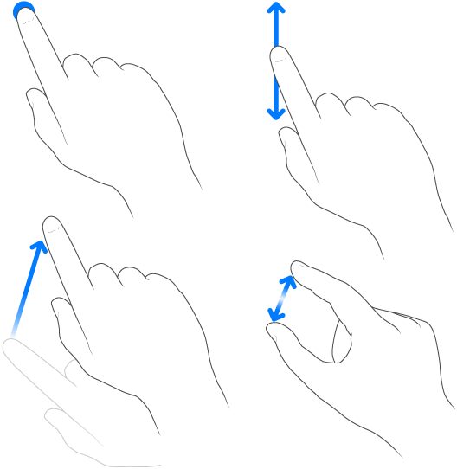
Gestures
There are several gestures that are essential to know when using your iPad
Tap: tap on the screen
Drag: leave your finger on the screen, and move it around the screen
Scroll: drag your finger up & down or left & right
Pinching: “Pinch” the screen. Usually used to zoom in and out

Slide 5
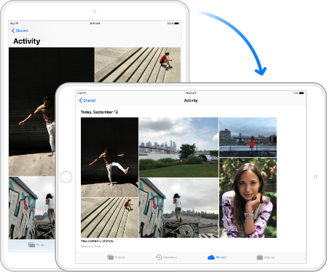
Orientation
The orientation of the iPad can be adjusted at almost any time. Simply flip your iPad to the orientation that you want it
You can lock your iPad in its current orientation by flipping the switch on the side of the iPad, above the volume buttons

Slide 6
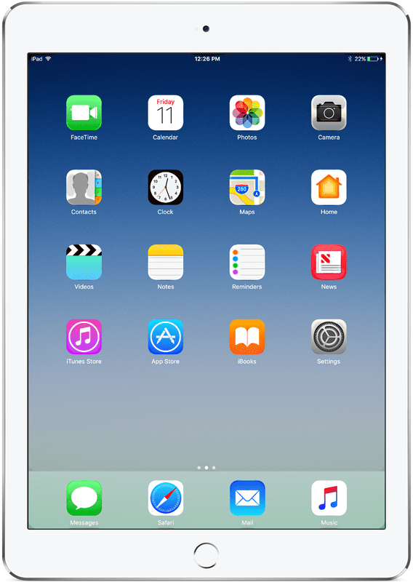
Inside your iPad there is a home screen with apps
This is your home screen, the hub of the iPad
These icons all represent apps, which perform various functions.
You can go into these apps by tapping on them

Slide 7
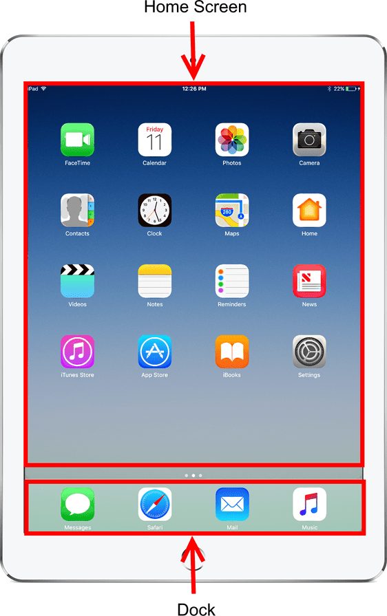
The Home Screen
The home screen consists of one or more pages, which can be scrolled through by swiping left or right on the screen
The dock is a bar at the bottom of the home screen which is permanent. Apps placed here will stay there regardless of which page you are on

Slide 8
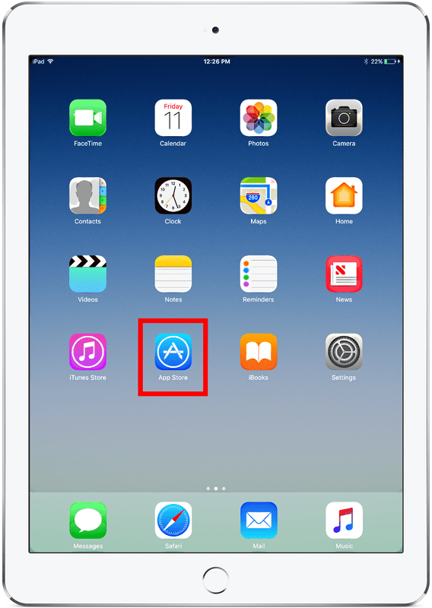
Going into apps
Tap on an app’s icon to enter it
Tap on the App Store app (blue)
Then press the Home button

Slide 9
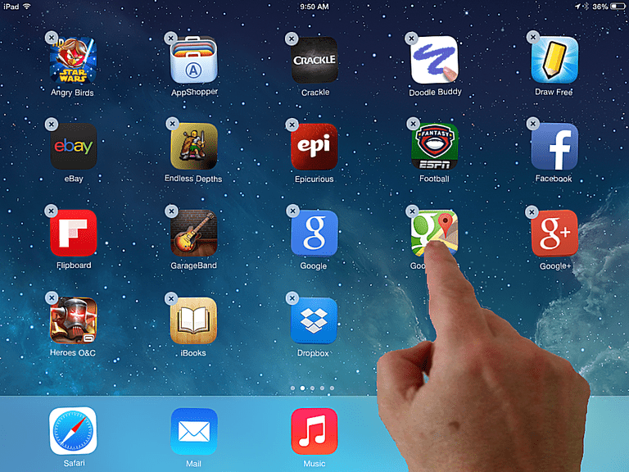
Moving apps
To move an app, tap and hold on the app’s icon until all the apps start to jiggle
Then tap, hold, and drag the app to the place you want it
Tap the circle with the “x” to delete an app. Some apps cannot be deleted

Slide 10
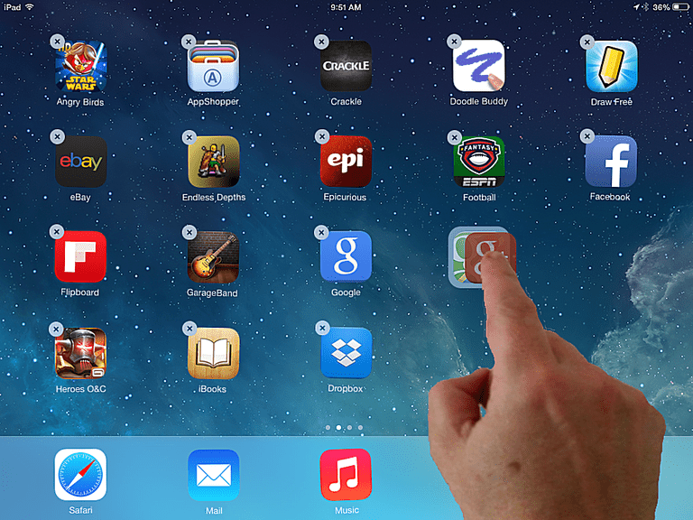
Creating Folders
Tap and hold on the app’s icon until all the apps start to jiggle
Then tap, hold, and drag the app on top of another app, and both apps will go into a new folder

Slide 11
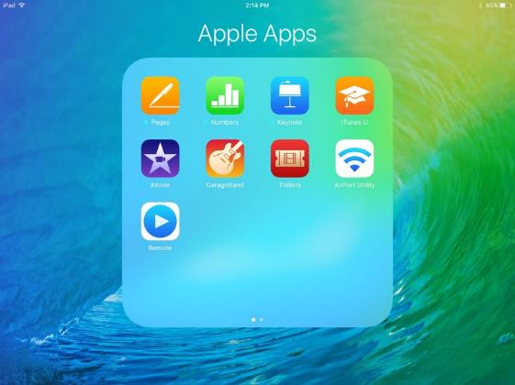
Tap outside of the blurred/grey area to exit the folder
To put another app inside the folder, tap, hold and drag the app until it is over the folder
Try putting 10 apps in a folder, and then drag them all out
The folder will automatically delete when there are no apps inside it

Slide 12
The App Store
The App Store is the app where you can get other apps that can perform many various functions
Tap on the App Store app to begin

Slide 13
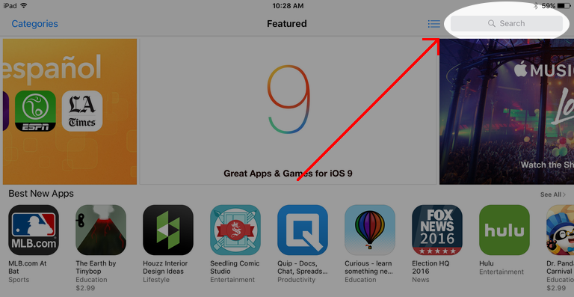
App Store
From here, go to the search bar in the top right corner
Type in the title of an app or a keyword on the on-screen keyboard

Slide 14
App Store
From here, there will be cards representing apps that show up in a grid
Tap on a card to open further information about the app
If you want to download the app, there will be a blue-bordered button that says either “Get” if the app is free or states the price. (You will be required to enter your Apple ID password when downloading an app, paid or free)

Slide 15
Camera
Open the camera app from the home screen
To take a picture, tap the white circle or press the volume button
--- Set a timer to take a photo
--- Turn flash on or off
--- View the photos you have just taken
-- Adjust the zoom
(NOTE: Adjusting the zoom will not make your pictures clearer)

Slide 16
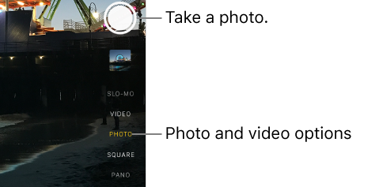
Camera
There are different camera modes that can be selected by tapping the one you want to use
Select video. To record, press the red circle or volume button. Press again to stop recording
Panorama: used to take ultra-wide photos. Hold up the iPad and follow the instructions on-screen

Slide 17
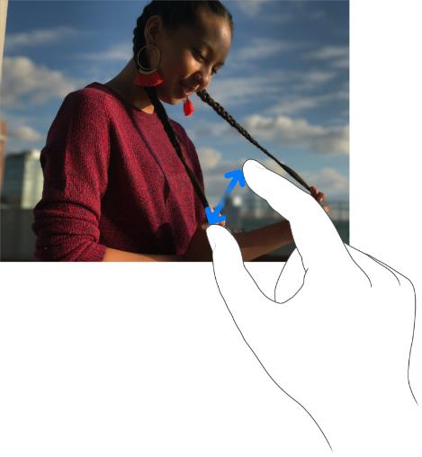
Photos
To view the photos on your iPad, select photos from the home screen
From here, a timeline will be shown of all the photos on your iPad
Tap on a photo to view it
You can zoom in and out by “pinching”; put two fingers on the screen and move them apart to zoom in. Move them closer together to zoom out.

Slide 18
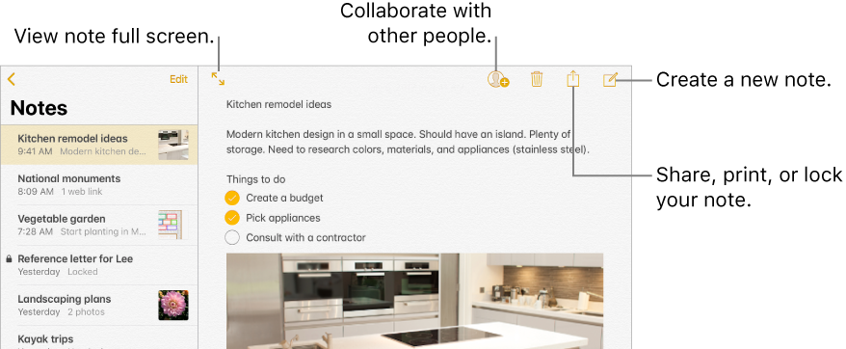
Notes
Open the Notes app
Press the paper and pencil icon at the top right to create a new note
From there tap the white space until the on-screen keyboard appears and type

Slide 19
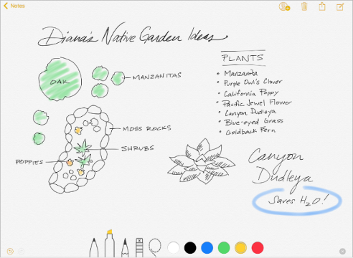
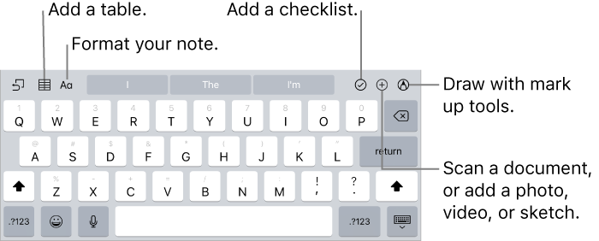
Notes continued
You can also draw in notes; tap the circle with the pen inside it to start drawing
Additional commands are also listed

Slide 20
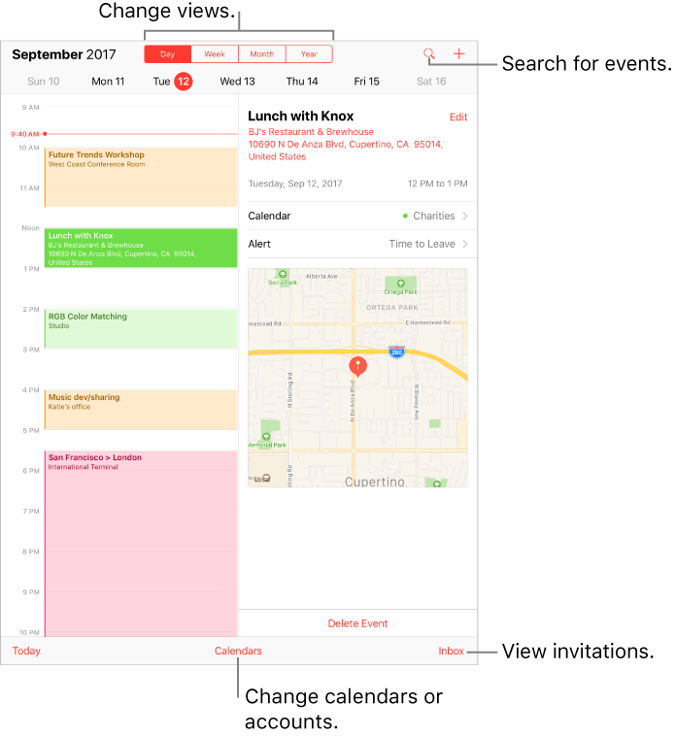
Calendar
Tap the plus in the top right corner to create a new event
From there you can edit the details of the event, including name, time, and location, and whether it repeats

Slide 21
Books
Here you can read e-books you own or browse for new ones
The bottom bar can take you to your e-books or different sections of the iBooks store
The iBooks store functions similarly to the app store, except the e-books can be accessed through the books app

Slide 22
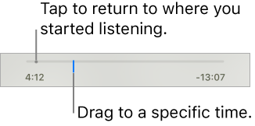
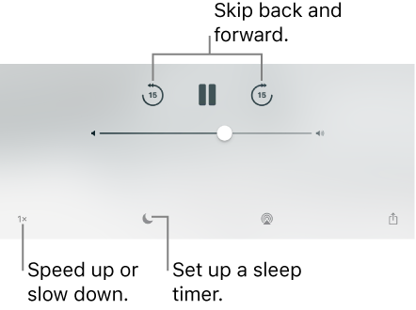
Audiobooks
Audiobooks can be accessed and bought through the books app, just like e-books

Slide 23
Safari
Safari is the iPad’s default web browser
In Safari you can surf the internet
To open up a new tab, tap the plus at the top of the screen
From there, type what you want to search (Keywords, titles, etc) into the search bar at the top of the screen
You can have multiple tabs open, so you can have multiple webpages you can switch between quickly
To view open tabs, tap the button that looks like two squares
Tap to switch between an open webpage
Switch tabs this way by tapping on them

Slide 24
Settings
Open the settings app
From here you can adjust many of the iPad’s settings. They are sorted into categories, or you can search settings by scrolling up to the top of the main list and tapping the search bar
There are many settings senior citizens may find useful in accessibility. From the main settings menu, tap General, then Accessibility.

Slide 25
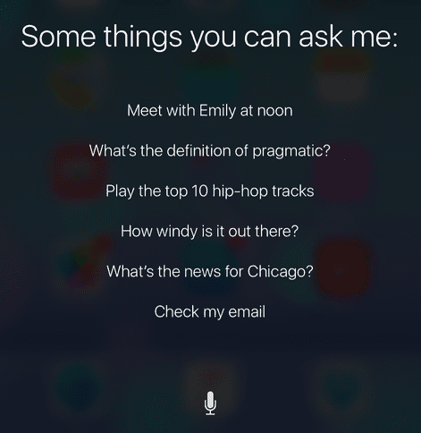
Siri
Siri is a virtual assistant that can be spoken to
You can ask for information or help, or give her commands
Activate Siri by holding down the home button
Ask Siri for help before contacting your nearest youth

Slide 26
The End
That concludes my presentation.
I can now individually help you and answer any questions you may have.

