Slide 1
2nd lecture
MMC1
Computer Application in Mass Comm.

Slide 2
What is Internet?
Interconnection of computers and computer networks using TCP/IP communication protocol
• Transport Control Protocol/ Internet Protocol (TCP/IP)
• What is a protocol?
– A protocol is a set of rules defining
communication between systems

Slide 3
History of internet
It was invented by Al Gore
Early 1960’s - DARPA (ARPA in 1960’s) project headed by Licklider
Late 1960’s - ARPANET & research on packet switching by Roberts
  First node installed by BBN at UCLA in September 1969
  1969 - Four host computers (UCLA, SRI, UCSB, University of Utah)

Slide 4
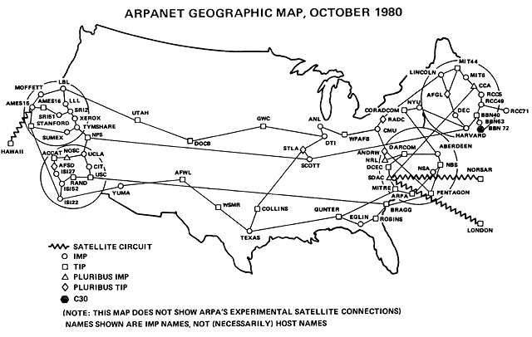
ARPANET, 1980

Slide 5
1969 - RFCs begun by S. Crocker (http://rfc.sunsite.dk/)
1972 - Email by Ray Tomlinson & Larry Roberts
1970’s - TCP by Vint Cerf & Bob Kahn
  Evolved into TCP/IP, and UDP
1980s – Hardware Explosion (LANs, PCs, and workstations)
  1983 – Ethernet by Metcalfe

Slide 6
Tim Berners-Lee at CERN in 1989
  Proposal for WWW in 1990
  First web page on November 13, 1990
Hypertext - Text that contains links to other text.
  Ted Nelson’s Xanadu
  Vannevar Bush’s Memex

Slide 7
Communicating Via the Internet

Slide 9


Search Engines
www.google.com
www.dogpile.com
www.ask.com

Slide 10

http://www.bing.com/
www.yahoo.com

Slide 11
AllTheWeb.com
http://www.alltheweb.com
AOL Search
http://aolsearch.aol.com (internal)
http://search.aol.com/(external)
HotBot
http://www.hotbot.com
AltaVista
http://www.altavista.com

Slide 12
Gigablast
http://www.gigablast.com
Live Search
http://www.live.com/
LookSmart
http://www.looksmart.com
Lycos
http://www.lycos.com
Netscape Search
http://search.netscape.com

Slide 13
Open Directory
http://dmoz.org/

