Slide 1
More Greek Mythology
Creatures, places, and more…

Slide 2
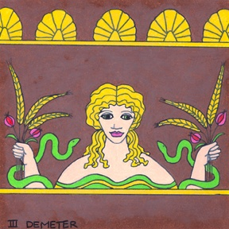
Demeter
She is the goddess of harvest, corn, and grain;
1st loaf of bread is sacrificed to her each year.

Slide 3

Pan
He is the god of flocks and shepherds;
He is half human and half goat;
He plays a flute or pipes.

Slide 4
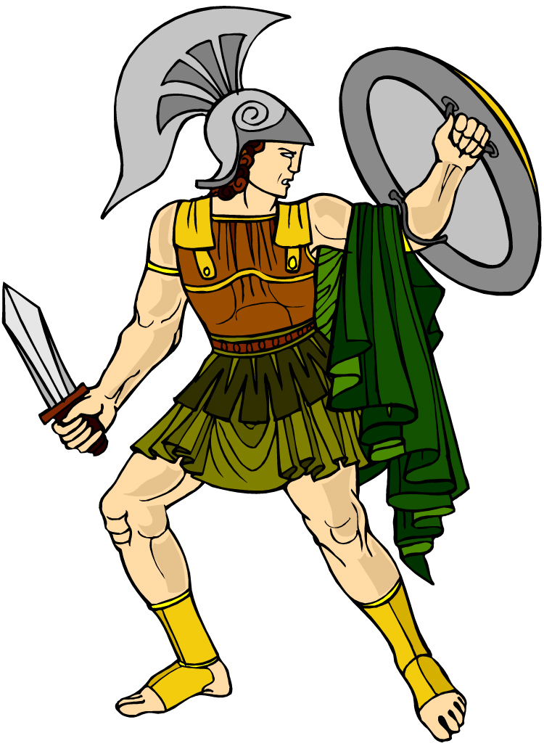
Ares
He is the god of battle
Son of Zeus and Hera
His bird is a vulture

Slide 5
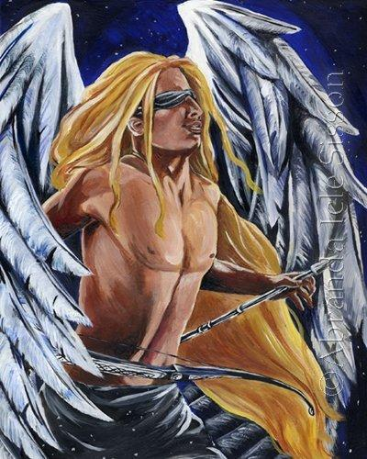
Eros
Son of Aphrodite
He is the god of love
He is often blindfolded to represent that love is blind

Slide 6
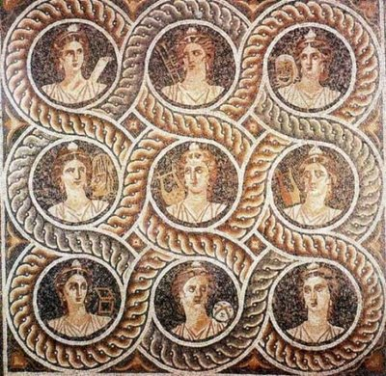
The Muses
There are 9 of these;
They are also daughters of Zeus;
They bring music and poetry;
Often inspire authors in their writings;

Slide 7
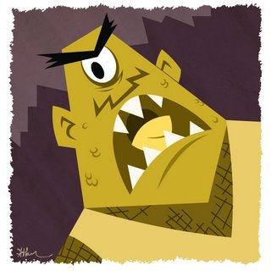
Cyclops
Gigantic, one-eyed monster;
Polyphemus is the Cyclops blinded by Odysseus.

Slide 8
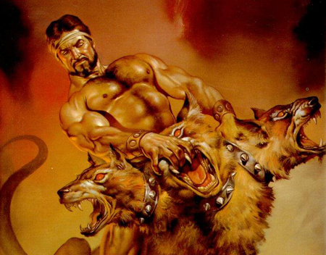
Cerberus
Dog that guards the gates to the Underworld;
He has 3 heads and a dragons tail;
He allows the dead to enter, but never to leave.

Slide 9
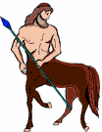
Centaur
Half man and half horse;
Chiron is the most famous;
He traded his life to free Prometheus.

Slide 10
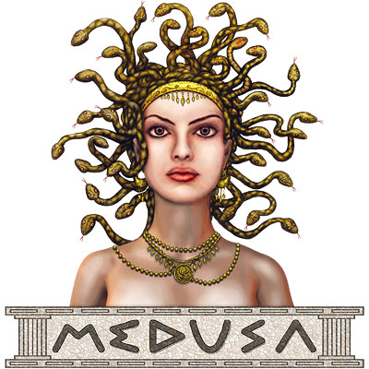
Medusa
Lied about Athena;
So, Athena punished her by turning her hair into snakes;
Also, she made Medusa so ugly that if you look into her eyes, you will turn to stone.

Slide 11
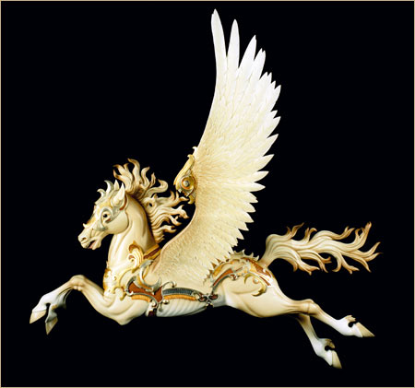
Pegasus
Winged horse
Carried lightening bolts for Zeus

Slide 12

Mount Olympus
Where the major gods live
Towers that come up from the center of the earth

Slide 13
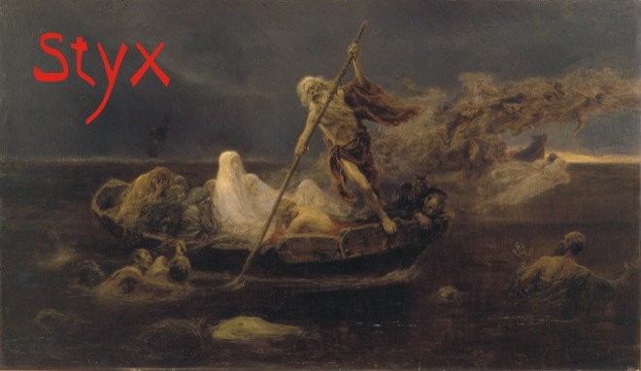
The Underworld
It is hidden in the earth;
Kingdom of the dead
Ruled by Hades
The river Styx runs in one of its borders;

Slide 14
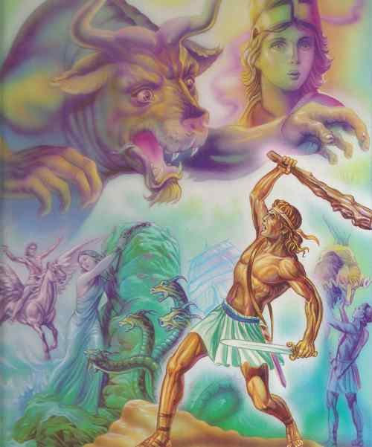
Heracles a.k.a. Hercules
Strongest of all mortals
Son of Zeus
Mother was a mortal or human
He became a god upon his death

Slide 15
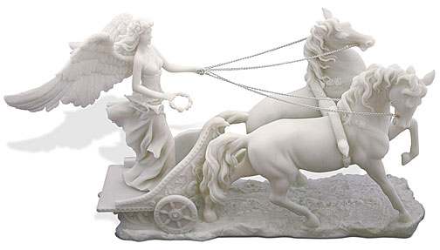
NIKE
The goddess of victory
She has wings

Slide 16
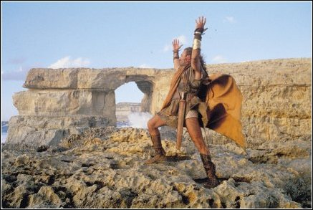
Odysseus
Ruler of Ithaca
Leader in the Trojan War
Wanted to marry Helen of Troy
Adventures written in “The Odyssey” by Homer

