Slide 1
Pest Management
Home Maintenance and Improvement

Slide 2
Objectives
Discuss common pests in the home
Identify the effective pest control programs
Discuss the Project each group is going to prepare

Slide 3
Common Pests in the Home:
Ants-
Ant traps, which contain baits of boric acid or other poisons, attract the pest to the poison, avoiding the need to apply poison throughout the environment.
Keep traps out of reach of children and pets.
Although ant traps are useful for some species, they do not work for all ants.
Clothes moths-
Use pheromone baited sticky traps.
To avoid damaging fabric, test a small area first.

Slide 4
Cockroaches-
Bait traps with boric acid are considered least toxic products.
To find hiding places, enter a dark room quietly, turn on the lights, and watch where roaches run.
They typically hide beneath kitchen sinks and under and behind appliances.
Crickets-
If needed, use silica gel plus boric acid powder or baits.
Apply in areas where crickets may hide.
Treat area around basement doors and windows where crickets enter.
Drain flies/Moth flies-
Use drain gels labeled for this purpose.
Household insecticide sprays labeled for ﬂies may be used to control adult drain ﬂies.

Slide 5
Fleas -
Control treatment should begin with the pet.
Check with your local veterinarian, topical flea and tick treatments may be an option for your pet
House flies-
Physically exclude with good screening on windows and doors.
Use mechanical means such as a fly swatter.

Slide 6
Lady beetles-
Prevent (physically block) entry into home where possible.
These insects are beneficial.
No pesticides registered.
Millipedes-
Prevent (physically block) entry into home where possible.
Mosquitoes-
Physically exclude with good screening on windows and -doors.
Use mechanical means such as a fly swatter.

Slide 7
Sowbugs-
Prevent (physically block) entry into home where possible.
Spiders-
Spray in corners of rooms, at both floor and ceiling levels.
Subterranean termites-
Effective insecticides for soil treatment are restricted for application by certified applicators only.

Slide 8
Ticks, brown dog tick-
Control treatment should begin with the pet; check with your local veterinarian.
Topical flea and tick products may be an option for your pet. Check label carefully before using on rugs or carpets.
Some products can cause damage.
Foggers labeled for ticks indoors can be useful for space spraying domestic dwellings.
Wasps and hornets-
If large numbers enter, a commercial wasp and hornet spray or a spray for indoor flying insects may be used.
Caution: insects trapped indoors may be irritated and can sting.

Slide 9
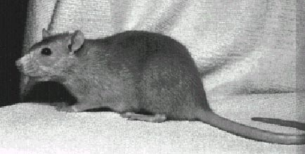
Other Pests: Rodents
Gophers
Rats and Mice
Opossums
Raccoon
Squirrels
Skunks
Snakes
Most of these rodents can be caught by using various traps. Sizes and styles vary depending on the size and amount of the pests

Slide 10
Pest Programs in the Home:
Just like before many traps sprays and pesticides are used to kill or trap the pests in the home
Safety is always a factor when using pest programs
You should always make sure that you apply or set the pest programs according to the manufacturers instructions
More is not always better
Never put these pest programs near where children might be

Slide 11

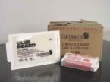
Yellow Sticky Paper
Sticky Boards

Slide 12
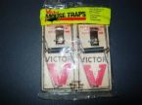

Mouse Traps
Plastic Trap

Slide 13
Your Project:
Students will divide themselves into pairs
They will then develop a pest control program for a home.
-it can be already done or it can be a new idea
The Final Project will include:
-a sketch or illustration of the product/program
-a description of what the product/program is used for
-a list of the materials that are used to develop this product/program
Friday each group will present their project to the class

