Slide 1
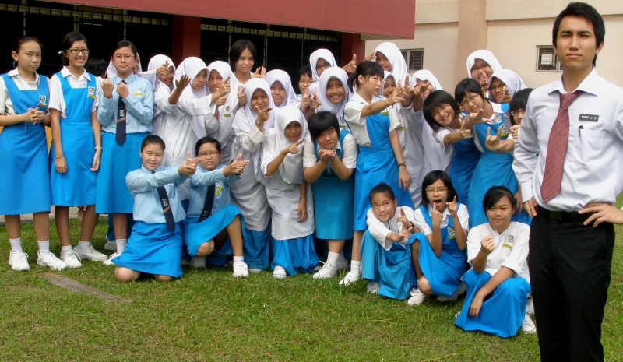
MY FRIENDS ☺ ☺
Notes:
MY FRIENDS ☺ ☺

Slide 2

MY SCHOOL

