Slide 1
What is a Conspiracy Theory?
A conspiracy theory explains an event as being the result of an alleged plot by a covert group or organization or, more broadly, the idea that important political, social or economic events are the products of secret plots that are largely unknown to the general public.

Slide 2
JFK ASSASSINATION
President John F. Kennedy was NOT killed by Lee Harvey Oswald, as the police claims.
Notes:
It’s believed that it was done by the FBI, the CIA, the Federal Reserve, Lyndon B. Johnson, the Bush family or anti-Castro Cuban radicals, depending on which wing of the conspiracy fringe you are talking to.

Slide 3
9/11
The 9/11 attacks were done by the US itself.
Notes:
The theories range all the way from US government officials turning a blind eye to various agencies actually assisting with the attack. Certain groups like the 9/11 Truth Movement have led to these ideas becoming very popular and they insist that there is no way the towers came down because of jet fuel alone.

Slide 4
Apollo Moon Landing
The landing never took place, it was all a farce.
Notes:
Conspiracy theorists claim that the entire thing was staged by the U.S. government in some type of dark room in order to spark patriotism and support among the populace.

Slide 5
Area 51
Area 51 has been a target of various conspiracies.
Notes:
Common claims include alien cover-ups, radioactive testing, nuclear experimentation and genetic modification of humans to create a “super-race” someday in the distant future.

Slide 6
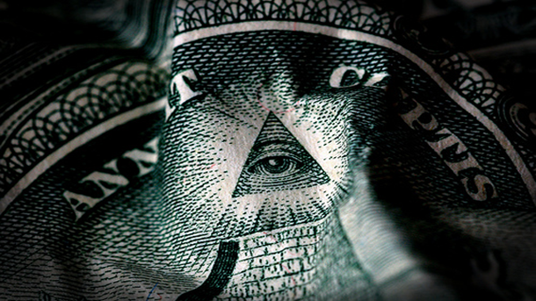
Illuminati
The existence of the secret society called the Illuminati.
Notes:
the Illuminati (literally Latin for “enlightened”) is spoken of among conspiracy theorists as a “shadow behind the throne” dictating world events through business and government, all with the goal of bringing about a New World Order.

Slide 7
Nazi Moon Base
The first moon-landing took place in 1942-by the Nazis.
Notes:
While some believe humans didn’t set foot on the moon in 1969, others maintain that mankind’s first lunar mission was completed in 1942 – by the Nazis.

Slide 8
Subliminal Media
A person’s brain can be controlled through subliminal messages via media.
Notes:
While it’s true that subliminal stimuli are effective when it comes to priming one’s senses, they are not capable of the complete brain control like many proponents fear.

Slide 9
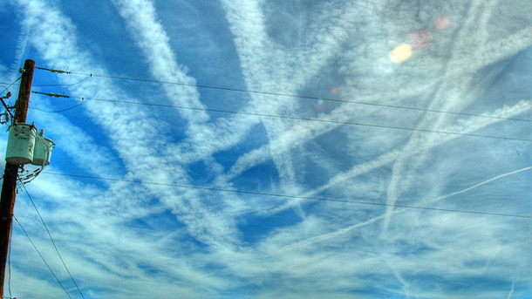
Chemtrails
The trails that we see on sky are actually poison chemicals.
Notes:
Some people are convinced that the government is spraying chemical agents at its citizens from 30,000 feet hence the name, chemtrail.

Slide 10
The Holocaust
Holocaust never happened, it was all made-up.
Notes:
The theory was thrust back into the spotlight last year when Iranian president Mahmoud Ahmadinejad held a Holocaust denial conference in his country.

Slide 11
Diana’s Death
Diana’s death was set-up by the British Intelligence.
Notes:
The father of Dodi Al-Fayed, who was in the car with Diane when their drunken chauffer failed to escape pursuing paparazzi, claimed that the car accident was actually a set up by British Intelligence acting on behalf of the Royal Family.

Slide 12
THE PEARL HARBOR
The Pearl Harbor attack was done by the U.S. itslef.
Notes:
Proponents often point out that none of the Navy’s three Pacific aircraft carriers were in port that day.

Slide 13
THE EVER-LASTING BULB
A bulb that never lasts.
Notes:
Some people have theorized that the light bulb industry is keeping the eternal glow of their everlasting light bulbs from the masses simply to increase their profit margins.

Slide 14
GLOBAL WARMING
The reasons for global warming are man-made.
Notes:
Is it cyclical, man made, are the thermometers broken? It seems as though there is no consensus and everyone is pointing the conspiracy finger at everyone else.

Slide 15
THE IRAQ WAR
The attack on Iraq was a means to obtain more oil.
Notes:
Although there have been numerous reasons, both real and contrived for the invasion of Iraq, none has been more influential than the idea of it being a war for oil.

Slide 16
ELVIS PRESLEY AND TUPAC SHAKUR
Elves and Tupac are alive…
Notes:
Although not directly related, the concept is similar. Elvis died in 1977 and Tupac in 1996, which not surprisingly doesn’t keep some people from passionately believing they are still with us.

Slide 17
THE BERMUDA TRIANGLE
The triangle causes disappearances.
Notes:
Bermuda Triangle is among those places in the world which are yet to discover by the humans. You would be amazed by reading this statement. I actually mean that though people know about this place but in fact nothing is much known about its mysteries that have happened to many aircrafts, airplanes and ships tried to pass through this triangle. They suddenly and yet mysteriously got disappeared and we still want to know anything about them. The topic was covered in numerous conspiracy theories

Slide 18
AIDS
AIDS is a man-made disease.
Notes:
The origin of AIDS is yet a controversial topic for the world and we have heard and learned about numerous conspiracy theories about this topic so far that claim the origination of AIDS. But two of such theories are widely accepted by majority of people and experts, therefore are considered more authentic. Many believe (as mentioned in one theory) that AIDS is the result of a biological weapon created and used by Pentagon only in intention to lower population in United States in the lower-class citizens.

Slide 19
The Reptilian Elite
The world is ruled by Reptiles.
Notes:
Popularized by former BBC sports writer David Icke, his theory posits that anyone holding a position of power or influence is actually a blood thirsty, extra-terrestrial, shapeshifting reptile. Since then he has written several books on the topic and not surprisingly been awarded the title “paranoid of the decade”.

Slide 20
GRAND UNIFIED CONSPIRACY THEORY
Everything is a conspiracy.
Notes:
It sounds complicated, but its really not. The premise is simple – everything is a conspiracy….which ironically includes the conspiracies themselves.

