Slide 1
Contents
Using Simple Functions
Regular Expression Functions
Using Aggregate Functions
Grouping Rows

Slide 2
Using Simple Functions
Regular Expression Functions

Slide 3
Using Simple Functions
Regular expression functions
which extend the search capabilities for strings and
allow you to search for a specified set of
characters or
pattern of characters

Slide 4
Using Simple Functions
A regular expression is a pattern you use to match against a string
For example let’s say you have the following series of years:
1965 1968 1971 1970
You want to get the years between 1965 and 1968 inclusive
You can do that using the following regular expression:
^196[5-8]$

Slide 5
Using Simple Functions
The regular expression contains a number of metacharacters
In this example, ^, [5-8], and $ are the metacharacters
^ matches the beginning position of a string
[5-8] matches characters between 5 and 8
$ matches the end position of a string
Therefore ^196 matches a string that begins with 196 and
[5-8]$ matches a string that ends with 5, 6, 7, or 8
So ^196[5-8]$ matches 1965, 1966, 1967, and 1968
which is the required result

Slide 6
Using Simple Functions
In this example assume you have the following string that contains a quote from
Shakespeare’s Romeo and Juliet
But, soft! What light through yonder window breaks?
Let’s say you want to get the substring light
You can do this by applying the following
regular expression to the quote string
l[[:alpha:]]{4}

Slide 7
Using Simple Functions
In this example
[[:alpha:]] and
{4} are the metacharacters
[[:alpha:]] matches an alphanumeric character A-Z and a-z
{4} repeats the previous match four times
When l, [[:alpha:]] and {4} are combined
they match a sequence of five letters starting with l
Therefore when the regular expression l[[:alpha:]]{4} is applied to the string
the substring light is matched

Slide 8
Using Simple Functions

Slide 9
Using Simple Functions

Slide 10
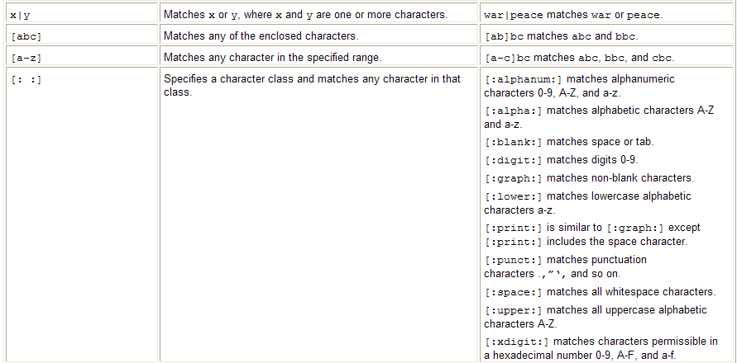
Using Simple Functions

Slide 11
Using Simple Functions

Slide 12
Using Aggregate Functions
The functions you’ve seen up to now
operate on a single row at a time and
return one row of output for each input row
Aggregate functions
operate on a group of rows at the same time and
return one row of output for each group of rows
Examples of when you want to use an aggregate function include
computing the average price of a product and
finding the maximum price of a product
Note Aggregate functions are also known as group functions because they operate on groups of rows

Slide 13
Using Aggregate Functions
The aggregate functions are
mainly numerical
and you typically use them to return a value based on a set of values contained in columns of rows
Some of the aggregate functions allow you to perform sophisticated statistical computations

Slide 14
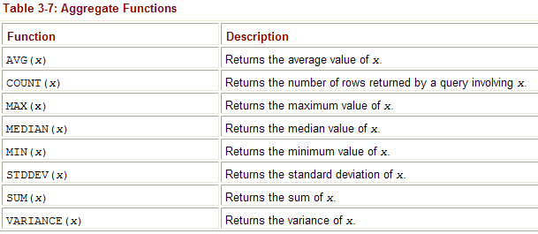
Using Aggregate Functions

Slide 15
Using Aggregate Functions
You can use the
COUNT(), MAX(), and MIN() functions
with numbers, strings and datetimes
Null values are ignored by aggregate functions
This is because a null value indicates the value is unknown and is therefore not applicable to the aggregate function’s calculation
You can use the DISTINCT keyword with an aggregate function to
exclude duplicate entries from the aggregate function’s calculation

Slide 16
Using Aggregate Functions
Use AVG(x) to get the average value of x
The following example gets the average price of the products
notice that the price column from the products table is passed to the AVG() function
SELECT AVG(price) FROM products;

Slide 17
Using Aggregate Functions
Can use the aggregate functions with any valid expression
For example the following query passes
the expression price + 2 to AVG()
this adds 2 to each row’s price column value and
then returns the average of those values
SELECT AVG(price + 2) FROM products;

Slide 18
Using Aggregate Functions
Can use the
DISTINCT keyword to exclude identical values from a group computation
For example, the following query uses the DISTICT keyword
to exclude identical values in the price column when computing the average using AVG()
SELECT AVG(DISTINCT price) FROM products;

Slide 19
Using Aggregate Functions
The average in this example value is
slightly different from the average shown
in the first example of this section
which didn’t include the DISTINCT keyword
The average values are different because the price column contains
two values that are the same: 13.49 for products #7 and #12
The price column value for product #12 is considered a duplicate and
is excluded from the computation performed by AVG()—
and this results in the average being different

Slide 20
Using Aggregate Functions
Use COUNT(x)
to get the number of rows returned by a query
The following example gets the number of rows in the products table using COUNT()
SELECT COUNT(product_id) FROM products;
You should avoid using the asterisk (*) with the COUNT() function
as it may take longer for COUNT() to return the result
Instead, you should use a column in the table or use the ROWID column

Slide 21
Using Aggregate Functions
The following example passes
ROWID to COUNT() and
gets the number of rows in the products table
SELECT COUNT(ROWID) FROM products;

Slide 22
Grouping Rows
Sometimes you might want to group blocks of rows
in a table and
get some information on those groups of rows
For example, you might want to get
the average price for the different types of products in the products table
how to do this the hard way
then the easy way
that involves using the GROUP BY clause to group similar rows together

Slide 23
Grouping Rows
To do it the hard way
limit the rows passed to the AVG() function
using a WHERE clause
For example, the following query gets
the average price for books from the products table (books have a product_type_id of 1)
SELECT AVG(price) FROM products WHERE product_type_id = 1;

Slide 24
Grouping Rows
To get the average price for
the other types of products
you would need to perform additional queries
with different values for the product_type_id in
the WHERE clause
This is all very labor intensive!
You’ll be glad to know there’s an easier way to do this through the use of
the GROUP BY clause

Slide 25
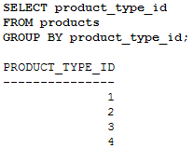
Grouping Rows
Using the GR
Use the GROUP BY clause
to group rows into blocks with a common column value
For example, the following query groups the rows from the products table
into blocks with the same product_type_id
SELECT product_type_id FROM products GROUP BY product_type_id;

Slide 26
Grouping Rows
Notice there’s one returned row in the result set
for each block of rows with the
same product_ type_id
For example there’s
one row for products with a product_type_id of 1
another for products with a product_type_id of 2
and so on
There are actually two rows in the products table with a product_type_id of 1 and
four rows with a product_type_id of 2
These rows are grouped together into separate blocks

Slide 27
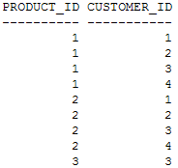
Grouping Rows
Using Multiple Columns in a Group
Can specify multiple columns in a GROUP BY clause
For example, the following query includes
the product_id and customer_id columns
from the purchases table in a GROUP BY clause
SELECT product_id, customer_id FROM purchases GROUP BY product_id, customer_id;

Slide 28
Grouping Rows
Using Groups of Rows with Aggregate Functions
Can use blocks of rows to an aggregate function
The aggregate function performs its computation on the group of rows in each block and
returns one value per block
For example, to get the average price for the different types of products in the products table
Use the GROUP BY clause to group rows into blocks with the same product_type_id
Use the AVG() function to get the average price for each block containing a group of rows

Slide 29
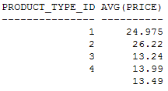
Grouping Rows
The following query shows the
use of the GROUP BY clause and AVG() function
SELECT product_type_id, AVG(price) FROM products GROUP BY product_type_id;

Slide 30
Grouping Rows
Notice
there are five rows in this output
with each row corresponding to one or more rows in the products table
grouped together with the same product_type_id column value
There are two rows in the products table with a product_type_id of 1
These two rows have been grouped together and passed to the AVG() function in the previous query
AVG() computes and returns the average price for the two rows which is 24.975 as shown in the first row of the previous result set
Similarly, there are four rows with a product_type_id of 2 with an average price of 26.22 as shown in the second row of the result set

Slide 31
Grouping Rows
Notice
the last row of output has a null value for the product_type_id
This final group consists of the single row with the null product_type_id at the end of the products table
If there was another row in the products table with a null product_type_id
that row would also be placed in the final group
That row’s price column value would have also been used in the average computation

Slide 32
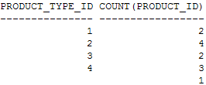
Grouping Rows
Can use any of the aggregate functions with the GROUP BY clause
For example, the following query gets the number of rows in each product_type_id group
using the COUNT() function
SELECT product_type_id, COUNT(product_id) FROM products GROUP BY product_type_id;

Slide 33
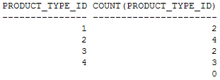
Grouping Rows
Notice
the product_id column in the COUNT() function in this query
rather than product_type_id
This is because product_type_id is null for product #12
and would be ignored by the COUNT() function
as shown in the following example
which displays 0 for COUNT(product_type_id) in the last row of the result set
SELECT product_type_id, COUNT(product_type_id) FROM products GROUP BY product_type_id;

Slide 34
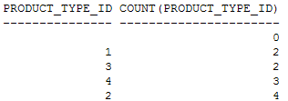
Grouping Rows
Using the ORDER BY Claus
By default, GROUP BY sorts the rows in ascending order based on the values in the group column
For example, in the previous query the rows were sorted on the product_type_id column
Can change the column used in the sort using the ORDER BY clause
For example, the following query sorts the output using ORDER BY COUNT (product_type_id)
SELECT product_type_id, COUNT(product_type_id) FROM products GROUP BY product_type_id ORDER BY COUNT(product_type_id);

Slide 35
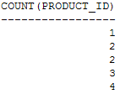
Grouping Rows
One point to note is that
you don’t have to include the columns used in the GROUP BY clause in your SELECT clause
For example
the following query is the same as the previous example except product_type_id is omitted from the SELECT clause
SELECT COUNT(product_id) FROM products GROUP BY product_type_id ORDER BY COUNT(price);

Slide 36
Grouping Rows
Incorrect Usage of Aggregate Function Calls
When your query contains an aggregate function—
and selects columns not placed within an aggregate function
those columns must be placed in a GROUP BY clause
If you forget to do this
you’ll get the following error:
ORA-00937: not a single-group group function
For example, the following query selects the product_type_id column and AVG(price)
but omits a GROUP BY clause for product_type_id

Slide 37
Grouping Rows
The error occurs because the database doesn’t know what to do
with the product_type_id column in the result set.
Think about it: the query attempts to use the AVG() aggregate function that operates on multiple rows
but the query also attempts to get the product_type_id column values for each individual row
You can’t have both at the same time

Slide 38
Grouping Rows
You must provide a GROUP BY clause to tell the database to
group multiple rows with the same product_type_id column value together
The database will then pass those groups of rows to the AVG() function
Caution
When your query contains an aggregate function
—and selects columns not placed within an aggregate function
—those columns must be placed in a GROUP BY clause

Slide 39
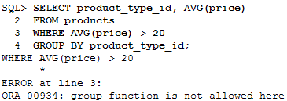
Grouping Rows
Also cannot use an aggregate function to
limit rows in a WHERE clause
If you try to do so you will get the following error:
ORA-00934: group function is not allowed here

Slide 40
Grouping Rows
Using the HAVING Clause to Filter Groups of Rows
Use the HAVING clause to filter groups of rows
You place the HAVING clause after your GROUP BY clause
SELECT ...
FROM ...
WHERE
GROUP BY ...
HAVING ...
ORDER BY ...
Note GROUP BY can be used without HAVING
but HAVING must be used in conjunction with GROUP BY

Slide 41
Grouping Rows
Example
Say you want to view the types of products that have an average price greater than $20
Use the GROUP BY clause to group rows into blocks with the same product_type_id
Use the HAVING clause to limit the returned results to those groups that have an average price greater than $20
The following query shows the use of these GROUP BY and HAVING clauses
SELECT product_type_id, AVG(price) FROM products GROUP BY product_type_id HAVING AVG(price) > 20;

Slide 42
Grouping Rows
Using the WHERE and GROUP BY Clauses Together
Can use the WHERE and GROUP BY clauses
together in the same query
When you do this
the WHERE clause first filters the rows returned
then the remaining rows are grouped into blocks by the GROUP BY clause
For example, the following query uses
A WHERE clause to filter the rows from the products table to those whose price is less than $15
A GROUP BY clause to group the remaining rows by the product_type_id column
SELECT product_type_id, AVG(price) FROM products WHERE price < 15 GROUP BY product_type_id;

Slide 43
Grouping Rows
Using the WHERE, GROUP BY, and HAVING Clauses Together
Can use the WHERE, GROUP BY, and HAVING clauses together in the same query
When you do this
the WHERE clause first filters the rows
then the remaining rows are grouped into blocks by the GROUP BY clause and
finally the row groups are filtered by the HAVING clause

Slide 44
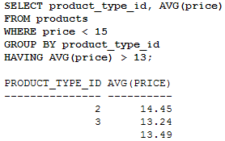
Grouping Rows
For example, the following query uses
A WHERE clause to filter the rows from the products table to those whose price is less than $15
A GROUP BY clause to group the remaining rows by the product_type_id column
A HAVING clause to filter the row groups to those whose average price is greater than $13

Slide 45
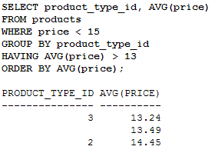
Grouping Rows
Compare these results with the previous example
Notice
that the group of rows with the product_type_id of 4 is filtered out
That’s because the group of rows has an average price less than $13
The final example adds an ORDER BY clause to the previous example to order the results by the average price

