Slide 1
Deprecation

Slide 2
Definitions continued…
Depreciation is an income tax deduction that allows a taxpayer to recover the cost or other basis of certain property.
The monetary value of an asset decreases over time due to use, wear and tear or obsolescence. This decrease is measured as depreciation.
A method of allocating the cost of a tangible asset over its useful life. Businesses depreciate long-term assets for both tax and accounting purposes.
A decrease in an asset's value caused by unfavorable market conditions.

Slide 3
Definitions …continued
Depreciation represents the systematic allocation of the cost of a capital asset over a period of time for financial reporting purposes, tax purposes, or both.
Generally, profitable firms prefer to use an accelerated method for tax reporting purposes.

Slide 4
Importance of Deprecation
Concept and in practice plays a very important role in a company's cash flow
Firstly because depreciation is a way of self finance for an organization
Secondly, a way of decreasing taxes that the government claims
Company doesn't have to pay taxes on depreciation which consequently enlarges the cash flow of the company.

Slide 5
Purposes of Deprecation
For accounting purposes, depreciation indicates how much of an asset's value has been used up.
For tax purposes, businesses can deduct the cost of the tangible assets they purchase as business expenses
Businesses must depreciate these assets in accordance with IRS (internal revenue services) rules about how and when the deduction may be taken based on what the asset is and how long it will last.

Slide 6
Depreciable Assets
Most types of tangible property (except, land), such as
    buildings,
    machinery,
    vehicles, furniture,
    and equipment are depreciable.
Likewise, certain intangible property, such as
    patents,
    copyrights, and
    computer software is depreciable.

Slide 7
Methods of Depreciation
Straight-line depreciation
Declining Balance Method
Annuity depreciation
Sum-of-years-digits method
Units-of-production depreciation method
Units of time depreciation
Group depreciation method
Composite depreciation method

Slide 8
Common Types of Depreciation
Straight Straight-line (SLSL)
Accelerated Types
  Double Declining Balance (DDB)
  Modified Accelerated Cost Recovery System (MACRS)

Slide 9
Straight-line method
Most common methods that businesses use is straight-line depreciation.
Take the same amount of depreciation each year over the useful life of the property.
The residual value derives its calculation from a base price, calculated after depreciation.

Slide 10
Residual Value
A company owns a machine which was bought for 20,000€. This machine has a useful life of five years which has just ended. The company knows that if it sells the machine now it will be able to recover 10% of the price of acquisition.
Therefore, the residual value would be:

Slide 11
Characteristics of the straight line method
The depreciation expense is constant
The valuation of the company is easier
Easier to adjust it if necessary.
Easy to predict.

Slide 12
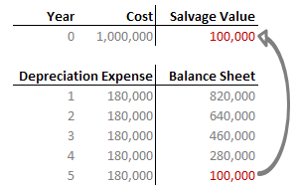
Example
For example, an equipment worth $1m with an estimated life of five years and salvage value of $100,000 would have the following depreciation schedule and asset value after each year as shown below.

Slide 13
Accelerated depreciation
Accelerated depreciation refers to any one of several methods by which a company, for 'financial accounting' or tax purposes, depreciates a fixed asset in such a way that the amount of depreciation taken each year is higher during the earlier years of an asset’s life.

Slide 14
Characteristics of the Accelerated depreciation
Allows companies to write off more of their assets in the earlier years and less in the later years
The biggest benefit of this method is the tax benefit.
By writing off more assets against revenue, companies report lower income and thus pay less tax.

Slide 15
Double Declining Balance (DDB) method
The common method of accelerated depreciation is called the double declining balance (DDB) method.
This is where the depreciation expense doubles the straight line depreciation expense of the first year.
The same percentage is then applied to the non depreciated amount in the subsequent years.

Slide 16
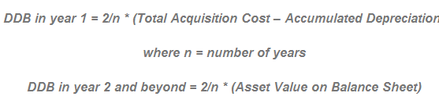
Formula

Slide 17
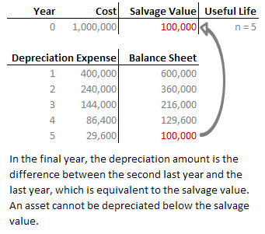
Example
For example, an equipment worth $1m with an estimated life of five years and salvage value of $100,000 would have the following depreciation schedule and asset value after each year as shown below.

Slide 18
Straight Line vs Accelerated Depreciation
In order to make the comparison as fair as possible, let’s assume company XYZ is just starting out as a business and they bought several new computers for their staff. The purchase value of the computers is $10,000.
Computers do not have a long useful life, but five years is realistic and adequate. Computers also deteriorate in value much quicker in the first year than the later years so an accelerated depreciation method is more than satisfactory. At then end of five years, computers are generally worthless so the salvage value will be $0.

Slide 19
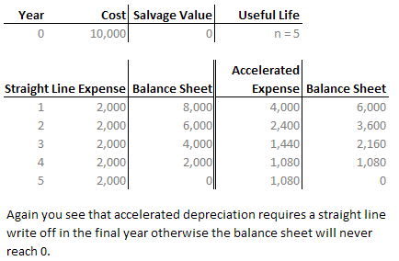
Example

Slide 20
Cont……..
One of the benefits to accelerated depreciation is the reduction of taxes, but another point of great benefit is if the equipment requires maintenance.
Accelerated depreciation will offset the increasing maintenance cost and essentially equalizes the combined charges of both maintenance and depreciation.
The graph below is a simplified view of how the accelerated depreciation and maintenance cost works out to give a straight line total expense.

Slide 21
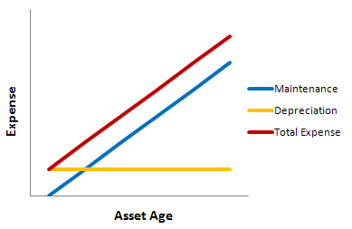
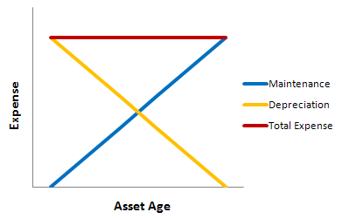
Graph

Slide 22
Modified Accelerated Cost Recovery System (MACRS)
The modified accelerated cost recovery system (MACRS) method of depreciation assigns specific types of assets to categories with distinct accelerated depreciation schedules.
MACRS is required by the IRS for tax reporting but is not approved by GAAP (Generally Accepted Accounting Principles) for external reporting.

Slide 23
MACRS Depreciation Calculation
To calculate depreciation for an asset using MACRS, first determine the asset’s classification, and then use the table to find the appropriate depreciation schedule.
When using MACRS, an asset does not have any salvage value – the asset is always depreciated down to zero, since the sum of the depreciation rates for each category always adds up to 100%.
When calculating depreciation expense for MACRS, always use the original purchase price of the asset as the depreciable base for each period.
Note: that each category is depreciated for one year longer than its classification period. An asset classified under 3-Year MACRS is depreciated for 4 years, an asset classified under 5-Year MACRS is depreciated for 6 years, and so on.

Slide 24
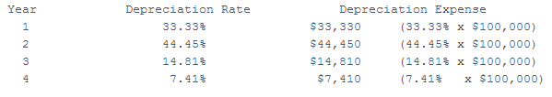
MACRS Depreciation Calculation
For example, an asset purchased for $100,000 that falls into the 3-Year MACRS category shown below, would be depreciated as follows:

Slide 25
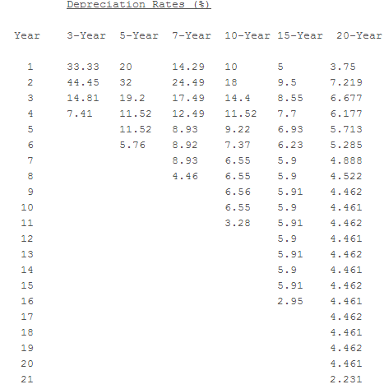
MACRS Depreciation Table

