Slide 1
Strategy Pattern
Define a family of algorithms, encapsulate each one, and make them interchangeable. Strategy lets the algorithm vary independently from clients that use it.

Slide 2
Strategy Pattern
In Strategy pattern, a class behavior or its algorithm can be changed at run time. This type of design pattern comes under behavior pattern.
In Strategy pattern, we create objects which represent various strategies and a context object whose behavior varies as per its strategy object. The strategy object changes the executing algorithm of the context object.

Slide 3
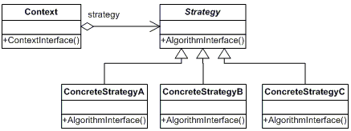
Strategy Pattern

Slide 4
Strategy Pattern-Participants
The classes and/or objects participating in this pattern are:
Strategy (SortStrategy)
  declares an interface common to all supported algorithms. Context uses this interface to call the algorithm defined by a ConcreteStrategy
ConcreteStrategy (QuickSort, ShellSort, MergeSort)
  implements the algorithm using the Strategy interface
Context (SortedList)
  is configured with a ConcreteStrategy object
  maintains a reference to a Strategy object
  may define an interface that lets Strategy access its data.

Slide 5
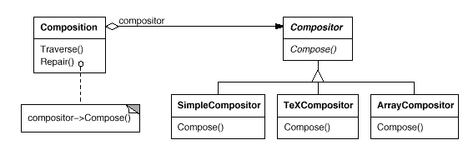
Strategy Pattern – Motivation
Many algorithms exist for breaking a stream of text into lines. Hard-wiring all such algorithms into the classes that require them isn't desirable for several reasons:
  Clients that need linebreaking get more complex if they include the linebreaking code. That makes clients bigger and harder to maintain, especially if they support multiple linebreaking algorithms.
  Different algorithms will be appropriate at different times. We don't want to support multiple linebreaking algorithms if we don't use them all.
  It's difficult to add new algorithms and vary existing ones when linebreaking is an integral part of a client.
We can avoid these problems by defining classes that encapsulate different linebreaking algorithms.
An algorithm that's encapsulated in this way is called a strategy.

Slide 6
Strategy Pattern – Example
Consider following main-loop structure
Initialize();
While (!done()) { //main loop
Idle(); //do something useful
}
Cleanup();
Ftocraw.java is a example program
public class ftocraw {
public static void main(String[] args) throws Exception {
InputStreamReader isr = new InputStreamReader(System.in);
BufferedReader br = new BufferedReader(isr);
boolean done = false;
while (!done) {
String fahrString = br.readLine();
if (fahrString == null || fahrString.length() == 0) done = true;
else { double fahr = Double.parseDouble(fahrString); double celcius = 5.0/9.0*(fahr-32);
System.out.println("F=" + fahr + ", C=" + celcius); }
}
System.out.println("ftoc exit");
}
}

Slide 7
Strategy Pattern – Example
We place the generic application algorithm into a concrete class named ApplicationRunner
public interface Application {
public void init();
public void idle();
public void cleanup();
public boolean done();
}
<<interface>>
Application
ApplicationRunner
+init
+idle
+cleanup
+done : boolean
+run
public class ApplicationRunner {
private Application itsApplication = null;
public ApplicationRunner(Application app){
itsApplication = app;
}
public void run() {
itsApplication.init();
while (!itsApplication.done()) itsApplication.idle();
itsApplication.cleanup();
}
}
focStrategy

Slide 8
Strategy Pattern – Example
public class ftocStrategy implements Application {
private InputStreamReader isr; private BufferedReader br; private boolean isDone = false;
public static void main(String[] args) throws Exception {
(new ApplicationRunner(new ftocStrategy())).run(); }
public void init() {
isr = new InputStreamReader(System.in);
br = new BufferedReader(isr); }
public void idle() {
String fahrString = readLineAndReturnNullIfError();
if (fahrString == null || fahrString.length() == 0) isDone = true;
else { double fahr = Double.parseDouble(fahrString);
double celcius = 5.0/9.0*(fahr-32);
System.out.println("F=" + fahr + ", C=" + celcius); }
}
public void cleanup() {System.out.println("ftoc exit"); }
public boolean done() { return isDone; }
private String readLineAndReturnNullIfError() { String s;
try {s = br.readLine(); } catch(IOException e) { s = null; }
return s;
}
}

Slide 9
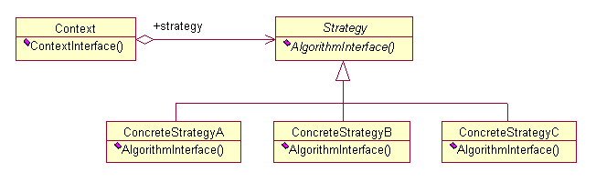
Strategy Pattern - Structure
Intent
  Define a family of algorithms, encapsulate each one, and make them interchangeable. Strategy lets the algorithm vary independently from the clients that use it.
Structure

Slide 10
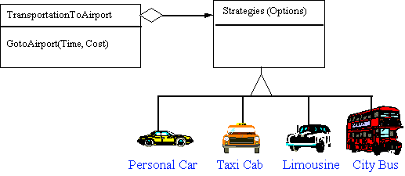
Strategy Pattern - example
A Strategy defines a set of algorithms that can be used interchangeably.
Modes of transportation to an airport is an example of a Strategy.
  Several options exist such as driving one's own car, taking a taxi, an airport shuttle, a city bus, or a limousine service.
  For some airports, subways and helicopters are also available as a mode of transportation to the airport.
  Any of these modes of transportation will get a traveler to the airport, and they can be used interchangeably.
  The traveler must chose the Strategy based on tradeoffs between cost, convenience, and tlme.

Slide 11
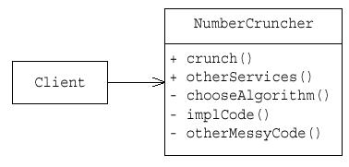
Strategy Pattern – Example
In this inflexible example, all the NumberCruncher code is in one big class… Why is this bad?
Strategy is similar to Bridge; same basic structure; very different intent.
The Strategy pattern is also similar to State, which allows a class to be
configured with different behaviors from which it can select whenever it
makes an interesting state transition.

Slide 12
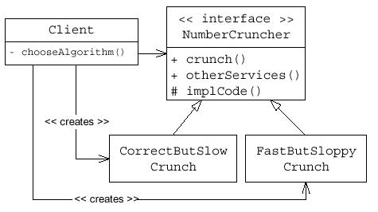
Strategy Pattern – Example
What if there were not a CrunchAlgorithm interface… suppose instead that
NumberCruncher had two subclasses, CorrectButSlowNumberCruncher, and
FastButSloppyNumberCruncher…? Why is this bad?

Slide 13
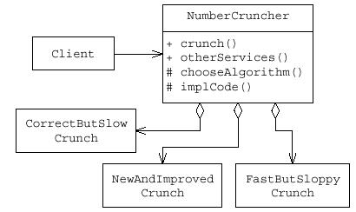
Strategy Pattern – Example
Here’s another “correct” design... But there can be no polymorphism in the
chooseAlgorithm() or implCode() methods, leading to maintenance difficulties.
Adding a NewAndImprovedCrunch would require adding if-then-else logic
everywhere that the different Crunches are used. If the Strategy pattern were
applied instead, the only place where the concrete CrunchImpls would get referred to specifically is the one place that they get instantiated.

Slide 14
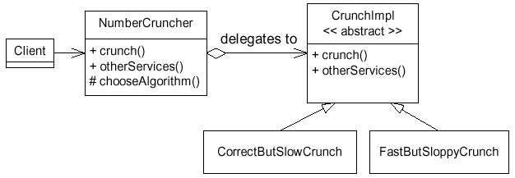
Strategy Pattern – Example
Intent: Allows multiple implementation strategies to be interchangeable, so that they can easily be swapped at run-time, and so that new strategies can be easily added.
In this example, notice that client’s of NumberCruncher do not know about the different crunch algorithms. The NumberCruncher.crunch() method is free to decide which CrunchImpl to use at any time; new algorithms can be easily added.

Slide 15
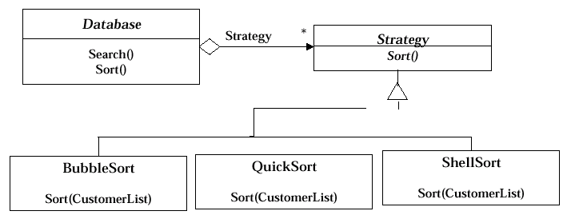
Applying a Strategy Pattern in a Database Application

Slide 16
Applicability of Strategy Pattern
Applicability of Strategy Pattern
1) Many related classes differ only in their behavior. Strategy
allows to configure a single class with one of many behaviors
2) Different variants of an algorithm are needed that trade-off
space against time. All these variants can be implemented as a
class hierarchy of algorithms

