Slide 1
Factory Method Pattern
Define an interface for creating an object, but let subclasses decide which class to instantiate

Slide 2
The Factory Method Pattern
This is a ‘Creational’ pattern, i.e. it is concerned with object instantiation.
Used where an abstract class (A) may, itself, need to create objects of other classes
  where the precise class is not necessarily known.
The precise class to be instantiated may only be known within a sub-class of A.
  However, all sub-classes of A will share the common signature of the super-class. Therefore, the abstract class (A) may interact with the created object through this interface.

Slide 3
Factory Method: Applicability
Use the Factory Method pattern when
  a class can't anticipate the class of objects it must create.
  a class wants its subclasses to specify the objects it creates

Slide 4
Factory Method pattern (1)
Define an interface for creating an object, but let subclasses decide which class to instantiate. It lets a class defer instantiation to subclasses
PROBLEM:
  A framework with abstract application classes and application-specific subclasses to instantiate to realize different implementations
SOLUTION:
  The Factory Method pattern encapsulates the knowledge of which subclass to create and moves this knowledge out of the framework

Slide 5
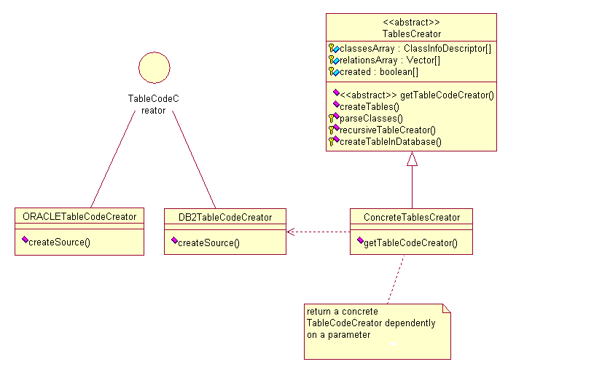
Factory Method: class diagram sample
factory method

Slide 6
Factory Method: sample code (1)
public abstract class TablesCreator
{…
public abstract TableCodeCreator getTableCodeCreator(String dbName) ;
}
public interface TableCodeCreator
{…
void createSource();
}
public class DB2TableCodeCreator implements TableCodeCreator
{…
public void createSource(padis.util.ClassInfoDescriptor descriptor, String workingDir)
{ // CREATES JAVA SOURCE CODE FOR tableName.java FILES}
}
public class ConcreteTablesCreator extends TablesCreator
{…
public TableCodeCreator getTableCodeCreator(String dbName)
{
if (dbName.equals (“DB2”))
return new DB2TableCodeCreator();
else if (dbName.equals (“ORACLE”))
return new ORACLETableCodeCreator();
…}
}
abstract
class
interface
concrete
class
concrete
class

Slide 7
Factory Method: sample code (2)
// ConcreteTablesCreator
String dbname = crs4.util.Configuration.getInstance().getProperty(“default.database.name”);
TableCodeCreator codeCreator = this.getTableCodeCreator(dbname); //read from property
for (int i=0; i<this.getClassesArray().length; i++)
{
codeCreator.createSource(this.getClassesArray()[i], this.getWorkingDirectory());
}
factory method

Slide 8
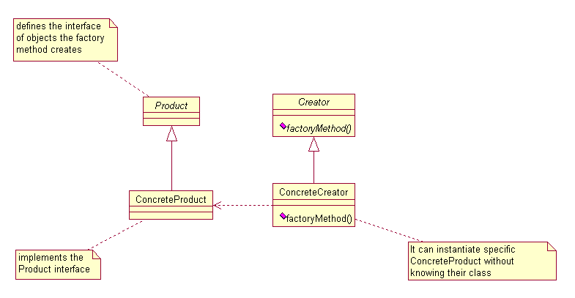
Factory Method: class diagram
the subclasses redefine abstract methods of the abstract class to return the appropriate subclass

Slide 9
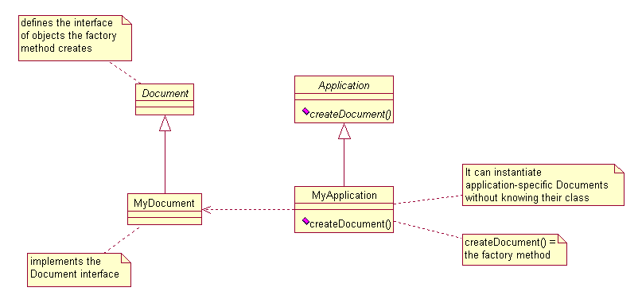
Factory Method: class diagram sample
we call createDocument() the factory method because it is responsible for “manufacturing” an object

Slide 10
Factory Method pattern (2)
applicabilities:
  the class that must instantiate classes only knows about abstract classes, which it cannot instantiate. It only knows when or how to create an object but not what kind oh object to create, because this is application-specific
  a class want its subclasses to specify the objects to be created
  classes delegate responsibility to one or several helper subclasses and you want to localize the knowledge of which helper subclass is the delegate

Slide 11
Factory Method pattern (3)
CONSEQUENCES:
  Factory methods eliminate the need to bind application-specific classes into your code
  The code only deals with the Product interface and then it can work with any user-defined ConcreteProduct class
  Clients might have to subclass the Creator class to create a particular ConcreteProduct object

Slide 12
Factory Method pattern (4)
implementations:
__
  abstract class with factory method
  interface
  subclasses of the abstract class that implement the interface
__
  concrete class with a default implementation of the factory method
  subclasses that override or not the factory method
__
  the factory method takes a parameter that identifies the kind of object to create

Slide 13
Factory Method: Consequences
Eliminates the need to bind application-specific classes into your code. The code only deals with the Product interface; therefore it can work with any user-defined ConcreteProduct classes.
Factory Method gives subclasses a hook for providing an extended version of an object.
Could be used to connect parallel class hierarchies
Factory method can be parameterized to specify a specific concrete product type.

