Slide 1
Subqueries and DB Security
  Subqueries
    Types of Subqueries
      Writing Nested Subqueries
      Writing UPDATE and DELETE Statements Containing Subqueries
      Summary
  Database security
    System Privillages
    Object Privilages
    Roles
    Summary

Slide 2

Subqueries
Writing Nested Subqueries
  can nest subqueries inside other subqueries to a depth of 255
  But you should use this technique sparingly
    you may find your query performs better using table joins
    nested subquery example
    Notice that it is contained within a subquery, which is itself contained in an outer query:
    SELECT product_type_id, AVG(price) FROM products GROUP BY product_type_id HAVING AVG(price) <
    (SELECT MAX(AVG(price)) FROM products WHERE product_type_id IN
    (SELECT product_id FROM purchases WHERE quantity > 1) GROUP BY product_type_id);

Slide 3

Subqueries
  you can see, this example is quite complex and
    contains three queries
    a nested subquery, a subquery, and the outer query
    These query parts are run in that order
    Let’s break the example down into the three parts and examine the results returned
    The nested subquery is as follows
    SELECT product_id FROM purchases WHERE quantity > 1 This subquery returns the product_id values for the products that have been purchased more than once. The rows returned by this subquery are

Slide 4

Subqueries
  The subquery that receives this output is
    SELECT MAX(AVG(price)) FROM products WHERE product_type_id IN (... output from previous nested subquery ...) GROUP BY product_type_id
    This subquery returns the maximum of the averages of the prices for the products
      returned by the previous nested subquery
      The row returned is

Slide 5
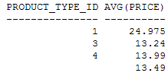
Subqueries
  This row is returned to the following outer query
    SELECT product_type_id, AVG(price) FROM products GROUP BY product_type_id HAVING AVG(price) < (... output from previous subquery ...);
    This query returns the product_type_id and average price of products that are less than
      average returned by the previous subquery
      The rows returned are
      These are, of course, the rows returned by the complete query shown earlier

Slide 6
Subqueries
Writing UPDATE and DELETE Statements Containing Subqueries
  So far, you’ve only seen subqueries contained in a SELECT statement
  you can also use subqueries with
    UPDATE and
    DELETE statements

Slide 7
Subqueries
Writing an UPDATE Statement Containing a Subquery
  In an UPDATE statement, you set the new column value equal to the result returned by a single row subquery
    For example, the following UPDATE statement sets employee #4’s salary to the average of the high salary grades returned by a subquery
    UPDATE employees SET salary = (SELECT AVG(high_salary) FROM salary_grades) WHERE employee_id = 4;
    1 row updated
    This increases employee #4’s salary from $500,000 to $625,000 (this is the average of the high salaries from the salary_grades table)
  Note If you execute the UPDATE statement, remember to execute a ROLLBACK to undo the change

Slide 8
Subqueries
Writing a DELETE Statement Containing a Subquery
  You use the results returned by the subquery in the WHERE clause of your DELETE statement
    For example, the following DELETE statement removes the employee whose salary is greater than the average of the high salary grades returned by a subquery
    DELETE FROM employees WHERE salary > (SELECT AVG(high_salary) FROM salary_grades);
    1 row deleted
    This DELETE statement removes employee #1
  Note If you execute the DELETE statement, remember to execute a ROLLBACK to undo the removal of the row.

Slide 9
Subqueries
In subqueries you learned that
  A subquery is a query placed within a SELECT, UPDATE, or DELETE statement
  Single row subqueries return zero or one row
  Multiple row subqueries return one or more rows
  Multiple column subqueries return more than one column
  Correlated subqueries reference one or more columns in the outer SQL statement
  Nested subqueries are subqueries placed within another subquery

Slide 10
Database Security
Learn more about users
See how privileges are used to enable users to perform tasks in the database
Explore how privileges are divided into two types
  system privileges and
  object privileges
  Learn how system privileges allow you to perform actions such as execute DDL statements
  See how object privileges allow you to perform actions such as execute DML statements
Explore how to manage privileges using roles

Slide 11
Database Security
Users
  you’ll learn how to create a user, alter a user’s password, and drop a user
Creating a User
  To create a user in the database, you use the CREATE USER statement
  The simplified syntax for the CREATE USER statement is as follows
    CREATE USER user_name IDENTIFIED BY password [DEFAULT TABLESPACE def_tabspace] [TEMPORARY TABLESPACE temp_tabspace]; where

Slide 12
Database Security
user_name specifies the name of the database user
password specifies the password for the database user
def_tabspace specifies the default tablespace where objects are stored
  These objects include tables
  If you omit a default tablespace, the default SYSTEM tablespace is used, which always exists in a database
  Note: Tablespaces are used by the database to separate objects For more details on tablespaces
  temp_tabspace specifies the default tablespace where temporary objects are stored
    These objects include temporary tables
    If you omit a temporary tablespace, the default SYSTEM tablespace is used

Slide 13
Database Security
The following example connects as system and creates a user named jason with a password of price:
  CONNECT system/manager
  CREATE USER jason IDENTIFIED BY price;
  Note If you want to follow along with these examples you’ll need to connect to the database as a privileged user
  I used system user in the example, which has a default password of manager in my database
  If you’re not acting as your own DBA, you’ll need to speak with your DBA to get the password for a privileged user who is able to create users

Slide 14
Database Security
The next example creates a user named
  henry and specifies a default and temporary tablespace
    CREATE USER henry IDENTIFIED BY hooray DEFAULT TABLESPACE users TEMPORARY TABLESPACE temp;
    Note If your database doesn’t have tablespaces named users and temp,
      you can skip this example
      The henry user isn’t used elsewhere in this book, and I included the example only so you can see how to specify tablespaces for a user
      You can view all the tablespaces in a database by connecting as the system user and running the query SELECT * FROM dba_tablespaces.

Slide 15
Database Security
If you want a user to be able to do things in the database
  that user must be granted the necessary permissions to do those things
  For example, to connect to the database a user must be granted the permission to create a session, which is the CREATE SESSION system privilege
  Permissions are granted by a privileged user (system, for example) using the GRANT statement
The following example grants the CREATE SESSION permission to jason:
  GRANT CREATE SESSION TO jason;
  You are now able to connect as jason
The following example creates other users used in this chapter and grants the CREATE SESSION privilege to those users
  CREATE USER steve IDENTIFIED BY button;
  CREATE USER gail IDENTIFIED BY seymour;
  GRANT CREATE SESSION TO steve, gail;

Slide 16
Database Security
Changing a User’s Password
You can change a user’s password using the
  ALTER USER statement
  For example, the following ALTER USER statement changes the password for jason to marcus
  ALTER USER jason IDENTIFIED BY marcus;
  You can also change the password for the user you’re currently logged in as using the PASSWORD command
  After you enter PASSWORD, SQL*Plus prompts you to
    enter the old password and the new password twice for confirmation. The following example connects as jason and executes PASSWORD
  CONNECT jason/marcus
  PASSWORD
  Changing password for JASON
    Old password: ******
    New password: ******
    Retype new password: ******
    Password changed

Slide 17
Database Security
Deleting a User
  You delete a user using the
    DROP USER statement
    The following example connects as system and uses DROP USER to delete jason
  CONNECT system/manager
  DROP USER jason;
  Note You must add the keyword CASCADE after the user’s name in the DROP USER statement if that user’s schema contains objects such as tables and so on

Slide 18
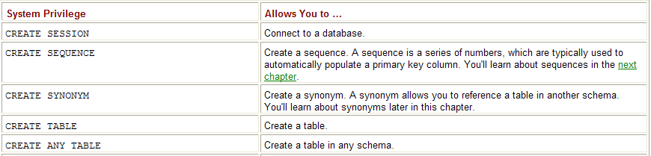
Database Security
System Privileges
A system privilege allows a user to perform certain actions within the database—such as
  executing DDL statements
  For example, CREATE TABLE allows a user to create a table in their schema
  Some of the commonly used system privileges are shown next

Slide 19
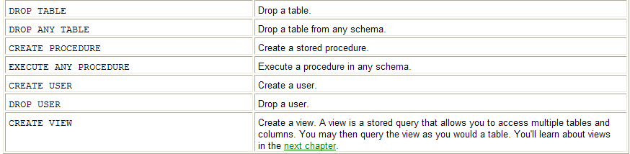
Database Security

Slide 20
Database Security
Granting System Privileges to a User
  As mentioned, you use GRANT to grant a system privilege to a user
  The following example grants some system privileges to steve using GRANT (assuming you’re still connected to the database as system):
  GRANT CREATE SESSION, CREATE USER, CREATE TABLE TO steve;
  You can also use WITH ADMIN OPTION to enable a user to grant a privilege to another user
  The following example grants the EXECUTE ANY PROCEDURE privilege with the ADMIN option to steve
  GRANT EXECUTE ANY PROCEDURE TO steve WITH ADMIN OPTION;
  The EXECUTE ANY PROCEDURE can then be granted to another user by steve
  The following example connects as steve and grants EXECUTE ANY PROCEDURE to gail:

Slide 21
Database Security
  CONNECT steve/button
  GRANT EXECUTE ANY PROCEDURE TO gail;
    You can grant a privilege to all users by granting to PUBLIC
    The following example connects as system and grants the EXECUTE ANY PROCEDURE privilege to PUBLIC
  CONNECT system/manager GRANT EXECUTE ANY PROCEDURE TO PUBLIC;
  Every user in the database now has the EXECUTE ANY PROCEDURE privilege

Slide 22
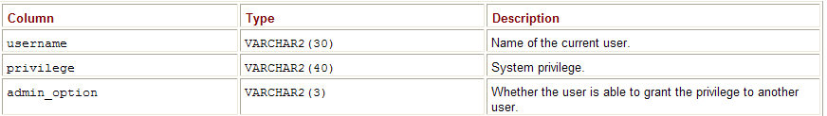
Database Security
Checking System Privileges Granted to a User
  You can check which system privileges a user has by querying user_sys_privs
  Table describes the columns in user_sys_privs
Note
  user_sys_privs forms part of the Oracle database’s data dictionary
  The data dictionary stores information on the database

Slide 23
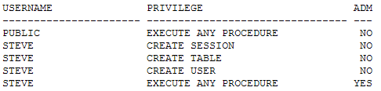
Database Security
The following example connects as steve and queries user_sys_privs:
  CONNECT steve/button SELECT * FROM user_sys_privs;

Slide 24

Database Security
The next example connects as gail and queries user_sys_privs:
  CONNECT gail/seymour SELECT * FROM user_sys_privs;
  Notice gail has EXECUTE ANY PROCEDURE that was granted earlier by steve

Slide 25
Database Security
Making Use of System Privileges
  Once a user has been granted a system privilege, they can use it to perform the specified task
  For example, steve has the CREATE USER privilege, so he is able to create a user
  CONNECT steve/button
  CREATE USER roy IDENTIFIED BY williams;
  If steve were to attempt to use a system privilege he doesn’t have, the database will return the error ORA-01031: insufficient privileges
    For example, steve doesn’t have the DROP USER privilege, and in the following example steve attempts to drop roy and fails:
    SQL> DROP USER roy;
    DROP USER roy *
    ERROR at line 1: ORA-01031: insufficient privileges

Slide 26

Database Security
Revoking System Privileges from a User
  You revoke system privileges from a user using REVOKE
  The following example connects as system and revokes the CREATE TABLE privilege from steve
    CONNECT system/manager
    REVOKE CREATE TABLE FROM steve;
    The next example revokes EXECUTE ANY PROCEDURE from steve:
    REVOKE EXECUTE ANY PROCEDURE FROM steve;
    When you revoke EXECUTE ANY PROCEDURE from steve—who has already passed on this privilege to gail—gail still gets to keep the privilege:
CONNECT gail/seymour SELECT * FROM user_sys_privs;

Slide 27
Database Security

