Slide 1
Contents
Using Simple Functions
  Regular Expression Functions
Using Aggregate Functions
Grouping Rows

Slide 2
  Using Simple Functions
  Regular Expression Functions

Slide 3
  Using Simple Functions
Regular expression functions
  which extend the search capabilities for strings and
  allow you to search for a specified set of
    characters or
    pattern of characters

Slide 4
  Using Simple Functions
  A regular expression is a pattern you use to match against a string
    For example let’s say you have the following series of years:
    1965 1968 1971 1970
    You want to get the years between 1965 and 1968 inclusive
    You can do that using the following regular expression:
    ^196[5-8]$

Slide 5
  Using Simple Functions
The regular expression contains a number of metacharacters
  In this example, ^, [5-8], and $ are the metacharacters
    ^ matches the beginning position of a string
    [5-8] matches characters between 5 and 8
    $ matches the end position of a string
    Therefore ^196 matches a string that begins with 196 and
    [5-8]$ matches a string that ends with 5, 6, 7, or 8
    So ^196[5-8]$ matches 1965, 1966, 1967, and 1968
      which is the required result

Slide 6
  Using Simple Functions
In this example assume you have the following string that contains a quote from
  Shakespeare’s Romeo and Juliet
    But, soft! What light through yonder window breaks?
  Let’s say you want to get the substring light
  You can do this by applying the following
    regular expression to the quote string
    l[[:alpha:]]{4}

Slide 7
  Using Simple Functions
  In this example
    [[:alpha:]] and
    {4} are the metacharacters
    [[:alpha:]] matches an alphanumeric character A-Z and a-z
    {4} repeats the previous match four times
    When l, [[:alpha:]] and {4} are combined
    they match a sequence of five letters starting with l
    Therefore when the regular expression l[[:alpha:]]{4} is applied to the string
      the substring light is matched

Slide 8
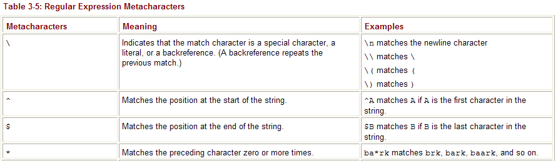
  Using Simple Functions

Slide 9
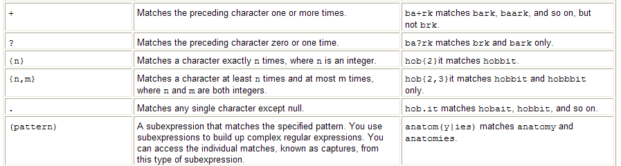
  Using Simple Functions

Slide 10
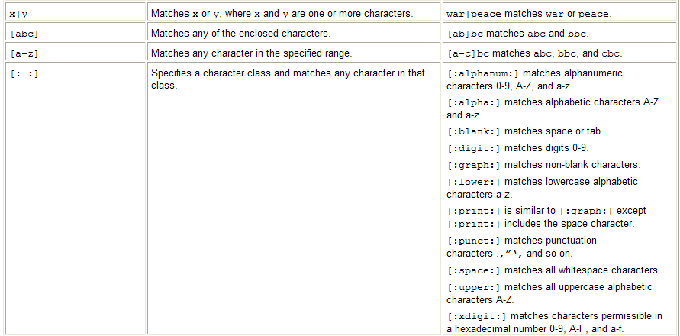
  Using Simple Functions

Slide 11
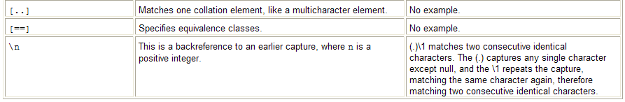
  Using Simple Functions

Slide 12
  Using Aggregate Functions
The functions you’ve seen up to now
  operate on a single row at a time and
  return one row of output for each input row
Aggregate functions
  operate on a group of rows at the same time and
  return one row of output for each group of rows
    Examples of when you want to use an aggregate function include
    computing the average price of a product and
    finding the maximum price of a product
  Note Aggregate functions are also known as group functions because they operate on groups of rows

Slide 13
  Using Aggregate Functions
The aggregate functions are
  mainly numerical
  and you typically use them to return a value based on a set of values contained in columns of rows
  Some of the aggregate functions allow you to perform sophisticated statistical computations

Slide 14
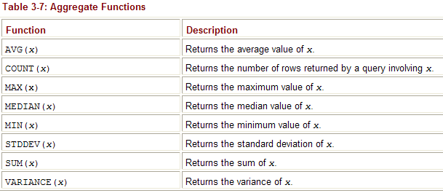
  Using Aggregate Functions

Slide 15
  Using Aggregate Functions
You can use the
  COUNT(), MAX(), and MIN() functions
  with numbers, strings and datetimes
  Null values are ignored by aggregate functions
    This is because a null value indicates the value is unknown and is therefore not applicable to the aggregate function’s calculation
  You can use the DISTINCT keyword with an aggregate function to
    exclude duplicate entries from the aggregate function’s calculation

Slide 16

  Using Aggregate Functions
Use AVG(x) to get the average value of x
  The following example gets the average price of the products
  notice that the price column from the products table is passed to the AVG() function
  SELECT AVG(price) FROM products;

Slide 17

  Using Aggregate Functions
Can use the aggregate functions with any valid expression
  For example the following query passes
  the expression price + 2 to AVG()
  this adds 2 to each row’s price column value and
  then returns the average of those values
SELECT AVG(price + 2) FROM products;

Slide 18

  Using Aggregate Functions
Can use the
  DISTINCT keyword to exclude identical values from a group computation
  For example, the following query uses the DISTICT keyword
    to exclude identical values in the price column when computing the average using AVG()
SELECT AVG(DISTINCT price) FROM products;

Slide 19
  Using Aggregate Functions
  The average in this example value is
    slightly different from the average shown
    in the first example of this section
    which didn’t include the DISTINCT keyword
    The average values are different because the price column contains
      two values that are the same: 13.49 for products #7 and #12
      The price column value for product #12 is considered a duplicate and
      is excluded from the computation performed by AVG()—
      and this results in the average being different

Slide 20

  Using Aggregate Functions
Use COUNT(x)
  to get the number of rows returned by a query
  The following example gets the number of rows in the products table using COUNT()
  SELECT COUNT(product_id) FROM products;
  You should avoid using the asterisk (*) with the COUNT() function
    as it may take longer for COUNT() to return the result
    Instead, you should use a column in the table or use the ROWID column

Slide 21

  Using Aggregate Functions
The following example passes
  ROWID to COUNT() and
  gets the number of rows in the products table
  SELECT COUNT(ROWID) FROM products;

Slide 22
  Grouping Rows
Sometimes you might want to group blocks of rows
  in a table and
  get some information on those groups of rows
    For example, you might want to get
    the average price for the different types of products in the products table
    how to do this the hard way
    then the easy way
    that involves using the GROUP BY clause to group similar rows together

Slide 23

  Grouping Rows
To do it the hard way
  limit the rows passed to the AVG() function
  using a WHERE clause
  For example, the following query gets
    the average price for books from the products table (books have a product_type_id of 1)
  SELECT AVG(price) FROM products WHERE product_type_id = 1;

Slide 24
  Grouping Rows
To get the average price for
  the other types of products
  you would need to perform additional queries
    with different values for the product_type_id in
    the WHERE clause
    This is all very labor intensive!
    You’ll be glad to know there’s an easier way to do this through the use of
      the GROUP BY clause

Slide 25
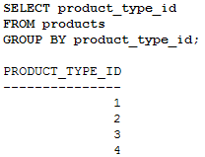
  Grouping Rows
Using the GR
  Use the GROUP BY clause
    to group rows into blocks with a common column value
    For example, the following query groups the rows from the products table
      into blocks with the same product_type_id
    SELECT product_type_id FROM products GROUP BY product_type_id;

Slide 26
  Grouping Rows
Notice there’s one returned row in the result set
  for each block of rows with the
    same product_ type_id
  For example there’s
    one row for products with a product_type_id of 1
    another for products with a product_type_id of 2
    and so on
    There are actually two rows in the products table with a product_type_id of 1 and
    four rows with a product_type_id of 2
    These rows are grouped together into separate blocks

Slide 27
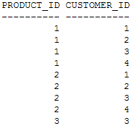
  Grouping Rows
Using Multiple Columns in a Group
  Can specify multiple columns in a GROUP BY clause
    For example, the following query includes
    the product_id and customer_id columns
    from the purchases table in a GROUP BY clause
SELECT product_id, customer_id FROM purchases GROUP BY product_id, customer_id;

Slide 28
  Grouping Rows
Using Groups of Rows with Aggregate Functions
  Can use blocks of rows to an aggregate function
  The aggregate function performs its computation on the group of rows in each block and
  returns one value per block
  For example, to get the average price for the different types of products in the products table
    Use the GROUP BY clause to group rows into blocks with the same product_type_id
    Use the AVG() function to get the average price for each block containing a group of rows

Slide 29
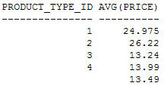
  Grouping Rows
The following query shows the
  use of the GROUP BY clause and AVG() function
    SELECT product_type_id, AVG(price) FROM products GROUP BY product_type_id;

Slide 30
  Grouping Rows
Notice
  there are five rows in this output
  with each row corresponding to one or more rows in the products table
  grouped together with the same product_type_id column value
  There are two rows in the products table with a product_type_id of 1
  These two rows have been grouped together and passed to the AVG() function in the previous query
  AVG() computes and returns the average price for the two rows which is 24.975 as shown in the first row of the previous result set
  Similarly, there are four rows with a product_type_id of 2 with an average price of 26.22 as shown in the second row of the result set

Slide 31
  Grouping Rows
Notice
  the last row of output has a null value for the product_type_id
  This final group consists of the single row with the null product_type_id at the end of the products table
  If there was another row in the products table with a null product_type_id
    that row would also be placed in the final group
    That row’s price column value would have also been used in the average computation

Slide 32
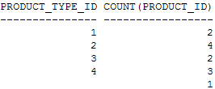
  Grouping Rows
Can use any of the aggregate functions with the GROUP BY clause
  For example, the following query gets the number of rows in each product_type_id group
    using the COUNT() function
    SELECT product_type_id, COUNT(product_id) FROM products GROUP BY product_type_id;

Slide 33
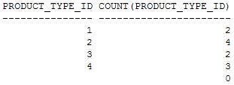
  Grouping Rows
Notice
  the product_id column in the COUNT() function in this query
    rather than product_type_id
    This is because product_type_id is null for product #12
    and would be ignored by the COUNT() function
    as shown in the following example
    which displays 0 for COUNT(product_type_id) in the last row of the result set
    SELECT product_type_id, COUNT(product_type_id) FROM products GROUP BY product_type_id;

Slide 34
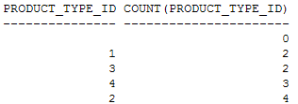
  Grouping Rows
Using the ORDER BY Claus
  By default, GROUP BY sorts the rows in ascending order based on the values in the group column
    For example, in the previous query the rows were sorted on the product_type_id column
      Can change the column used in the sort using the ORDER BY clause
      For example, the following query sorts the output using ORDER BY COUNT (product_type_id)
    SELECT product_type_id, COUNT(product_type_id) FROM products GROUP BY product_type_id ORDER BY COUNT(product_type_id);

Slide 35
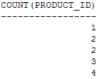
  Grouping Rows
One point to note is that
  you don’t have to include the columns used in the GROUP BY clause in your SELECT clause
  For example
    the following query is the same as the previous example except product_type_id is omitted from the SELECT clause
    SELECT COUNT(product_id) FROM products GROUP BY product_type_id ORDER BY COUNT(price);

Slide 36

  Grouping Rows
Incorrect Usage of Aggregate Function Calls
  When your query contains an aggregate function—
    and selects columns not placed within an aggregate function
    those columns must be placed in a GROUP BY clause
    If you forget to do this
      you’ll get the following error:
      ORA-00937: not a single-group group function
      For example, the following query selects the product_type_id column and AVG(price)
        but omits a GROUP BY clause for product_type_id

Slide 37
  Grouping Rows
The error occurs because the database doesn’t know what to do
  with the product_type_id column in the result set.
  Think about it: the query attempts to use the AVG() aggregate function that operates on multiple rows
  but the query also attempts to get the product_type_id column values for each individual row
  You can’t have both at the same time

Slide 38
  Grouping Rows
  You must provide a GROUP BY clause to tell the database to
    group multiple rows with the same product_type_id column value together
    The database will then pass those groups of rows to the AVG() function
  Caution
    When your query contains an aggregate function
      —and selects columns not placed within an aggregate function
      —those columns must be placed in a GROUP BY clause

Slide 39
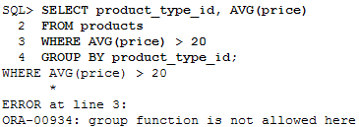
  Grouping Rows
Also cannot use an aggregate function to
  limit rows in a WHERE clause
  If you try to do so you will get the following error:
    ORA-00934: group function is not allowed here

Slide 40
  Grouping Rows
Using the HAVING Clause to Filter Groups of Rows
  Use the HAVING clause to filter groups of rows
  You place the HAVING clause after your GROUP BY clause
  SELECT ...
  FROM ...
  WHERE
  GROUP BY ...
  HAVING ...
  ORDER BY ...
  Note GROUP BY can be used without HAVING
    but HAVING must be used in conjunction with GROUP BY

Slide 41

  Grouping Rows
Example
  Say you want to view the types of products that have an average price greater than $20
  Use the GROUP BY clause to group rows into blocks with the same product_type_id
    Use the HAVING clause to limit the returned results to those groups that have an average price greater than $20
    The following query shows the use of these GROUP BY and HAVING clauses
    SELECT product_type_id, AVG(price) FROM products GROUP BY product_type_id HAVING AVG(price) > 20;

Slide 42

  Grouping Rows
Using the WHERE and GROUP BY Clauses Together
  Can use the WHERE and GROUP BY clauses
    together in the same query
    When you do this
      the WHERE clause first filters the rows returned
      then the remaining rows are grouped into blocks by the GROUP BY clause
    For example, the following query uses
      A WHERE clause to filter the rows from the products table to those whose price is less than $15
      A GROUP BY clause to group the remaining rows by the product_type_id column
    SELECT product_type_id, AVG(price) FROM products WHERE price < 15 GROUP BY product_type_id;

Slide 43
  Grouping Rows
Using the WHERE, GROUP BY, and HAVING Clauses Together
  Can use the WHERE, GROUP BY, and HAVING clauses together in the same query
  When you do this
    the WHERE clause first filters the rows
    then the remaining rows are grouped into blocks by the GROUP BY clause and
    finally the row groups are filtered by the HAVING clause

Slide 44
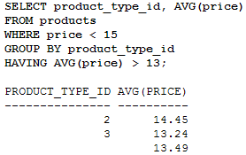
  Grouping Rows
    For example, the following query uses
      A WHERE clause to filter the rows from the products table to those whose price is less than $15
      A GROUP BY clause to group the remaining rows by the product_type_id column
      A HAVING clause to filter the row groups to those whose average price is greater than $13

Slide 45
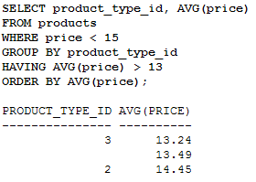
  Grouping Rows
Compare these results with the previous example
  Notice
    that the group of rows with the product_type_id of 4 is filtered out
    That’s because the group of rows has an average price less than $13
    The final example adds an ORDER BY clause to the previous example to order the results by the average price

