Slide 1
Contents
Using Simple Functions
  Character Functions
  Numeric Functions
  Conversion Functions

Slide 2
Character Functions

Slide 3
  Using Simple Functions
  Character Functions
INSTR()
Use INSTR(x, find_string [, start] [, occurrence])
  to search for find_string in x
  INSTR() returns
    the position at which find_string occurs
    the optional start position allows you to specify the position to start the search in x
    You can also supply an optional occurrence that indicates which occurrence of find_string should be returned

Slide 4

  Using Simple Functions
  Character Functions
INSTR()
The following example selects the
  name column from the products table and
  displays the position where the
  string Science occurs in the name column for product #1:
SELECT name, INSTR(name, 'Science') FROM products WHERE product_id = 1;

Slide 5

  Using Simple Functions
  Character Functions
INSTR()
This example displays the position
  where the second occurrence of e occurs
  starting from the beginning of the product name
  using INSTR():
  SELECT name, INSTR(name, 'e', 1, 2) FROM products WHERE product_id = 1;

Slide 6

  Using Simple Functions
  Character Functions
INSTR()
Can also use dates in character functions
  The following example displays the position
  where the string JAN occurs in dob for customer #1 using INSTR():
SELECT customer_id, dob, INSTR(dob, 'JAN') FROM customers WHERE customer_id = 1;

Slide 7
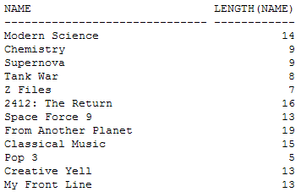
  Using Simple Functions
  Character Functions
LENGTH()
  You use LENGTH(x) to get
    the number of characters in x
  The following example displays the length of
    the strings in the name column of the products table using LENGTH():
SELECT name, LENGTH(name) FROM products;

Slide 8

  Using Simple Functions
  Character Functions
LENGTH()
This example displays the total number of characters
  that make up the product price
  using LENGTH()
  notice that the decimal point (.) is counted in the number of price characters
SELECT price, LENGTH(price) FROM products WHERE product_id < 3;

Slide 9
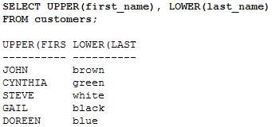
  Using Simple Functions
  Character Functions
LOWER() and UPPER()
Use LOWER(x)
  to convert the letters in x to lowercase
Use UPPER(x)
  to convert the letters in x to uppercase
Following example selects the first_name and last_name columns
  from the customers table and
  converts them to uppercase using the UPPER() function and
  the strings in the last_name column are converted to
  lowercase using the LOWER() function
SELECT UPPER(first_name), LOWER(last_name) FROM customers;

Slide 10
  Using Simple Functions
  Character Functions
LPAD() and RPAD()
Use LPAD(x, width [, pad_string]) to pad x
  with spaces to left to bring the total length of the string
  up to width characters
  If a string is supplied in pad_string, this string is repeated to the left to fill up the padded space
  The resulting padded string is then returned
  Similarly, you use RPAD(x, width [, pad_string]) to pad x with strings to the right

Slide 11

  Using Simple Functions
  Character Functions
LPAD() and RPAD()
The following example selects
  the name and price columns from
  the products table
The name column is right-padded using RPAD()
  to a length of 30 characters
  with periods filling up the padded space
The price column is left-padded using LPAD()
  to a length of 8
  with the string *+ filling up the padded space
SELECT RPAD(name, 30, '.'), LPAD(price, 8, '*+') FROM products WHERE product_id < 4;

Slide 12
  Using Simple Functions
  Character Functions
LTRIM(), RTRIM(), and TRIM()
Use LTRIM(x [, trim_string]) to trim characters from the left of x
Can supply an optional trim_string that specifies the characters to trim
  if no trim_string is supplied
  spaces are trimmed by default
  Similarly, use RTRIM() to trim characters from the right of x
  You use TRIM() to trim characters from the left and right of x

Slide 13

  Using Simple Functions
  Character Functions
  LTRIM(), RTRIM(), and TRIM()
  For example
    SELECT LTRIM(' Hello Gail Seymour!'), RTRIM('Hi Doreen Oakley!abcabc', 'abc'), TRIM('0' FROM '000Hey Steve Button!00000') FROM dual;

Slide 14
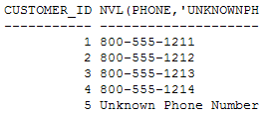
  Using Simple Functions
  Character Functions
NVL()
Use NVL() to convert a null to a known value
  NVL(x, value) returns value if x is null
  otherwise x is returned
The following example selects
  the customer_id and phone columns from
  the customers table
  Null values for the phone column are converted to the string Unknown Phone Number by NVL()
SELECT customer_id, NVL(phone, 'Unknown Phone Number') FROM customers;

Slide 15
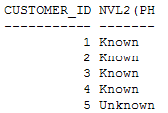
  Using Simple Functions
  Character Functions
NVL2()
NVL2(x, value1, value2) returns
  value1 if x is not null
  If x is null value2 is returned
The following example
  selects the customer_id and phone columns
  From the customers table
  Not null values for the phone column are converted
    to the string Known and
    null values are converted to Unknown by NVL2()
SELECT customer_id, NVL2(phone, 'Known', 'Unknown') FROM customers;

Slide 16

  Using Simple Functions
  Character Functions
REPLACE()
Use REPLACE(x, search_string, replace_string)
  to search x for search_string and
  replace it with replace_string
  The following example retrieves
    the name column from the products table for product #1 (whose name is Modern Science) and
    replaces the string Science with Physics using REPLACE():
  SELECT REPLACE(name, 'Science', 'Physics') FROM products WHERE product_id = 1;
  REPLACE() doesn’t modify the actual row in the database, only the returned row in the result set

Slide 17
  Using Simple Functions
  Character Functions
SOUNDEX()
Use SOUNDEX(x) to get a string containing
  the phonetic representation of x
  Lets you compare words that are spelled differently but sound alike in English
  The following example selects
  the first_name and last_name columns from the customers table
  where last_name sounds like whyte using SOUNDEX()

Slide 18


  Using Simple Functions
  Character Functions
SOUNDEX()
  SELECT first_name, last_name FROM customers WHERE SOUNDEX(last_name) = SOUNDEX('whyte');
Example does the same thing as the previous one except the string bloo is passed to SOUNDEX()
  SELECT first_name, last_name FROM customers WHERE SOUNDEX(last_name) = SOUNDEX('bloo');

Slide 19

  Using Simple Functions
  Character Functions
SUBSTR()
Use SUBSTR(x, start [, length])
  to return a substring of x
  that begins at the position specified by start
  can also provide an optional length for the substring
    The following example uses SUBSTR()
    to select a seven-character substring
    starting at position 2 from
    the name column of the products table
SELECT SUBSTR(name, 2, 7) FROM products WHERE product_id < 4;

Slide 20

  Using Simple Functions
  Character Functions
Using Expressions with Functions
  Not limited to just using columns in functions
  can supply any valid expression that
    evaluates to a string
    The following example uses the SUBSTR() function
    to select the substring little from the string Mary had a little lamb
    SELECT SUBSTR('Mary had a little lamb', 12, 6) FROM dual;

Slide 21

  Using Simple Functions
  Character Functions
Combining Functions
Can use any valid combination of functions in a SQL statement
  The following example combines the
  UPPER() and SUBSTR() functions
  notice that the output from SUBSTR() is passed to UPPER()
    SELECT name, UPPER(SUBSTR(name, 2, 8)) FROM products WHERE product_id < 4;
  This ability to combine functions is
    not limited to character functions
    Any valid combination of functions will work

Slide 22
Numeric Functions

Slide 23
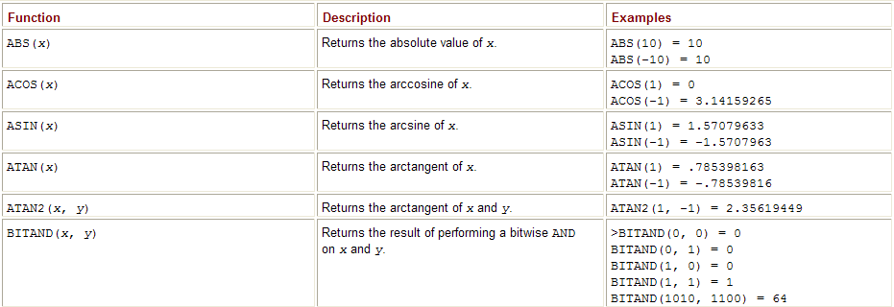
  Using Simple Functions
  Numeric Functions
Use the numeric functions to perform calculations
  These functions accept an input number
  which may come from a column in a table or
  from an expression that evaluates to a number
  A calculation is performed with this input and a number is returned
  An example of a numeric function is
  SQRT() which returns the square root of the input number
Note Some numeric functions, strictly speaking
  don’t actually perform a calculation
  Some just return some attribute of the input number
  For example,
    SIGN() returns –1 if the input number is negative
    1 if the input number is positive, or zero if the input number is 0

Slide 24
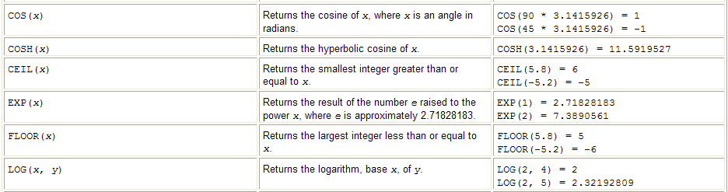
  Using Simple Functions
  Numeric Functions

Slide 25
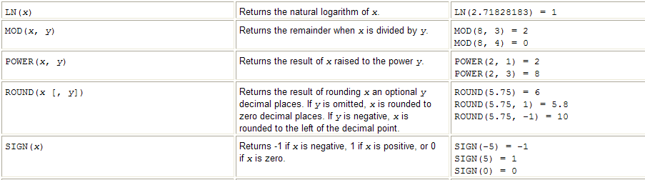
  Using Simple Functions
  Numeric Functions

Slide 26
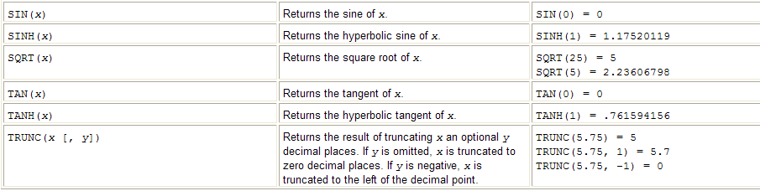
  Using Simple Functions
  Numeric Functions

Slide 27

  Using Simple Functions
  Numeric Functions
Use ABS(x) to get the absolute value of x
  The absolute value of a number is that number
    without any positive or negative sign
    The following example displays
      the absolute value of 10 and - 10

Slide 28
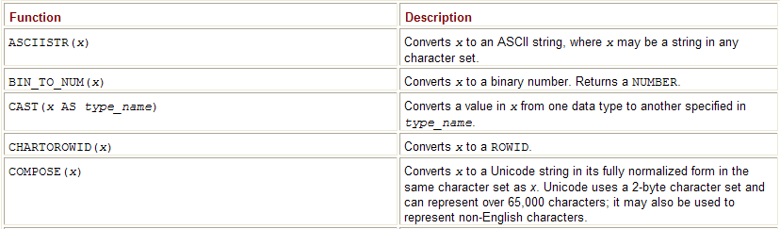
  Using Simple Functions
  Conversion Functions
Sometimes you might want to
  convert a value from one data type to another
    For example, you might want to reformat the price of a product that is stored
      as a number (1346.95, for example)
      to string containing dollar signs and commas ($1,346.95)
      Use a conversion function to convert a value from one data type to another

Slide 29
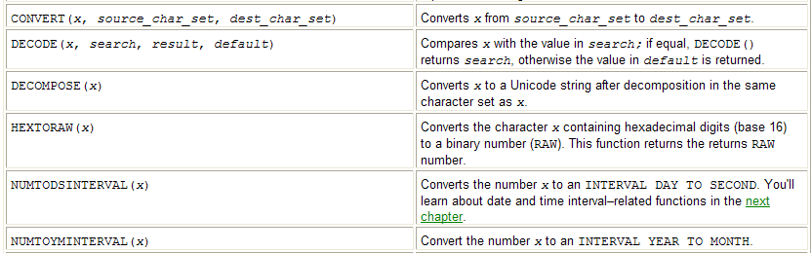
  Using Simple Functions
  Conversion Functions

Slide 30
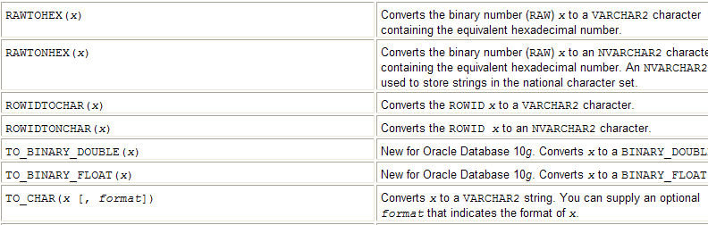
  Using Simple Functions
  Conversion Functions

Slide 31
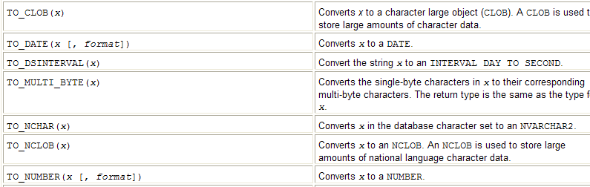
  Using Simple Functions
  Conversion Functions

Slide 32
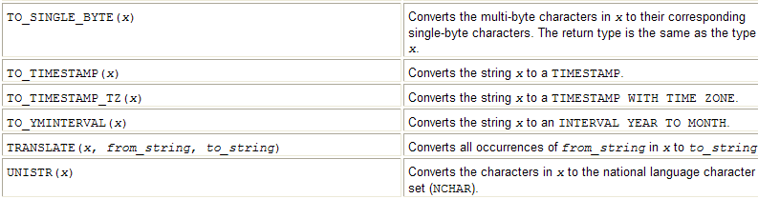
  Using Simple Functions
  Conversion Functions

Slide 33
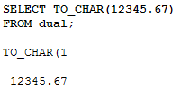
  Using Simple Functions
  Conversion Functions
TO_CHAR()
Use TO_CHAR(x [, format])
  to convert x to a string
  can also provide an optional format that indicates the format of x
  The structure format depends on whether x is a number or date
  You’ll learn how to use TO_CHAR() to convert
  a number to a string in this section
Examples that use TO_CHAR() to convert a number to a string
  Following example converts 12345.67 to a string

Slide 34

  Using Simple Functions
  Conversion Functions
This example uses TO_CHAR()
  to convert 12345678.90
  to a string and
    specifies this number is to be converted using the format 99,999.99
    This results in the string returned by TO_CHAR() having a comma to delimit the thousands

Slide 35
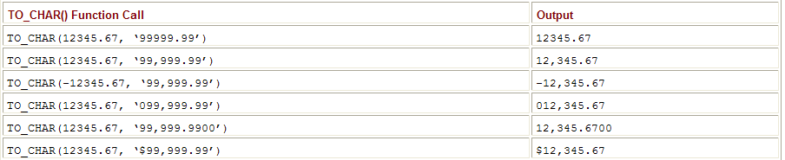
  Using Simple Functions
  Conversion Functions

Slide 36
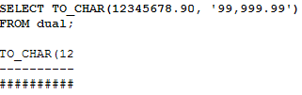
  Using Simple Functions
  Conversion Functions
TO_CHAR()
  will return a string of pound characters (#)
  if you try and format a number that contains too many digits
    for the format you have provided

Slide 37
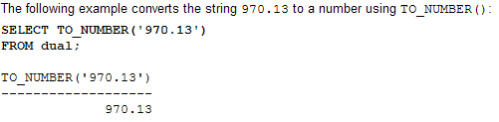

  Using Simple Functions
  Conversion Functions

