Slide 1
Contents
Understanding Join Conditions
Join Types
Using Simple Functions

Slide 2
Understanding Join Conditions and Join Types

Slide 3
Understanding Join Conditions and Join Types
Explore
  join conditions and
  join types
    that allow you to create more advanced queries
There are two types of join conditions
  based on the operator you use in your join:
    Equijoins You use the equality operator (=) in the join
    You’ve already seen examples of equijoins
    Non-equijoins You use an operator other than equals in the join
    such as <, >, BETWEEN, and so on
    See examples of non-equijoins shortly

Slide 4
Understanding Join Conditions and Join Types
In addition to the join condition there are
  three different types of joins
Inner joins
  Return a row only when the columns in the join contain values that satisfy the join condition
  This means that if a row has a null value
    in one of the columns in the join condition
    that row isn’t returned
    examples you’ve seen so far have been inner joins

Slide 5
Understanding Join Conditions and Join Types
Outer joins
  Can return a row even when one of the columns in the join condition contains a null value
Self joins
  Return rows joined on the same table

Slide 6
Understanding Non-equijoins
A non-equijoin uses
  an operator other than the equality operator in the join
  Examples of non-equality operators are
    not-equal (<>)
    less than (<)
    greater than (>)
    less than or equal to (<=)
    greater than or equal to (>=)
    LIKE
    IN and
    BETWEEN

Slide 7
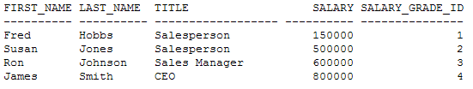
Understanding Non-equijoins
The following example uses a non-equijoin
  to retrieve the salary grades for the employees
  using the BETWEEN operator
  SELECT e.first_name, e.last_name, e.title, e.salary, sg.salary_grade_id
    FROM employees e, salary_grades sg
    WHERE e.salary
    BETWEEN sg.low_salary AND sg.high_salary;

Slide 8
Understanding Outer Joins
An outer join retrieves a row
  even when one of the columns in the join contains a null value
  Perform an outer join by supplying the outer join operator
    in the join condition
    the outer join operator is a plus character in parentheses (+)
Remember the query earlier that didn’t show
  the “My Front Line” product because its
    product_type_id is null
    You can use an outer join to get that row
    notice that the outer join operator (+) is on the opposite side of the product_type_id column in the product table
      this is the column that contains the null value

Slide 9
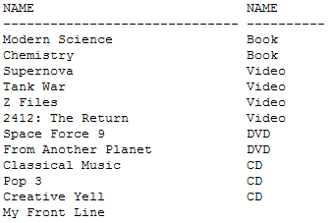
Understanding Outer Joins
SELECT p.name, pt.name
FROM products p, product_types pt
WHERE p.product_type_id = pt.product_type_id (+);

Slide 10
Understanding Outer Joins
Left and Right Outer Joins
Outer joins can be split into two types:
  Left outer joins
  Right outer joins
To understand the
  difference between left and right outer joins
  consider the following syntax:
    SELECT ... FROM table1, table2 ...
    Assume the tables are to be joined on table1.column1 and table2.column2
    Also, assume table1 contains a row with a null value in column1
    To perform a left outer join, the WHERE clause is
  WHERE table1.column1 = table2.column2 (+);
    In a left outer join, the outer join operator is actually on the right of the equality operator

Slide 11
Understanding Outer Joins
Left and Right Outer Joins
Assume
  table2 contains a row with a null value in column2
  To perform a right outer join
    you switch the position of the outer join operator to the left of the equality operator and the WHERE clause becomes
  WHERE table1.column1 (+) = table2.column2;
    you’ll see depending on whether table1 and table2 both contain rows with null values
      you get different results depending on whether you use a left or right outer join

Slide 12
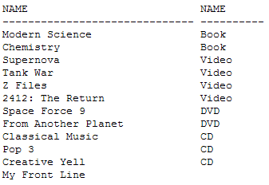
Understanding Outer Joins
Left and Right Outer Joins
An Example of a Left Outer Join
  The following example shows the use of a left outer join
  Notice that the outer join operator appears on the right of the equality operator:
SELECT p.name, pt.name
FROM products p, product_types pt
WHERE p.product_type_id = pt.product_type_id (+);

Slide 13
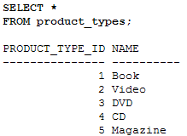
Understanding Outer Joins
Left and Right Outer Joins
An Example of a Right Outer Join
  The product_types table contains a type of product
    not referenced in the products table (magazine)
    notice this product type at the end of the following listing

Slide 14
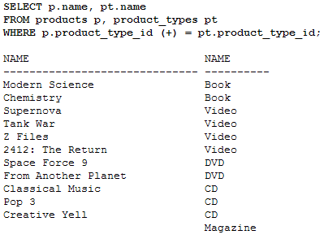
Understanding Outer Joins
Left and Right Outer Joins

Slide 15
Understanding Outer Joins
Limitations on Outer Joins
You may only place the outer join operator on one side of the join
  not both
  If you try to place the outer join operator on both sides you get an error
  See following example:
SQL> SELECT p.name, pt.name
      FROM products p, product_types pt
    WHERE p.product_type_id (+) = pt.product_type_id (+);
  WHERE p.product_type_id (+) = pt.product_type_id (+) *
  ERROR at line 3: ORA-01468: a predicate may reference only one outer-joined table

Slide 16
Understanding Outer Joins
Limitations on Outer Joins
You cannot use an outer join condition
  with the IN operator
SQL> SELECT p.name, pt.name
    FROM products p, product_types pt
    WHERE p.product_type_id (+) IN (1, 2, 3, 4);
    WHERE p.product_type_id (+) IN (1, 2, 3, 4)
    ERROR at line 3: ORA-01719: outer join operator (+) not allowed in operand of OR or IN

Slide 17
Understanding Outer Joins
Limitations on Outer Joins
You cannot use an outer join condition with
  another join using the OR operator:
  SQL> SELECT p.name, pt.name
      FROM products p, product_types pt
      WHERE p.product_type_id (+) = pt.product_type_id
      OR p.product_type_id = 1;
      WHERE p.product_type_id (+) = pt.product_type_id
      ERROR at line 3: ORA-01719: outer join operator (+) not allowed in operand of OR or IN
  These are only a few of the limitations when using
    the outer join operator
    For all the limitations, consult Oracle Corporation’s SQL Reference manual

Slide 18
Understanding Self Joins
A self join is a join
  made on the same table
  To perform a self join
    you must use a different table alias to identify each reference of the table used in your query
    Let’s consider an example
    The store schema contains a table named employees
      that contains a list of the employees
    The manager_id column contains the employee_id of the manager for the employee
      if that employee has a manager

Slide 19

Understanding Self Joins
You can see
  James Smith—the CEO—has a null value for the manager_id
  meaning that he doesn’t have a manager
  he answers only to the shareholders
  Fred Hobbs and Susan Jones both
    work for Ron Johnson

Slide 20
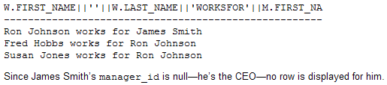
Understanding Self Joins
You can use a self join to display the names of each
  employee and
  their manager
  In example, the employees table is referenced twice
    using two aliases w and m
    The w alias is used to get the worker name and
    the m alias is used to get the manager name
    The self join is made between w.manager_id and m.employee_id:
    SELECT w.first_name || ' ' || w.last_name || ' works for '|| m.first_name || ' ' || m.last_name
    FROM employees w, employees m
    WHERE w.manager_id = m.employee_id;

Slide 21
Understanding Self Joins
You can of course perform outer joins
  in combination with self joins
  Following example
    an outer join is used with the self join
    shown in the previous example
    so that you can see the row for James Smith.
    You’ll notice the use of the
      NVL() function to provide a string
        indicating that James Smith works for the shareholders (remember, he’s the CEO, so he reports to the shareholders of the company)

Slide 22
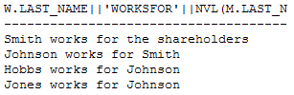
Understanding Self Joins
SELECT w.last_name || ' works for ' || NVL(m.last_name, 'the shareholders')
FROM employees w, employees m
WHERE w.manager_id = m.employee_id;

Slide 23
Using Simple Functions

Slide 24
In this chapter, you’ll learn about some of the Oracle database’s built-in functions. A function accepts zero or more input parameters and returns an output parameter. There are two main types of functions you can use in an Oracle database:

Slide 25
Using Simple Functions
Learn about some of the Oracle database’s
  built-in functions
  A function accepts zero or more input parameters
  and returns an output parameter.
  There are two main types of functions you can use in an Oracle database:
    Single row functions
    Aggregate functions

Slide 26
Using Simple Functions
Single row functions
  These operate on one row at a time and
  return one row of output for each input row
    An example single row function
    CONCAT(x, y), which appends y to x and returns the resulting string
Aggregate Functions
  These operate on multiple rows at the same time and
  return one row of output
    An example aggregate function
    AVG(x), which returns the average of x
    where x may be a column or, more generally, an expression

Slide 27
Using Simple Functions
Single row functions first
Aggregate functions
More complex types of functions
Sometimes you might want to group blocks of rows
  in a table and get some information on those groups of rows
    For example
    to get the average price for the different types of products in the products table

Slide 28
Using Simple Functions
There are five main types of single row functions:
  Character functions
    Allow you to manipulate strings of characters and return strings or numbers
  Numeric functions
    Allow you to perform calculations and return numbers
  Conversion functions
    Allow you to convert a value from one data type to another
  Date functions
    Allow you to process dates and times
  Regular expression functions
    Allow you to use regular expressions when searching data
    These functions are new for Oracle Database 10g

Slide 29
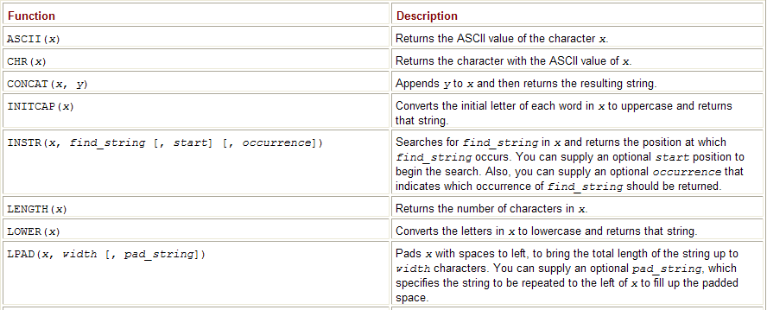
Using Simple Functions
Character Functions
  These functions accept character input
  which may come from a column in a table or
  more generally from any expression
  Input is then processed in some way and a result returned
  One example function
    UPPER(), which converts all the letters in a character string
      to uppercase and returns the new string
    NVL(), which converts a null value to a value passed to the function

Slide 30
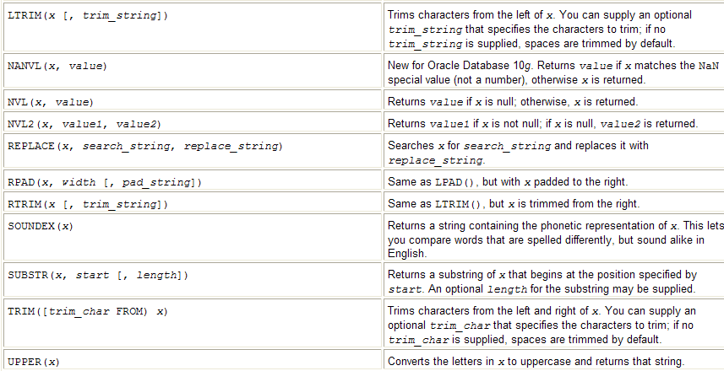
Using Simple Functions

Slide 31
Using Simple Functions
ASCII() and CHR()
  You use ASCII(x)
    to get the ASCII value of the character x
  You use CHR(x)
    to get the character with the ASCII value of x
Example gets the ASCII value of
  a, A, z, Z, 0, and 9 using ASCII():
SELECT
  ASCII('a'), ASCII('A'), ASCII('z'), ASCII('Z'), ASCII(0), ASCII(9)
  FROM dual;

Slide 32
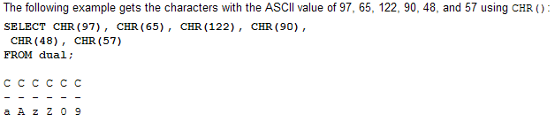
Using Simple Functions
The dual table is used
  As you saw in the slides
    the dual table contains a single row
      through which you may perform queries
      that don’t go against a particular table
The characters returned from
  CHR() in this example are the same as those
  passed to ASCII() in the previous example
    Shows that CHR() and ASCII() have the opposite effect

Slide 33
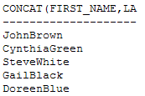
Using Simple Functions
CONCAT()
  You use CONCAT(x, y) to append y to x
  CONCAT() then returns the resulting string
    Following example selects the
      first_name and last_name columns from the products table
      appending last_name to first_name using CONCAT():
SELECT CONCAT(first_name, last_name) FROM customers;
The CONCAT() function is the same as the || operator you saw in previous lectures

Slide 34

Using Simple Functions
INITCAP()
  You use INITCAP(x) to convert the
  initial letter of each word in x to uppercase
    Following example selects the
      product_id and description columns from the products table
      and uses INITCAP() to convert the first letter of each word in description to uppercase:
SELECT product_id, INITCAP(description) FROM products WHERE product_id < 4;

