Slide 1
Contents
Adding, Modifying, and Removing Rows
Quitting SQL*Plus
Introducing Oracle PL/SQL
Performing SELECT Statements that Use More than Two Tables

Slide 2
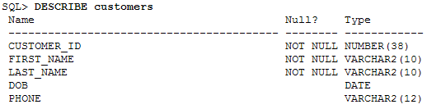
SQL (Adding a Row to a Table)
Use the INSERT statement
  to add new rows to a table
  Specify the following information in an INSERT statement:
    The table into which the row is to be inserted
    A list of columns for which you want to specify column values
    A list of values to store in the specified columns
  Supply a value for the primary key and
  all other columns that are defined as NOT NULL
  You don’t have to specify values for the other columns if you don’t want to
    those columns will be automatically set to null

Slide 3
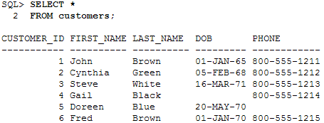
SQL (Adding a Row to a Table)
INSERT statement adds a row to the customers table
Notice that the order of values in the VALUES list matches
  the order in which the columns are specified in the column list
  the statement has two parts
    the column list and
    the values to be added
INSERT INTO customers ( customer_id, first_name, last_name, dob, phone ) VALUES ( 6, 'Fred', 'Brown', '01-JAN-1970', '800-555-1215'
);
1 row created.

Slide 4
SQL (Adding a Row to a Table)
Date Type
  By default, the Oracle database displays dates in the format DD-MON-YY
    where DD is the day number
    MON are the first three characters of the month (in uppercase) and
    YY are the last two digits of the year
  The database actually stores all four digits for the year
    but by default it only displays the last two digits

Slide 5

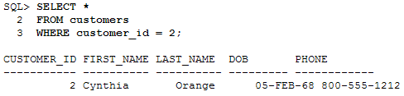
SQL (Modifying an Existing Row in a Table)
Use the UPDATE statement to change rows in a table
When using the UPDATE statement
  specify the following information:
    The table containing the rows that are to be changed
    A WHERE clause that specifies the rows that are to be changed
    A list of column names, along with their new values, specified using the SET clause
Can change one or more rows using the same UPDATE statement
  If more than one row is specified the same change will be implemented for all of those rows

Slide 6
SQL (Removing a Row from a Table)
Use the DELETE statement to remove rows from a table
  As with the UPDATE statement
  you typically use a WHERE clause to limit the rows you wish to delete
    if you don’t, all the rows will be deleted from the table
SQL> DELETE FROM customers 2 WHERE customer_id = 2;
1 row deleted.
SQL*Plus confirms that one row has been deleted.
To undo any changes you make to the database use ROLLBACK:
SQL> ROLLBACK;
Rollback complete
Go ahead and issue a ROLLBACK to undo any changes you’ve made so far

Slide 7
SQL (Quitting SQL*Plus)
Quitting SQL*Plus
  Use the EXIT command to quit from SQL*Plus
  On Windows this will terminate SQL*Plus
  On Unix and Linux it will terminate SQL*Plus and take you back to the command-line prompt from which you started SQL*Plus
  The following example quits SQL*Plus using the EXIT command:
SQL> EXIT

Slide 8
Introducing Oracle PL/SQL
PL/SQL is Oracle’s procedural language
  allows you to add programming constructs around SQL
  PL/SQL is primarily used for adding
    procedures and functions to a database
    to implement business logic
  PL/SQL contains standard programming constructs such as the following:
    Blocks
    Variable declarations
    Conditionals
    Loops
    Cursors
    The ability to define procedures and functions

Slide 9
Introducing Oracle PL/SQL
Following CREATE PROCEDURE statement defines
  a procedure named update_product_ price()
  The procedure multiplies the price of a product by a factor
    the product ID and the factor are passed as parameters to the procedure
    If the specified product doesn’t exist
      the procedure takes no action otherwise
      it updates the product price by the factor
Don’t worry too much about the details of
  the PL/SQL shown in the following listing for now
  you’ll learn the details as you progress
  I just want you to get a feel for PL/SQL at this stage

Slide 10
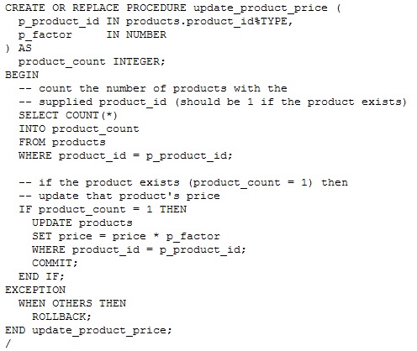
Introducing Oracle PL/SQL

Slide 11
Introducing Oracle PL/SQL
Exceptions are used to handle errors
  that occur in PL/SQL code
  The EXCEPTION block in the previous example performs a
    ROLLBACK if any exception is thrown in the code
You’ll learn more about PL/SQL in later lectures

Slide 12
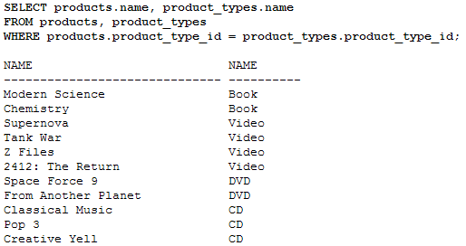
SQL (Performing SELECT Statements that Use More than Two Tables)
Joins can be used to connect any number of tables
  Use the following formula to calculate the number of joins you will need in your WHERE clause:
  Add all the number of tables used in your query, and then subtract 1 from this total
In the example shown in the previous lecture
  there were two tables used in the query:
  products and
  product_types
  The number of joins required is 1 (=2 - 1), and indeed only one join is used in that example

Slide 13
SQL (Performing SELECT Statements that Use More than Two Tables)
Let’s consider a more complicated example
  that will involve four tables and
  will therefore require three joins
  Let’s say you want to see the following information:
    The purchases each customer has made
    The customer’s first and last name
    The name of the product they purchased
    The name of the product type

Slide 14

SQL (Performing SELECT Statements that Use More than Two Tables)
In order to view this information you need to query the
  Customers
  Purchases
  products and
  product_types tables
and your joins will need to navigate
  the foreign key relationships between these tables
  The following list shows the required navigation:
    To get the customer who made the purchase join the customers and purchases tables using the customer_id columns from those respective tables
    To get the product purchased join the products and purchases tables using the product_id columns from those respective tables
    To get the product type name for the product join the products and product_types tables using the product_type_id columns from those respective tables
Using this navigation, your query may appear as follows (notice the aliases and joins used in this query):

Slide 15
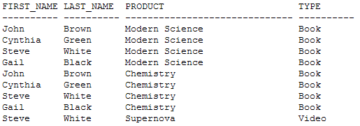
SQL (Performing SELECT Statements that Use More than Two Tables)
Notice renaming of heading for the product name to PRODUCT and
renamed the product type name to TYPE
  The output of this query is as follows

