Slide 1
Contents
Functions
Packages, which may be used to group procedures and functions together in one unit
Triggers

Slide 2
Introducing PL/SQL Programming
Functions
A function is similar to a procedure except that a function must return a value to the statement from which it is called
  Together, stored procedures and functions are sometimes referred to as stored subprograms because they are, in one sense, small programs
    In this section, you’ll learn how to:
      Create a function
      Call a function
      Get information on functions
      Drop a function

Slide 3
Introducing PL/SQL Programming
Creating a Function
  You create a function using the CREATE FUNCTION statement
  The simplified syntax for the CREATE FUNCTION statement is as follows:
    CREATE [OR REPLACE] FUNCTION function_name [(parameter_name [IN | OUT | IN OUT] type [, ...])]
    RETURN type {IS | AS} BEGIN function_body
    END function_name;

Slide 4
Introducing PL/SQL Programming
where
    OR REPLACE specifies the function that is to replace an existing function if present
      You can use this option when you want to modify the definition of a function
    function_name specifies the name of the function
    parameter_name specifies the parameter name
      A function may be passed multiple parameters
    IN |OUT | IN OUT specifies the mode of the parameter
    type specifies the PL/SQL type of the parameter
    function_body contains the SQL and PL/SQL statements to perform the function’s task
      Unlike a procedure, the body of a function must return a value of the PL/SQL type specified in the RETURN clause

Slide 5
Introducing PL/SQL Programming
The following CREATE FUNCTION statement creates a function named circle_area()
    which returns the area of a circle
    The radius of the circle is passed as a parameter to circle_area()
    This function is created when you run the store_schema.sql script:
  CREATE OR REPLACE FUNCTION circle_area ( p_radius IN NUMBER )
    RETURN NUMBER AS v_pi NUMBER := 3.1415926;
    v_area NUMBER; BEGIN v_area := v_pi * POWER(p_radius, 2);
    RETURN v_area;
    END circle_area;
    /

Slide 6
Introducing PL/SQL Programming
Notice circle_area() returns a NUMBER whose value is set to the computed area of a circle
  The next example creates a function named average_product_price()
    which returns the average price of products whose product_type_id equals the parameter value
    This function is created by the store_schema.sql script:
    CREATE OR REPLACE FUNCTION average_product_price ( p_product_type_id IN INTEGER )
      RETURN NUMBER AS v_average_product_price NUMBER;
      BEGIN SELECT AVG(price) INTO v_average_product_price FROM products
      WHERE product_type_id = p_product_type_id;
      RETURN v_average_product_price;
      END average_product_price;
      /

Slide 7
Introducing PL/SQL Programming
Calling a Function
    You call your own functions as you would call any of the built-in database functions;
      you saw how to call built-in functions in Chapter 3
      To refresh your memory, you can call a function using a SELECT statement that uses the dual table in the FROM clause
      The following example calls circle_area(), passing a radius of 2 meters to the function:
  SELECT circle_area(2) FROM dual;
    CIRCLE_AREA(2) --------------
    12.5663704
  The next example calls average_product_price()
    passing the parameter value 1 to the function to get the average price of products whose product_type_id is 1:
    SELECT average_product_price(1) FROM dual;
      AVERAGE_PRODUCT_PRICE(1) ------------------------
      29.965

Slide 8
Introducing PL/SQL Programming
Getting Information on Functions
  You can get information on your functions from the user_procedures view;
    this view was covered earlier in the section “Getting Information on Procedures.”
    The following example retrieves the object_name, aggregate, and parallel columns from user_procedures for circle_area() and average_product_price():
    SELECT object_name, aggregate, parallel FROM user_procedures WHERE object_name IN ('CIRCLE_AREA', 'AVERAGE_PRODUCT_PRICE');
    OBJECT_NAME AGG PAR
    ------------------------------ --- ---
    AVERAGE_PRODUCT_PRICE NO NO
    CIRCLE_AREA NO NO

Slide 9
Introducing PL/SQL Programming
Dropping a Function
  You drop a function using DROP FUNCTION
  For example, the following statement drops circle_area():
    DROP FUNCTION circle_area;

Slide 10
Introducing PL/SQL Programming
Packages
  you’ll learn how to group procedures and functions together into packages
  Packages allow you to encapsulate related functionality into one self-contained unit
  By modularizing your PL/SQL code in such a manner, you can potentially build up your own libraries of code that other programmers could reuse
  Packages are typically made up of two components:
    a specification and
    a body.
  The package specification contains information about the package, and it lists the available procedures and functions
  These are potentially available to all database users, so refering to these procedures and functions as being public
    (although only users who have the privileges to access your package can use it)
  The specification generally doesn’t contain the code that makes up those procedures and functions—the package body contains the actual code

Slide 11
Introducing PL/SQL Programming
  The procedures and functions listed in the specification are available to the outside world
    but any procedures and functions only contained in the body are only available within that body—
      they are private to that body
  By using a combination of public and private procedures and functions
    you can build up very complex packages whose complexity is hidden from the outside world
    This is one of the primary goals of all programming:
      hide complexity from your users

Slide 12
Introducing PL/SQL Programming
Creating a Package Specification
  You create a package specification using the CREATE PACKAGE statement
  The simplified syntax for the CREATE PACKAGE statement is as follows:
    CREATE [OR REPLACE] PACKAGE package_name {IS | AS} package_specification
    END package_name;
where
  package_name specifies the name of the package
  package_specification specifies the list of procedures and functions
    (along with any variables, type definitions, and cursors)
    that are available to your package’s users

Slide 13
Introducing PL/SQL Programming
The following example creates a package specification for a package named product_package:
  CREATE OR REPLACE PACKAGE product_package AS TYPE t_ref_cursor IS REF CURSOR;
  FUNCTION get_products_ref_cursor RETURN t_ref_cursor;
  PROCEDURE update_product_price ( p_product_id IN products.product_id%TYPE, p_factor IN NUMBER );
  END product_package;
  /

Slide 14
Introducing PL/SQL Programming
  The type t_ref_cursor uses the PL/SQL REF CURSOR type
    A REF CURSOR is similar to a pointer in the C programming language and
      it basically points to rows retrieved from the database using a PL/SQL cursor
      In the following section, you’ll see the use of a REF CURSOR to point to the result set
        returned by a SELECT statement that retrieves rows from the products table using a PL/SQL cursor
      This is done using the function get_products_ref_cursor(), which returns a variable of type t_ref_cursor

Slide 15
Introducing PL/SQL Programming
Creating a Package Body
    You create a package body using the CREATE PACKAGE BODY statement
    The simplified syntax for the CREATE PACKAGE BODY statement is as follows:
    CREATE [OR REPLACE] PACKAGE BODY package_name {IS | AS} package_body END package_name;
    where
      package_name specifies the name of the package, which must match the package name previously set in the package specification
      package_body specifies the code for the procedures and functions, along with any variables and cursors

Slide 16
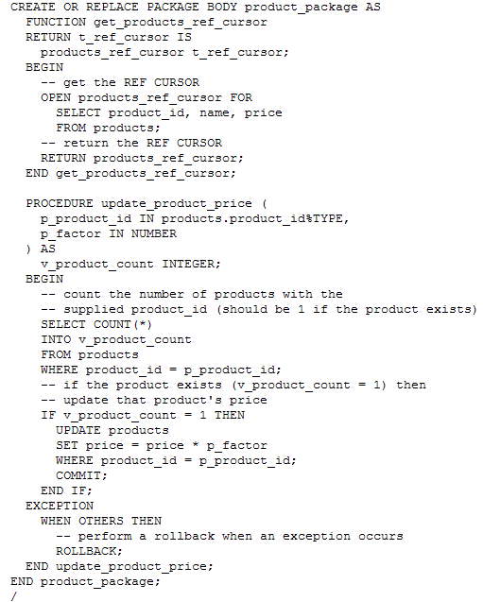
Introducing PL/SQL Programming
The following example creates the package body for product_package:

Slide 17
Introducing PL/SQL Programming
  The get_products_ref_cursor() function
    opens a cursor and retrieves the product_id, name, and price columns from
    the products table
    The reference to this cursor (the REF CURSOR ) is then returned by the function
    This REF CURSOR may then be accessed to read the column values
    The update_product_price() procedure updates the price of a product

Slide 18
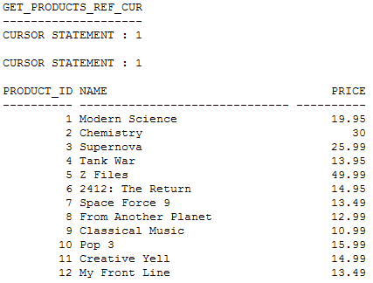
Introducing PL/SQL Programming
Calling Functions and Procedures in a Package
  When calling functions and procedures in a package, you include the package name in the call
    The following example calls product_package.get_products_ref_cursor(), which returns a cursor containing the product_id, name, and price for the products:
    SELECT product_package.get_products_ref_cursor FROM dual;

Slide 19
Introducing PL/SQL Programming
The example calls
  product_package.update_product_price() to multiply product #3’s price by 1.25:
    CALL product_package.update_product_price(3, 1.25);
    The next query retrieves the details for product #3;
    notice the price has increased:
    SELECT price FROM products WHERE product_id = 3; PRICE ----------
    32.49

Slide 20

Introducing PL/SQL Programming
Getting Information on Functions and Procedures in a Package
  You can get information on your functions and procedures in a package from the user_procedures view;
    this view was covered earlier in the section “Getting Information on Procedures.”
    The following example retrieves the object_name, and procedure_name columns from user_procedures for product_package:
    SELECT object_name, procedure_name FROM user_procedures WHERE object_name = 'PRODUCT_PACKAGE';

Slide 21
Introducing PL/SQL Programming
Dropping a Package
  You drop a package using DROP PACKAGE
    For example, the following statement drops product_package:
  DROP PACKAGE product_package;

Slide 22
Introducing PL/SQL Programming
Triggers
  A trigger is a
    procedure that is run automatically by the database—
    or in technical terms, fired—
    when a specified SQL DML INSERT, UPDATE, or DELETE statement
      is run against a specified database table
    Triggers are useful for doing things like
      advanced auditing of changes made to column values in a table

Slide 23
Introducing PL/SQL Programming
When a Trigger Runs
  A trigger can fire before or after the SQL statement runs
  Also, since a DML statement can affect more than one row at the same time
    the procedure code for the trigger may be run once for every row affected (such a trigger is known as a row-level trigger)
    or just once for all the rows (known as a statement-level trigger)
    For example, if you had an UPDATE statement that modified ten rows and you had also created a row trigger that would fire
      for this UPDATE statement, then that trigger would run ten times—
      once for each row
      If, however, your trigger was a statement-level trigger
      the trigger would only fire once for the whole UPDATE statement
  Note A row-level trigger has access to the old and new column values when the trigger fires as a result of an UPDATE statement on that column
  The firing of a trigger may also be limited using a trigger condition
    for example, when a column value is less than a specified value

Slide 24
Introducing PL/SQL Programming
Set Up for the Example Trigger
    Triggers are useful for doing advanced auditing of changes made to column values
    In the next section, you’ll see a trigger that records when a product’s price is lowered by more than 25 percent
    When this event occurs, the trigger will add a row to the product_price_audit table
      which is created by the following CREATE TABLE statement in the store_schema.sql script:
    CREATE TABLE product_price_audit ( product_id INTEGER CONSTRAINT price_audit_fk_products REFERENCES products(product_id), old_price NUMBER(5, 2), new_price NUMBER(5, 2) );

Slide 25
Introducing PL/SQL Programming
  As you can see
    the product_id column of the product_price_audit table is a foreign key
      to the product_id column of the products table
      The old_price column will be used to store the old price of a product prior to the change
      and the new_price column will be used to store the new price after the change

Slide 26
Introducing PL/SQL Programming
Creating a Trigger
  You create a trigger using the CREATE TRIGGER statement
  The simplified syntax for the CREATE TRIGGER statement is as follows:
  CREATE [OR REPLACE] TRIGGER trigger_name {BEFORE | AFTER | INSTEAD OF} trigger_event
  ON table_name [FOR EACH ROW [WHEN trigger_condition]]
  BEGIN trigger_body
  END trigger_name;

Slide 27
Introducing PL/SQL Programming
where
  OR REPLACE specifies the trigger is to replace an existing trigger if present
  You can use this option when you want to modify the definition of a trigger
  BEFORE specifies the trigger fires before the triggering event is performed
  AFTER specifies the trigger fires after the triggering event is performed
  INSTEAD OF specifies the trigger fires instead of performing the triggering event
  trigger_event specifies the event that causes the trigger to fire
  table_name specifies the table that the trigger references
  FOR EACH ROW specifies the trigger is a row-level trigger, which means the code contained within trigger_body is run for each row when the trigger fires
  If you omit FOR EACH ROW, the trigger is a statement-level trigger, which means the code within trigger_body is run once when the trigger fires regardless of the number of rows affected
  trigger_condition specifies a Boolean condition that limits when a trigger actually runs its code
  trigger_body contains the SQL and PL/SQL statements that perform the trigger’s task

Slide 28
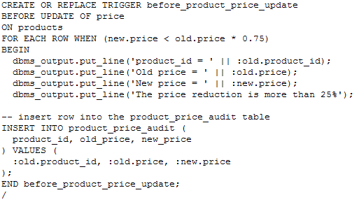
Introducing PL/SQL Programming
  The example trigger you’ll see in this section will fire before an update of the price column from the products table,
    and therefore name of trigger
    before_product_price_update
    Also, because I want to use the price column values before and after any UPDATE statement modifies the price column’s value
    I must use a row-level trigger
    Finally, since I only want to audit a price change when the new price is lowered by more than 25 percent of the old value
    I’ll need to specify a trigger condition
    The following statement creates the before_product_price_update trigger:

Slide 29
Introducing PL/SQL Programming
  Getting Information on Triggers
    SELECT * FROM user_triggers WHERE trigger_name = 'BEFORE_PRODUCT_PRICE_UPDATE';
  Disabling and Enabling Trigger
    You can stop a trigger from firing by disabling it using the ALTER TRIGGER statement
    For example, the following statement disables the before_product_price_update trigger:
  ALTER TRIGGER before_product_price_update DISABLE;
  The following example enables the before_product_price_update trigger:
    ALTER TRIGGER before_product_price_update ENABLE;
  Dropping a Trigger
    You drop a trigger using DROP TRIGGER
      For example, the following statement drops the before_product_price_update trigger:
      DROP TRIGGER before_product_price_update;

Slide 30
Introducing PL/SQL Programming

