Slide 1
Contents
Creating Tables
Sequences
Indexes and
Views

Slide 2
Creating Tables, Sequences, Indexes, and Views
Sequences
  A sequence is a database item that generates a sequence of integers
  You typically use the integers generated by a sequence to populate a numeric primary key column
    Create a sequence
    Get information on a sequence from the data dictionary
    Use a sequence
    Modify a sequence
    Drop a sequence

Slide 3
Creating Tables, Sequences, Indexes, and Views
Creating a Sequence
  You create a sequence using the
    CREATE SEQUENCE statement, which has the following syntax
    CREATE SEQUENCE sequence_name
    [START WITH start_num]
    [INCREMENT BY increment_num]
    [ { MAXVALUE maximum_num | NOMAXVALUE } ]
    [ { MINVALUE minimum_num | NOMINVALUE } ]
    [ { CYCLE | NOCYCLE } ]
    [ { CACHE cache_num | NOCACHE } ]
    [ { ORDER | NOORDER } ];

Slide 4
Creating Tables, Sequences, Indexes, and Views
  NOMINVALUE
    specifies the maximum is 1 for an ascending sequence or -10²⁶ for a descending sequence. NOMINVALUE is the default
  NOMAXVALUE
    specifies the maximum is 10²⁷ for an ascending sequence or –1 for a descending sequence. NOMAXVALUE is the default
  NOCYCLE is the default
  CACHE
    cache_num specifies the number of integers to keep in memory
    The default number of integers to cache is 20
    The minimum number of integers that may be cached is 2
    The maximum integers that may be cached is determined by the formula CEIL(maximum_num minimum_num)/ABS(increment_num)
  NOORDER is the default

Slide 5
Creating Tables, Sequences, Indexes, and Views
The following example creates a sequence named test_seq:
  CREATE SEQUENCE test_seq;
  Since this CREATE SEQUENCE statement omits the optional parameters, the default values are used
  This means that parameters such as start number and the increment by numbers are set to the default of 1
The next example creates a sequence named test2_seq that supplies values for the optional parameters:
  CREATE SEQUENCE test2_seq START WITH 10 INCREMENT BY 5 MINVALUE 10 MAXVALUE 20 CYCLE CACHE 2 ORDER;
The final example creates a sequence named test3_seq that starts at 10 and counts down to 1:
  CREATE SEQUENCE test3_seq START WITH 10 INCREMENT BY -1 MINVALUE 1 MAXVALUE 10 CYCLE CACHE 5;

Slide 6
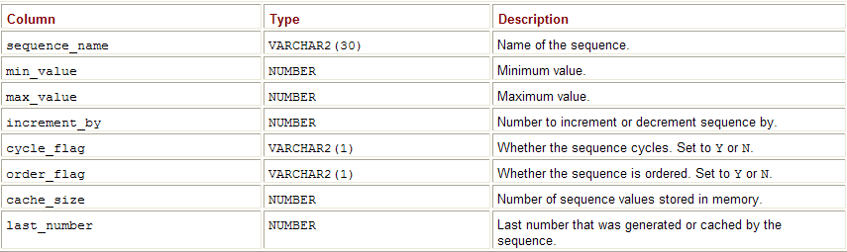
Creating Tables, Sequences, Indexes, and Views
Getting Information on Sequences
  You get information on your sequences from user_sequences, which forms part of the data dictionary Table 10-6 describes the columns in user_sequences

Slide 7
Creating Tables, Sequences, Indexes, and Views
  Using a Sequence
    The next example initializes test2_seq by selecting test_seq2.nextval. Notice the first value in the sequence is 10:
    SELECT test2_seq.nextval FROM dual;
      NEXTVAL ---------- 10
      CREATE TABLE order_status2 ( id INTEGER CONSTRAINT order_status2_pk PRIMARY KEY, status VARCHAR2(10), last_modified DATE DEFAULT SYSDATE );
      CREATE SEQUENCE order_status2_seq NOCACHE;
      INSERT INTO order_status2 ( id, status, last_modified ) VALUES ( order_status2_seq.nextval, 'PLACED', '01-JAN-2006' );

Slide 8
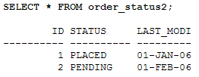
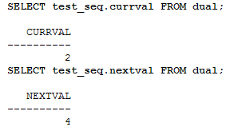
Creating Tables, Sequences, Indexes, and Views
  INSERT INTO order_status2 ( id, status, last_modified ) VALUES ( order_status2_seq.nextval, 'PENDING', '01-FEB-2006' );
  ALTER SEQUENCE test_seq INCREMENT BY 2;

Slide 9
Creating Tables, Sequences, Indexes, and Views
You drop a sequence using
  DROP SEQUENCE
  The following example drops test3_seq:
    DROP SEQUENCE test3_seq;

Slide 10
Creating Tables, Sequences, Indexes, and Views
Indexes
When looking for a particular topic in a book,
  you can either scan the whole book looking for your topic,
  or you can use the book’s index to find the exact location of the topic directly
  An index for a database table is similar in concept to a book index, except that database indexes are used to find specific rows in a table
  The downside of indexes is that when a row is added to the table, additional time is required to update the index for the new row
Generally, you should only create an index on a column when you find
  that you are retrieving a small number of rows from a table containing many rows
  A good rule of thumb is that an index is useful when you expect any single query to retrieve 10 percent or less of the total rows in a table

Slide 11
Creating Tables, Sequences, Indexes, and Views
This means that the candidate column for an index should be used to store a wide range of values
  A good candidate for indexing would be a column containing a unique number for each record
  while a poor candidate for indexing would be a column that only contains a small range of numeric codes such as 1, 2, 3, or 4
  This consideration applies to all database types, not just numbers
  An Oracle database automatically creates an index for the primary key of a table and for columns included in a unique constraint
  Normally, the DBA is responsible for creating indexes
    but as an application developer you will be able to provide the DBA with feedback on which columns are good candidates for indexing
    This is because you may know more about the application than the DBA

Slide 12
Creating Tables, Sequences, Indexes, and Views
  Create an index
  Create a function-based index
  Get information on an index from the data dictionary
  Modify an index
  Drop an index
Creating an Index
  You create an index using CREATE INDEX , which has the following simplified syntax:
    CREATE [UNIQUE] INDEX index_name ON table_name(column_name[, column_name...]) TABLESPACE tab_space;

Slide 13
Creating Tables, Sequences, Indexes, and Views
  UNIQUE specifies the values in the indexed columns must be unique
  index_name specifies the name you assign to the index
  table_name specifies the name of the table on which the index is created
  column_name specifies the name of the column on which the index is created
    You can create an index on multiple columns; such an index is known as a composite index
  tab_space specifies the tablespace for the index
    If you don’t provide a tablespace, the index is stored in the user’s default tablespace
  For performance reasons you should typically store indexes in a different tablespace from tables
    but for simplicity the examples in this chapter use the default tablespace
    In your own database you should have the DBA create separate tablespaces for tables and indexes

Slide 14
Creating Tables, Sequences, Indexes, and Views
for example:
  SELECT customer_id, first_name, last_name FROM customers WHERE last_name = 'Brown';
    Also assume that the last_name column contains fairly unique values,
    so that any query using the last_name column in a WHERE clause will return less than 10 percent of the total number of rows in the table
    The last_name column is therefore a good candidate for indexing
  The following CREATE INDEX statement creates an index named customers_last_name_idx on the last_name column of the customers table:
    CREATE INDEX customers_last_name_idx ON customers(last_name);

Slide 15
Creating Tables, Sequences, Indexes, and Views
You can enforce uniqueness of values in a column using a unique index
  For example, the following statement creates a unique index named customers_phone_idx on the customers.phone column:
    CREATE UNIQUE INDEX customers_phone_idx ON customers(phone);
    You can also create a composite index on multiple columns
    For example, the following statement creates a composite index named employees_first_last_name_idx on the first_name and last_name columns of the employees table:
    CREATE INDEX employees_first_last_name_idx ON employees(first_name, last_name);

Slide 16
Creating Tables, Sequences, Indexes, and Views
Creating a Function-Based Index
CREATE INDEX customers_last_name_func_idx ON customers(UPPER(last_name));
  In addition, your DBA must set the initialization parameter QUERY_REWRITE_ENABLED to true (the default is false) in order to take advantage of function-based indexes. For example:
  CONNECT system/manager ALTER SYSTEM SET QUERY_REWRITE_ENABLED=TRUE;

Slide 17
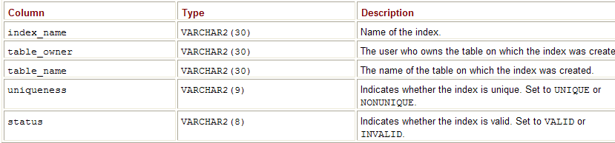
Creating Tables, Sequences, Indexes, and Views
Getting Information on Indexes
  You can get information on your indexes from user_indexes. Table 10-7 describes some of the columns in user_indexes.

Slide 18
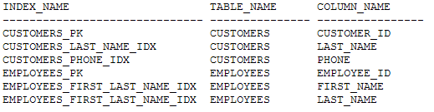
Creating Tables, Sequences, Indexes, and Views
  COLUMN table_name FORMAT a15
  COLUMN column_name FORMAT a15
  SELECT index_name, table_name, column_name FROM user_ind_columns WHERE table_name IN ('CUSTOMERS', 'EMPLOYEES');

Slide 19
Creating Tables, Sequences, Indexes, and Views
Modifying an Index
  You modify an index using ALTER INDEX
  The following example renames the customers_phone_idx index to customers_phone_number_idx:
    ALTER INDEX customers_phone_idx RENAME TO customers_phone_number_idx;
Dropping an Index
    You drop an index using the DROP INDEX statement
    The following example drops the customers_phone_number_idx index:
    DROP INDEX customers_phone_number_idx;

Slide 20
Creating Tables, Sequences, Indexes, and Views
A view is basically a predefined query on one or more tables (known as base tables)
  Retrieving information from a view is done in the same manner as retrieving from a table:
  you simply include the view in the FROM clause of a SELECT statement
  With some views you can also perform DML operations on the base tables.
  Note Views don’t store data, they only access rows in the base tables.

Slide 21
Creating Tables, Sequences, Indexes, and Views
Views offer you several benefits, such as:
  Only allow a user to retrieve data through a view
    This allows you to hide the underlying base tables on which a view is built from an end user
  Write complex queries as a view
    This allows you to hide complexity from an end user
  Only allow a view to access certain rows in the base tables
    This allows you to implement another layer of security and allows you to hide rows from an end user

Slide 22
Creating Tables, Sequences, Indexes, and Views
  Create and use a view
  Get details of a view from the data dictionary
  Modify a view
  Drop a view
You create a view using CREATE VIEW , which has the following simplified syntax:
  CREATE [OR REPLACE] VIEW [{FORCE | NOFORCE}] VIEW view_name [(alias_name[, alias_name...])] AS subquery [WITH {CHECK OPTION | READ ONLY} CONSTRAINT constraint_name];

Slide 23
Creating Tables, Sequences, Indexes, and Views
OR REPLACE specifies the view is to replace an existing view if present
FORCE specifies the view is to be created even if the base tables don’t exist
NOFORCE specifies the view is not to be created if the base tables don’t exist; NOFORCE is the default
view_name specifies the name of the view
alias_name specifies the name of an alias for an expression in the subquery. There must be the same number of aliases as there are expressions in the subquery

Slide 24
Creating Tables, Sequences, Indexes, and Views
subquery specifies the subquery that retrieves from the base tables. If you’ve supplied aliases, you can use those aliases in the list after the SELECT clause
WITH CHECK OPTION specifies that only the rows that would be retrieved by the subquery can be inserted, updated, or deleted. By default, rows are not checked that they are retrievable by the subquery before they are inserted, updated, or deleted
constraint_name specifies the name of the WITH CHECK OPTION or READ ONLY constraint
WITH READ ONLY specifies that rows may only read from the base tables

Slide 25
Creating Tables, Sequences, Indexes, and Views
Creating and Using Simple Views
Simple views access one base table
The following example creates a view named cheap_products_view whose subquery only retrieves products where the price is less than $15
  CREATE VIEW cheap_products_view AS SELECT * FROM products WHERE price < 15;
  The next example creates a view named employees_view whose subquery retrieves all the columns from the employees table except salary:
  CREATE VIEW employees_view AS SELECT employee_id, manager_id, first_name, last_name, title FROM employees;

Slide 26
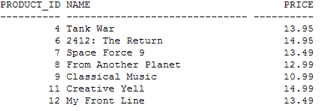
Creating Tables, Sequences, Indexes, and Views
Performing a SELECT on a View
Once you’ve created a view, you can use it to access the base table. The following example performs a SELECT on cheap_products_view:
SELECT product_id, name, price FROM cheap_products_view;

Slide 27
Creating Tables, Sequences, Indexes, and Views
Performing an INSERT Using a View
You can also perform DML operations using cheap_products_view
  The following example performs an INSERT into cheap_products_view and then retrieves the row:
  INSERT INTO cheap_products_view ( product_id, product_type_id, name, price ) VALUES ( 13, 1, 'Westerrn Front', 13.50 ); 1 row created.

Slide 28
Creating Tables, Sequences, Indexes, and Views
Modifying a View
You can completely replace a view using
  CREATE OR REPLACE ;
  you can alter the constraints on a view using ALTER VIEW
  The following example uses CREATE OR REPLACE to replace product_average_view:
    CREATE OR REPLACE VIEW product_average_view AS SELECT product_type_id, AVG(price) average_price FROM products WHERE price < 12 GROUP BY product_type_id HAVING AVG(price) > 11;
    The next example uses ALTER VIEW to drop the cheap_products_view2_price constraint from cheap_products_view2:
  ALTER VIEW cheap_products_view2
    DROP CONSTRAINT cheap_products_view2_price;

Slide 29
Creating Tables, Sequences, Indexes, and Views
Dropping a View
  You drop a view using DROP VIEW. The following example drops cheap_products_view2:
  DROP VIEW cheap_products_view2;

Slide 30
Creating Tables, Sequences, Indexes, and Views
A table is created using the CREATE TABLE statement
A sequence is a database item that generates a sequence of integers. You typically use the integers generated by a sequence to populate a numeric primary key column
An index for a database table is similar in concept to a book index, except that database indexes are used to find specific rows in a table
Generally, you should only create an index on a column when you find that you are retrieving a small number of rows from a table containing many rows
A view is basically a predefined query on one or more base tables. Among other benefits, views allow you to hide complexity from a user, and implement another layer of security by only allowing a view to access a limited set of data in the base tables

Slide 31
Creating Tables, Sequences, Indexes, and Views

Slide 32
Creating Tables, Sequences, Indexes, and Views

Slide 33
Creating Tables, Sequences, Indexes, and Views

Slide 34
Creating Tables, Sequences, Indexes, and Views

