Slide 1
Creating Table Contents
Creating Table Contents
  Database Transactions
  Query Flashbacks
  Summary

Slide 2
Creating Table Contents
Transaction Isolation Levels
  The transaction isolation level is the degree to which the changes made by one transaction are separated from other transactions running concurrently
  Before you see the details of the various transaction isolation levels, you need to understand the types of problems that may occur when current transactions attempt to access the same rows in a table
    In the following bullets, you’ll see examples of two concurrent transactions that are accessing the same rows to illustrate
      the three types of potential transaction processing problems

Slide 3
Creating Table Contents
Phantom reads
  T1 reads a set of rows returned by a specified WHERE clause
  T2 then inserts a new row, which also happens to satisfy the WHERE clause of the query previously used by T1
  T1 then reads the rows again using the same query, but now sees the additional row just inserted by T2
  This new row is known as a “phantom” because to T1 this row seems to have magically appeared
Nonrepeatable reads
  T1 reads a row, and T2 updates the same row just read by T1
  T1 then reads the same row again and discovers that the row it read earlier is now different
  This is known as a “nonrepeatable” read, because the row originally read by T1 has been changed
Dirty reads
  T1 updates a row, but doesn’t commit the update
  T2 reads the updated row
  T1 then performs a rollback, undoing the previous update
  Now the row just read by T2 is no longer valid (it’s “dirty”) because the update made by T1 wasn’t committed when the row was read by T2

Slide 4
Creating Table Contents
To deal with these potential problems, databases implement various levels of transaction isolation to prevent concurrent transactions from interfering with each other
  The SQL standard defines the following transaction isolation levels, shown in order of increasing isolation
  READ UNCOMMITTED Phantom reads, nonrepeatable reads, and dirty reads are permitted
  READ COMMITTED Phantom reads and nonrepeatable reads are permitted, but dirty reads are not
  REPEATABLE READ Phantom reads are permitted, but nonrepeatable and dirty reads are not
  SERIALIZABLE Phantom reads, nonrepeatable reads, and dirty reads are not permitted

Slide 5
Creating Table Contents
The Oracle database supports the READ COMMITTED and SERIALIZABLE transaction isolation levels
  It doesn’t support READ UNCOMMITTED or REPEATABLE READ levels
The default transaction isolation level defined by the SQL standard is SERIALIZABLE
  but the default used by the Oracle database is READ COMMITTED
  which is usually acceptable for nearly all applications

Slide 6
Creating Table Contents
Caution Although you can use SERIALIZABLE with the Oracle database
  it may increase the time your SQL statements take to complete
  so you should only use SERILIZABLE if you absolutely have to
You set the transaction isolation level using the SET TRANSACTION statement
  For example, the following statement sets the transaction isolation level to SERIALIZABLE
  SET TRANSACTION ISOLATION LEVEL SERIALIZABLE;
You’ll see an example of a transaction that uses the isolation level of SERIALIZABLE next

Slide 7
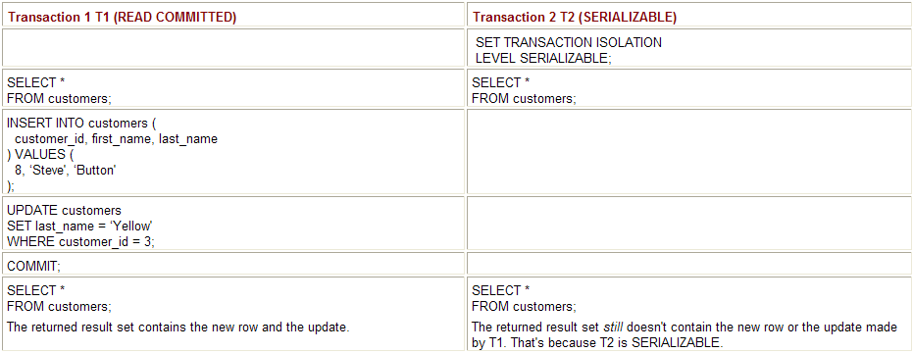
Creating Table Contents
A SERIALIZABLE Transaction Example
An example that shows the effect of setting the
  transaction isolation level to SERIALIZABLE
The example uses two transactions named T1 and T2
  T1 has the default isolation level of READ COMMITTED
  T2 has a transaction isolation level of SERIALIZABLE
  T1 and T2 will read the rows in the customers table, and then
  T1 will insert a new row and update an existing row in the customers table
  Because T2 is SERIALIZABLE, it doesn’t “see” the inserted row or the update made
    to the existing row by T1, even after T1 commits its changes
  That’s because reading the inserted row would be a phantom read
    and reading the update would be a nonrepeatable read
    which is not permitted by SERIALIZABLE transactions
  Table shows the SQL statements that make up T1 and T2 in the interleaved order in which the statements are to be performed

Slide 8
Creating Table Contents
Query Flashbacks
  If you mistakenly commit changes and you want to view rows as they originally were
  you can use a query flashback
  You can then use the results of a query flashback to manually change rows back to their original values if you need to
  In addition, flashbacks can be based on a datetime or system change number (SCN)
  The database uses SCNs to track changes made to data,
  and you can use them to flash back to a particular SCN in the database

Slide 9
Creating Table Contents
Granting the Privilege for Using Flashbacks
  Flashbacks use the PL/SQL DBMS_FLASHBACK package
    for which you must have the EXECUTE privilege
    The following example connects as the sys user and grants the EXECUTE privilege on DBMS_FLASHBACK to the store user
  CONNECT sys/change_on_install AS sysdba
  GRANT EXECUTE ON SYS.DBMS_FLASHBACK TO store;
    Note Speak with your DBA if you get errors when performing these statements
    You’ll learn more about PL/SQL packages in Chapter 11

Slide 10
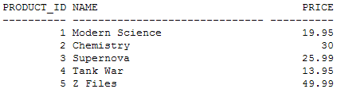
Creating Table Contents
Time Query Flashbacks
  The following example connects as store and retrieves the product_id, name, and price columns for the first five rows from the products table:
  CONNECT store/store_password SELECT product_id, name, price FROM products WHERE product_id <= 5;

Slide 11
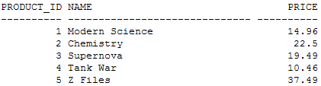
Creating Table Contents
The next example reduces the price of these rows
  commits the change and
  retrieves the rows again so you can see the new prices
    UPDATE products SET price = price * 0.75
    WHERE product_id <= 5; COMMIT;
    SELECT product_id, name, price FROM products WHERE product_id <= 5;

Slide 12
Creating Table Contents
The next example executes the DBMS_FLASHBACK.ENABLE_AT_TIME() procedure
  which enables you to perform a flashback to a particular datetime
  This procedure accepts a datetime and
  the example passes SYSDATE – 10 / 1440 to the procedure, which is ten minutes in the past
EXECUTE DBMS_FLASHBACK.ENABLE_AT_TIME(SYSDATE – 10 / 1440);
  Note 24 hours * 60 minutes per hour = 1440 minutes

Slide 13
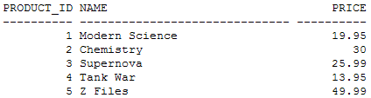
Creating Table Contents
Any queries you execute now will display the rows as they were ten minutes ago
  Assuming you performed the earlier UPDATE less than ten minutes ago
  the following query will display the prices as they were before you updated them
  SELECT product_id, name, price FROM products WHERE product_id <= 5;
To disable a flashback, you execute DBMS_FLASHBACK.DISABLE(), as shown in the following example:
  EXECUTE DBMS_FLASHBACK.DISABLE();
  Caution You must disable a flashback before you can enable it again

Slide 14
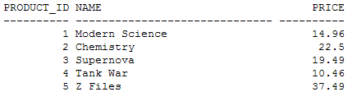
Creating Table Contents
Now when you perform queries, the rows as they currently exist will be retrieved
  For example
    SELECT product_id, name, price FROM products WHERE product_id <= 5;

Slide 15

Creating Table Contents
System Change Number Query Flashbacks
  Flashbacks based on system change numbers (SCNs) can be more precise than those based on a time
  because the database uses SCNs to track changes
  To get the current SCN, you can execute DBMS_FLASHBACK.GET_SYSTEM_CHANGE_NUMBER()
    For example
    VARIABLE current_scn NUMBER
    EXECUTE :current_scn :=DBMS_FLASHBACK.GET_SYSTEM_CHANGE_NUMBER();
    PRINT current_scn

Slide 16

Creating Table Contents
The next example adds a row to the products table
  commits the change, and retrieves the new row
    INSERT INTO products ( product_id, product_type_id, name, description, price )
    VALUES ( 15, 1, 'Physics', 'Textbook on physics', 39.95 ); COMMIT;
    SELECT * FROM products WHERE product_id = 15;

Slide 17
Creating Table Contents
The next example executes the DBMS_FLASHBACK.ENABLE_AT_SYSTEM_CHANGE_NUMBER() procedure
  which enables you to perform a flashback to an SCN
  This procedure accepts an SCN and the example passes the current_scn variable to the procedure
  EXECUTE DBMS_FLASHBACK.ENABLE_AT_SYSTEM_CHANGE_NUMBER(:current_scn);
  Any queries you execute now will display the rows as they were at the SCN stored in current_scn before you performed the INSERT
  The following query attempts to get the row with a product_id of 15 and fails because that new row was added after the SCN stored in current_scn:
    SELECT product_id FROM products WHERE product_id = 15;
    no rows selected

Slide 18
Creating Table Contents
To disable a flashback, you execute
    DBMS_FLASHBACK.DISABLE()
    as shown in the following example
    EXECUTE DBMS_FLASHBACK.DISABLE();
    If you perform the previous query again, you’ll see the new row that was added by the INSERT
  Note
    If you followed along with the examples go ahead and rerun the store_schema.sql script to re-create everything
    That way, the results of your SQL statements will match mine as you progress through the rest of this book

Slide 19
Creating Table Contents
Summary
  How to add rows using the INSERT statement
  How to modify rows using the UPDATE statement
  How to remove rows using the DELETE statement
  How the database maintains referential integrity through the enforcement of constraints
  How to use the DEFAULT keyword to specify default values for columns
  How to merge rows using the MERGE statement
  That a database transaction is a group of SQL statements that comprise a logical unit of work
  That an Oracle database can handle multiple transactions that are performed concurrently

Slide 20
Remaining Chapters
Chapter 7
  Advanced Queries
Chapter 10
  Creating Tables ,sequences , indexes and views
Chapter 11
  Introducing PL/SQL

