Slide 1
Creating Table Contents
Creating Table Contents
  Modifying Rows Using the UPDATE Statement
  Removing Rows Using the DELETE Statement
  Database Integrity
  Using Default Values
  Merging Rows Using MERGE
  Database Transactions
  Query Flashbacks
  Summary

Slide 2
Creating Table Contents
Merging Rows Using MERGE
  The Oracle9i database introduced the MERGE statement
    that allows you to merge rows from one table into another
  For example, you might want to merge changes to products listed in one table into the products table
  The store schema contains a table named product_changes
    that was created using the following CREATE TABLE statement in store_schema.sql:
  CREATE TABLE
    product_changes ( product_id INTEGER CONSTRAINT prod_changes_pk PRIMARY KEY,
    product_type_id INTEGER CONSTRAINT prod_changes_fk_product_types REFERENCES product_types(product_type_id),
    name VARCHAR2(30) NOT NULL,
    description VARCHAR2(50), price NUMBER(5, 2) );

Slide 3
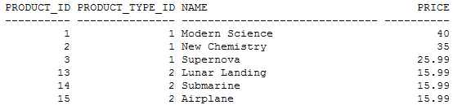
Creating Table Contents
  The following query shows the product_id, product_type_id, name, and price columns for the rows in the product_changes table
  SELECT product_id, product_type_id, name, price FROM product_changes;

Slide 4
Creating Table Contents
Let’s say the merge should do the following
  For existing rows with matching product_id values in products and product_changes
  update the rows in products with the column values that are listed in product_changes
  For example, product #1 has a different price in product_changes from that in products
    so product #1’s price must be updated in the products table
  Similarly, product #2 has a different name and price and must be updated in the products table
  Finally, product #3 has a different product_type_id and must be updated in products

Slide 5
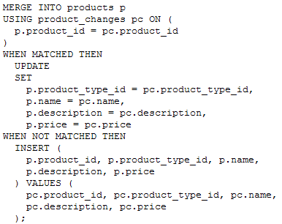
Creating Table Contents
For new rows in product_changes
  insert those new rows into the products table
  Products #13, #14, and #15 are new in product_changes and must therefore be inserted into products
The easiest way to learn how to use the MERGE statement is to see an example
  The following example performs the merge as defined in the previous bullet points to merge the changes in product_changes into products

Slide 6
Creating Table Contents
Notice the following points about the MERGE statement
  The MERGE INTO clause specifies the name of the table to merge the rows into
  In the example, the table to merge rows into is the products table, which has an alias of p that is referenced in the rest of the MERGE statement
The USING ... ON clause specifies a table join
  In the example, the join is made on the product_id columns in the products and product_changes tables
  the product_changes table has an alias of pc that is referenced in the rest of the MERGE statement
The WHEN MATCHED THEN clause specifies the action to take when the USING ... ON clause is satisfied for a row
  In the example, the action is an UPDATE statement that sets the product_type_id, name, description, and price columns of the existing row in the products table to the column values for the matching row in the product_changes table

Slide 7
Creating Table Contents
  The WHEN NOT MATCHED clause specifies the action to take when the USING ... ON clause is not satisfied for a row
    In the example, the action is an INSERT statement that adds a row to the products table, taking the column values from the row in the product_changes table
  If you run the previous MERGE statement, you’ll see that it reports six rows are merged
    which are the rows with product_id values of 1, 2, 3, 13, 14, and 15
    The following query retrieves the six merged rows from the products table
    SELECT product_id, product_type_id, name, price FROM products WHERE product_id IN (1, 2, 3, 13, 14, 15);

Slide 8
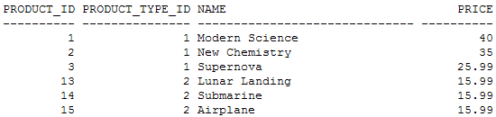
Creating Table Contents
Product #1 has a new price
Product #2 has a new name and price
Product #3 has a new product type ID
Products #13, #14, and #15 are new

Slide 9
Creating Table Contents
Database Transactions
  A database transaction is a group of SQL statements that are a logical unit of work
  You can think of a transaction as an inseparable set of SQL statements that should be made permanent in the database (or undone) as a whole
  An example of this would be a transfer of money from one bank account to another
  One UPDATE statement would subtract from the total amount of money from one account and
    another UPDATE would add money to the other account
    Both the subtraction and the addition must either be permanently recorded in the database
    or they both must be undone—otherwise money will be lost
  This simple example uses only two UPDATE statements, but a more realistic transaction may consist of many INSERT, UPDATE, and DELETE statements

Slide 10
Creating Table Contents
Committing and Rolling Back a Transaction
  To permanently record the results of the SQL statements in a transaction, you perform a commit with the COMMIT statement
  To undo the results of the SQL statements, you perform a rollback with the ROLLBACK statement, which resets all the rows back to what they were originally
  Any changes you make prior to performing a rollback will be undone, as long as you haven’t disconnected from the database beforehand
  The following example adds a row to the customers table and then makes the change permanent by performing a COMMIT
  INSERT INTO customers VALUES (6, 'Fred', 'Green', '01-JAN-1970', '800-555-1215');
  1 row created
  COMMIT;
  Commit complete

Slide 11
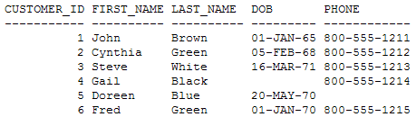
Creating Table Contents
The following example updates a row in the customers table and then undoes the change by performing a ROLLBACK:
  UPDATE customers SET first_name = 'Edward' WHERE customer_id = 1;
  1 row updated
  ROLLBACK;
  Rollback complete
  You can verify the changes to the customers table using the following query:
  SELECT * FROM customers;

Slide 12
Creating Table Contents
  Notice
    that the result of the INSERT statement that added customer #6 is indeed made permanent by the COMMIT and
    that the result of the UPDATE statement that changed the first name of customer #1 is undone by the ROLLBACK

Slide 13
Creating Table Contents
Starting and Ending a Transaction
  As mentioned, transactions are logical units of work you use to split up your database activities
  A transaction has both a beginning and an end
  it begins when one of the following events occurs
    You connect to the database and perform the first DML statement
    A previous transaction ends and you enter another DML statement

Slide 14
Creating Table Contents
A transaction ends when one of the following events occurs
  You perform a COMMIT or a ROLLBACK statement
  You perform a DDL statement, such as a CREATE TABLE statement, in which case a COMMIT is automatically performed
  You perform a DCL statement, such as a GRANT statement, in which case a COMMIT is automatically performed

Slide 15
Creating Table Contents
You disconnect from the database
If you exit SQL*Plus normally by entering the EXIT command, a COMMIT is automatically performed for you
If SQL*Plus terminates abnormally—for example
  if the computer on which SQL*Plus was running were to crash—a ROLLBACK is automatically performed
  This applies to any program that accesses a database
  For example, if you wrote a Java program that accessed a database and your program crashed, a ROLLBACK would be automatically performed
You perform a DML statement that fails, in which case a ROLLBACK is automatically performed for that individual DML statement
  Tip It is considered poor practice not to explicitly commit or roll back your transactions once they are complete
    so make sure you perform a COMMIT or ROLLBACK at the end of your transactions

Slide 16

Creating Table Contents
Savepoints
  You can also set a savepoint at any point within a transaction
  These allow you to roll back changes to that point
  This might be useful if you have a very long transaction because if you make a mistake after you’ve set a savepoint, you don’t have to roll back the transaction all the way to the start
  You should use savepoints sparingly
  you might be better off restructuring your transaction into smaller transactions instead
  an example of using a savepoint, but before we begin, let’s check the details for product #1 and product #2:
SELECT product_id, price FROM products WHERE product_id IN (1, 2);

Slide 17
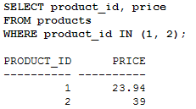
Creating Table Contents
  the price for product #1 is $19.95, and the price for product #2 is $30
  Next, let’s increase the price of product #1 by 20 percent
    UPDATE products SET price = price * 1.20 WHERE product_id = 1; Set a savepoint here named save1
    This will allow you to roll back any further DML statements and preserve the previous UPDATE:
  SAVEPOINT save1;
    Next, let’s increase the price of product #2 by 30 percent
    UPDATE products SET price = price * 1.30 WHERE product_id = 2; Let’s check the prices of the two products, just to make sure everything’s set as we expect
    SELECT product_id, price FROM products WHERE product_id IN (1, 2);

Slide 18

Creating Table Contents
Everything looks good:
  product #1’s price is 20 percent greater, and product #2’s price is 30 percent greater
  Okay, let’s roll back the transaction to the savepoint established earlier:
  ROLLBACK TO SAVEPOINT save1;
  This should preserve the new price set for product #1, but it will roll back the price for product #2 to its original price before we began, because the savepoint was set before the change to product #2’s price was made:
  SELECT product_id, price FROM products WHERE product_id IN (1, 2);

Slide 19
Creating Table Contents
These are the expected results:
  product #1’s new price is $23.94 and product #2’s price is back to the original
  Finally, roll back the entire transaction
  ROLLBACK;
  This rolls back the changes all the way to the start of the transaction and undoes the change made to the price of product #1

Slide 20
Creating Table Contents
ACID Transaction Properties
  Earlier, I defined a transaction as being a logical unit of work, that is, a grouping of related SQL statements that are either committed or rolled back as one unit
    One example of this is a transfer of money from one bank account to another using two UPDATE statements
    one that takes money out of one account, and another that puts that money into a different account
  Both UPDATE statements may be considered to be a single transaction because both statements must be either committed or rolled back together; otherwise, money might be lost
  Database theory has a more rigorous definition of a transaction and states that a transaction
    has four fundamental properties
    known as ACID properties

Slide 21
Creating Table Contents
Atomicity
  Transactions are committed or rolled back as a group, and are atomic, meaning that all SQL statements contained in a transaction are considered to be a single indivisible unit
Consistency
  Transactions ensure that the database state remains consistent, meaning that the database starts at one consistent state and ends in another consistent state when the transaction finishes
Isolation
Separate transactions should appear to run without interfering with each other
Durability
  Once a transaction has been committed, the database changes are preserved, even if the machine on which the database software runs later crashes
The Oracle database software ensures that each transaction possesses these ACID properties and has extensive recovery facilities for restoring databases that may have crashed for one reason or another

Slide 22
Creating Table Contents
Concurrent Transactions
  The Oracle database supports many users
    interacting with the database at the same time, with each user running their own transactions at the same time
    These transactions are known as concurrent transactions.
  If users are running transactions that affect the same table
    the effects of those transactions are separated from each other until a COMMIT is performed
  The following sequence of events
    based on two transactions named
    T1 and T2 accessing the customers table, illustrates the separation of transactions

Slide 23
Creating Table Contents
T1 and T2 perform a SELECT that retrieves all the rows from the customers table
T1 performs an INSERT to add a row in the customers table, but T1 doesn’t perform a COMMIT
T2 performs another SELECT and retrieves the same rows as those in step 1
  T2 doesn’t “see” the new row added by T1 in step 2
T1 finally performs a COMMIT to permanently record the new row added in step 2
T2 performs another SELECT and finally sees the new row added by T1

Slide 24
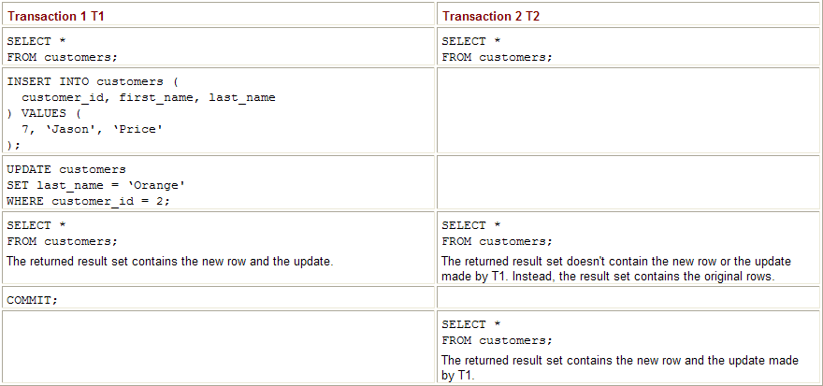
Creating Table Contents
  To summarize:
    T2 doesn’t see the changes made by T1 until T1 commits its changes
    This is the default level of isolation between transactions
    As you’ll learn later in the section “Transaction Isolation Levels,” you can change this level of isolation
  Table shows example SQL statements that further illustrate concurrent transactions
    The table shows the interleaved order in which statements are to be performed by two transactions named T1 and T2
    T1 retrieves rows, adds a row, and updates a row in the customers table
    T2 retrieves rows from the customers table
    T2 doesn’t see the changes made by T1 until T1 commits its changes

Slide 25
Creating Table Contents
  You can enter the statements shown in Table
    and see their results by starting two separate SQL*Plus sessions and connect as the store user for both sessions
    Enter the statements in the interleaved order shown in the table into the SQL*Plus sessions

Slide 26
Creating Table Contents
Transaction Locking
  To support concurrent transactions, an Oracle database must ensure that the data in the tables remains valid
  It does this through the use of locks
  Consider the following example in which two transactions named T1 and T2 attempt to modify customer #1 in the customers table:
    T1 performs an UPDATE to modify customer #1, but T1 doesn’t perform a COMMIT
    T1 is said to have “locked” the row
    T2 also attempts to perform an UPDATE to modify customer #1, but since this row is already locked by T1, T2 is prevented from getting a lock on the row
    T2’s UPDATE statement has to wait until T1 ends and frees the lock on the row

Slide 27
Creating Table Contents
T1 ends by performing a COMMIT, thus freeing the lock on the row
T2 gets the lock on the row and the UPDATE is performed. T2 holds the lock on the row until T2 ends.
To summarize:
  A transaction cannot get a lock on a row while another transaction already holds the lock on that row
  Note
    The easiest way to understand default locking is:
      readers don’t block readers
      writers don’t block readers and
      writers only block writers when they attempt to modify the same row

Slide 28
Creating Table Contents
Transaction Isolation Levels
  The transaction isolation level is the degree to which the changes made by one transaction are separated from other transactions running concurrently
  Before you see the details of the various transaction isolation levels, you need to understand the types of problems that may occur when current transactions attempt to access the same rows in a table
    In the following bullets, you’ll see examples of two concurrent transactions that are accessing the same rows to illustrate
      the three types of potential transaction processing problems

Slide 29
Creating Table Contents
Phantom reads
  T1 reads a set of rows returned by a specified WHERE clause
  T2 then inserts a new row, which also happens to satisfy the WHERE clause of the query previously used by T1
  T1 then reads the rows again using the same query, but now sees the additional row just inserted by T2
  This new row is known as a “phantom” because to T1 this row seems to have magically appeared.
Nonrepeatable reads
  T1 reads a row, and T2 updates the same row just read by T1
  T1 then reads the same row again and discovers that the row it read earlier is now different
  This is known as a “nonrepeatable” read, because the row originally read by T1 has been changed
Dirty reads
  T1 updates a row, but doesn’t commit the update
  T2 reads the updated row
  T1 then performs a rollback, undoing the previous update
  Now the row just read by T2 is no longer valid (it’s “dirty”) because the update made by T1 wasn’t committed when the row was read by T2

Slide 30
Creating Table Contents
To deal with these potential problems, databases implement various levels of transaction isolation to prevent concurrent transactions from interfering with each other
  The SQL standard defines the following transaction isolation levels, shown in order of increasing isolation:
  READ UNCOMMITTED Phantom reads, nonrepeatable reads, and dirty reads are permitted
  READ COMMITTED Phantom reads and nonrepeatable reads are permitted, but dirty reads are not
  REPEATABLE READ Phantom reads are permitted, but nonrepeatable and dirty reads are not
  SERIALIZABLE Phantom reads, nonrepeatable reads, and dirty reads are not permitted

Slide 31
Creating Table Contents
The Oracle database supports the READ COMMITTED and SERIALIZABLE transaction isolation levels
  It doesn’t support READ UNCOMMITTED or REPEATABLE READ levels
The default transaction isolation level defined by the SQL standard is SERIALIZABLE,
  but the default used by the Oracle database is READ COMMITTED
  which is usually acceptable for nearly all applications

Slide 32
Creating Table Contents
Caution Although you can use SERIALIZABLE with the Oracle database
  it may increase the time your SQL statements take to complete
  so you should only use SERILIZABLE if you absolutely have to
You set the transaction isolation level using the SET TRANSACTION statement
  For example, the following statement sets the transaction isolation level to SERIALIZABLE:
  SET TRANSACTION ISOLATION LEVEL SERIALIZABLE;
You’ll see an example of a transaction that uses the isolation level of SERIALIZABLE next.

Slide 33
Creating Table Contents

Slide 34
Creating Table Contents

Slide 35
Creating Table Contents

Slide 36
Creating Table Contents

Slide 37
Creating Table Contents

