Slide 1
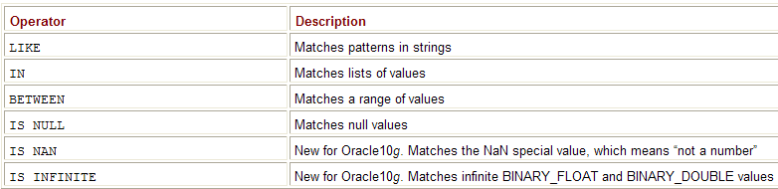
SQL (Filtering Rows Using Where Clause)
Using the SQL Operators

Slide 2
SQL (Filtering Rows Using Where Clause)
Use the NOT operator to reverse the meaning of
  LIKE, IN, BETWEEN, and IS NULL
NOT LIKE
NOT IN
NOT BETWEEN
IS NOT NULL
IS NOT NAN
IS NOT INFINITE

Slide 3
SQL (Filtering Rows Using Where Clause)
Use the LIKE operator in a WHERE clause to see
  if any of the character strings in a text column match
  a pattern that you specify
Specify patterns using a combination of
  normal characters and
  the following two wildcard characters:
    Underscore character (_) Matches one character in a specified position
    Percent character (%) Matches any number of characters beginning at the specified position

Slide 4
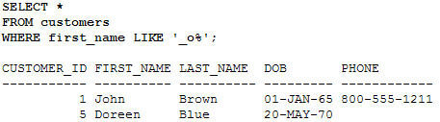
SQL (Filtering Rows Using Where Clause)
Using the LIKE Operator

Slide 5
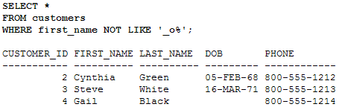
SQL (Filtering Rows Using Where Clause)

Slide 6

SQL (Filtering Rows Using Where Clause)
To Perform a text match on the actual underscore or
percent characters in a string
  Use the ESCAPE option
  For example the products whose name contains the string a_product are retrieved in the following way

Slide 7
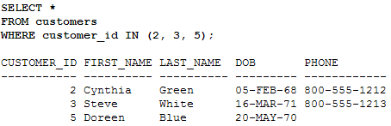
SQL (Filtering Rows Using Where Clause)
Using the IN Operator

Slide 8

SQL (Filtering Rows Using Where Clause)
NOT IN reverses the rows selected by IN—if IN replaces NOT IN for the previous example
  all rows except those shown above would be retrieved
NOT IN returns false if a value in the list is null

Slide 9
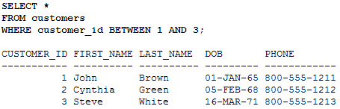
SQL (Filtering Rows Using Where Clause)
Using the BETWEEN Operator
Select rows whose column value is inclusive within a specified range

Slide 10
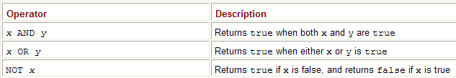
SQL (Filtering Rows Using Where Clause)
Using the Logical Operators
Three logical operators that may be used in a WHERE clause
The logical operators allow you to limit rows based on logical conditions

Slide 11
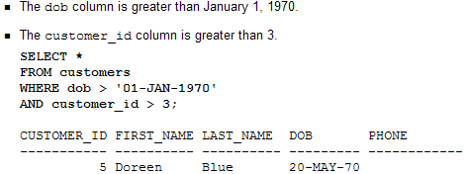
SQL (Filtering Rows Using Where Clause)

Slide 12
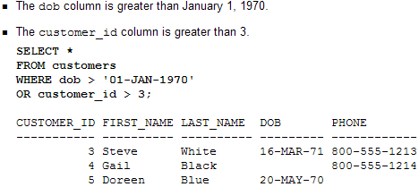
SQL (Filtering Rows Using Where Clause)

Slide 13
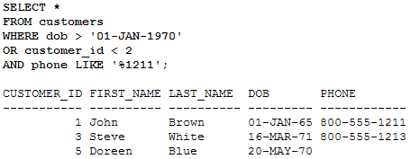
SQL (Filtering Rows Using Where Clause)
Understanding Operator Precedence
Combine AND and OR in the same expression
  AND operator takes precedence over the OR operator (which means it’s executed first)
  Comparison operators take precedence over AND
  Of course, you can override these using parentheses
Example retrieves rows from the customers table
  where either of the following two conditions is met
    The dob column is greater than January 1, 1970
    The customer_id column is less than 2 and the phone column has 1211 at the end

Slide 14
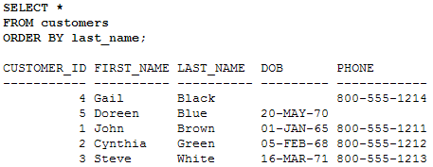
SQL (Sorting Rows Using the ORDER BY Clause)
Use the ORDER BY clause to sort the rows retrieved from the database
The ORDER BY clause may specify one or more columns on which to sort the data and
must follow the FROM clause or
the WHERE clause (if a WHERE clause is supplied
By default, the ORDER BY clause sorts the columns in ascending order (lower values appear first)
Use the DESC keyword to sort the columns in descending order (higher values appear first)
Use the ASC keyword to explicitly specify an ascending sort—, this is the default, but you can still specify it

Slide 15
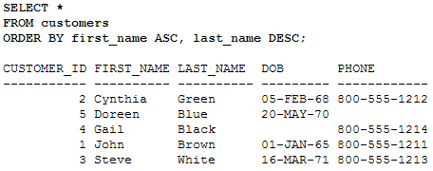
SQL (Sorting Rows Using the ORDER BY Clause)
ORDER BY clause to sort
  the first_name column values from the customers table in ascending order
  followed by a sort on the last_name column values in descending order

Slide 16
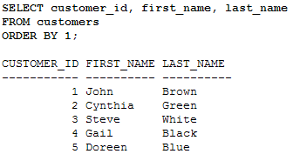
SQL (Sorting Rows Using the ORDER BY Clause)
Use a column position number in the ORDER BY clause to indicate which column to sort:
  1 means sort by the first column selected
  2 means sort by the second column, and so on

Slide 17
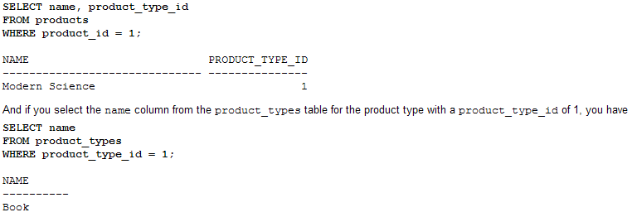
SQL (Performing SELECT Statements that Use Two Tables)
The product_type_id column (the foreign key) of the products table
  points to the product_type_id column (the primary key) of the product_types table

Slide 18
SQL (Performing SELECT Statements that Use Two Tables)
To join two tables means that you specify both the tables in the query’s FROM clause and
use related columns
    (a foreign key from one table and
    the primary key from another table, for example)
    from each table
  You also use an operator—such as the equality operator (=)—in the query’s WHERE clause
  The tables whose columns are used in the join must also be contained in the FROM clause of the SELECT statement
  The columns used in the join are usually related through a foreign key

Slide 19
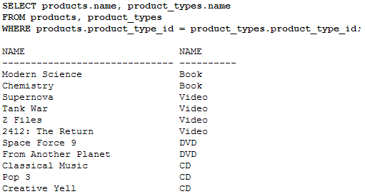
SQL (Performing SELECT Statements that Use Two Tables)
The WHERE clause could be as follows:
  WHERE product_type_id = product_type_id
There’s a problem with this WHERE clause:
    both the products and product_types tables
    contain a column named product_type_id
    WHERE products.product_type_id = product_types.product_type_id
how do you tell the database you want the name columns from
  both the product_types and products tables?
    SELECT products.name, product_types.name

Slide 20
SQL (Performing SELECT Statements that Use Two Tables)
Perfect! This is exactly what you wanted
  the name of the product and the name of the product type
  however, that the product with the name “My Front Line” is missing from this output
    The product_type_id for this product row is null
    because of that the row doesn’t appear in the output
    How to include this row later in the section “Understanding Outer Joins”
You should use the SQL/92 standard in your queries
  when working with Oracle9i and above
  use SQL/86 queries only when you’re using Oracle8i and below

Slide 21


SQL (Supplying Table Aliases)
Table aliases make your queries more readable
  especially when you start writing longer queries referencing many tables

Slide 22
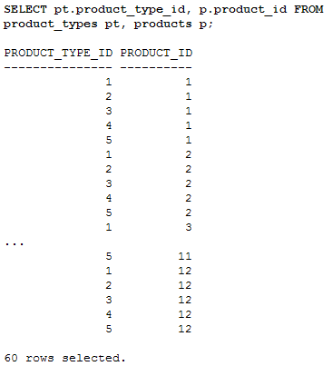
SQL (Cartesian Product)
If a join condition is missing
  end up selecting all rows from one table joined to all the rows in the other table
  situation known as a Cartesian product
  May end up with a lot of rows being displayed
  For example,
    assume one table containing 50 rows and
    a second table containing 100 rows.
    select columns from those two tables without a join
    get 5,000 rows returned
    This is because each row from table 1 would be joined to each row in table 2
    which would yield a total of 50 multiplied by 100 rows, or 5,000 rows

Slide 23
SQL (Performing SELECT Statements that Use More than Two Tables)
Joins can be used to connect any number of tables
  use the following formula to calculate the number of joins you will need in your WHERE
  Two tables used in the query in previous example: products and product_types
    the number of joins required is 1 (=2 - 1), and indeed only one join is used in that example c
    four tables and will therefore require three joins

Slide 24
SQL (Performing SELECT Statements that Use More than Two Tables)
Four tables
    The purchases each customer has made
    The customer’s first and last name
    The name of the product they purchased
    The name of the product type
    Query the customers, purchases, products, and product_types tables and
    joins will need to navigate the foreign key relationships between these tables

