Slide 1
SQL (Introduction)
What Is a Relational Database?
1970 by Dr. E.F. Codd
Paper entitled
  5“A Relational Model of Data for Large Shared Data Banks” published in Communications of the ACM (Association for Computing Machinery), Vol. 13, No. 6, June 1970

Slide 2
SQL (Introduction)
A relational database
  is a collection of related information
  that has been organized into structures
known as tables
Each table contains rows
that are further organized into columns
tables are stored in the database in structures known as schemas
  areas where database users may store their tables
Each user may also choose to grant permissions to other users to access their tables

Slide 3
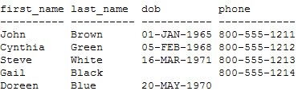
SQL (Introduction)

Slide 4
SQL (Introduction)
Structured Query Language (SQL)
standard language designed to access relational databases
SQL is pronounced either as the word
  “sequel” or
  the letters “S-Q-L.” (I prefer “sequel” as it’s quicker to say)
groundbreaking work of Dr. E.F. Codd\
SQL developed by IBM in the mid-1970s
Later in 1979, a company then known as Relational Software Inc
  (known today as Oracle Corporation) released the first commercial version of SQL

Slide 5
SQL (Introduction)
SQL is now fully standardized and recognized by
  the American National Standards Institute (ANSI)
You can use SQL to access
  Oracle
  SQL Server
  DB2
  MySQL database

Slide 6
SQL (Introduction)
Query statements
  Allow you to retrieve rows stored in database tables
  You write a query using the SQL SELECT statement
Data Manipulation Language (DML) statements
  Allow you to modify the contents of tables
  There are three DML statements
    INSERT Allows you to add rows to a table
    UPDATE Allows you to change a row
    DELETE Allows you to remove rows

Slide 7
SQL (Introduction)
Data Definition Language (DDL) statements
  Allow you to define the data structures
    such as tables, that make up a database
  There are five basic types of DDL statements
    CREATE Allows you to create a database structure
      For example, CREATE TABLE is used to create a table
      CREATE USER, which is used to create a database user
    ALTER Allows you to modify a database structure
      For example, ALTER TABLE is used to modify a table
    DROP Allows you to remove a database structure
      For example, DROP TABLE is used to remove a table
    RENAME Allows you to change the name of a table
    TRUNCATE Allows you to delete the entire contents of a table

Slide 8
SQL (Introduction)
Transaction Control (TC) statements
  Allow you to permanently record the changes made to the rows stored in a table
  There are three TC statements:
    COMMIT
      Allows you to permanently record changes made to rows
    ROLLBACK
      Allows you to undo changes made to rows
    SAVEPOINT
      Allows you to set a “savepoint” to which you can roll back changes made to rows

Slide 9
SQL (Introduction)
Data Control Language (DCL) statements
  Allow you to change the permissions on database structures
  There are two DCL statements
    GRANT
      Allows you to give another user access to your database structures
      such as tables, views
    REVOKE
      Allows you to prevent another user from accessing to your database structures
      such as tables, views

Slide 10
SQL (Introduction)
There are many ways to run SQL statements and get results back from the database e.g.
  programs written using Oracle Forms and
  Reports
SQL statements may also be embedded within programs written in other languages, such as
  Oracle’s Pro*C, which allows you to add SQL statements to a C program
  add SQL statements to a Java program though JDBC
Oracle also has a tool called SQL*Plus that allows you
  to enter SQL statements using the keyboard or
  to supply a file that contains SQL statements

Slide 11
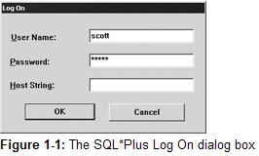
SQL (Introduction)
Performing a SELECT Statement Using SQL*Plus
User name and Passwrod: scott/tiger
SQL> EXIT

Slide 12
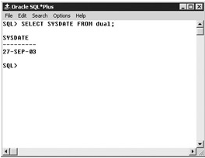
SQL (Introduction)
SELECT SYSDATE FROM dual;

Slide 13
SQL (Retrieving Information from Database Tables)
  Retrieve information from one or more database tables
  Use arithmetic expressions to perform calculations
  Filter rows to just those you are interested in using a WHERE clause
  Sort the rows retrieved from a table

Slide 14
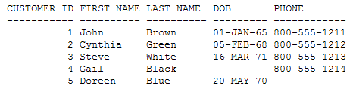
SQL (Retrieving Information from Database Tables)
Selecting Selected Columns from a Table
SELECT customer_id, first_name, last_name, dob, phone FROM customers;

Slide 15
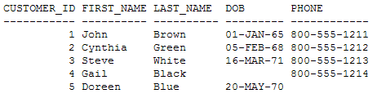
SQL (Retrieving Information from Database Tables)
Selecting All Columns from a Table
  SELECT * FROM customers;

Slide 16
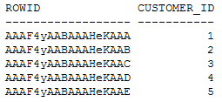
SQL (Retrieving Information from Database Tables) (M27-26/09)
Understanding Row Identifiers
  Each row in an Oracle database has a unique row identifier, or rowid
  used internally by the Oracle database to access the row
  A rowid is an 18-digit number that is represented as a base-64 number,
  it contains the physical address of a row in an Oracle database
  You can view the rowid value for rows in a table by specifying the ROWID column in the select list of a query
  The query in the following example retrieves the ROWID and customer_id columns from the customers table:
SELECT ROWID, customer_id FROM customers;

Slide 17


SQL (Performing Arithmetic)
+ Addition
- Subtraction
* Multiplication
/ Division

Slide 18
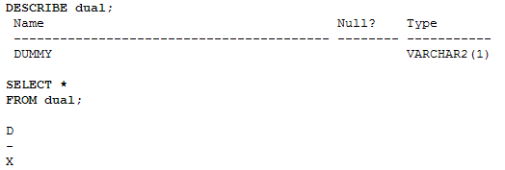
SQL (Performing Arithmetic)
Dual is a table that contains a single row
  Output from the DESCRIBE command shows the structure of the dual table
  with a SELECT statement that selects the row in the dual table

Slide 19
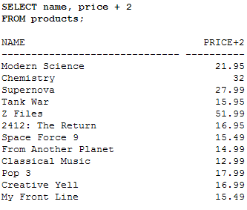
SQL (Performing Arithmetic)

Slide 20

SQL (Performing Arithmetic)
The normal rules of arithmetic operator precedence apply in SQL
  multiplication and division are performed first
  followed by addition and subtraction
  If operators of the same precedence are used,
    they are performed from left to right
    For example, if you were to use the following expression: 10*12/3–1, 10
    multiplied by 12 would be calculated first
    yielding a result of 120
    120 would then be divided by 3
    yielding 40; finally, 1 would be subtracted from 40, yielding 39

Slide 21
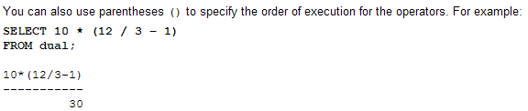
SQL (Performing Arithmetic)

Slide 22
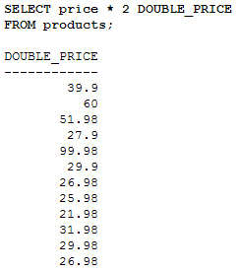
SQL (Using Column Aliases)

Slide 23
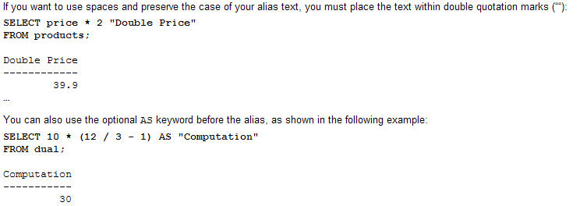
SQL (Using Column Aliases) F-27/09

Slide 24
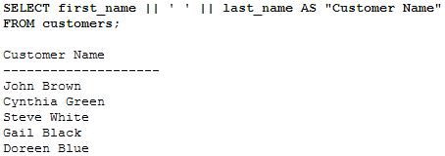
SQL (Merging Column Output using Concatenation)
Merge display of columns using concatenation
Create more friendly and useful output
Customer name example

Slide 25
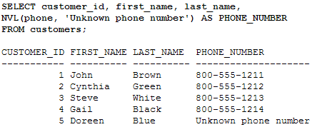
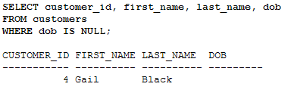
SQL (Null Values)
Database represents unknown value as null values
Not a blank string
Distinct value
Selection of null value column results in no result
Check for null values using IS NULL clause in Select Statement
Difference between null values and blank string
  Use NVL function
  Allows you to convert a null value into another value

Slide 26
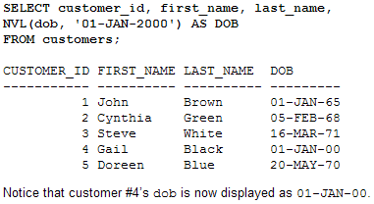
SQL (Null Values)
NVL function excepts two parameters
  A column or more generally any expression that results in a value
  The value should be substituted if the first parameter is null
  NVL can also be used to convert number and date columns

Slide 27
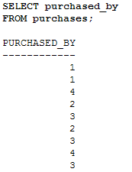
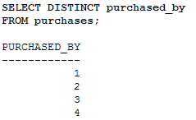
SQL (Display Distinct Rows)
Who purchased
Who purchased (Distinctly)
  Suppress the display
  DISTINCT keyword

Slide 28
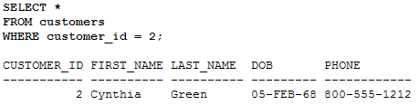
SQL (Filtering Rows Using Where Clause)
Use WHERE clause in the SELECT statement
Subset selection from the rows
Place WHERE clause after the FROM clause

Slide 29
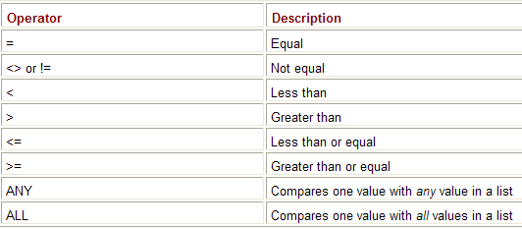
SQL (Filtering Rows Using Where Clause)
Using Comparison Operators

Slide 30
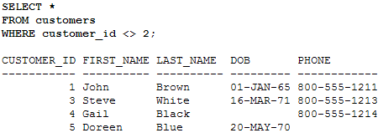
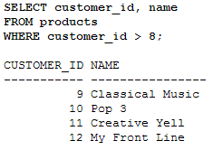
SQL (Filtering Rows Using Where Clause)

Slide 31
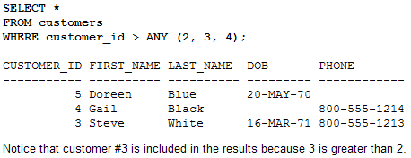
SQL (Filtering Rows Using Where Clause)
ANY operator in a WHERE clause to
  compare a value with any of the values in a list
  must place an =, <>, <, >, <=, or >= operator before ANY

Slide 32
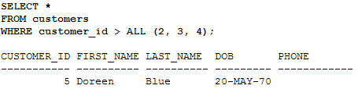
SQL (Filtering Rows Using Where Clause) (M-29/09)
ALL operator in a WHERE clause to
  compare a value with all of the values in a list
  must place an =, <>, <, >, <=, or >= operator before ALL

Slide 33
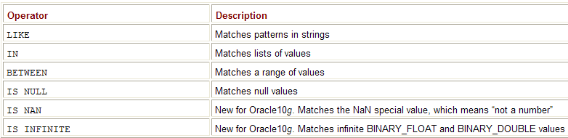
SQL (Filtering Rows Using Where Clause)
Using the SQL Operators

