Slide 1
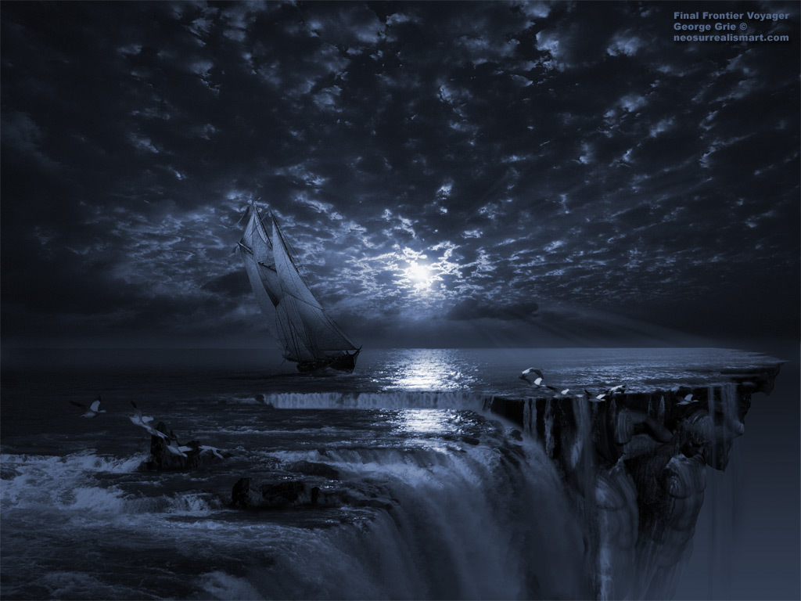


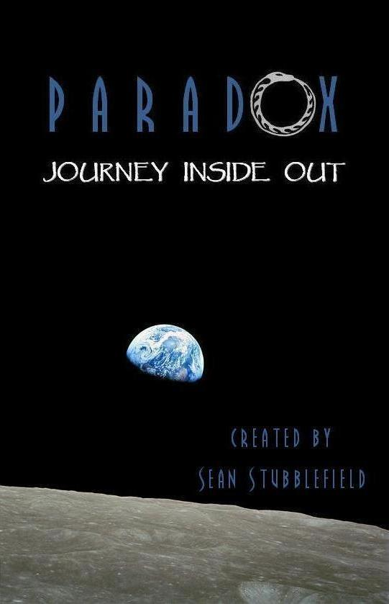


The Philosophy Trilogy
An EPIC story of challenging society’s expectations, becoming who we are, and taking nothing for granted
Let It Begin
Imagine The Possibilities
Nothing Lasts Forever…

