Slide 1
Under the Hood
By Virus

Slide 2
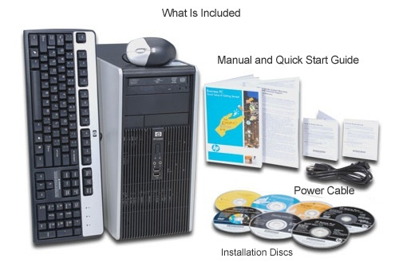
Standard Computer or PC

Slide 3
instructions
These buttons are located on slides for your assistance.
For help press
Return to previous slide
A clickable object

Slide 4
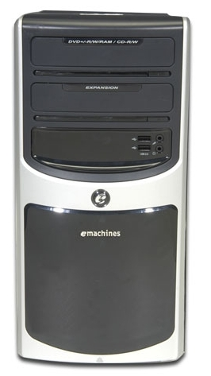
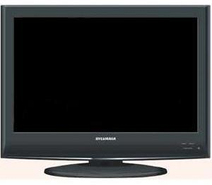
Tower with monitor

Slide 5
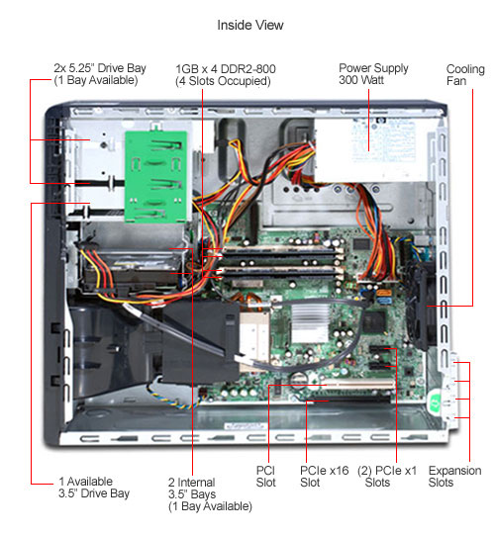

Slide 6
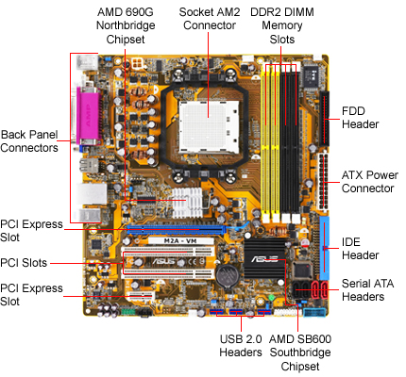

Slide 7
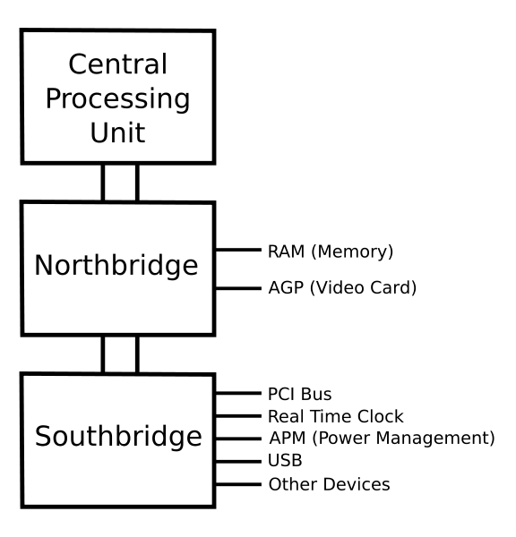

Northbridge
The communications between the CPU and memory occur over what is known as the frontside bus (FSB), which is just a set of signal pathways between the CPU and main memory. The backside bus, on the other hand, is a set of signal pathways between the CPU and Level 2 cache memory (if present).
The Northbridge chipsets also manage the communications between the Southbridge chipset (discussed next) and the rest of the computer. Finally, if a motherboard has onboard video circuitry (especially if it needs direct access to main memory), that circuitry will be found within the Northbridge chipset.

Slide 8

Southbridge
The Southbridge chipset, as mentioned earlier, is responsible for providing support to the myriad onboard peripherals (PS/2, Parallel, IDE, and so on), managing their communications with the rest of the computer and the resources given to them.
The Southbridge chipset is also responsible for managing communications with the other expansion buses, such as PCI, USB, and legacy buses.

Slide 9
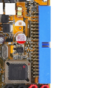
IDE Controller
There are usually two IDE Controllers that connect your hard drive(s), DVD/ROM drives to the motherboard
There is a primary and a secondary. It does not matter what device is connected to what only that its connected.
The cable can only go on easily one-way. If its hard to put on the most likely your forcing it on backwards and that’s incorrect.

Slide 10
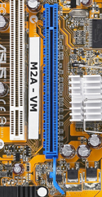
PCI expansion slot
Accelerated Graphics Port (AGP) slots are very popular for video card use.
In the past, if you wanted to use a high-speed, accelerated 3D graphics video card, you had to install the card into an existing PCI or ISA slot.
AGP slots were designed to be a direct connection between the video circuitry and the PC’s memory.
They are also easily recognizable because they are usually brown, are located right next to the PCI slots on the motherboard, and are shorter than the PCI slots.

Slide 11
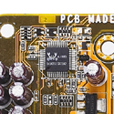
Onboard Audio Chip
Some motherboards have this chip as a substitute for an audio/sound card.
I do not recommend this because if the sound goes bad you have to replace the entire motherboard versus replacing a sound card

Slide 12
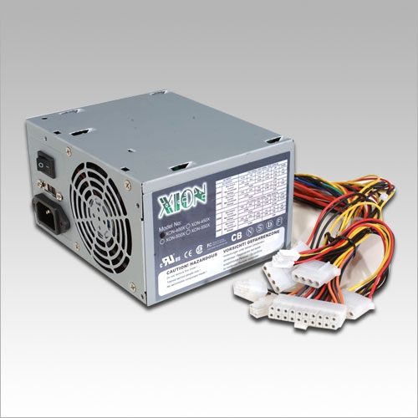
Power Supply
A power supply converts 110 volt or 220 volt AC voltages into the DC voltages that a computer needs to operate.
These voltages are +3.3 volts DC, +5 volts DC, –5 volts DC (ground), +12 volts DC, –12 volts DC (ground), and +5 volts DC standby.
The 3.3 volts DC and +5 volts DC standby voltages were first used by ATX motherboards.

Slide 13

PCIe slot
The newest expansion slot architecture that is being used by motherboards is PCI Express
(PCIe).
It was designed to be a replacement for AGP and PCI. It has the capability of being faster than AGP while maintaining the flexibility of PCI. And motherboards with PCIe will have regular PCI slots for backward compatibility with PCI.

Slide 14
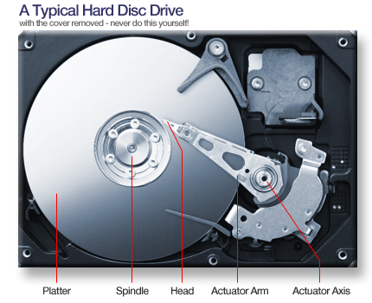
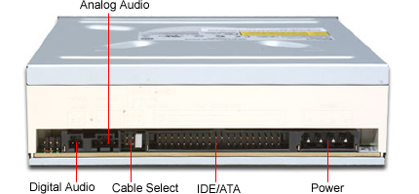
HDD
Rear HDD
Inside the HDD

Slide 15
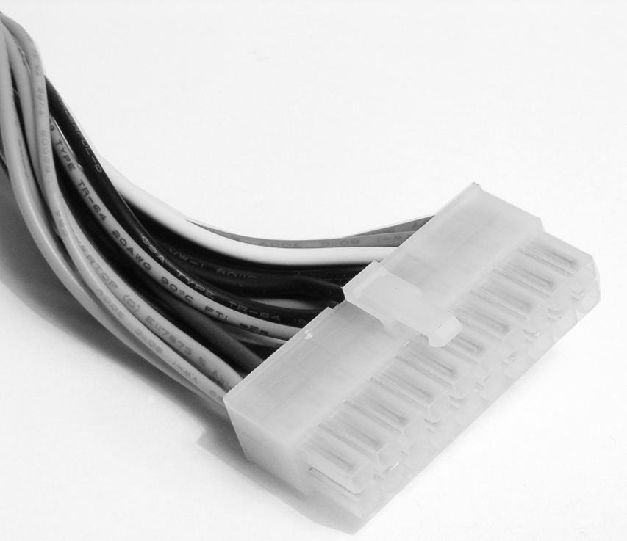
ATX Power Connection
Most computers today use some form of ATX power connector to provide power to the motherboard.
The power supply connector plugs directly into the motherboards ATX Power connection.

Slide 16
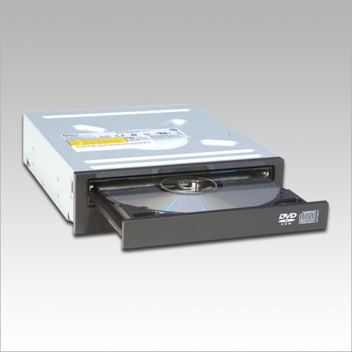
DVDROM Drive
DVDROM (also known as Digital Video Disc ) is a popular optical disc storage media format. Its main uses are video and data storage.
A DVD-ROM drive is basically the same as the DVD player’s drive in a home theater system. As a result, a computer equipped with a DVD-ROM drive and the proper video card can play back DVD movies on the monitor.
However, in a computer, a DVD-ROM drive is much more useful. Because DVD-ROMs use slightly different technology than CD-ROMs, they can store up to 4.3GB of data.
A CDROM plays only CDs and Audio CDs and not DVDs. Don’t confuse the two.

Slide 17
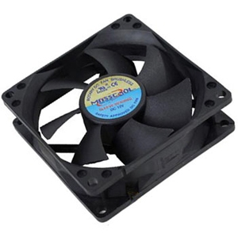
CPU Fan
The CPU Fan along with a metal heat sink is hat draws the heat away from the chips on the motherboard.
Without the heat sink and the fans the CPU would be destroyed due to excessive heat.

Slide 18
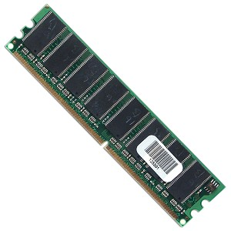
184 Pin SIMM Memory
Random access memory (RAM) is the computer’s physical memory. The more RAM you
put into the machine, the more items it can remember without looking anything up. And the
larger the swap file, the fewer times the machine has to do intensive drive searches.
Restarting the computer clears the memory and starts the computer with a clean slate.
Bottom line is the more memory in your computer the faster the computers programs will run. If you want a fast computer put as much memory as you can for what your needs are.

Slide 19

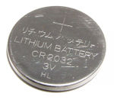
CMOS Battery
Non-volatile BIOS memory refers to the memory on a personal computer motherboard containing BIOS settings and sometimes the code used to initialize the computer and load the operating system. The non-volatile memory was historically called CMOS RAM or just CMOS because it traditionally used a low-power CMOS memory chip (the Motorola MC146818, or one of its higher-capacity clones), which was powered by a small battery when the system power was off.
Two ways to access the BIOS setup or reset BIOS password if forgotten when the machine fails to operate, occasionally a drastic move is required.
  motherboards offer a CMOS-reset jumper
  Remove CMOS battery for 2 minutes then replace.
For a PM CMOS battery should be replaced every 5 years or when Date & Time settings are incorrect and reset to Jan 1999 at 12:00 every time you reboot your computer after you just set the correct time and date.

Slide 20
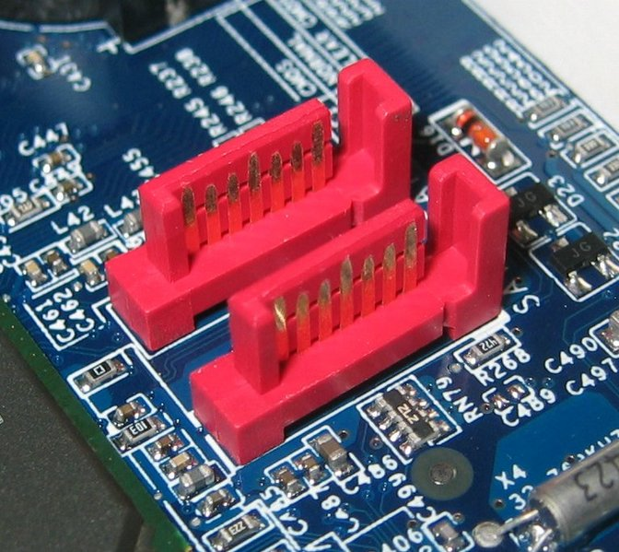
SATA
Serial Advanced Technology Attachment (SATA, is a computer bus primarily designed for transfer of data between a computer and mass storage devices such as hard disk drives and optical drives (CDROM/DVDROM).
The main advantages over the older parallel ATA (known as IDE Controllers) interface are faster data transfer, ability to remove or add devices while operating (hot swapping), thinner cables that let air cooling work more efficiently, and more reliable operation with tighter data integrity checks.
It is expected to eventually replace the older IDE technology (Parallel ATA or IDE Controllers. Serial ATA adapters and devices communicate over a high-speed serial cable.
Click icon to see cables illustrations

Slide 21


HDD Cable

Slide 22
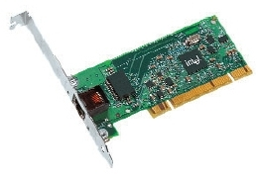
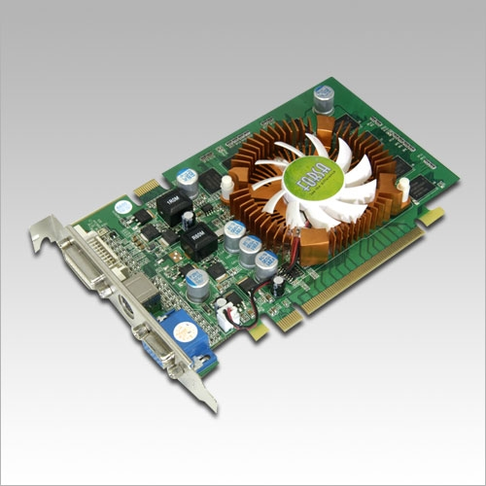
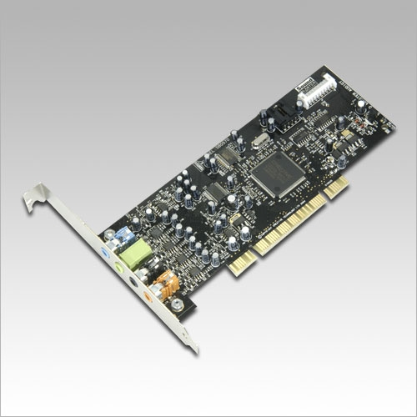
What components can we insert into
PCI Slots
Video Card
NIC
Sound card

Slide 23
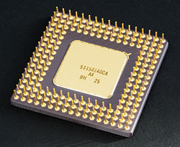
CPU
A Central Processing Unit (CPU), or sometimes just called processor, is a description of a class of logic machines that can execute computer programs. It’s the brains of the machine where from decision making to calculations are made.
Moore's law describes an important trend in the history of computer hardware: that the number of transistors that can be inexpensively placed on an integrated circuit is increasing doubles approximately every six months to two years.
Popular processors are : Advanced Micro Devices, (AMD) and Pentium

