Slide 1
^{ISLAMIC}
^{ARCHITECTURE week 9}

Slide 2
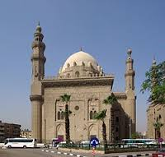
The Mosque-Madrassa of Sultan Hassan is a massive Mamluk era mosque and madrassa located near the Citadel in Cairo. Its construction began 757 AH/1356 CE with work ending three years later "without even a single day of idleness".[1] At the time of construction the mosque was considered remarkable for its fantastic size and innovative architectural components. Commissioned by a sultan of a short and relatively unimpressive profile, al-Maqrizi noted that within the mosque were several "wonders of construction".[1] The mosque was, for example, designed to include schools for all four of the Sunni schools of thought: Shafi'i, Maliki, Hanafi and Hanbali.
SULTAN HASSAN MOSQUE

Slide 3
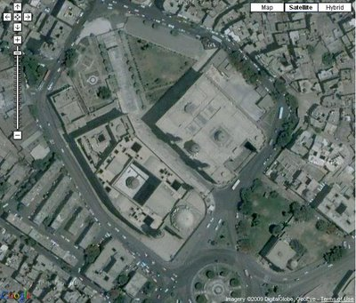
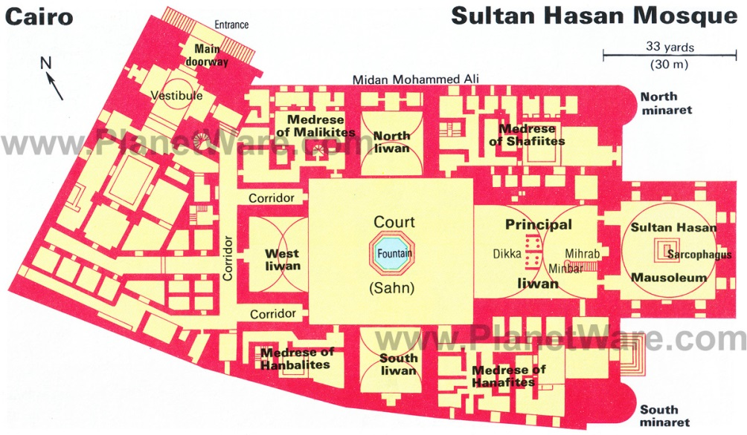
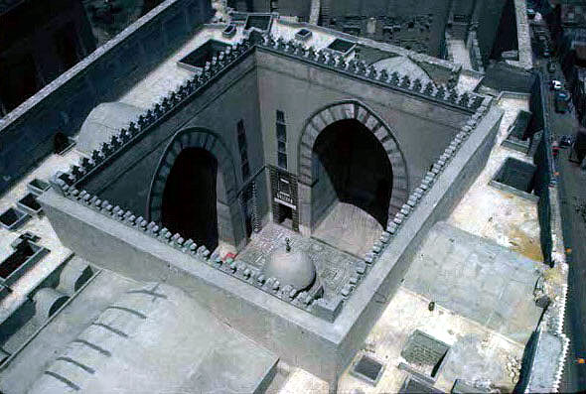

Slide 4
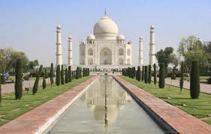
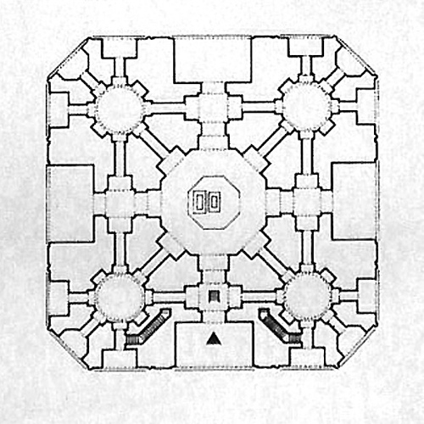
THE TAJ MAHAL
At the heart of the Taj Mahal lies the cenotaphs, the very reason why this monument was built - to make a tomb for Shah Jahan's wife Mumtaz Mahal..
Shah Jahan's cenotaph lies next to his wife, and that is the only visible asymmetry in the entire Taj complex. Mumtaz's tomb is exactly at the centre, the other being placed as an after thought

Slide 5
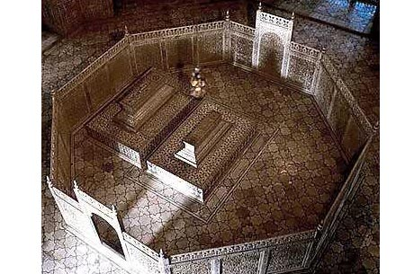
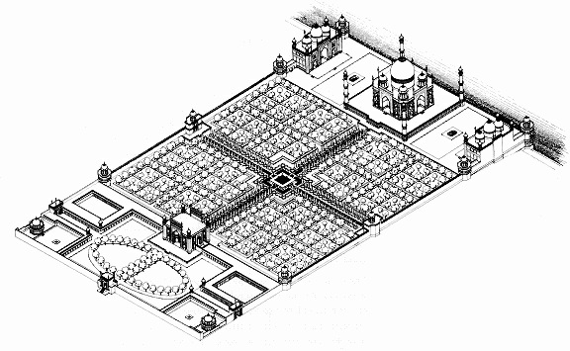
Plan Legend
A. To river
B. Mausoleum
C. Minaret
D. Garden divided into quadrants
E. Intersection symbolizes mountain at the center of paradise
F. Water channel
G. Entry gate
H. Forcourt

Slide 6
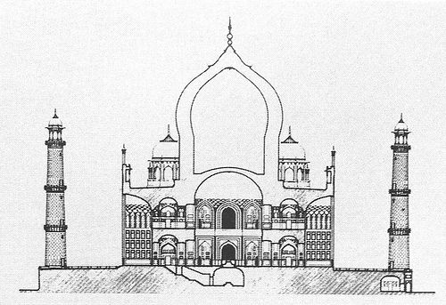
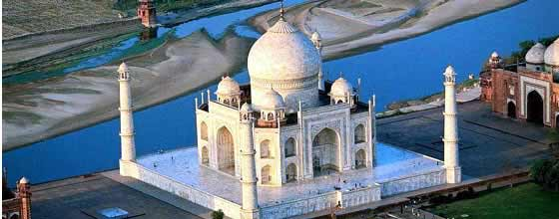
The Taj Mahal consists of seven floors with its base or plinth at the level of the riverbed. The courtyard level through which the modern day visitor enters is actually the fourth level. The second and third floors can be clearly seen from the image below. This is the riverside view of the Taj Mahal. The door on the left side of the image opens up to the river bed.
It is said that there is a corridor near the cenotaphs which leads to a staircase. The stairs go down to another hidden level. It is said that the actual grave of the empress was buried here.

Slide 7
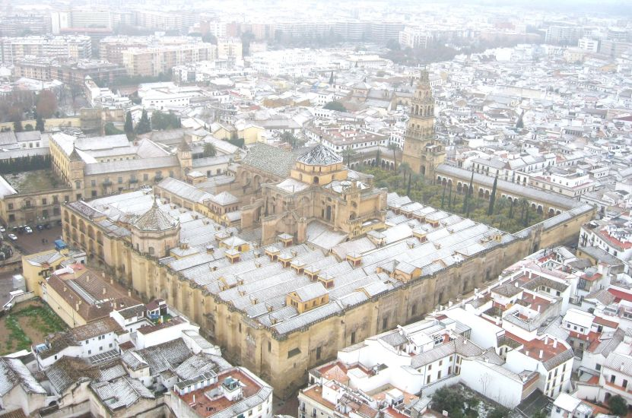
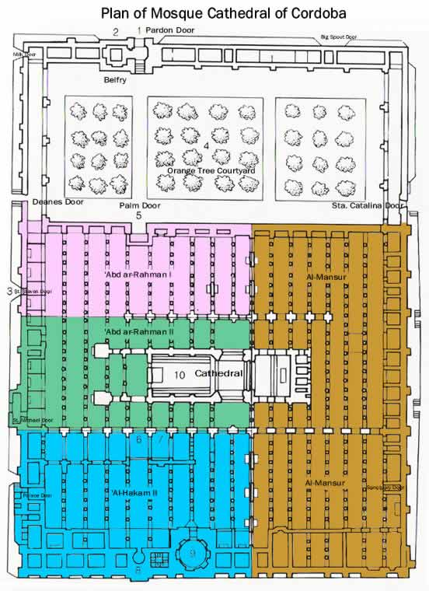
THE GREAT MOSQUE OF CORDOVA,
ANDALUSIA, SPAIN
The building is most notable for its arcaded hypostyle hall, with 856 columns of jasper, onyx, marble, and granite.

Slide 8
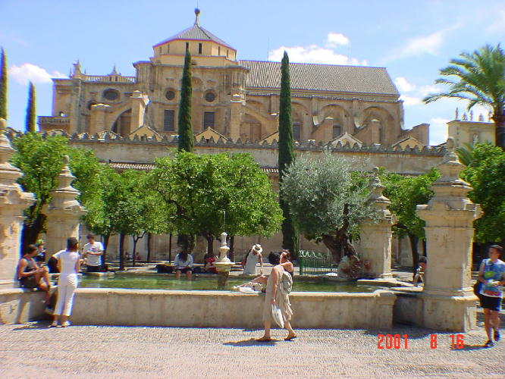
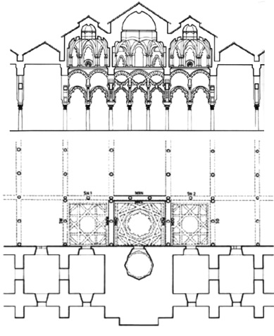
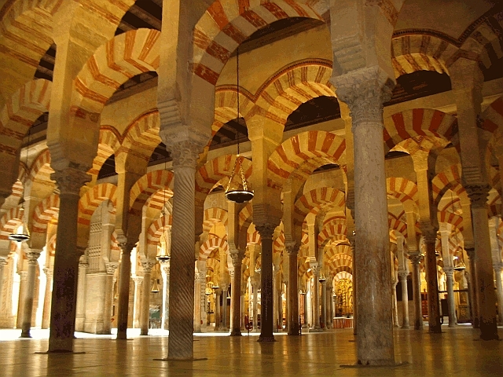
The double arches were a new introduction to architecture, permitting higher ceilings than would otherwise be possible with relatively low columns. The double arches consist of a lower horseshoe arch and an upper semi-circular arch. The famous alternating red and white voussoirs of the arches were inspired by those in the Dome of the Rock.

Slide 9
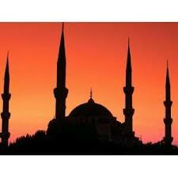
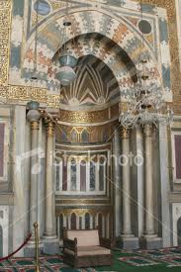
MINARETS
MIHRAB
the place where imam leads the prayer

Slide 10
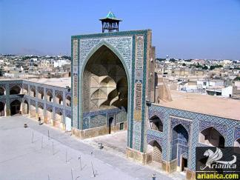
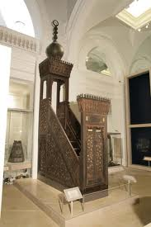
IWAN
An iwan is a rectangular hall or space, usually vaulted, walled on three sides, with one end entirely open. The formal gateway to the iwan is called pishtaq,
MINBAR
The place where imam say the sermon

Slide 11
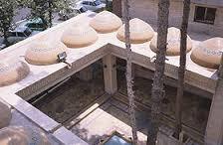
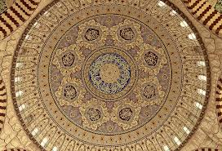
A sahn is a courtyard in Islamic architecture. Most traditional mosques have a large central sahn, which is surrounded by a riwaq or arcade on all sides.
SAHN
CALLIGRAPHY
/ KHAT

Slide 12
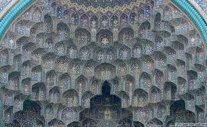
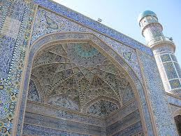
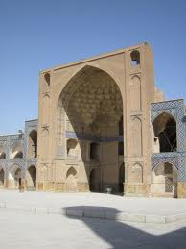
An architectural ornamentation reminiscent of stalactites, muqarnas
MUQARNAS
ARABESQUE
PISHTAQ
The arabesque is a form of artistic decoration consisting of "surface decorations based on rhythmic linear patterns of scrolling and interlacing foliage, tendrils" or plain lines,[1] often combined with other elements.
The formal gateway to the iwan is called pishtaq

Slide 13
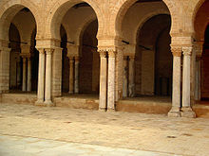
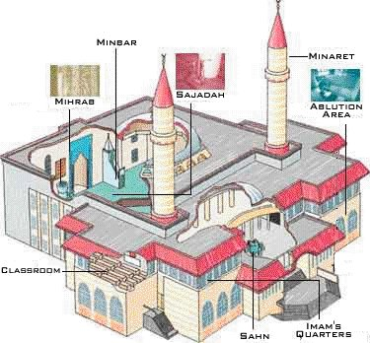
As an arcade element the structure is often found surrounding and defining the courtyards of mosques and madrasahs, and used for covered circulation, meeting and rest
RIWAQ
MOSQUE PARTS

Slide 14
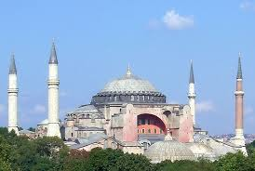
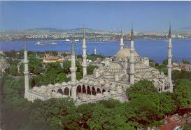
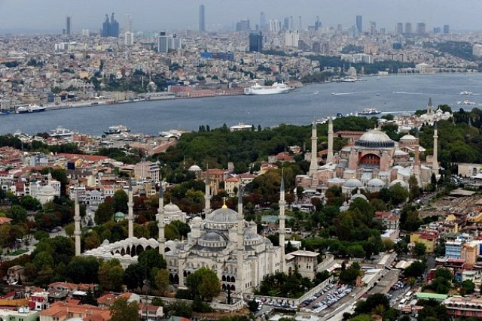
HAGIA SOPHIA
BLUE MOSQUE
The Sultan Ahmed Mosque is an historic mosque in Istanbul. The mosque is popularly known as the Blue Mosque

Slide 15
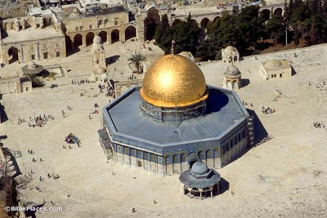
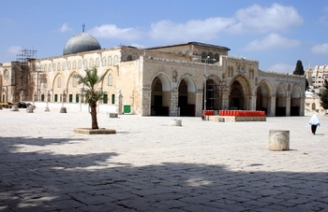
DOME OF THE ROCK
According to some Islamic scholars, the rock is the spot from which Muhammad ascended to Heaven accompanied by the angel Gabriel.
AL AQSA MOSQUE
Al-Aqsa Mosque also known as Al-Aqsa and Bayt al-Muqaddas, is the third holiest site in Islam and is located in the Old City of Jerusalem.

Slide 16
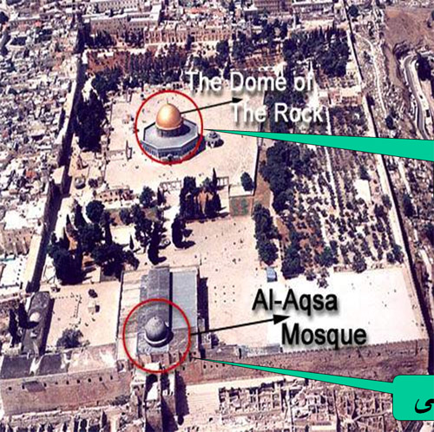
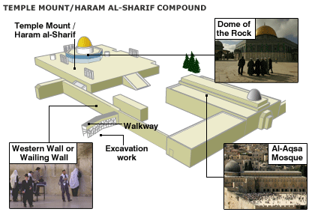

Slide 17
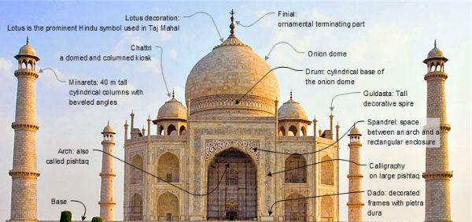
Based on the figure above, name and describe the purpose of the building
Name: Taj Mahal, Agra, India
Function: A mausoleum complex. It was
built by Shah Jahan in
memory of his favourite wife,
Arjumand Banu Begam also
known as ‘Mumtaz Mahal’

Slide 18

‘Mosque of Sultan Hassan is one of the largest, not only in Cairo but in the whole of Islamic world’. Sketch and label the plan of Sultan Hassan Mosque.

Slide 19
List FIVE characteristics of Islamic Architectural style
i. Khat/ calligraphy carving
ii. Floral encravings
iii. Decorated by geometrical pattern
iv. Facing qiblah
v. Horseshoe arch
vi. Minaret
vii. Water elements in the design
viii. More ventilations

Slide 20
Elaborate the Islamic features below
i. Muqarnas:
ii. Riwaq :
iii. Mimbar:
iv. Sahn :
-decorative elements resembles stalactite
-area that saparated by columns and arches / corridor
-the stage where the Imam stands while delivering important lectures during prayer time
-courtyard which is located at the center of the mosque

Slide 21
What is the main element of Islamic Architecture?
Calligraphy, geometric patterns and flora and fauna patterns
Minaret is one of the components in Mosque architecture which functions as
A place for Bilal to call (adhan) for prayer
Which building was commissioned by Sultan Hassan bin Al Nasir Muhammad bin Qalawun between the year of 1356 AD and 1363 AD?
The Mosque of Sultan Hassan

Slide 22
Mihrab is a space found in the mosques. State the function of Mihrab?
Mihrab located inside wall indicating the direction to Mecca. It was the place where the leads the solat
State of decorative patterns and motifs found in Islamic architecture ?
Calligraphy
Arabesque

Slide 23
Explain why that patterns and decorative motifs art are use.
Calligraphy : Associated with geometric Islamic art on the wall and ceilings of mosque as well as on the page, calligraphy also have a very special place in Islam.
Arabesque : Is an elobrate application of repeating geometric forms that often echo the form of plants, shapes and sometimes animal use to symbolize the infinite and therefore uncentralized nature of the creation of the one God.

