Slide 1
^{BYZANTINE}
^{ARCHITECTURE}
^{ANTIQUITY AGE}
^{week} 7

Slide 2
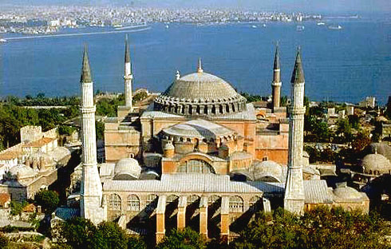
HAGIA SOPHIA

Slide 3
Hagia Sophia means “Holy Wisdom” in Greek. Built by famous architects of the 6th century İsidoros and Anthemius. The character of Byzantine architecture, which dates from the fourth century to the present day, is determined by the novel development of the dome to cover polygonal and square plans for churches, tombs, and baptisteries.

Slide 4
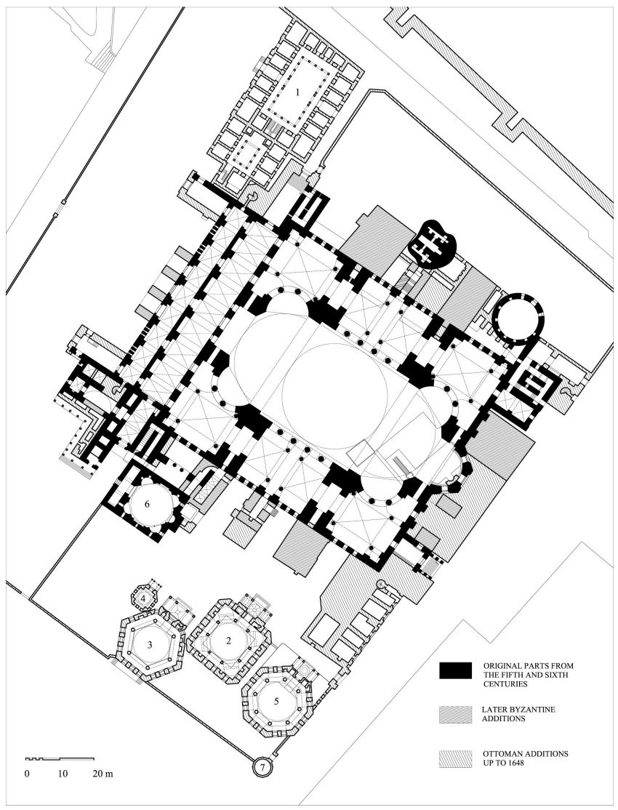
Hagia Sophia was built as a Orthadox Patriarchal Basilica by Justinyen at the date of between A.C 532 and A.C 537 at the center of Old City that was in historical peninsula. Fatih Sultan Mehmet, who conquered İstanbul at 1453, had converted the church into mosque

Slide 5
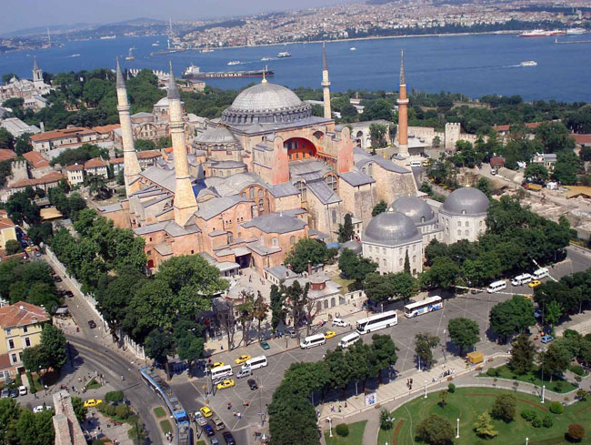

Slide 6
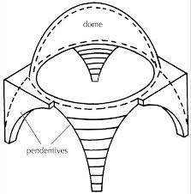
The dome, which had always been a traditional feature in the East, became the prevailing motif of Byzantine architecture, which was a fusion of the domical construction with the Classical columnar style. Domes of various types were now placed over square compartments by means of "pendentives," whereas in Roman architecture domes were only used over circular or polygonal structures.
PENDENTIVE DOME

Slide 7
What is the characteristics of Byzantine architecture?
Pendentive,
dome on square plan

Slide 8
Give an example of Byzantine architecture.
Hagia Sophia, Istanbul, Turkey

Slide 9
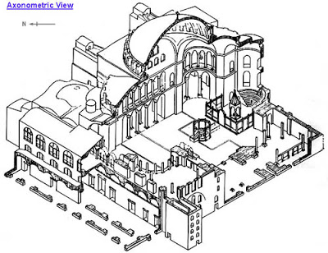
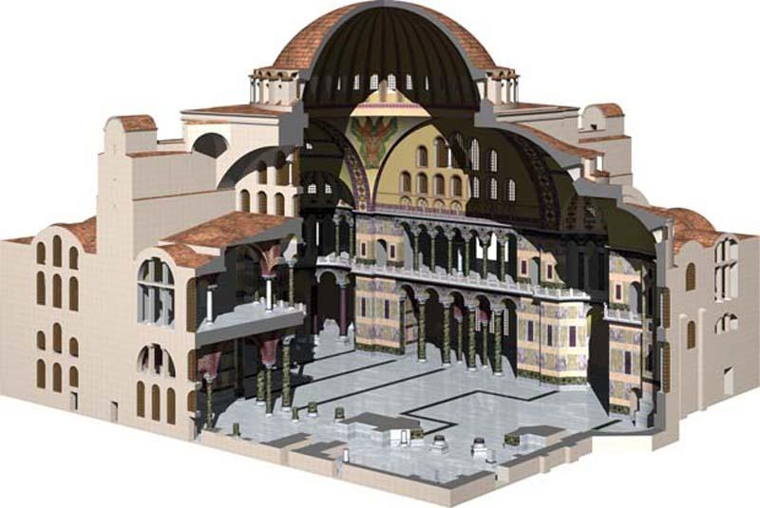
The above building was a former orthodox patriarchal basilica and later changed to a mosque on 29th May 1453 until 1934. What is the name of the building?
Hagia Sophia, Istanbul, Turkey

Slide 10
Describe Hagia Sophia.
a. It was design by Isidore and Anthemius
c. It is considered the epitome of Byzantine architecture
d. It is a Byzantine church and converted to a mosque during the Ottoman Empire

