Slide 1
^{ANTIQUITY AGE}
^{ROMAN ARCHITECTURE}

Slide 2
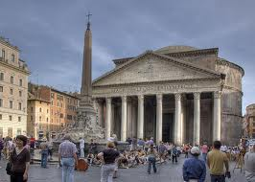
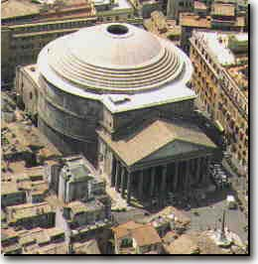
^{PANTHEON}
Pantheon is an ancient Greek composite word meaning All Gods: speculated that the name comes either from the statues of so many gods placed around this building, or from the resemblance of the dome to the heavens.

Slide 3
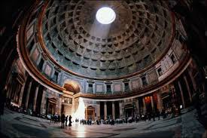
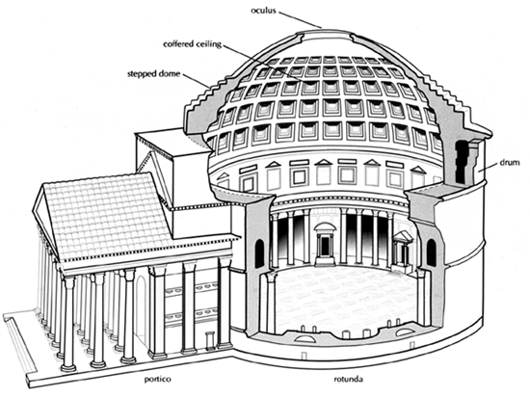
The building is circular with a portico of large granite Corinthian columns (eight in the first rank and two groups of four behind) under a pediment.

Slide 4
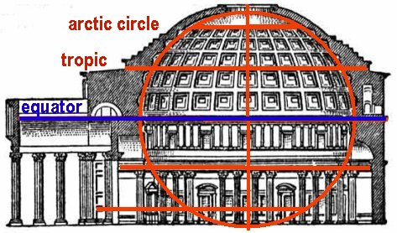
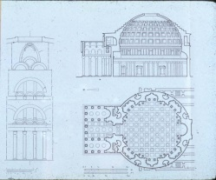
A rectangular vestibule links the porch to the rotunda, which is under a coffered concrete dome, with a central opening (oculus) to the sky. Almost two thousand years after it was built, the Pantheon's dome is still the world's largest unreinforced concrete dome. The height to the oculus and the diameter of the interior circle are the same, 43.3 metres (142 ft).

Slide 5
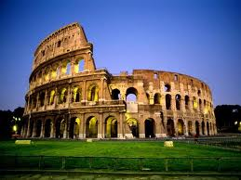
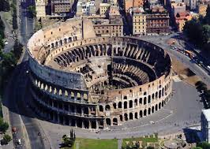
COLLOSEUM
Unlike earlier Greek theatres that were built into hillsides, the Colosseum is an entirely free-standing structure. It derives its basic exterior and interior architecture from that of two Roman theatres back to back. It is elliptical in plan and is 189 meters (615 ft / 640 Roman feet) long, and 156 meters (510 ft / 528 Roman feet) wide, with a base area of 6 acres (24,000 m2). The height of the outer wall is 48 meters (157 ft / 165 Roman feet). The perimeter originally measured 545 meters (1,788 ft / 1,835 Roman feet). The central arena is an oval 87 m (287 ft) long and 55 m (180 ft) wide, surrounded by a wall 5 m (15 ft) high, above which rose tiers of seating.

Slide 6
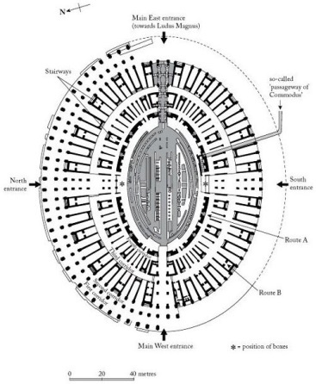
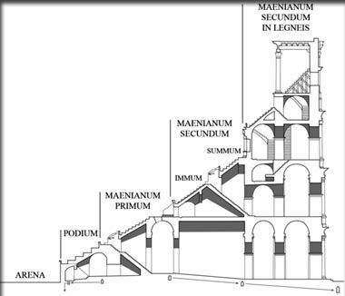
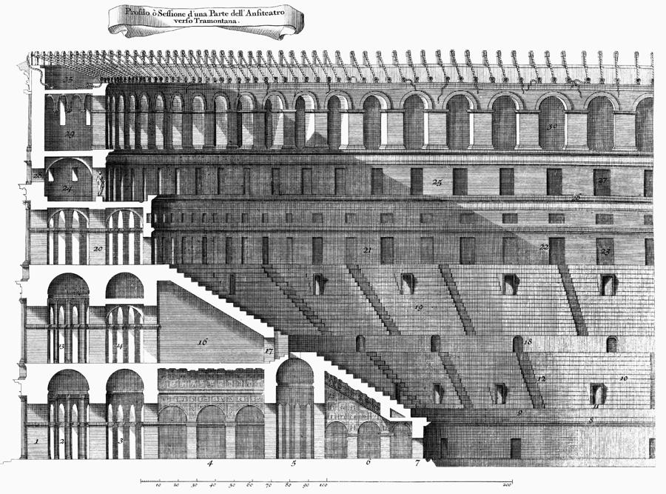
The Colosseum was used to host gladiatorial shows as well as a variety of other events.
The Colosseum could accommodate 87,000 people, although modern estimates put the figure at around 50,000.

Slide 7
Explain briefly historical buildings during Roman Era.
^{COLOSSEUM}
is originally the flavian amphitheatre. It is an elliptical amphitheatre in the centre of the city of Rome, Italy, the largest ever built in the Roman Empire. It is considered one of the greatest works of roman architechture and roman engineering..

Slide 8
Bath of Caracalla
The Caracalla bath complex of buildings was more a leisure centre than just a series of baths. The "baths" were the second to have a public library within the complex. Like other public libraries in Rome, there were two separate and equal sized rooms or buildings; one for Greek language texts and one for Latin language texts.The baths consisted of a central 55.7 by 24 metre (183x79 ft) frigidarium (cold room) under three 32.9 meter (108 ft) high groin vaults, a double pool tepidarium (medium), and a 35 meter (115 ft) diameter caldarium (hot room), as well as two palaestras (gyms where wrestling and boxing was practised). The north end of the bath building contained a natatio or swimming pool. The natatio was roofless with bronze mirrors mounted overhead to direct sunlight into the pool area. The entire bath building was on a 6 metre (20 ft) high raised platform to allow for storage and furnaces under the building.

Slide 9
Triumphal Arch
is a monumental structure in the shape of an archway with one or more arched passageways, often designed to span a road. In its simplest form a triumphal arch consists of two massive piers connected by an arch, crowned with a flat entablature or attic on which a statue might be mounted or which bears commemorative inscriptions. The main structure is often decorated with carvings, sculpted reliefs and dedications. More elaborate triumphal arches may have multiple archways.
Triumphal arches are one of the most influential and distinctive types of architecture associated with ancient Rome. Thought to have been invented by the Romans, the triumphal arch was used to commemorate victorious generals or significant public events such as the founding of new colonies, the construction of a road or bridge, the death of a member of the imperial family or the accession of a new emperor.

Slide 10
AQUEDUCTS
is a water supply or navigable channel constructed to convey water. In modern engineering, the term is used for any system of pipes, ditches, canals, tunnels, and other structures used for this purpose.[1] In a more restricted use, aqueduct (occasionally water bridge) applies to any bridge or viaduct that transports water—instead of a path, road or railway—across a gap. Large navigable aqueducts are used as transport links for boats or ships. Aqueducts must span a crossing at the same level as the watercourses on each end. The word is derived from the Latin aqua ("water") and ducere ("to lead").

Slide 11
What is the characteristics of Roman architecture?
arch,
groin vault,
dome on circular plan

Slide 12
Roman architecture was influenced by materials found in the locality of their conquest; such as earth, limestone, and mud in North Africa; limestone, shale, and gravel, and timber in British isle; volcanic earth, lava, travertine in Italy, and marble and stone in Greece

Slide 13
Colosseum is an example of Roman architecture

Slide 14
They built aqueduct to supply water and thermae as a public bath. It shows that this civilization concerns about people’s need

Slide 15
The Romans required large-scale building to accommodate their big population. Thus they invented new material such as concrete
for stability and strength.

Slide 16
The natural product such as concrete is largely determine the style of architecture of which era?
Roman

Slide 17
Describe the Colloseum in Rome.
It was for gladiator competition and other public events
The colloseum is divided into four levels for sitting area and supported by columns and arches

Slide 18
Describe the Composite Order?
The capital combined the elements of acanthus leaves and supplemented with volutes

Slide 19
Romans were famous for their advancement in architecture and engineering. They built aqueducts, bridge and large structure. Explain how Romans could build such structure?
The Romans discovered quick drying cement called pozzolana

