Slide 1
^{ANTIQUITY AGE:}
^{GREEK ARCHITECTURE}

Slide 2
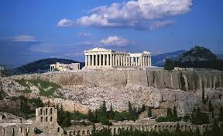
^{ACROPOLIS}
A HIGH CITY 500 FEET ABOVE SEA LEVEL. CONSTRUCTED DURING THE GOLDEN AGE OF ATHENS

Slide 3
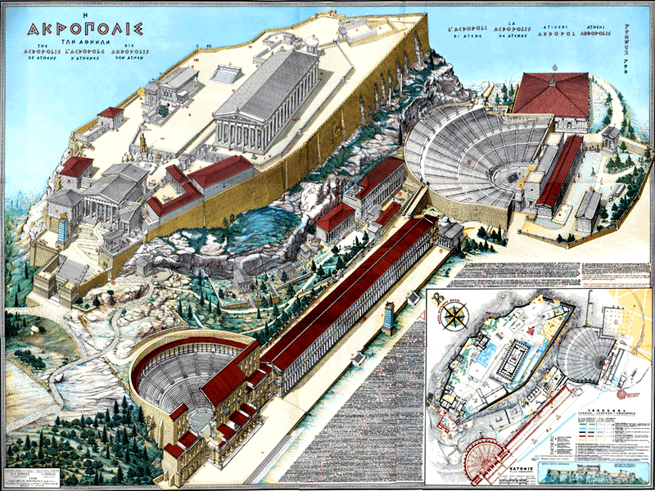
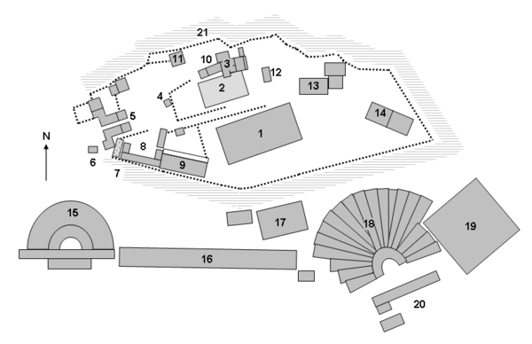
Site plan of the Acropolis at Athens
1 Parthenon
3 Erechtheum
5 Propylaea
15 Odeon of Herodes Atticus
18 Theatre of Dionysus Eleuthereus

Slide 4
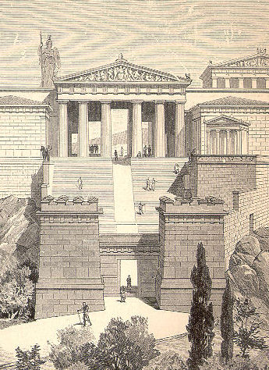
^{PROPYLAEA}
The entrance to the Acropolis was a
monumental gateway called the Propylaea.

Slide 5
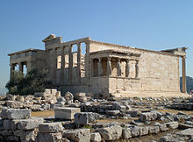
^{ERECHTEUM}
A TEMPLE DEDICATED TO ATHENA POLIAS (GODDES OF THE CITY)

Slide 6
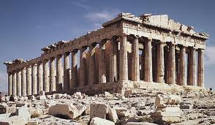
PARTHENON
A TEMPLE DEDICATED TO ATHENA PARTHENOS. IT WAS BUILT IN DORIC ORDER & ALMOST
EXCLUSIVELY IN PENTELIC MARBLE

Slide 7
PARTHENON
The large building on the top of the Acropolis. It was completely made out of pentelic marble and surrounded by freestanding columns. Its was built in Doric Order & almost exclusively of pentelic marble. The Parthenon retained its religious character in the following centuries & was converted into a Byzantine church, a Latin church and Muslim mosque.
The Parthenon is a Doric peripteral temple, which means that it consists of a rectangular floor plan with a series of low steps on every side, and a colonnade (8x17) of Doric columns extending around the periphery of the entire structure. Each entrance has an additional six columns in front of it. The larger of the two interior rooms, the naos, housed the cult statue. The smaller room (the opisthodomos) was used as treasury.

Slide 8
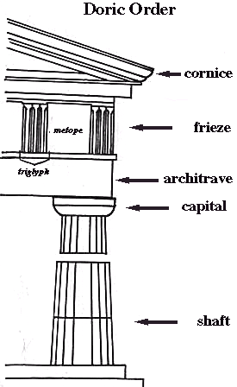
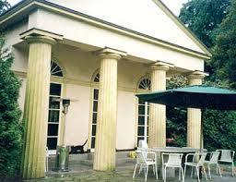
ARCHITECTURAL SYSTEM
CLASSICAL ORDER
DORIC
PLAIN CAPITAL

Slide 9
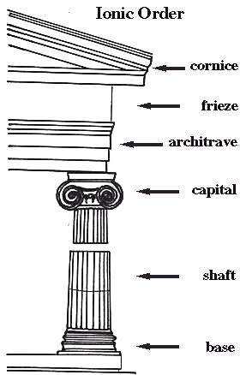

ARCHITECTURAL SYSTEM
CLASSICAL ORDER
THINNER. SCROOL-LIKE CAPITAL
A volute is a spiral scroll-like ornament that forms the basis of the Ionic order, found in the capital of the Ionic column.
IONIC

Slide 10
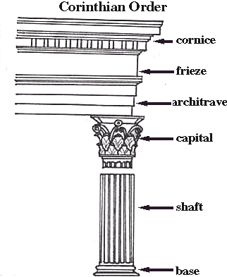
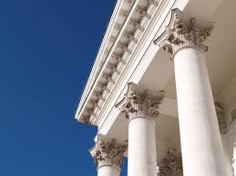
ARCHITECTURAL SYSTEM
CLASSICAL ORDER
ELABORATE. DECORATED ACANTHUS LEAVES CAPITAL
CORINTHIAN

Slide 11
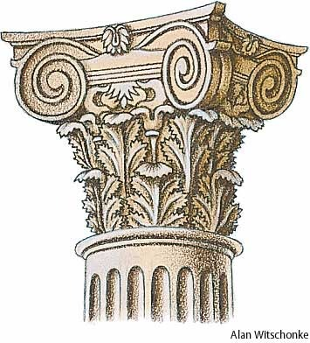
COMPOSITE ORDER
The composite order is a mixed order, combining the volutes of the Ionic order capital with the acanthus leaves of the Corinthian order.
A volute is a spiral scroll-like ornament that forms the basis of the Ionic order, found in the capital of the Ionic column.
Francesco Borromini (1599–1667) developed the composite order in San Carlo alle Quattro Fontane, Rome, (1638).
The Composite order, due to its delicate appearance, was deemed by the Renaissance to be suitable for the building of churches dedicated to The Virgin Mary or other female saints.

Slide 12
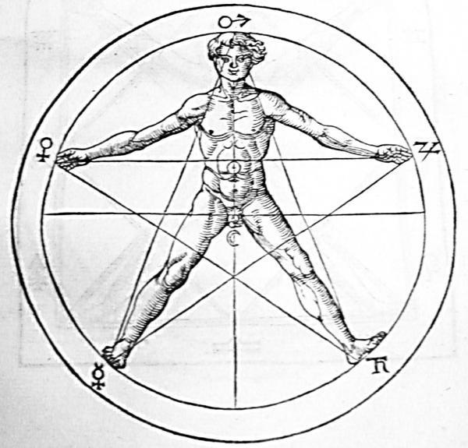
GOLDEN SECTION
In mathematics and the arts, two quantities are in the golden ratio if the ratio of the sum of the quantities to the larger quantity is equal to the ratio of the larger quantity to the smaller one.
The golden ratio is also called the golden section
The Parthenon’s façade as well as elements of its façade and elsewhere are said by some to be circumscribed by golden rectangles.
Ancient Greek mathematicians first studied what we now call the golden ratio because of its frequent appearance in geometry.

Slide 13
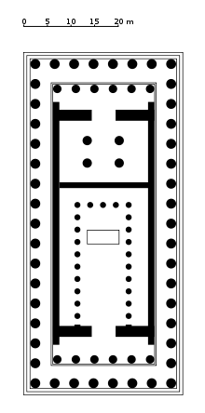
Sketch the layout plan of Parthenon. Explain the functions of the spaces.
The large building on the top of the Acropolis. It was completely made out of pentelic marble and surrounded by freestanding columns. Its was built in Doric Order & almost exclusively of pentelic marble. The Parthenon retained its religious character in the following centuries & was converted into a Byzantine church, a Latin church and Muslim mosque.
The Parthenon is a Doric peripteral temple, which means that it consists of a rectangular floor plan with a series of low steps on every side, and a colonnade (8x17) of Doric columns extending around the periphery of the entire structure. Each entrance has an additional six columns in front of it. The larger of the two interior rooms, the naos, housed the cult statue. The smaller room (the opisthodomos) was used as treasury.

Slide 14
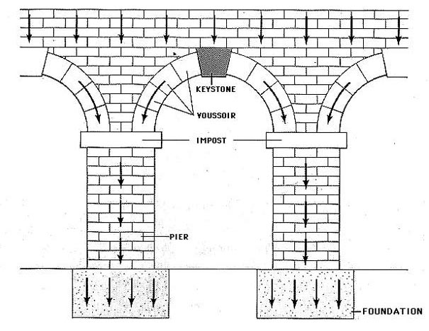
The picture above shows part of the architecture from the _______ era
^{b. Roman}
Which of the following buildings are located in Acropolis, Greek?
b. Parthenon, Propylaea, Erechtheum

