Slide 1
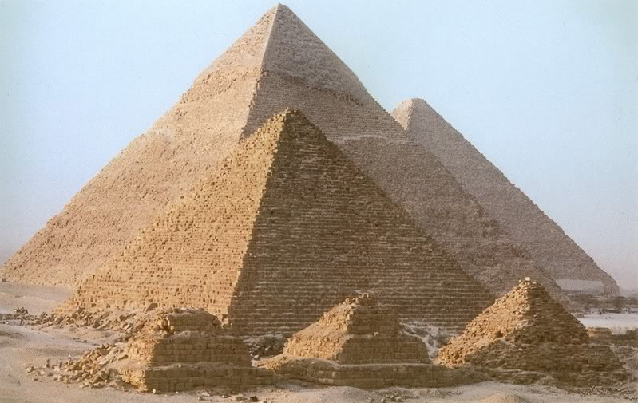
^{ANTIQUITY AGE:}
^{EGYPT ARCHITECTURE}
^{THE GREAT PYRAMID OF GIZA}

Slide 2
During Cheop’s or Khufu’s reign, the funerary monument and the royal burial ground was moved from Dashur to Giza i.e. north of the capital Memphis. It is during this reign the Great Pyramids of ancient Egypt were contructed. The great pyramid contained six and a quarter million tons of stone, each polished blocks of 2 feet by 6 feet weighed about 2 ½ ton.
The pyramid was 480 feet high with sides of the square base measuring 760 feet length. The joint between each stone was /15th of an inch. The mathematical error was 0.03%. During Cheop’s son Chephren reign, solar religion gained an importance. The great sphinx, built near the king’s pyramid at Giza was a representation of the solar-God Harmakhis. The pyramid built for him (chepren/kefren) was located beside his father’s and is slightly smaller. Its temple chapel and mortuary or funerary temples constructed to the east of the pyramid were better preserved than what was built during Cheop’s.

Slide 3
The tallest and biggest pyramid of the three at Giza belongs to
^{Cheop’s.}
The smallest pyramid of the three belongs to
^{Cheop’s grandson, Mykerins.}
The three small pyramids at the foot of the bigger pyramids were for the
^{Queens.}
Mykerino’s son, Shepseskaf, the next king, did not build any pyramid. He chose a sarcophagus like Mastaba as a tomb and moved the royal funerary ground back to old cemetery of Saqqara.

Slide 4
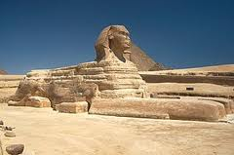
^{THE SPHINX}
The Sphinx with its monumental proportion, a lion’s body and human feature provides an unexpected naturalistic. Contact to the geometric shapes of the pyramids. The Sphinx was carved out of a natural outcropping rock.
The Sphinx is a statue of a reclining that stand on the Giza Plateau on the west bank of the Nile in Giza, Egypt. It is the largest monolith statue in the world, standing 73.5 metres (241 ft) long, 6 metres (20 ft) wide, and 20.22m (66.34 ft) high.

Slide 5
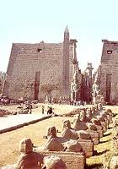
^{THE GREAT TEMPLE OF KARNAK}
Located at the northern end of the town of luxor. Karnak Temple has three main sacred areas that honor three gods:
Montu, an ancient local warrior god
Anum, the chief god of Thebes; and
the goddness Mut, wife of Anum.

Slide 6
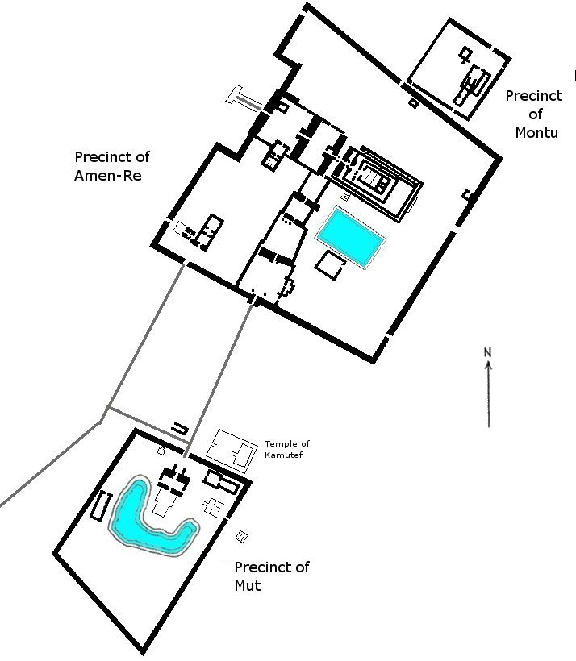
plan

Slide 7
Anum, Mut and their son, Khonsu, were members of the sacred family known as the Theban Triad. Flanking each doorway are the pylons. These pairs of pylons are most prominent features of every Egyptian temple. At Karnak they are 140 feet high. Symmetry and grandeur have become part of architecture. Symmetry and grandeur begins all the way before the entrance from the avenue of rams into the outer courts and from the court into the hypostyle hall.
The cylindrical columns are very massive and closely spaced so that single slab on bridge from one column to another. The vistas and glimpse from one side of the hall to the other are mysterious and the dramatic. The significance of this hall is that it is a columned hall.

Slide 8
Which of the following statement is NOT TRUE about Egypt?
A. Ancient Egypt was called the ‘Land of Khem’ and ‘Land of Pharaohs’
B. Egypt lies in the Sahara Desert, bordering the Mediterranean Sea, the Sinai Peninsula and the Red Sea
C. Egypt was known for its great monuments such as the Pyramids and temples
^{Egypt was cold and dry climate}
^{throughout the year}

Slide 9
Which of these are the renowned building in Egypt?
^{i. The Acropolis Complex}
^{ii. The Great Pyramid of Giza}
iii. The Great Temple of Karnak

Slide 10
The construction of monuments and temples in Egyptian architecture was influenced by;
The belief in life or survival after death on preservation of the body, as immortality was only for the privileged royal and priestly being

Slide 11
The largest temple in Karnak complex is _____
^{a. The temple of Mun}
^{b. The temple of Monthu}
^{c. The temple of Ramon}
^{d. The temple of Amun}

Slide 12
The characteristics of Egyptian architecture is influenced by the following,
^{Belief in life after death}
^{Belief Pharoah as the god}
^{Arable banks of the Nil River}

Slide 13
11. The following statements are factors influencing the characteristics of Egyptian architecture,
^{a. Believe in life after death}
^{b. Pharaoh as the king of God}
c. Spirits will fly up to heaven

