Slide 1
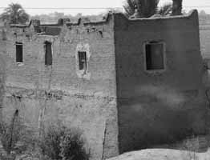
^{INTRO TO HISTORY OF}
^{ARCHITECTURE}
^{WEEK 1}
^{HOT CLIMATE}
The wall thickness was about 40 cm, with narrow windows, this helped to keep the house cool by protecting from the outside heat Flat roofs, which formed part of the living area, and provided additional storage space

Slide 2
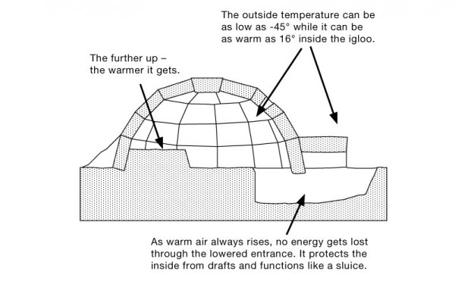
^{COLD CLIMATE}

Slide 3
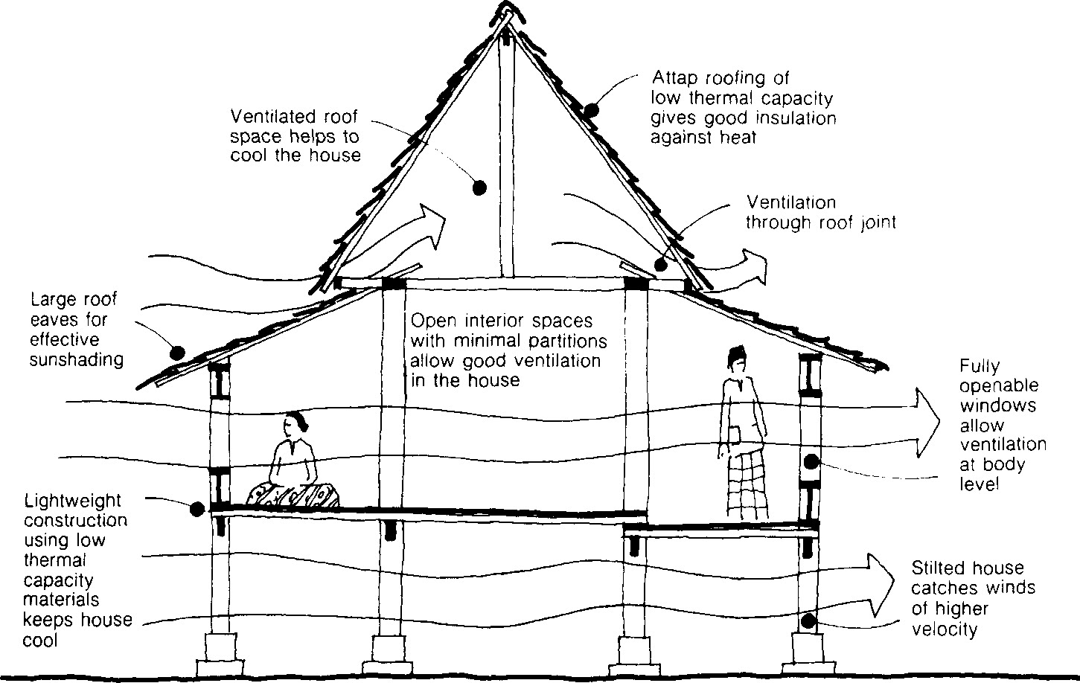
^{EQUATORIAL CLIMATE}

Slide 4
• Affecting the choices of building materials – low thermal materials from the natural surroundings
• The roof form considers the climate conditions; steep roofs are for high density rain and to reduce heat in the interior of the house or building
• Affecting the windows and door sizes to give high ventilation effect in the interior
• Wall thicknesses are according to temperature and moisture as well as the number of wall and partition is less – open plan design
• Built on stilt (Malay traditional house) – to avoid flood and wet as well as damp effecting the columns and walls
To protect occupant from undesirable environmental / nature force (rain, sun, wind) e.g. Tradition Malay house : open plan, wood contruction / material, built on stilt, low window / opening, low and deep of overhang.

Slide 5
^{Define Architecture}
The combination of art and science in designing and erecting building
Shaped by the culture since the dawn of time with its own distinctive style

Slide 6
^{List FIVE (5) factors that}
^{affect the architecture.}
^{Religious and belief}
^{Climate and geographical}
^{Science and technology}
^{Material}
^{Social/culture}

Slide 7
Explain how ‘religious and belief ‘ affect architecture
i. Religion as a way of life influences the work of architecture
ii. Provide a holistic approach in viewing architecture as apart of the built environment to design a culture that strives for an environmental harmony
iii. The religion and beliefs affects architecture in many ways as its affect on the space planning, the facade, the form of the building as well as the decorations and ornamentations,
iv. It also determined the building orientation and the functions as most religious buildings such as mosque, church and temples
v. For ex, the facade of a church usually have a decoration in a form of figurines and stained glass show a Jesus or Saint Mary, while in mosque design, the decorations are in a form of calligraphy, arabesque, floral as well as the geometrical form
vi. Influence the building orientation, space planning, and facade as well as ornamentations and decorations

Slide 8
Explain how ‘climatic and geographical’
^{affect architecture}
i. To dictate how buildings should be as to provide the most suitable and comfortable built environment according to different climatic requirements
ii. To design according to surrounding : site, weather, vegetations and soils
iii. To design with the emphasis of the natural elements around the site
iv. To protect occupant from undesirable environmental force such as rain, sun and wind
v. For ex, traditional Malay house – open plan , wood/timber construction and material, built on stilt, low and large window/opening, low and deep overhang

Slide 9
Explain how ‘Science and technology ‘
^{affect architecture}
i. Helps to provide the structural logic of forms
ii. Architects must understand the relationship between technologies to produce architecture that satisfy the needs of users without destroying nature – balance
iii. The use of technology should also be in relation of climatic condition, culture, religion, economic factors, availability of materials and energy resources.
iv. The study of science and technology in architecture not only affects to building design but also affect the environmental balance as well as human life
v. It also ensuring the workability and built ability of the building design and the functions of the supporting elements such as building services and structures

Slide 10
^{Explain how ‘ Materials’}
^{affect architecture}
i. The envelope of a building can be made of all kinds of building materials – brick, stone, concrete, wood, glass, steel, plastic, etc
ii. The choice of materials of the building depends on certain propriety such as climate and surrounding
iii. Each material has its own generic quality relating to structure and texture
iv. The generally accepted rules of texture , color and form; wood is warm, steel is cold, marble is formal, field stone is informal, shinglee sis homey, metal foof s are institutional
v. The use of building materials such or the combination of materials usage also influence the construction technique or method used in building construction

Slide 11
^{Explain how ‘ Social/culture ’}
^{affect architecture}
i. Buildings reveal the culture of people which relate to the needs and aspiration of the people
ii. Considering the whole aspects which includes knowledge, belief, arts, morals, law, custom, and any other capabilities and habits acquired by man as a member of society
iii. To support the way of life of a group of people
iv. How people interpret the meaning and relation between man and architecture
v. The culture of a place will help in producing suitable buildings succesfully for mental and behavioral activities
vi. Culture and environment mainly affect people’s attitude and thinking, as this context is considered to be a mirror for the people who live in it. Whenever culture or environment differs, people’s attitudes and thinking also differ

Slide 12
Explain how was climate and geographical play an important role in shaping the architecture of Egypt ( Hot Climate)
• Egypt has been said to have two seasons, spring and summer
• The climate is equable and warm: snow and frost are unknown, while storm, fog, and even rain are rare, and these conditions have contributed to the preservation of buildings
• Such a climate, with its brilliant and continuos sunshine, conduced also to simplicity of design; for, as sufficient light reached the interior through doors and roof slits
• There was no need for windows, and thus unbroken massive walls not only protected the interior from the fierce heat of the sun
• It also provided an uninterrupted surface for hieroglyphics or pictorial representations of religious ritual, historic incidents, and daily pursuits
• In the absence of rain, roof drainage was not a consideration
• Flat roofs of thick stone slabs sufficed to cover in the building and to exclude the heat, while in the temples these roofs served for religious processions

Slide 13
Explain how was climate and geographical play an important role in shaping the architecture of Asian (Equatorial Climate)
• Affecting the choices of building materials – low thermal materials from the natural surroundings
• The roof form considers the climate conditions; steep roofs are for high density rain and to reduce heat in the interior of the house or building
• Affecting the windows and door sizes to give high ventilation effect in the interior
• Wall thicknesses are according to temperature and moisture as well as the number of wall and partition is less – open plan design
• Built on stilt (Malay traditional house) – to avoid flood and wet as well as damp effecting the columns and walls

Slide 14
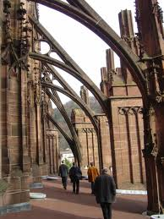
What is the main factor affecting the construction of Figure 1? (Flying butresses)
^{A. Religious}
^{B. Political}
^{C. Climate}
^{Materials and}
^{technology}

Slide 15
^{DESCRIPTION}
• Inscriptions on numerous and precious offerings to the sanctuary of Athena (marble korai, bronze, and clay statuettes and vases)
• Three important temples : The Parthenon, The Erechtheum and the Temple of Athena Nike, dedicated to Athena Parthenon, Athena Polias and Athena Nike.
What is the main factor that influences the development of the buildings in the above statement?
^{A. Religious and belief}
^{B. Materials}
^{C. Climate}
^{D. Social}

Slide 16
These are the benefits of studying
^{architectural history :}
Architectural history is used as a supplement for architecture and urban planning programs
Architectural history teaches us about preservation and importance of architecture in urban development
Architectural history allows us to develop a broad framework in economics, philosophy and art

Slide 17
^{Description}
• Helps to provide the structural logic of form
• Architects must understand the relationship between technologies to produce architecture that satisfy the needs of users without destroying nature v- balance.
Based on the above statements, what are the factors affecting architecture?
^{A. Religion}
^{B. Climate and geographical}
^{C. Science and technology}
^{D. Material}

Slide 18
The following statements explain the climatic and geographical factors that effect architecture:
i. Building should be as to provide the most suitable and comfortable built environment according to different climatic requirements
ii. Design according to surrounding : site, weather, vegetations, and soils
iii. Design with the emphasis of the natural elements around the site
iv. Protect occupant from undesireable environmental nature force such as rain, sun and wind

Slide 19
^{DESCRIPTION}
• The roof of the house is flat to collect some rain water to cool the hot air in the house
• The house has few openings to avoid direct sunlight penetration
• The house uses clay as the construction material
Which climate is the house probably located in?
^{A. Hot climate}
^{B. Cold climate}
^{C. Equator}
^{D. Hot and cold climate}

Slide 20
Describe the meaning of the word architecture ?
The art and science of designing
^{and erecting building.}

Slide 21
Give the definition of “architecture” and the relationship with an architect.
Architecture as a profession is the practice of providing architectural services. The practice of architecture includes the planning, designing and oversight of a building’s construction by an architect. Architectural services typically address both feasibility and cost for the builder, as well as function and aesthetics for the user.
Architect is a person who qualified in designing and drawing up plans for buildings and generally supervising the construction.

Slide 22
Architecture is moulding the “attitude” of the society indirectly. Describe this statement.
architecture indirectly moulding the attitude of the society in the aspects of
  ^{physical,}
  ^{emotional,}
  ^{and intellectual.}
Physical is about proportion, colour, texture, furniture or the painting on the wall.
Emotional is about the sensuous experience of space and form.
Intellectual is about responds to the space and form through knowledge.

Slide 23
Scope of works in architecture expands when the needs of specialization increase. List down scope of works related to architecture.
Architecture has 9 scopes of work
  ^{Designing the building.}
  ^{Preparing of working drawing.}
  Approving of architecture drawing.
  Send the drawing for local authority approval.
  Preparing of document tender and specification.
  Choosing the tender, quotation and contractor.
  ^{Supervising the project.}
  Handling the payment of certificate of fitness(CF).
Certificate of fitness approval.

Slide 24
The roof of the house flat with thicked wall and has small openings. Which climate is the house probably located in?
^{a. Hot climate}
^{b. Cold climate}
^{c. Equator climate}
^{d. Hot and cold climate}

Slide 25
Why does the houses in hot climate have a thick wall and a small opening?
Ability to control direct solar radiation and heat loss
c. Ability to control heat from transmitting into the house
d. Ability to control heat from absorbing through the wall
b. Ability to absorb and store heat at daytime and release at night

Slide 26
They built aqueduct to supply water and thermae as a public bath. It shows that this civilization concerns about _____
^{a. Life after death}
^{b. Planting purpose}
^{c. Exploring ideas}
^{d. People’s need}

Slide 27
...control direct solar radiation
…control glare from the open sky
^{…protection against rain}
The above factors should be considered when designing a house in
^{a. Equator}
^{b. Hot climate}
^{c. Cold climate}
^{d. Hot and cold climate}

Slide 28
“… high temperatures, solar radiation, humidity and glare”. Which design could achieve climatic comfort for that environment?
a. Thick wall and less openings
^{Flat roof with less openings}
^{Pitch roof with large}
^{overhang}
^{d. Pitch roof with thick wall}

Slide 29
Explain how climate influence the architecture of the regional place below:
^{Hot climate}
a. Hot at daytime and cold at night
b. To control the temperature – use thick wall made of adobe/ sun baked mud brick – the available material in this area – ability to absorb heat at daytime and release heat at night
c. Flat roofs provides a larger surface area for heat loss
d. Small window – to prevent wind/ sand into the house

Slide 30
^{Cold climate}
a. The form – dome shaped structure built entirely out of blocks of ice with a small tunnel leading into the igloo
b. Material available – ice and snow – snow and ice work as an insulators to trap body heat inside the igloo
c. The walls block he wind, which is often so bitter that I can make freezing temperature feel many degrees colder
d. The entrance is built like - to prevent the heat loss and reduce the cold wind going inside when the door is open

Slide 31
With the aid of sketches, describe how the climate influence the architecture of Malay Traditional house

Slide 32
^{What is Chronology?}
Chronology is the science of arranging events in their order of occurrence in time, such as the use of a timeline or sequence of events. It is also "the determination of the actual temporal sequence of past events".

