Slide 1
CLASSICISM
ARCHITECTURE
Week 15

Slide 2
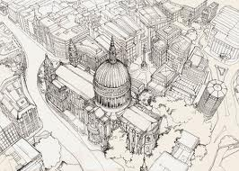
Classicism in architecture developed during the italian Renaissance, notably in the writing and designs of Leon Battista Albertini and the work of Filippo Brunelleschi.
It places emphasis on symmetry proportion, geometry and the regularity of parts as they are demonstrated in the architecture of classical antiquity and in particular, the architecture of ancient rome, of which many examples remained.
ST PAUL’S CATHEDRAL
Sir Christopher Wren

Slide 3
Orderly arrangements of columns, pilasters and lintels, as well as the use of semicircular arches, hemispherical domes, niches and replaced the more complex proportional systems and irregular profiles of medieval buildings. This style quickly spread to other italian cities and then to france, germany, england, russia and elsewhere.

Slide 4
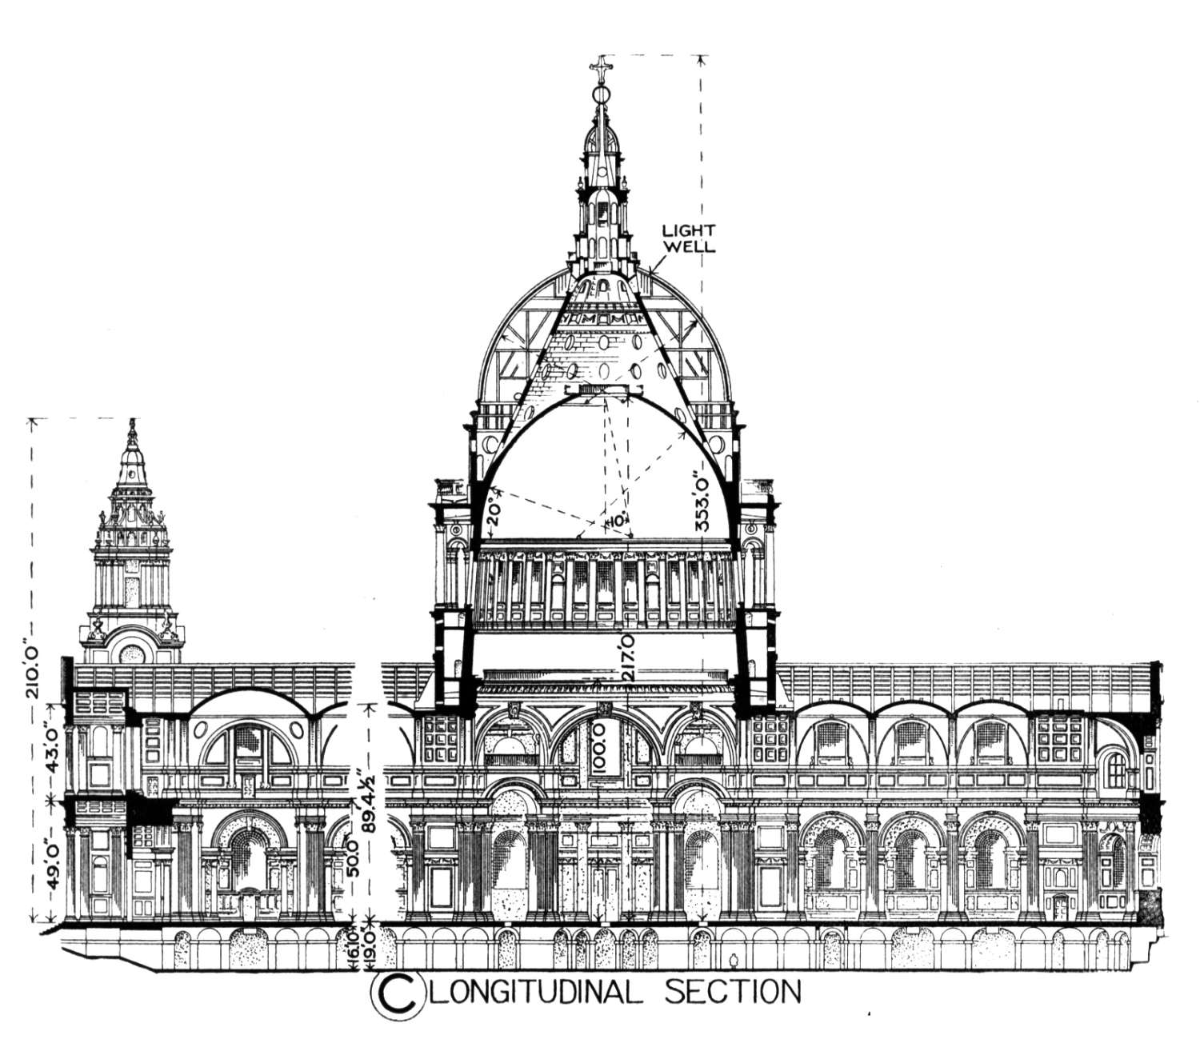
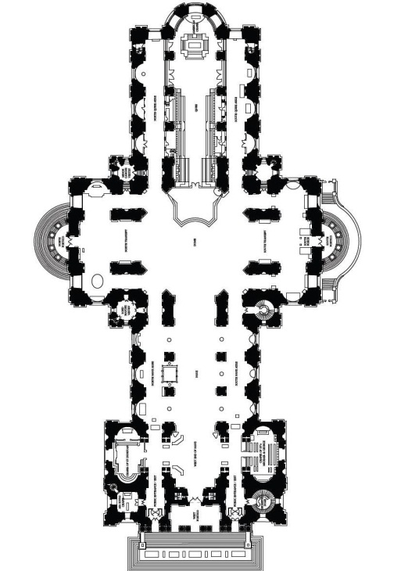
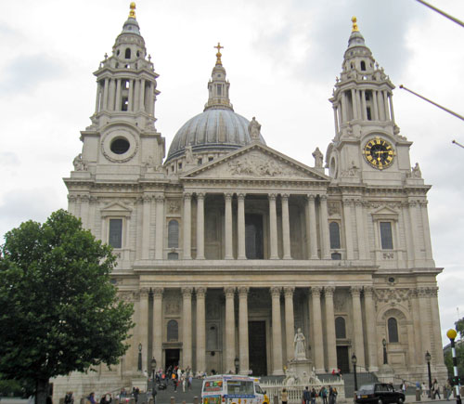
ST PAUL’S CATHEDRAL
two towers, upper and lower portico in the front,triangular pediment, facade - two tiers of
paired corinthian columns
symmetrical shape
a huge dome, two storeys

Slide 5
This building was built with the Classicism architectural style on Ludgate Hill, the highest point in the city of London, and is the seat of the Bishop of London. The present building dates from the 17th century and was designed by Sir Christopher Wren. This building refers to: St Paul’s Cathedral

Slide 6
The building in the figure shown below was build during the Classicism age. Discuss FOUR(4) characteristics of the building.
i. Symmetrical shape
ii. It has two storeys with two towers above and a huge dome
iii. It has an upper and lower portico in the front
iv. Triangular pediment – on top of the portico
Facade – two tiers of paired Corinthian columns
Construction system : masonary, brick, timber,
and cut stone

Slide 7
What is the features of classicism architecture
a. Symmetry, proportion, geometry
b. The architecture of classical antiquity
c. Ancient rome

