Slide 1
BAROQUE ROCOCO
Week 14

Slide 2
After a Renaissance period, the architects of the era started to get bored with the symmetry and same old forms they had been using for the last 200 years. Two main architects were Bermini and Borromini. It was about the end of the High Renaissance that the buildings started to take on a new look. One can see in the San Carlo alle Quattro Fontane in Rome, that the architects didn’t use very much symmetry at all

Slide 3
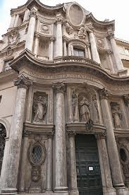
SAN CARLO ALLE QUATTRO
FONTANE
a Roman catholic church in Rome, designed by the architect Francesco Borromini (1599-1667) and was his first independent commission. It is an iconic masterpiece of Baroque architecture, built as part of a complex of monastic buildings on the Quirinal Hill for the Spanish Trinitarians, an order dedicated to the freeing of Christian slaves.

Slide 4
It was during the Rococo style that term “French Window” came into use. A French window is a large window stretching all the ways from the ground to the ceiling. Also, mirrors were common in Rococo style rooms. Rococo architecture was common among the French aristocracy. For that reason, it was unpopular among the common people, and did not last long.

Slide 5
Compare the characteristics of Renaissance and Baroque architecture
i. Renaissance architecture
a. Harmony with symmetrical plan
b. Incorporate with pilaster between windows
Pilaster – columns from one of the orders of
Greek and Rome
d. Used of rustification – huge block
e. Classic styles architecture

Slide 6
ii. Baroque architecture
a. Curves /free flowing forms
b. Asymmetrical plan
c. Bizzare shapes
d. Heavily elaborated ornamentation
Concave and convex forms, oval space and oval
dome
Usage of lighting to give dramatic effect on
structural treatment and mural

Slide 7
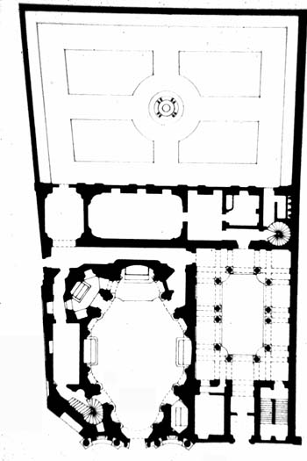
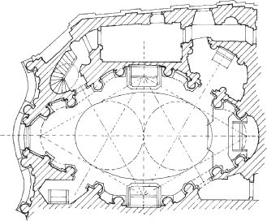
Sketch the layout plan and describe THREE characteristics of San Carlo alle Quatro Fontane, Rome.

Slide 8
Characteristics of San Carlo alle Quatro Fontane , Rome
• A double storey church building
• Its lower façade, can be divided into 3 parts
• The 2 parts on the left and right curved in while the center curved out
• United by the long entablature
• On the upper façade , the entablature was separated by an oval brick at the center
• The interior façade was rich by the decorations which can be seen from the incredible sculptural treatment and murals on the walls and the oval dome
• Asymmetrical plan with an oval space in the middle and curve on the outer side
• Showed curves and free flowing forms like wave

Slide 9
• After the Rennaissance period, the architects of the era started to get bored with the symmetry and same old forms they had been using for the last 200 years
• Two main architects were Bermini and Borromini.
• The façade of San Carloalle Quattro Fontane did not use very much symmetry
What is the architectural style related to the above statement?
Baroque and Rococo Architecture

Slide 10
Describe the difference between Baroque and Rococo architecture.
Baroque
-Centric forms of the human figure.
-Dynamic maneuverability human figure in a variety of styles.
-Concerned with illumination.
-Carve of sculpt with the above fine marble and stone.
Rococo
-Use a lot of gold.
-Room designated to have the music player.
-Obsolete room rectangular with rounded corner, and bars have not carved deep.

