Slide 1
RENAISSANCE
ARCHITECTURE
Week 13

Slide 2
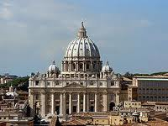
St Peter’s Basilica
Michalengelo’s dome was a masterpiece of design using two masonry shells, one within the other and crowned by a massive lantern supported, as at Florence, on ribs.

Slide 3
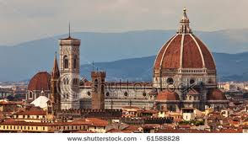
THE CATHEDRAL OF FLORENCE
Brunelleschi first major architectural commission was for the enormous brick dome which covers the central space that of Florence’s cathedral, designed by Alforno di Cambio in the 14th century but left unroofed. While often described as the first building of the Renaissance, Brunelleschi’s daring design utilizes the pointed Gothic arch and Gothic ribs. It seem certain, however, that while stylistically Gothic, in keeping with the building it surmounts, the dome is in fact structurally influenced by the great dome of ancient Rome, which Brunelleschi could hardly have ignored in seeking a solution. This is dome of the Pantheon, a circular temple, now a church .

Slide 4
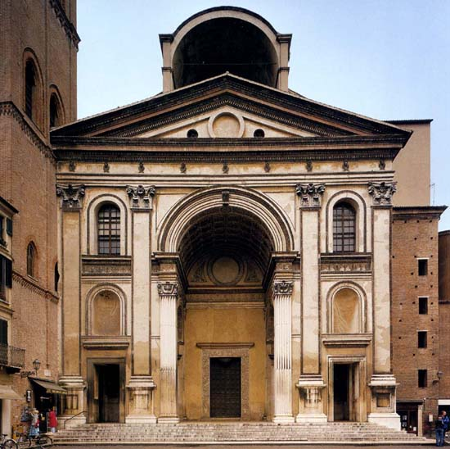
Sant’ Andrea
(Mantua)

Slide 5
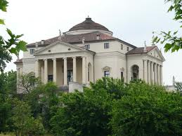
LA ROTUNDA
The best known of Palladio’s domestic buildings is the Villa Capra, otherwise known as “la Rotonda”, a centrally planned house with a domed central hall and four identical facades, each with a temple-like portico like that of the Pantheon in Rome.

Slide 6
Villa Capra Rotunda, Italy, is a Renaissance villa designed by Andrea Palladio
List FOUR great architects and name a building built by that architects during Renaissance period.
Fillipo Brunelleschi The Cathedral of Florence
Leon Battista Alberti Sant’ Andrea Mantua
Michaleangelo St Peter’s Basilica
Andrea Palladio Villa Capra “La Rotunda”

Slide 7
Compare the characteristics of Renaissance and Baroque architecture
Renaissance architecture
a. Harmony with symmetrical plan
b. Incorporate with pilaster between windows
c. Pilaster – columns from one of the orders of Greek and Rome
d. Used of rustification – huge block
e. Classic styles architecture

Slide 8
Baroque architecture
a. Curves /free flowing forms
b. Asymmetrical plan
c. Bizzare shapes
d. Heavily elaborated ornamentation
e. Concave and convex forms, oval space and oval dome
f. Usage of lighting to give dramatic effect on structural treatment and mural

Slide 9
Renaissance architecture is the architectural style that evolved between the early 15th and early 17th centuries in different regions of Europe in which there was a conscious revival and development of certain elements of ancient Greek and Roman thought and material culture
What are the MAIN factors affecting Rennaissance Architecture?
Religious
Philosophic
Political

Slide 10
What is NOT the MAIN factors affecting Rennaissance Architecture?
Climate
Describe Villa Capra La Rotunda.
Perfectly symmetrical plan, central room is a circular hall crowned by a low dome, each façade has a flight of steps leading to a portico

Slide 11
List down four famous architects and their buildings in the Renaissance period
Filippo Brunellesschi - The cathedral of Florence
Leon Battista Alberti - the Church of Sant’ Andrea in Mantua
Michelangelo Buonarroti - the Basilica of St.Peter in Rome
Andre Palladio - Villa Capra also known as “la Rotonda”

Slide 12
Give the definition of “Renaissance”
Renaissance comes from the French language, which means healing or reviving cultural aspects with emphasis on the aspect of cultural revival of knowledge such as science, literature and classical art ever to lift the European world as a center of civilization at the time.

