Slide 1
^{GOTHIC ARCHITECTURE}
^{Week 11}

Slide 2
Gothic architecture is a style of architecture which flourished during the high and late medieval period. It evolved from Romanesque architecture and was succeeded by Renaissance architecture.
Its characteristic features include the pointed arch, the ribbed vault and the flying buttress.

Slide 3
Gothic architecture is most familiar as the architecture of many of the great cathedrals, abbeys and parish churches of Europe. It is also the architecture of many castles, palaces, town halls, guild halls, universities, and to a less prominent extent private dwellings.

Slide 4
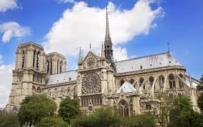
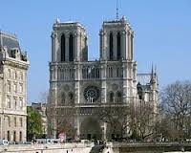
THE CATHEDRAL OF notre dame
Notre Dame de Paris is widely considered one of the finest examples of French Gothic architecture in France and in Europe.
Notre Dame de Paris was one of the first Gothic cathedrals, and its construction spanned the Gothic period. Its sculptures and stained glass show the heavy influence of naturalism, unlike that of earlier Romanesque architecture.

Slide 5
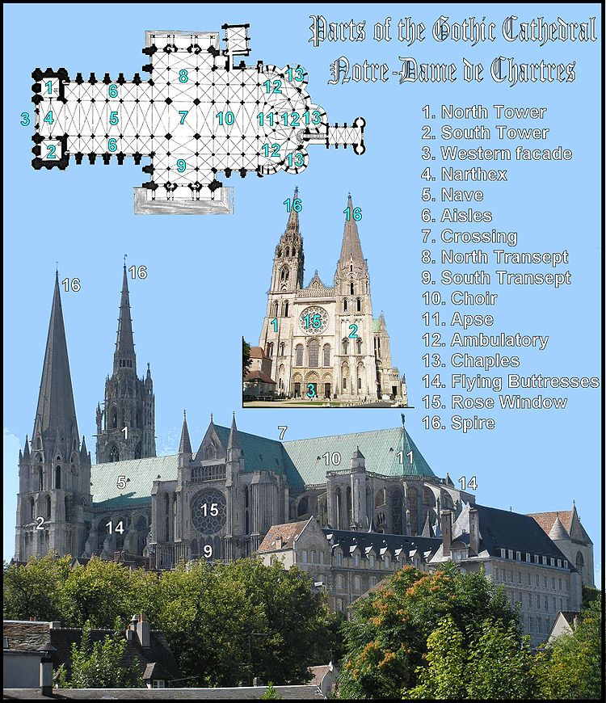
Notre Dame de Paris was among the first buildings in the world to use the flying buttress (arched exterior supports). The building was not originally designed to include the flying buttresses around the choir and nave. After the construction began and the thinner walls (popularized in the Gothic style) grew ever higher, stress fractures began to occur as the walls pushed outward. In response, the cathedral’s architects built supports around the outsides walls, and later additions continued the pattern.

Slide 6
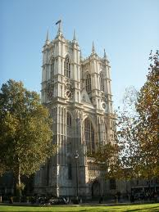
WEST MINISTER ABBEY
The Collegiate of St Peter at Westminster, which is almost always referred to popularly and informally as Westminster Abbey, is a large, mainly Gothic church, in Westminster, London, England (UK), located just to the west of the Palace of Westminster. It is the traditional place of coronation and burial site for English, Commonwealth Realms. It briefly held the status of the cathedral from 1546-1556, and is Royal Peculiar.

Slide 7
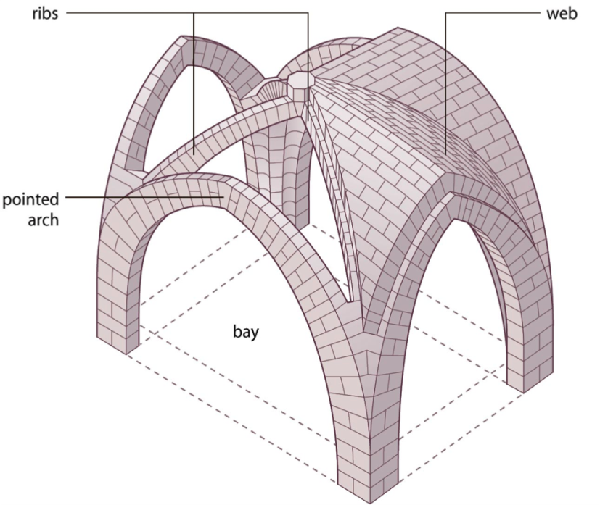
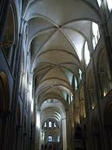
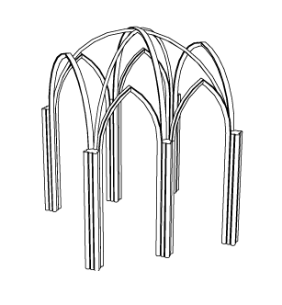
rib vault
The gothic vaults, unlike the semi-circular vault of Roman and Romanesque buildings, can be used to roof rectangular and irregularly shaped plans such as trapezoids. The other structural advantage is that the pointed arch channels the weight onto the bearing piers or columns at a steep angles. This enabled architects to raise vaults much higher than was possible in Romanesque architecture.

Slide 8
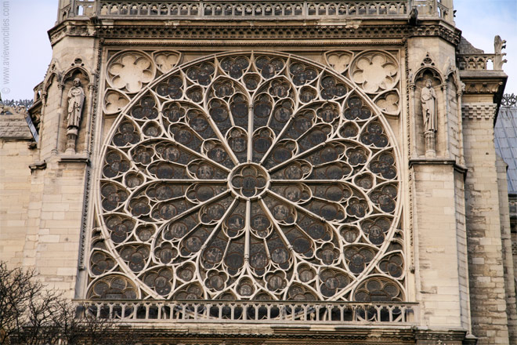
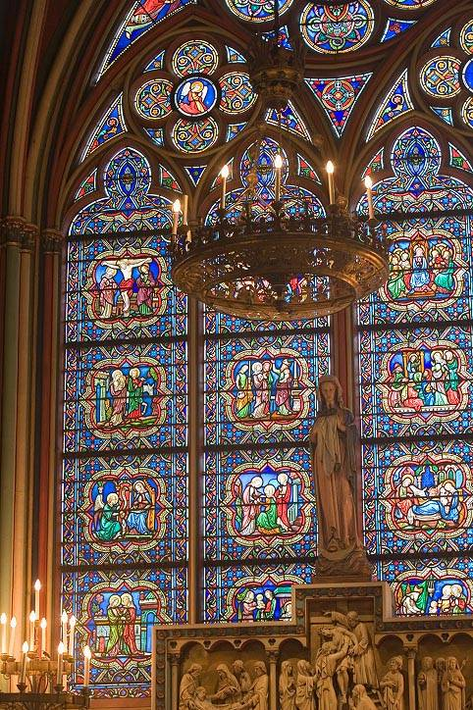
rose window
large stained glass
window

Slide 9
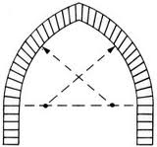
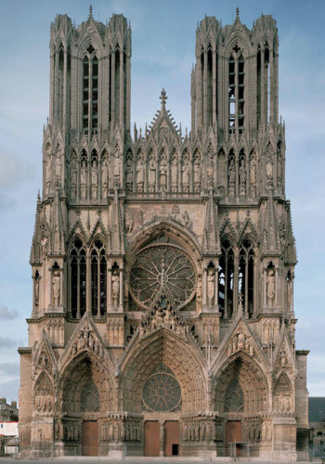
pointed arch
pointed arch. Notre Dame

Slide 10
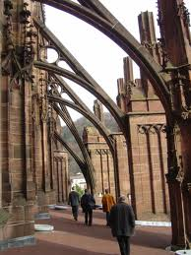
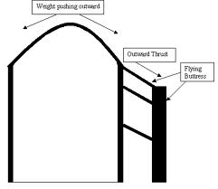
flying buttress -
thinner wall

Slide 11
Name the building above and write FOUR statements about the building’s façade
Building: The Cathedral of Notre Dame
Façade characteristics:
The west front of the cathedral – two tall towers with 69 meter height. The south tower houses the cathedral’s famous bell
The beautiful Rose Window, collonates and tracery screens – on the west exterior building appears to be High Gothic
Flying buttresses and pinnacles – at the east end of the cathedral
3 central portals – depicting Virgin Mary, the Last Judgment, and scenes from the life of St Anne – on the west front cathedral

Slide 12
Describe FOUR differences between Romanesque and Gothic architecture
i. Romanesque
a. Groin vault
b. Rounded arch
c. Buttresses – thick wall
d. Small window
e. Horizontal, modest height, plain, little decoration, solid
ii. Gothic
a. Rib vault
b. Pointed arch
c. Flying buttresses – thinner wall
d. Large stained glass window
e. Tall and soaring, ornate, delicate, lots of sculpture

Slide 13
The flying buttress was one of the Gothic inventions in construction. Determine the functions of this structure.
Able to be build larger openings to the wall
Able to distribute the weight of roofs down to the ground
List some of the basic shapes of Gothic arches?
Lancet arch
Equilateral arch
Flamboyant arch

Slide 14
Religion and technology are factors influencing the styles of Gothic Architecture
Explain how religion influenced Gothic Architecture
i. Gothic architecture was developed from a christian perspective – emphasizes verticality and light – reaching for the sky were the architects’ way of bringing their cathedrals and churches closed to god
ii. Characterictics of Gothic style were the use of light - God encompassed many things, such as light
iii. Pointed arch and flying butress – could build a taller churches and more lights – image of heavens

Slide 15
iv. Stained glass windows – these windows are possible because the walls are supported by flying buttresses. These windows were used to teach the Bible to the illiterate, as light illuminated to the religious images and religious scenes in each window
v. The decorative schemes usually incorporated Biblical stories of the Bible in its portals, paintings, and stained glass

Slide 16
Explain how technology influenced Gothic Architecture
i. Ribbed vaults - gave the builders a flexibility of design and construction that was simply not possible with the barrel or groin vault. It was easier to construct than the barrel or groin vault, and it was stronger and more flexible
ii. Flying buttresses – the purpose is to resist the lateral forces pushing a wall outwards (which may arise from stone vaulted ceilings or from wind-loading on roofs ) by redirecting them to the ground. The characteristic of a flying buttress is that the buttress is not in contact with the wall all the way to the ground, so that the lateral forces are transmitted across an intervening space

Slide 17
iii The pointed arch
- is more sturdy and it works by the opposition of forces and exerts less thrust. This means the arch puts up a resistance to the force of gravity and therefore the walls that hold the arch in place need not be as big and thick as the ones used in correspondence with the rounded arch/less material needed to construct the walls
- pointed arches overcome the difficulties created by the rigid geometry of semi-circular arches by enabling arches of different spans to rise to the same heights

Slide 18
What are the distinct characteristics of Gothic Architecture?
i. Pointed arch
ii. Ribbed vault
iii Flying Buttresses

Slide 19
(Figure of ‘flying buttress’)
What is the main factor affecting the construction of Figure?
Materials and technology
Gothic Architecture is an architectural style which flourished during the high and late Medieval Period. It evolved from the Romanesque Architecture and was succeeded by the Rennaissance Architecture

