Slide 1
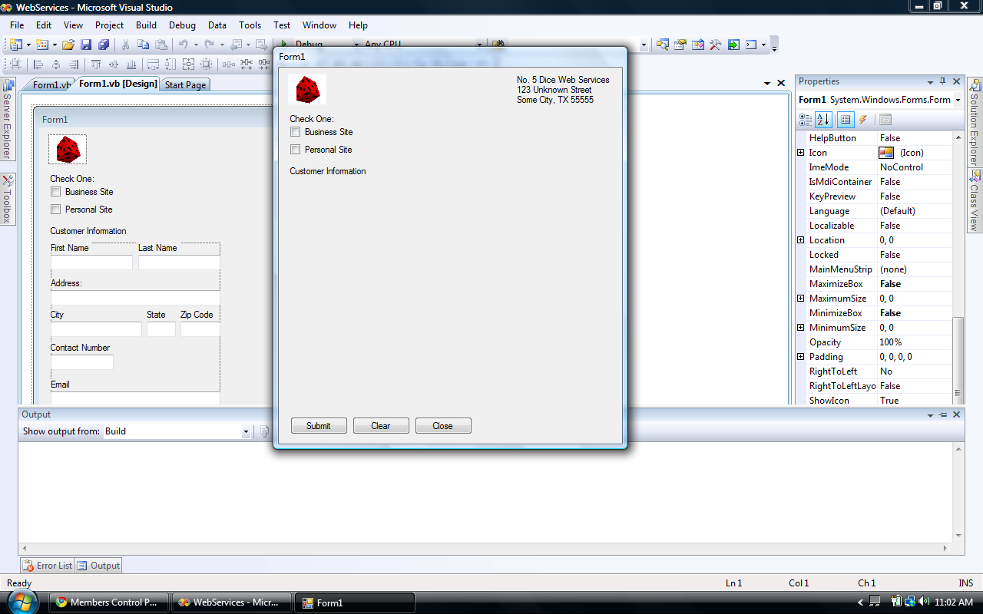
This is for a web order service. A customer can call and you ask them for the appropriate information. To start off, “Is this a business site or a personal site?” Then we go from there. I will be showing both of these check boxes as well as the partial coding that I have done.

Slide 2
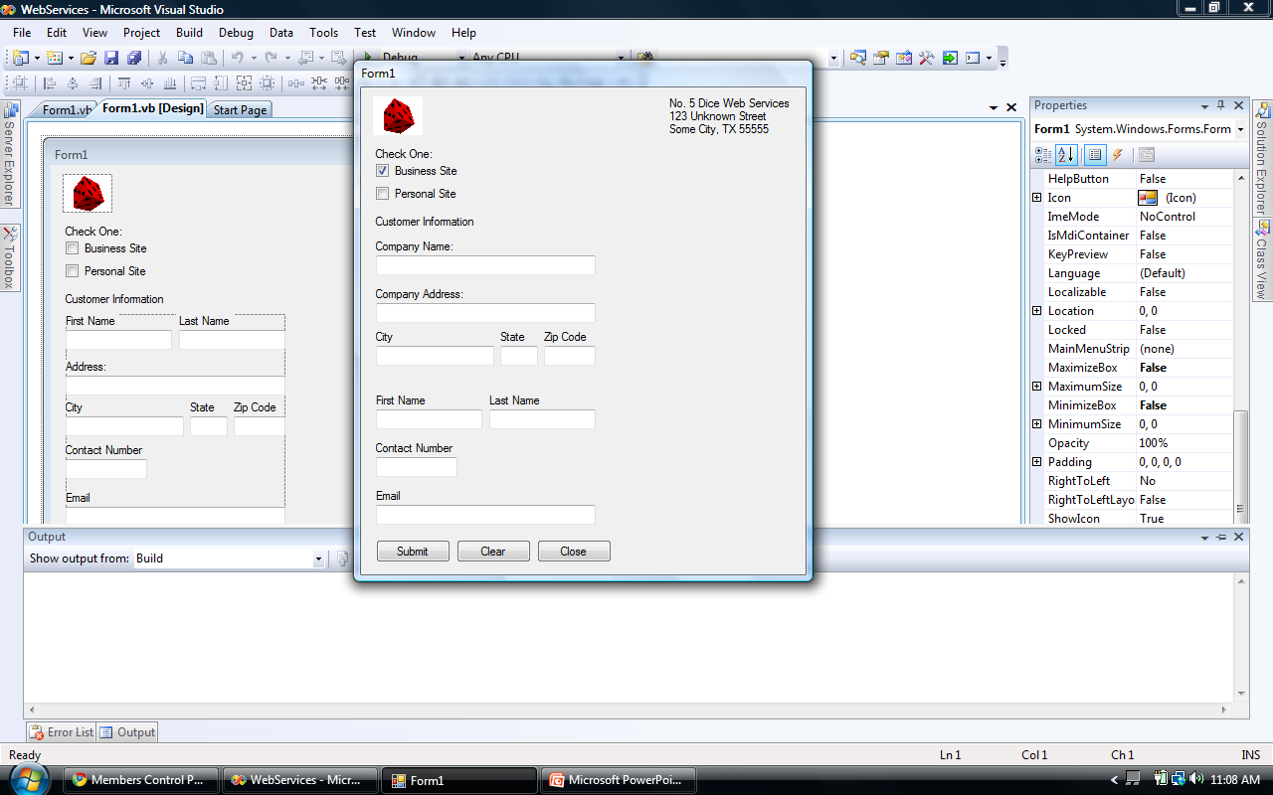
This is what displays upon clicking the “Business Site” check box. This is the one that I have the most coding for. I have this written to write the information to a text file that it creates using the customer’s first name. I will demonstrate this.

Slide 3
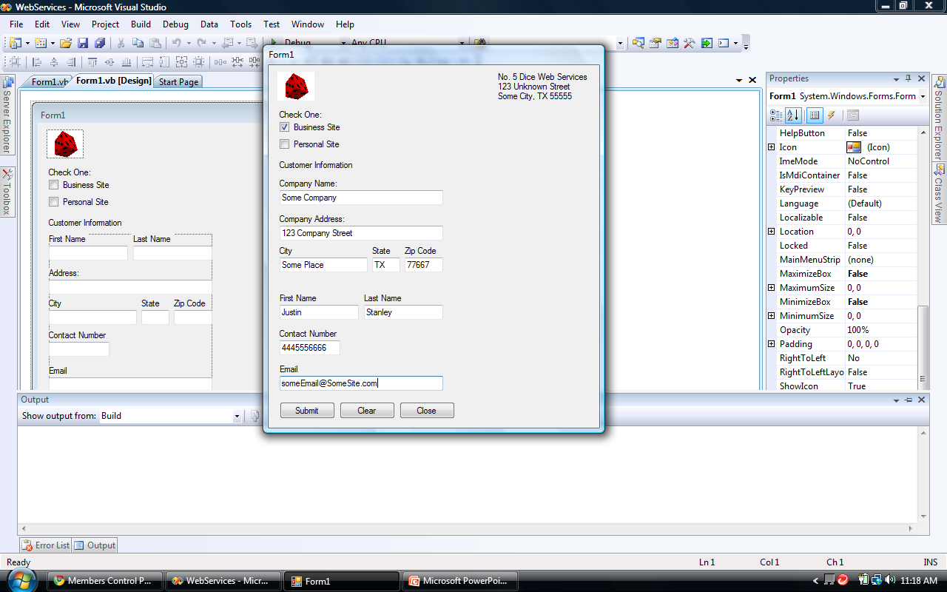
This is the “Business Site” form filled out.

Slide 4
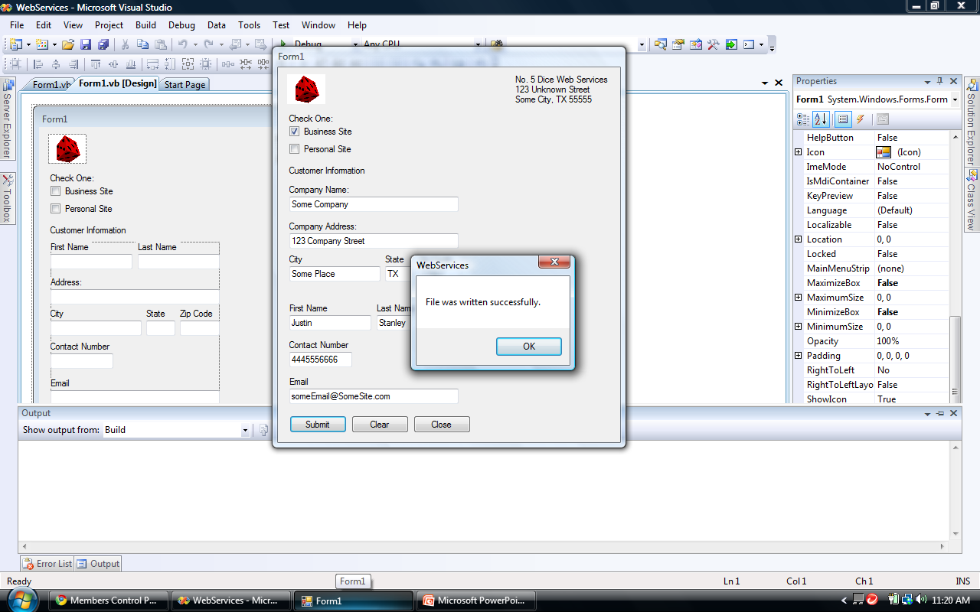
When you click “Submit” a message box pops up that says “File was written successfully.” Once you click “OK” the fields on the form will clear.

Slide 5
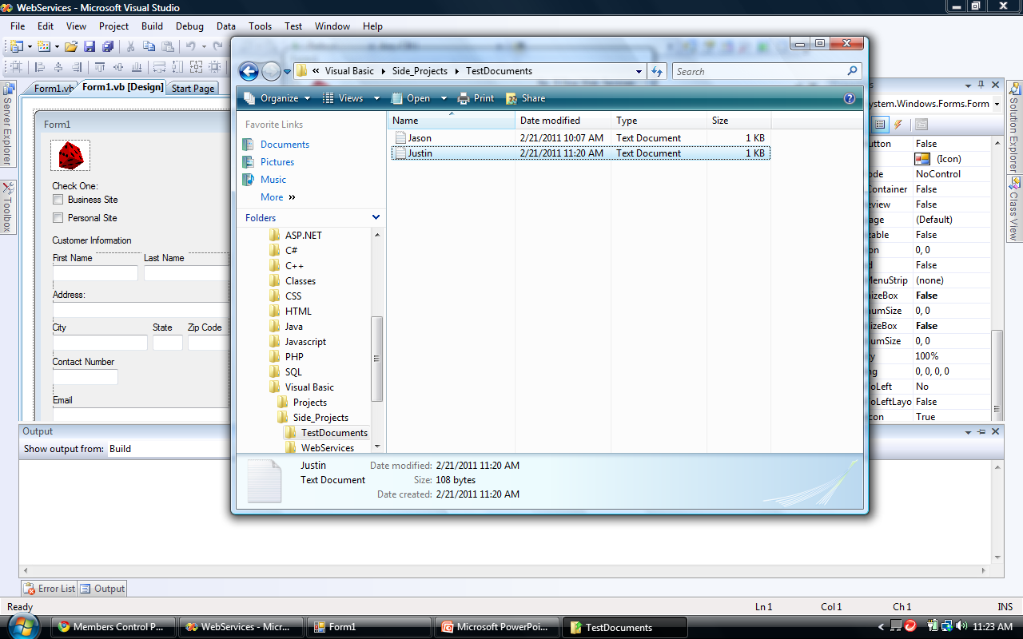
The file that was just created is titled “Justin” since that is the customer’s first name that was entered.

Slide 6
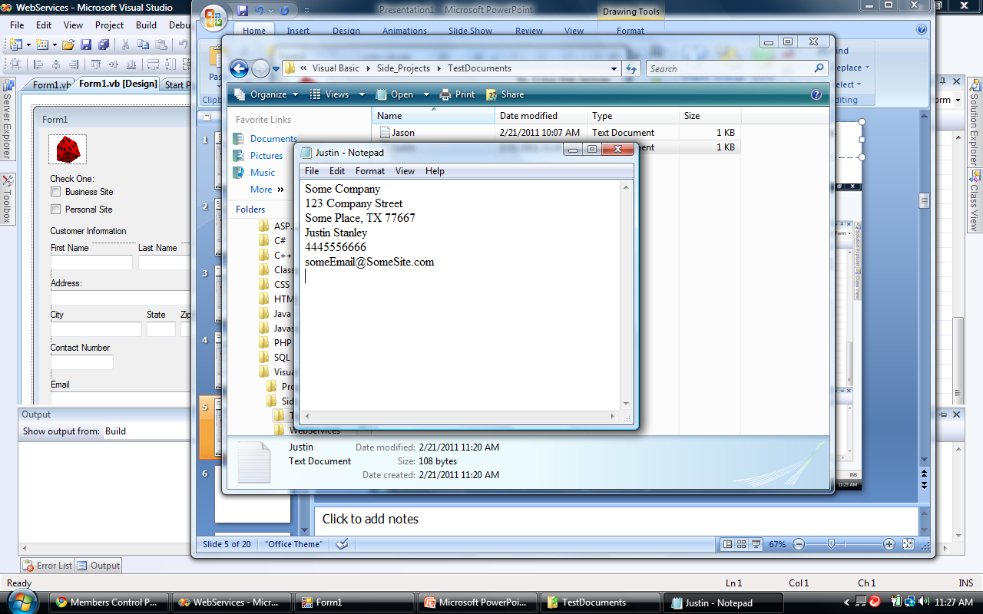
Here is the opened file that was just created. As you can see, it contains the information that was just entered into the form. And that is it for the “Business Site” check box. This is just a small taste of the possibilities that are available.

Slide 7
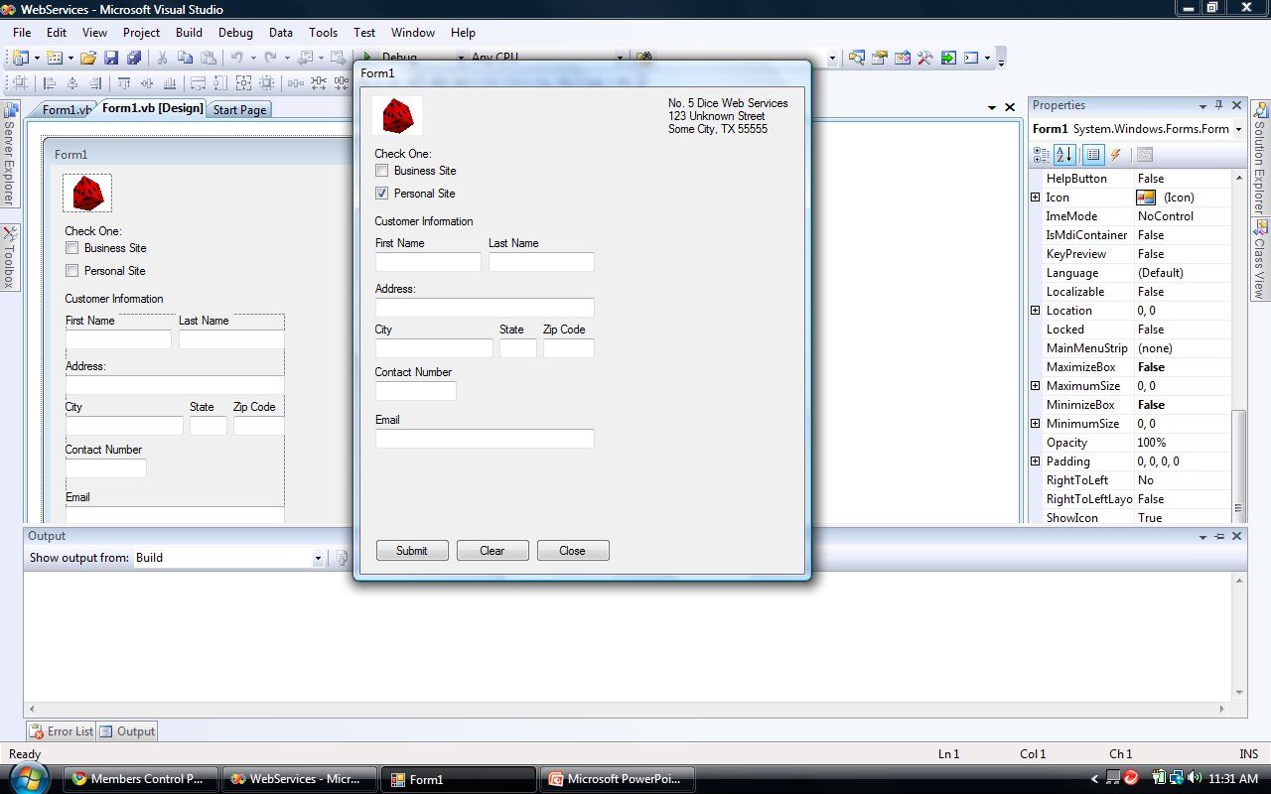
This is the form that appears upon clicking the “Personal Site” check box. I do not have this coded yet. Once it is coded, it will do the same thing as the other one. As far as the final product goes, there will be small changes to the final code.

Slide 8
Public Class Form1
Private Sub Form1_Load(ByVal sender As System.Object, ByVal e As System.EventArgs) Handles MyBase.Load
End Sub
Private Sub BusinessSiteCheckBox_CheckedChanged(ByVal sender As System.Object, ByVal e As System.EventArgs) Handles BusinessSiteCheckBox.CheckedChanged
If BusinessSiteCheckBox.Checked = True Then
BusinessPanel.Visible = True
Else
BusinessPanel.Visible = False
End If
If BusinessSiteCheckBox.Checked = True Then
PersonalSiteCheckBox.Checked = False
End If
End Sub

Slide 9
Private Sub PersonalSiteCheckBox_CheckedChanged(ByVal sender As System.Object, ByVal e As System.EventArgs) Handles PersonalSiteCheckBox.CheckedChanged
If PersonalSiteCheckBox.Checked = True Then
PersonalPanel.Visible = True
Else
PersonalPanel.Visible = False
End If
If PersonalSiteCheckBox.Checked = True Then
BusinessSiteCheckBox.Checked = False
CustComanyNameTextBox.Text = ""
CompanyAddressTextBox.Text = ""
CityTextBox1.Text = ""
StateTextBox1.Text = ""
ZipCodeTextBox1.Text = ""
FirstNameTextBox1.Text = ""
LastNameTextBox1.Text = ""
ContactNumberTextBox1.Text = ""
EmailTextBox1.Text = ""
End If
End Sub

Slide 10
Private Sub SubmitButton_Click(ByVal sender As System.Object, ByVal e As System.EventArgs) Handles SubmitButton.Click
Dim fileName As System.IO.FileStream
fileName = System.IO.File.Create("C:\Users\James Smith\Desktop\My Portfolio\Visual Basic\Side_Projects\TestDocuments\" + FirstNameTextBox1.Text + ".txt")
If BusinessSiteCheckBox.Checked Then
Dim i As Integer
Dim arrayString(5)
Dim objWriter As New System.IO.StreamWriter(fileName)
arrayString(0) = CustComanyNameTextBox.Text
arrayString(1) = CompanyAddressTextBox.Text
arrayString(2) = CityTextBox1.Text + ", " + StateTextBox1.Text + " " + ZipCodeTextBox1.Text
arrayString(3) = FirstNameTextBox1.Text + " " + LastNameTextBox1.Text
arrayString(4) = ContactNumberTextBox1.Text
arrayString(5) = EmailTextBox1.Text
For i = 0 To 5
objWriter.WriteLine(arrayString(i))
Next
objWriter.Close()

Slide 11
MsgBox("File was written successfully.")
CustComanyNameTextBox.Text = ""
CompanyAddressTextBox.Text = ""
CityTextBox1.Text = ""
StateTextBox1.Text = ""
ZipCodeTextBox1.Text = ""
FirstNameTextBox1.Text = ""
LastNameTextBox1.Text = ""
ContactNumberTextBox1.Text = ""
EmailTextBox1.Text = ""
End If
End Sub
Private Sub ClearButton_Click(ByVal sender As System.Object, ByVal e As System.EventArgs) Handles ClearButton.Click
If BusinessSiteCheckBox.Checked Then
CustComanyNameTextBox.Text = ""
CompanyAddressTextBox.Text = ""
CityTextBox1.Text = ""
StateTextBox1.Text = ""
ZipCodeTextBox1.Text = ""
FirstNameTextBox1.Text = ""

Slide 12
LastNameTextBox1.Text = ""
ContactNumberTextBox1.Text = ""
EmailTextBox1.Text = ""
End If
End Sub
Private Sub CloseButton_Click(ByVal sender As System.Object, ByVal e As System.EventArgs) Handles CloseButton.Click
Me.Close()
End Sub
End Class
This is the incomplete code that I have written so far. There is plenty more to come.

