Slide 1
GOOGLE
Derek Beaton
Business Law I 14EW6
BUS-206-X6016

Slide 2
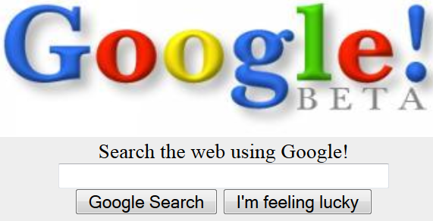
HOW IT STARTED…
Google Inc. founded in 1998
Best known for innovations in internet search
Official Mission, “organize the world’s information and make it universally accessible and useful.”
Company , Google. (n.d.). Company, Google. Retrieved July 27, 2014, from https://www.google.com/intl/en/about/company/
2014 Financial Tables. Investor Relations, Google. (n.d.). 2014 Financial Tables. Investor Relations Google. Retrieved July 27, 2014, from https://investor.google.com/financial/tables.html
Notes:
Google was founded in 1998 by two Stanford University Ph.D. students, Larry Page and Sergey Brin. The company made its start on Stanford University servers with an index of 25 million web pages where it ran for over a year before it began to consume too much bandwidth. On September 4, 1998, Google filed for incorporation in California. Outgrowing its garage office Google moved to Palo Alto, California with 8 employees in February, 1999. August, 1999 Google moves to the first Mountain View location. Since then, Google has opened up offices in various locations around the world, including New York and Tokyo. Currently, the company is headquartered in Mountain View, CA and it employs 52,069 people.

Slide 3
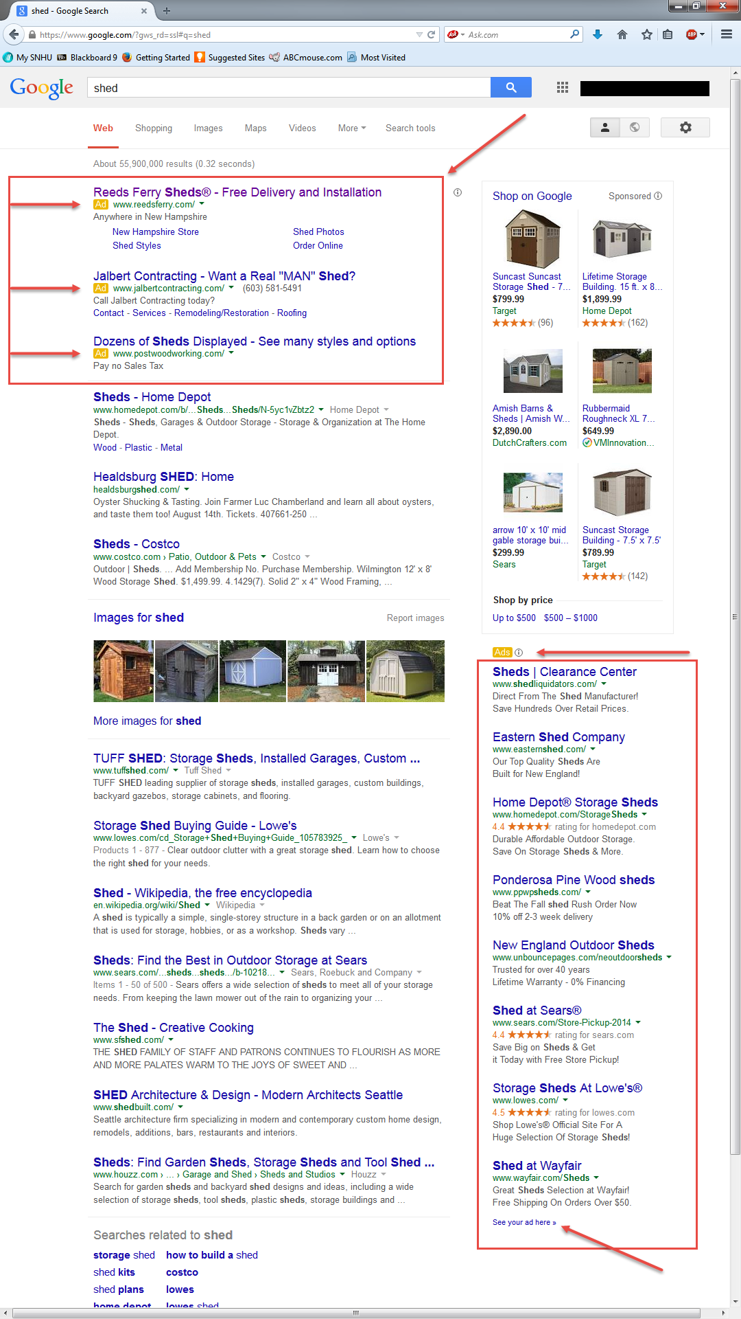
How it Works
Relative advertisement via AdWords
Clearly marked, text only advertisements displayed above / next to search results
Coy, P. (2006, March 5). The Secret To Google's Success. Bloomberg Business Week. Retrieved July 13, 2014, from http://www.businessweek.com/stories/2006-03-05/the-secret-to-googles-success
2014 Financial Tables. Investor Relations, Google. (n.d.). 2014 Financial Tables. Investor Relations Google. Retrieved July 27, 2014, from https://investor.google.com/financial/tables.html
Notes:
Since inception, Google has experienced extremely high levels of success and rapid growth which are due to its ability to capitalize on targeted advertising. Google’s innovation in internet advertising is called, “AdWords” and it accounts for 99% of the company’s revenue. AdWords pay-per-click advertising, targets advertisements to internet searches based off of relevance to the search query. In 2013 Google’s total advertising revenue equaled $50,547 million.

Slide 4
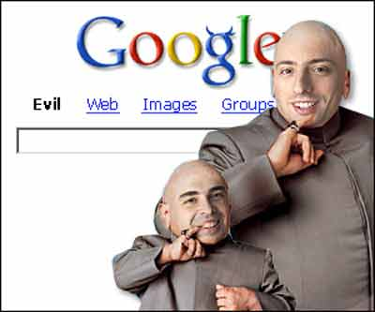
Code of Conduct
Don’t be evil
Do the right thing
Follow the Law
Act honorably
Treat each other with respect
Code of Conduct. Investor Relations, Google. (n.d.). Code of Conduct. Investor Relations. Google. Retrieved August 10, 2014, from http://investor.google.com/corporate/code-of-conduct.html
Notes:
In the preface for its code of conduct, Google loosely defines their slogan, “Don’t be evil” as being, “about providing our users unbiased access to information, focusing on their needs and giving them the best products and services that we can. But it’s also about doing the right thing more generally – following the law, acting honorably and treating each other with respect. The Google Code of Conduct is one of the ways we put “Don’t be evil” into practice. It’s built around the recognition that everything we do in connection with our work at Google will be, and should be, measured against the highest possible standards of ethical business conduct.” (Code of Conduct). However, Google, which is best known for its dominance in internet search has fallen under scrutiny for what people are saying violates its own code of conduct of, “Don’t be evil.” Google has been accused of invading internet users’ privacy through the unlawful collection of data via its mapping project (Street View).

Slide 5
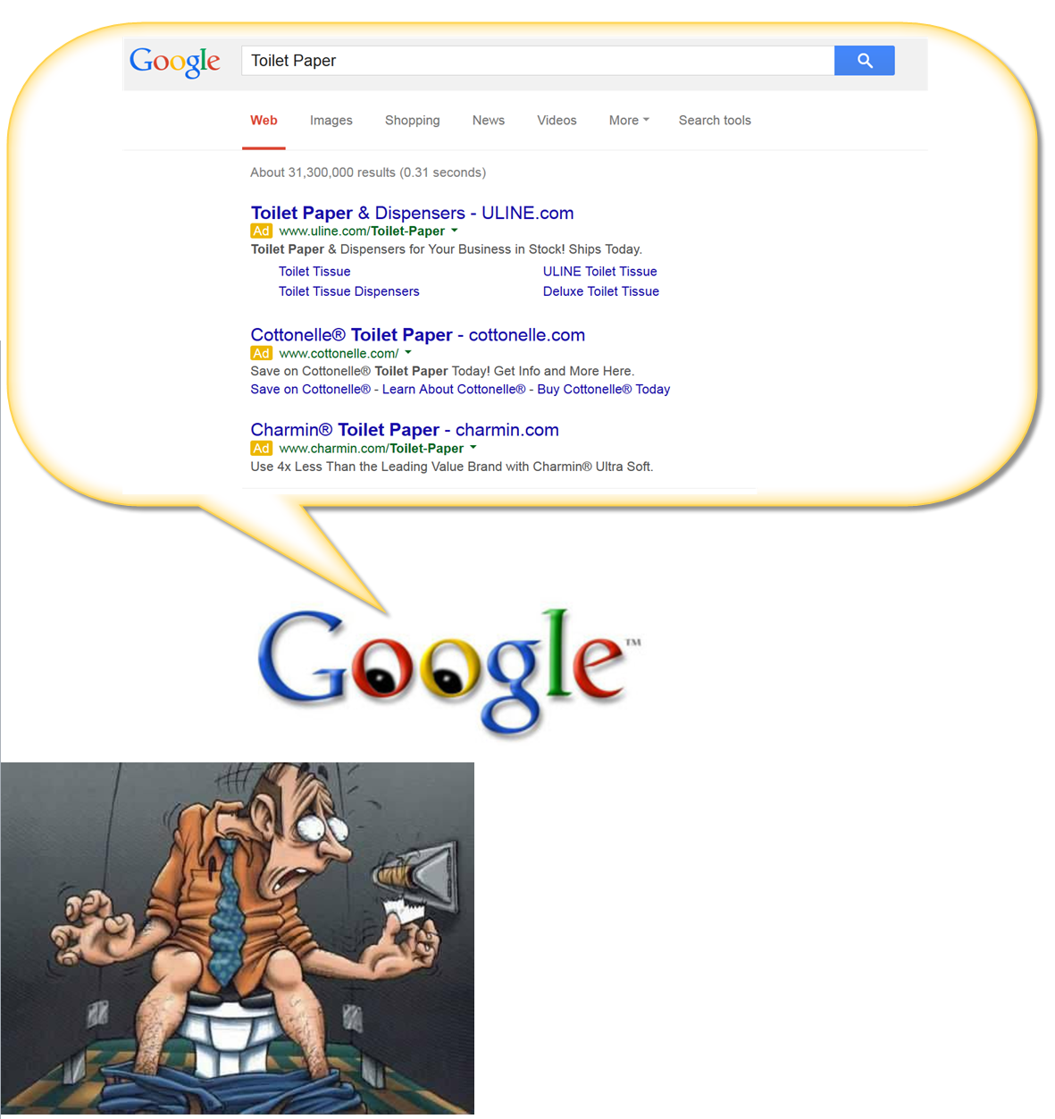
Privacy ???
Google violates users trust and privacy
Gathers Wi-Fi data through Street View mapping project
EPIC - Electronic Privacy Information Center. (n.d.). EPIC. Retrieved July 27, 2014, from http://epic.org/amicus/google-street-view/
Notes:
Residents in 38 U.S. states and the District of Columbia filed suit against Google for intrusion on individual’s affairs or seclusion. More specifically, the cases were brought forth alleging that Google had violated federal anti-wiretapping law which is part of the Electronic Communications Privacy Act of 1986. Plaintiffs alleged that Google’s Street View vehicles scooped up payload data transmitted over unencrypted Wi-Fi connections originating from people’s homes. The case was transferred to the Northern District of California and was filed on August 17, 2010. Information which was gathered includes mac addresses, network SSID’s, and transmission data which included emails, usernames, passwords, browsing history, and other personal information. By intercepting and decoding payload data transmitted over Wi-Fi networks Google may have violated the federal Wiretap Act, 18 U.S.C. §§2511, et seq., the California Business and Professional Code, and various state wiretap statutes.

Slide 6

The Defense
Radio communication exclusion
Wi-Fi Readily accessible to general public
Where do ethics come in?
EPIC - Electronic Privacy Information Center. (n.d.). EPIC. Retrieved July 27, 2014, from http://epic.org/amicus/google-street-view/
Streitfeld, D. (2013, September 10). Court Says Privacy Case Can Proceed vs. Google. The New York Times. Retrieved July 13, 2014, from http://www.nytimes.com/2013/09/11/technology/court-says-privacy-case-can-proceed-vs-google.html
Notes:
Google defends their behavior by asserting that the Wi-Fi communications it captured were “readily accessible to the general public” and therefore not a violation of federal wiretapping laws (Streitfeld, 2013). The Electronic Privacy Information Center explains, “The Wiretap Act provides a private right of action against any person who "intentionally intercepts ... any wire, oral, or electronic communication..." 18 U.S.C. § 2511(1)(a). However, Section 2511(2) provides exceptions to this private right of action where the "electronic communications system [is] configured so that such electronic communication is readily accessible to the general public." 18 U.S.C. § 2511(2)(g)(i).” Despite this potential loophole, the District Court determined that Congress did not intend for Wi-Fi communications to be included in this exception and on September 10, 2013, the Ninth Circuit affirmed the District Courts decision. Further petitions by Google for rehearing were subsequently denied (EPIC). Although the public is capable of obtaining the hardware and software required to intercept and decode such transmissions does not mean that these communications are readily accessible to the general public. The amount of effort required by the average or ordinary citizen to achieve such a feat is too great and negates the readily accessible defense.

Slide 7

A call for Action
Google’s request to dismiss denied
Case allowed to continue
Google settles out of court
Gross, G. (2014, June 30). Supreme Court declines to hear Google's request in Street View lawsuit. PCWorld. Retrieved July 27, 2014, from http://www.pcworld.com/article/2449360/supreme-court-declines-to-hear-googles-request-in-street-view-lawsuit.html
Williams, M. (2013, March 12). Google to pay $7M to US states for Wi-Fi eavesdropping. Retrieved August 10, 2014, from http://www.networkworld.com/article/2164338/infrastructure-management/google-to-pay--7m-to-us-states-for-wi-fi-eavesdropping.html
Notes:
March 2013, Google agreed to settle these complaints with a $7 million settlement and it also agreed to destroy the personal data collected (Gross, 2014). Google will also provide a training program to its employees for 10 years about privacy and the confidentiality of user data, and will launch a public-service advertising campaign to educate consumers about keeping their personal information secure on Wi-Fi networks. For a company who’s annual revenues are in the billions of dollars, the outcome is a meager slap on the wrist and does little to deter future violations. The lack of reform and seemingly insignificant consequences is setting a bad precedent for Google and other large scale corporations. At this level of punishment, the amount of money paid is simply factored into the cost of doing business. As long as we allow these types of unethical practices to continue to be profitable they will continue to happen and users privacy will continuously be violated.

Slide 8

Let Your Conscience Be Your Guide
Laws in need of interpretation
Existing laws outdated and in need of reform
Ethics don’t go out of style
Helft, M., & Miller, C. (2011, January 9). Web Outruns Privacy Law. The New York Times. Retrieved July 27, 2014, from http://www.nytimes.com/2011/01/10/technology/10privacy.html?hp
Notes:
It is widely held among internet companies and consumer advocates, that the ECPA of 1986 is outdated and does not properly address the rapidly changing communication technologies that have emerged after it was first enacted. Additionally, Helft & Miller note, “The rules established by the 1986 Electronic Communications Privacy Act depend on what type of information is sought and how old it is. And courts in different jurisdictions have interpreted the rules differently.” With the shortcomings of the ECPA, it is entirely possible and reasonable to say, that Google believed they were acting within the limits prescribed by existing law. However, had they given more thought to all of the stakeholders, particularly the end users they claim to serve, and acted with their stated code of conduct in mind, then the company could have avoided this legal confrontation and negative criticism entirely. Based on the information already provided it can be reasonably assumed that there are some substantial “grey” areas which leave too much open to interpretation and are in need of further reform. Based on the aforementioned findings I would recommend stricter policies defining that one’s expectation of privacy be extended to include electronic communications transmitted over their own person Wi-Fi networks, thereby extending the protections afforded to the citizens of the United States under the Fourth Amendment.

Slide 9


